Slide 1
EP58 Coding: Order Item Google Firebase – Function FireStore (Database) Case Study “Restaurant E-menu” ระบบสั่งอาหารผ่านมือถือ
See-Flutter เรียนรู้ไปด้วยกัน เรียนฟรี พร้อม Source Code
6 Sep 2020
Day#47

Slide 2
CONTENT เนื้อหาวันนี้
Use Case (Review)
UI Design (Review)
Coding Design
Coding
Target Group: Mobile Developer (iOs,Andriod)

Slide 3
Key Knowledge
Get Data from Database
StreamBuilder (snapshot)
ListView.Builder (index)
Pass Parameter from file to file
Convert to Inkwell (Can click in each order item row)
Target Group: Mobile Developer (iOs,Andriod)

Slide 4
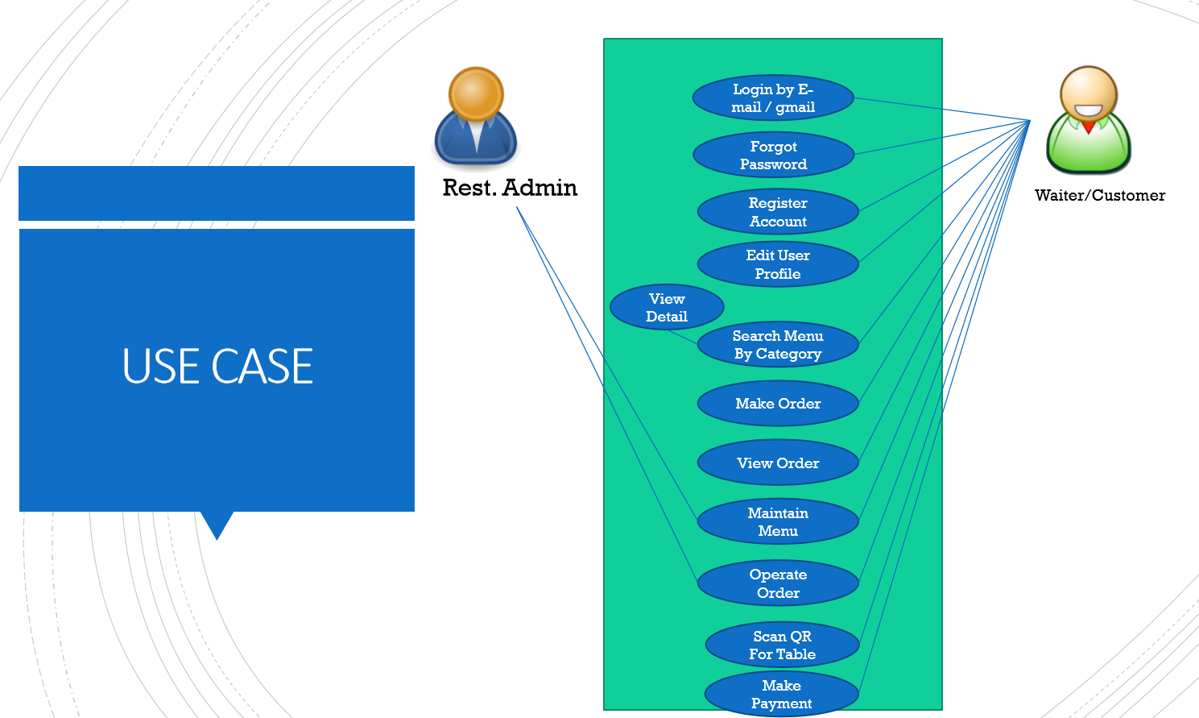
Use Case
OK
OK
OK
Count Order Item
Order Item

Slide 5
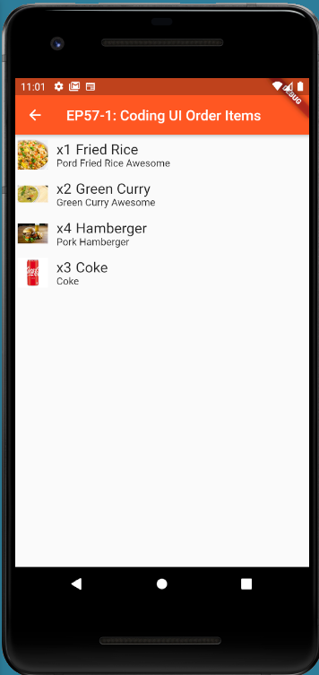
UI Design (Review)

Slide 6
Coding Concept
Stream Builder
Get Data from Database
stream: Firestore.instance.collection("TT_ORDERS").snapshots()
Get Snapshot Data using Builder
Builder: (context, snapshot)
Return ListView.builder & define itemCount
itemCount: snapshot.data.documents.length
Show Data using Item Builder
itemBuilder: (context, index)
{ return Widget using index}

Slide 7
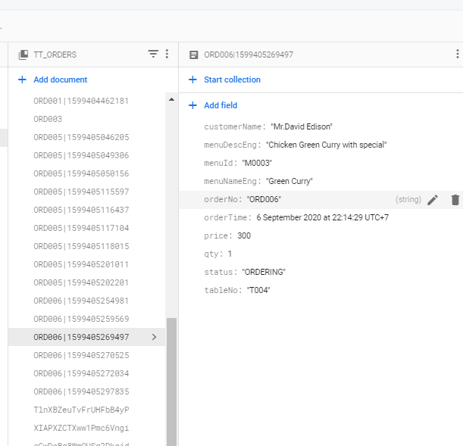
Database

Slide 8
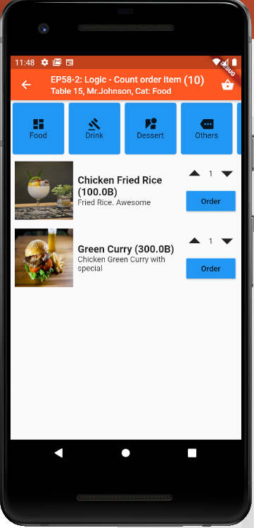
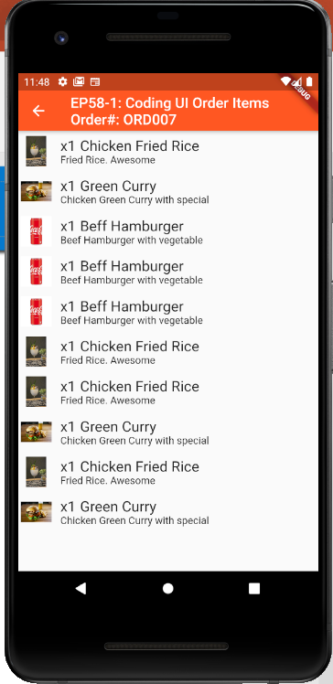
Final UI

Slide 9
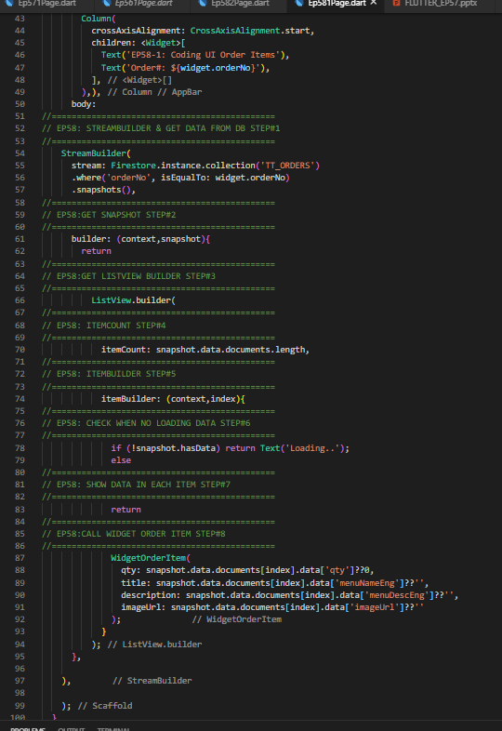
Coding
StreamBuilder -> stream, builder(snapshot)
ListView.Builder -> itemCount, itemBuilder (index)
Return Widget
1
2
3

