Slide 1
EP59 Coding: Delete Order Item Google Firebase – Function FireStore (Database) Case Study “Restaurant E-menu” ระบบสั่งอาหารผ่านมือถือ
See-Flutter เรียนรู้ไปด้วยกัน เรียนฟรี พร้อม Source Code
7 Sep 2020
Day#48

Slide 2
CONTENT เนื้อหาวันนี้
Use Case (Review)
UI Design
Coding Concept
Coding
Target Group: Mobile Developer (iOs,Andriod)

Slide 3
Key Knowledge
Get Document Number from Database
Delete Data from Database
Row Widget & Expanded
IconButton Widget
Pass Parameter VoidCallback (onPressed) to Widget
Target Group: Mobile Developer (iOs,Andriod)

Slide 4
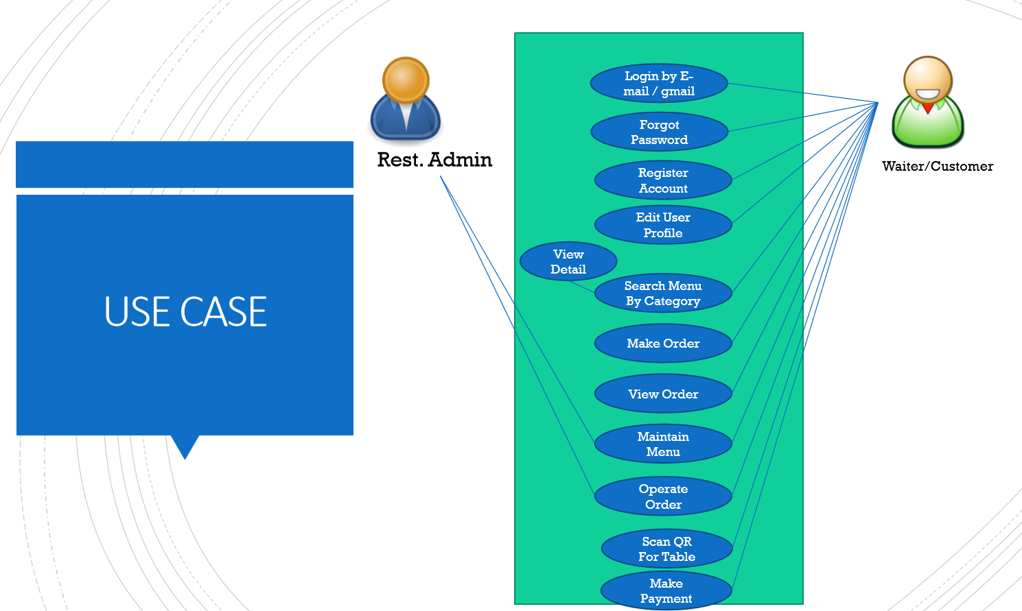
Use Case
OK
OK
OK
Count Order Item
Order Item
Delete Item
Edit Item

Slide 5
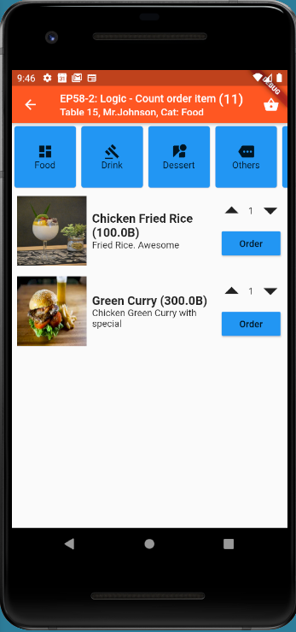
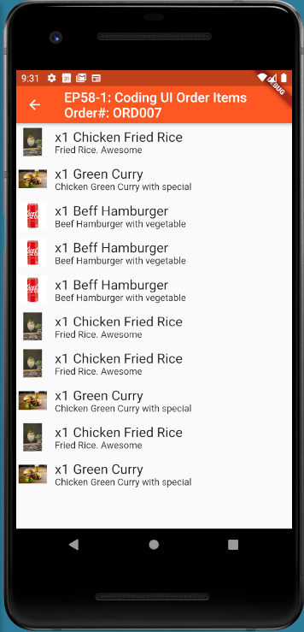
UI Design
-
Row#3
-
-
Row#1
Row#2
+Expanded
Row#3

Slide 6
Coding Concept
Add IconButton (Delete) in Row#3
Implement Delete Function with Document ID (DB key)
Pass Parameter onPressed (VoidCallback) from Widget Class
-
-
-

Slide 7
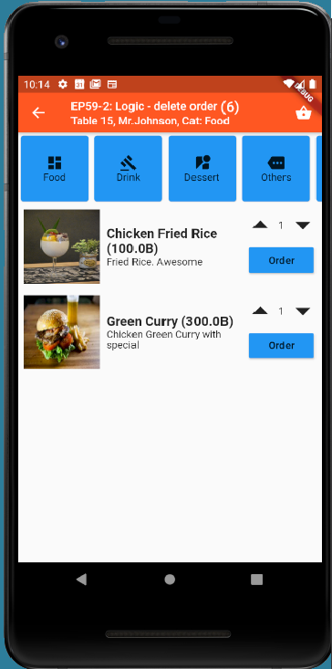
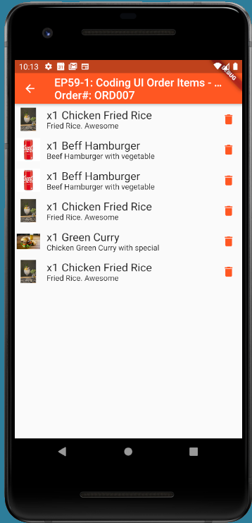
Final UI

Slide 8
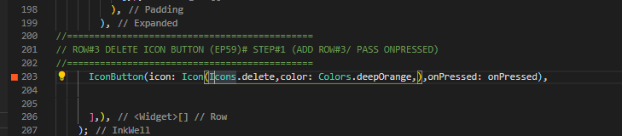
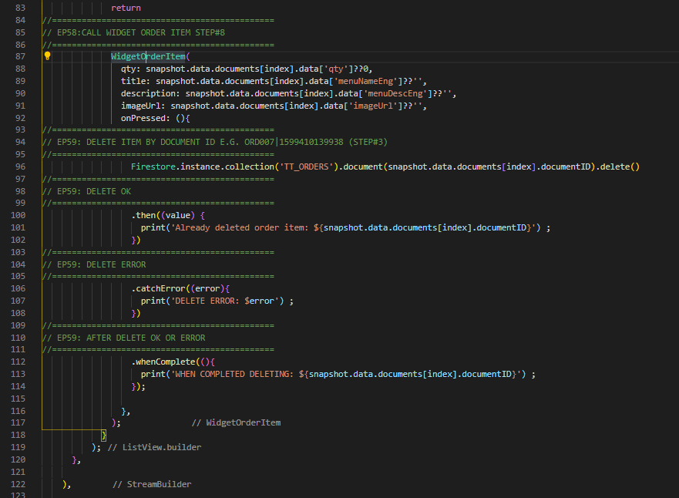
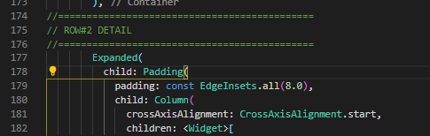
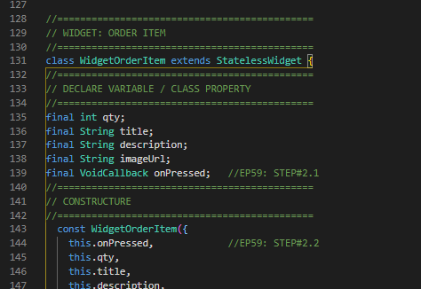
Coding
1. Add Icon Button + onPressed
4. Delete by DocumentID
1
2
2
2. Expaned in Row#2
DocumentID
3. Declare onPressed as VoidCallBack
3

