Slide 1
EP60 Coding: Edit Order Item – Get Data Google Firebase – Function FireStore (Database) Case Study “Restaurant E-menu” ระบบสั่งอาหารผ่านมือถือ
See-Flutter เรียนรู้ไปด้วยกัน เรียนฟรี พร้อม Source Code
8 Sep 2020
Day#49

Slide 2
CONTENT เนื้อหาวันนี้
Use Case (Review)
UI Design
Coding Concept
Coding
Target Group: Mobile Developer (iOs,Andriod)

Slide 3
Key Knowledge
Get data from Database by DocumentID
Pass Parameter from Class to Class
InitState to load “Order Item” data
SetState to set variable & upadate UI
Link Text Widget with TextEditController
ButtonIcon Widget
Check null condition for show loading…
Target Group: Mobile Developer (iOs,Andriod)

Slide 4
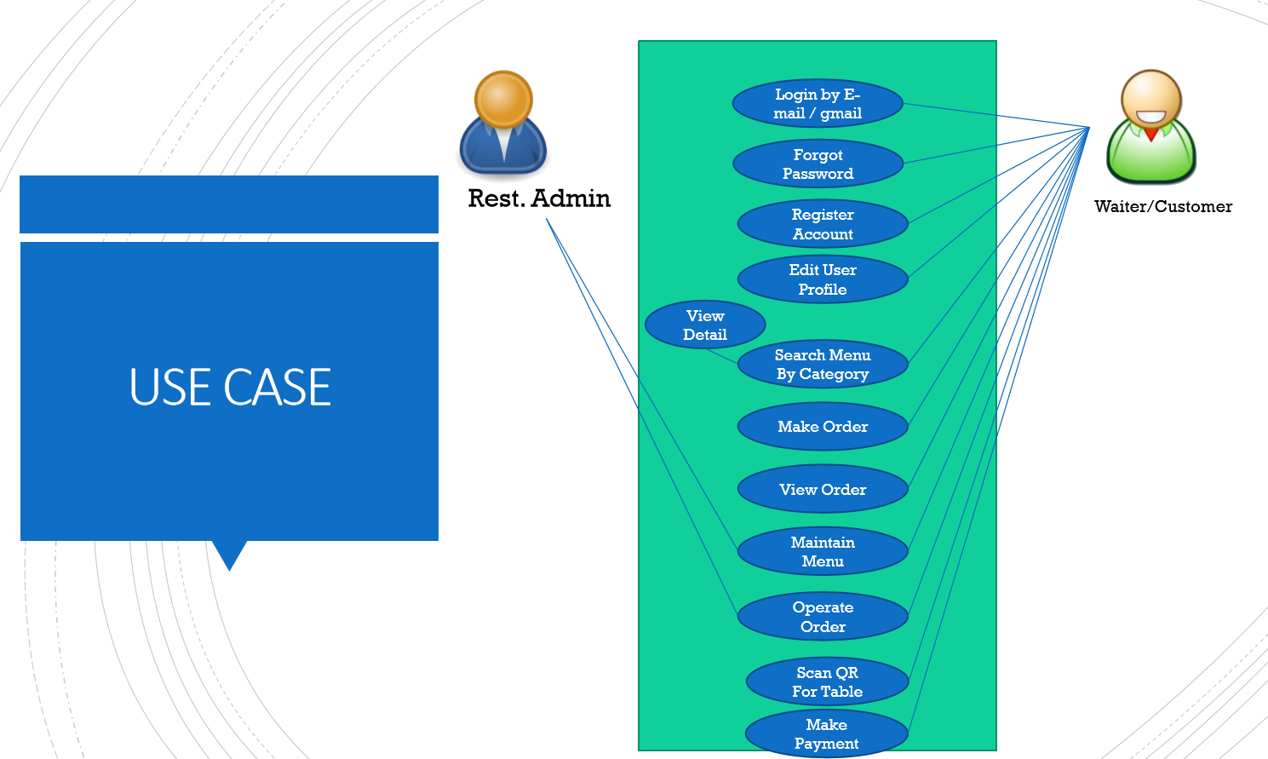
Use Case
OK
OK
OK
OK
OK
OK
Count Order Item
OK
OK
Order Item
Delete Item
OK
OK
Edit Item
Get Order Item
Update Order Item

Slide 5
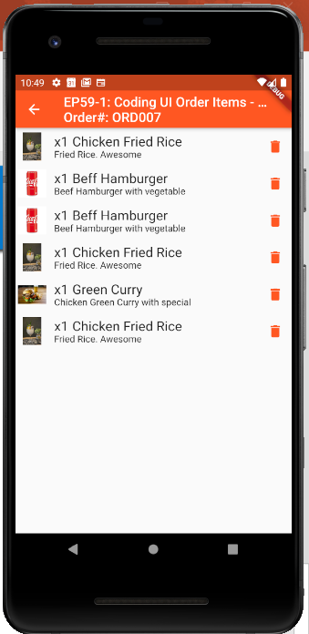
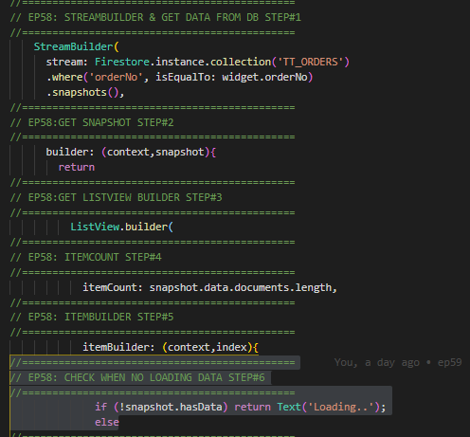
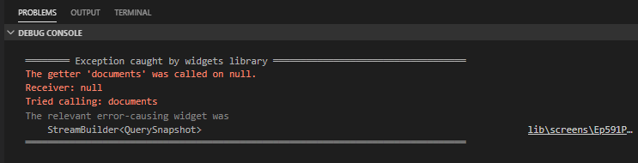
Change Correct Code in EP58, 59
ep581Page.dart
ep591Page.dart
How to fix ?
Move code before return
Error:
‘document’ was called on null
Reason:
Return Listview before get snapshot data from database
↓
【 Note: We will fix in ep601Page.dart only to prevent confusing when download sourcecode from GitHub & Watch Video 】

Slide 6
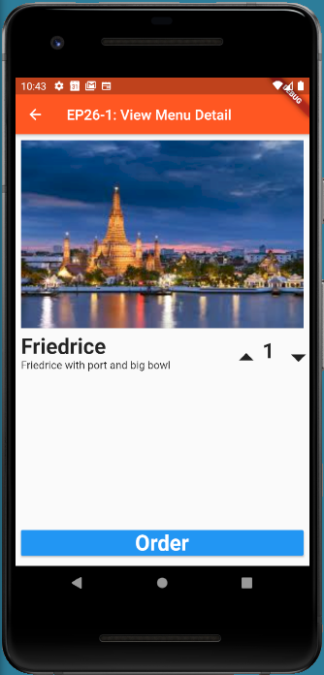
UI Design
E
E
E

Slide 7
Coding Concept
Pass Parameter
DocumentID
@Override initState() to load intial data from DB
Create variable to use for show UI
TextEditController (_menuNameEngController)
TextEditController (_menuDescEngController)
Int _qty = 1
String _imageUrl = ‘’
Get data from Database by documentID
Link TextEditController with Text Widget
_menuNameEngController.Text
_menuDescEngController.Text
E
E
E

Slide 8
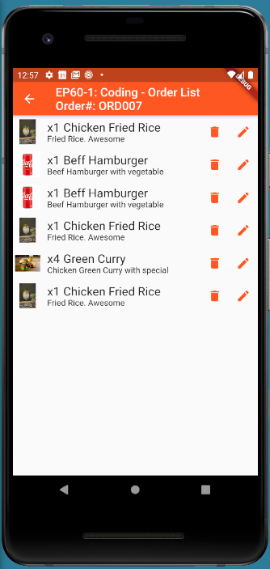
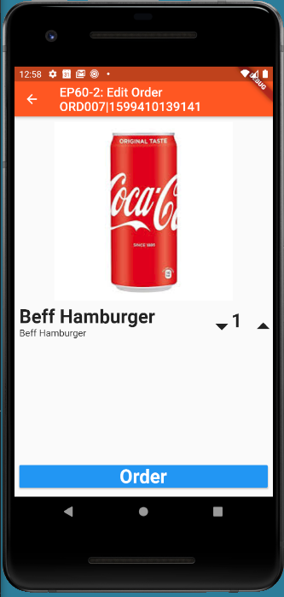
Final UI

Slide 9
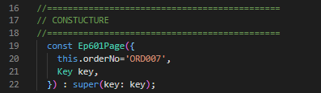
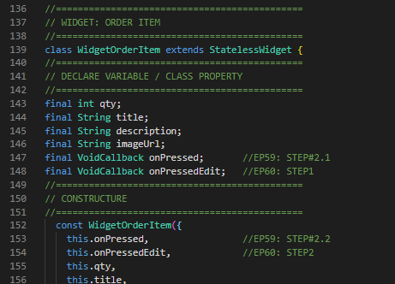
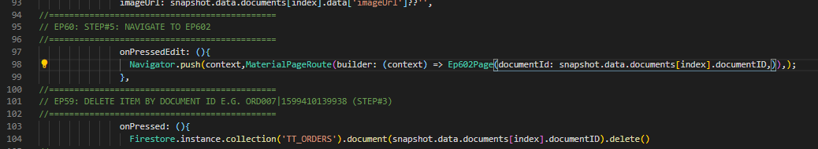
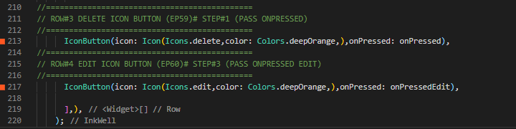
Coding – EP60-1
2. Declare VoidCallBack in Widget Class
(Can use this ‘onPressEdit’ in function parameter)
1. Hardcode ‘ORD007’
4. Navigate to EP61-1 with parameter (documentId) when click Edit Button
3.onPressed: onPressedEdit

Slide 10
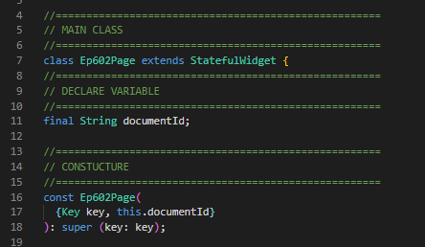
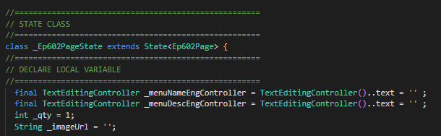
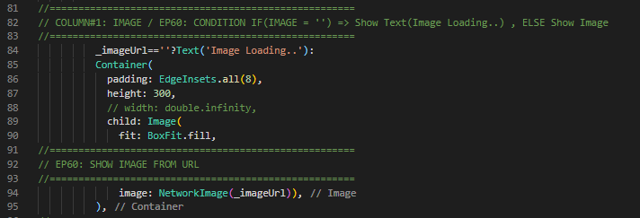
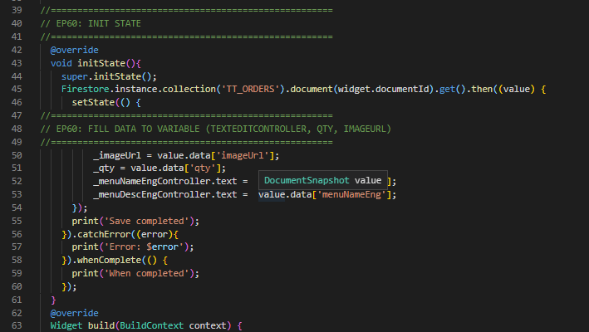
Coding – EP60-2
1. Declare Paramter (get from EP60-1)
3. Declare TextEditController, _qty, _imageUrl
4. Show _imageUrl
2. initState to load initial data from DB

Slide 11
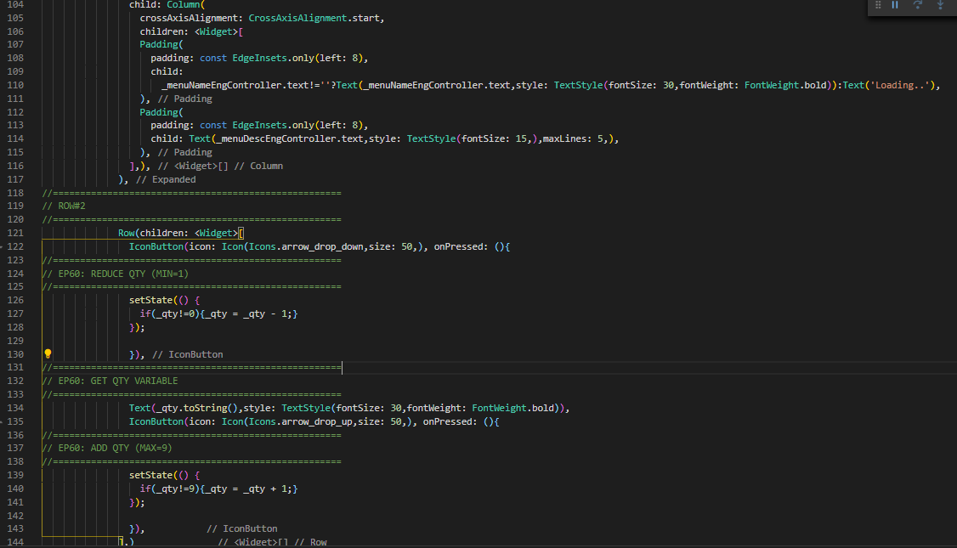
Coding – EP60-2
5. Link TextEditController with Text Widget
6. Click Button decrease qty
7. Click Button increase qty

