Slide 1
EP61 Download code from GitHub Upload code to your own GitHub Case Study “Restaurant E-menu” ระบบสั่งอาหารผ่านมือถือ
See-Flutter เรียนรู้ไปด้วยกัน เรียนฟรี พร้อม Source Code
9 Sep 2020
Day#50

Slide 2
CONTENT เนื้อหาวันนี้
How to download source code from github
Create & run Project for download code
How to upload source code to your github
Write flutter EP61 for show this PowerPoint as images
Target Group: Mobile Developer (iOs,Andriod)

Slide 3
Source Code in GitHub
URL | EP in YouTube | Content
[ Future ] | EP01-10 | TBC e.g. How to install flutter, What is flutter, coding Technique, dart language
https://github.com/traitet/flutterep11 | EP11-20 | Basic Knowldge
https://github.com/traitet/flutterep21 | EP21-30 | Restaurant E-menu Case Study
https://github.com/traitet/flutterep31 | EP31-40 | Restaurant E-menu Case Study
https://github.com/traitet/flutterep41 | EP41-50 | Restaurant E-menu Case Study
https://github.com/traitet/flutterep51 | EP51-60 | Restaurant E-menu Case Study
https://github.com/traitet/flutterep61 | EP61-70 | Restaurant E-menu Case Study

Slide 4
Step
Download from GitHub https://github.com/traitet/flutterep51
Change Folder Name from flutterep51-master to flutterep61
Open & Run Flutter Project by VSCode
Download Package
Upload code to Github as https://github.com/traitet/flutterep61

Slide 5
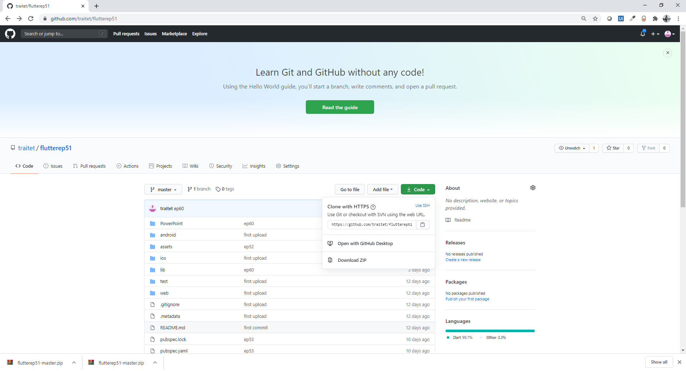
Download source code from Git Hub
https://github.com/traitet/flutterep51

Slide 6
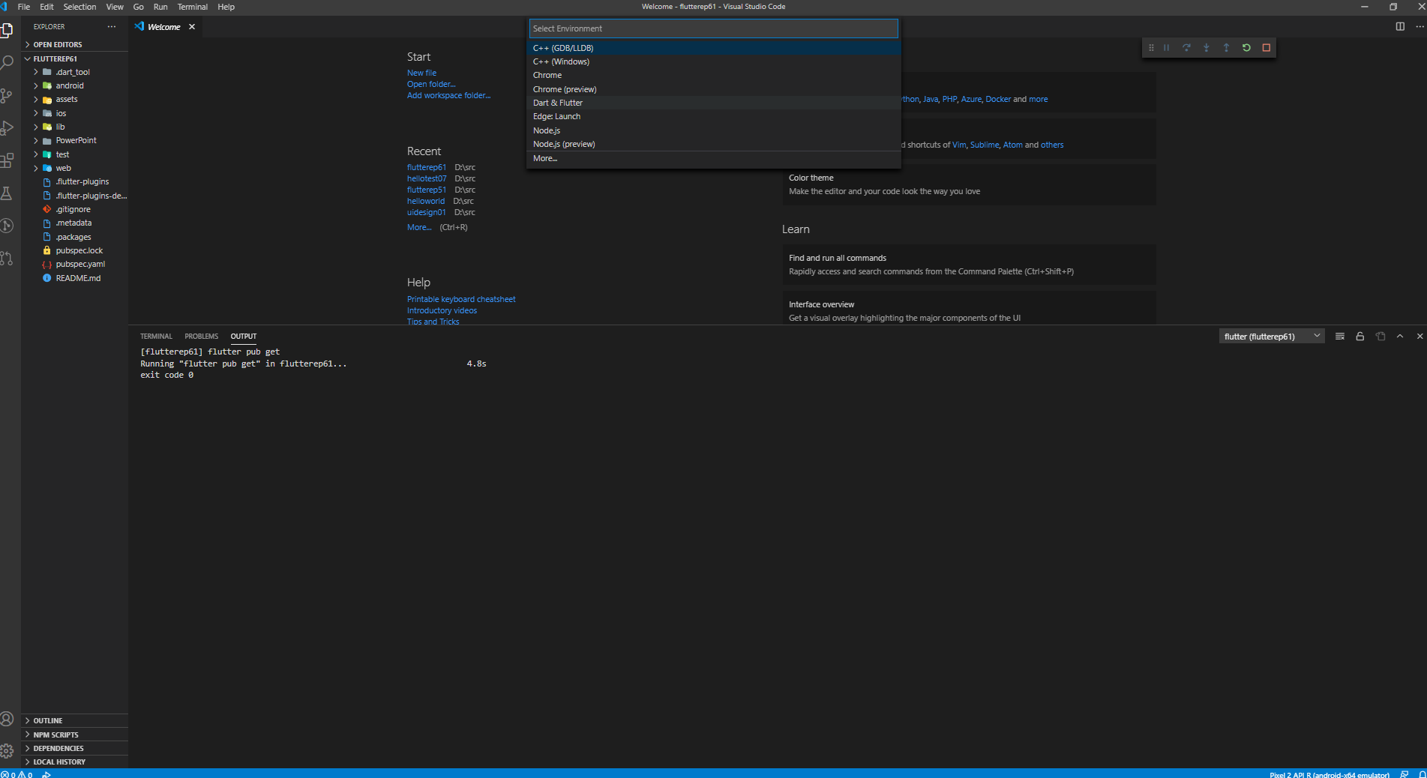
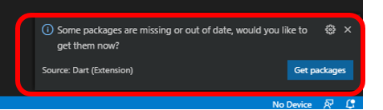
Open Flutter Project, Download Package, Run Flutter
1
3.2
3.3
File, Open Folder, Flutterep61
Download Package (see next screen)
Run, Dart & Flutter (Select Pixel API R for Emulator)
Wait around 5 min for build and run
2
3.1

Slide 7
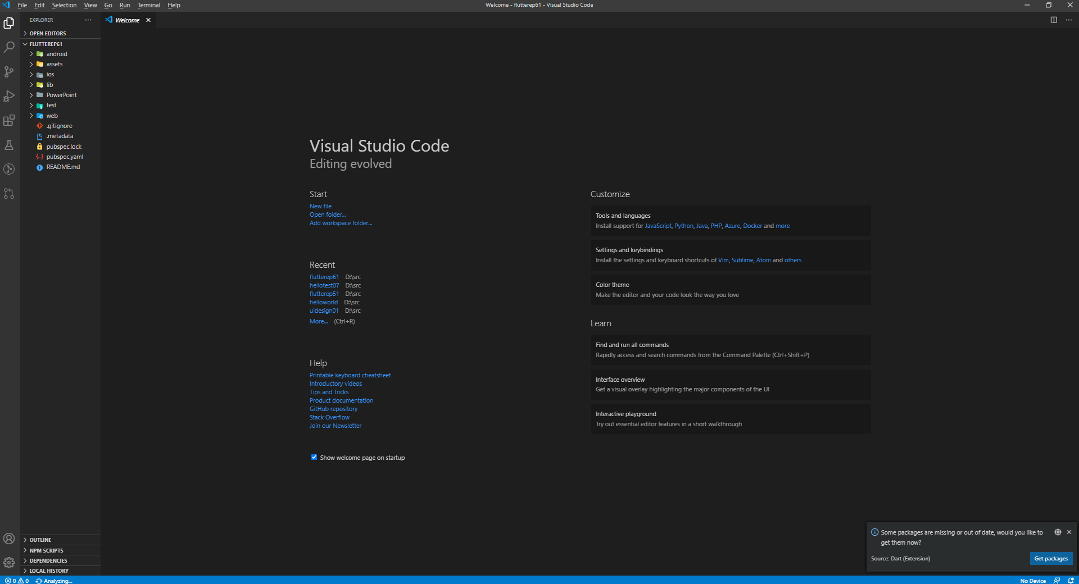
Download Flutter Package

Slide 8
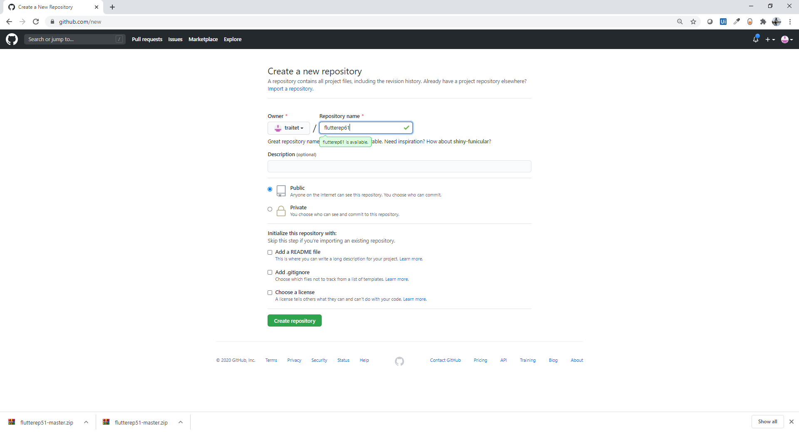
Create New Project on GitHub Web
https://github.com/traitet/flutterep61

Slide 9
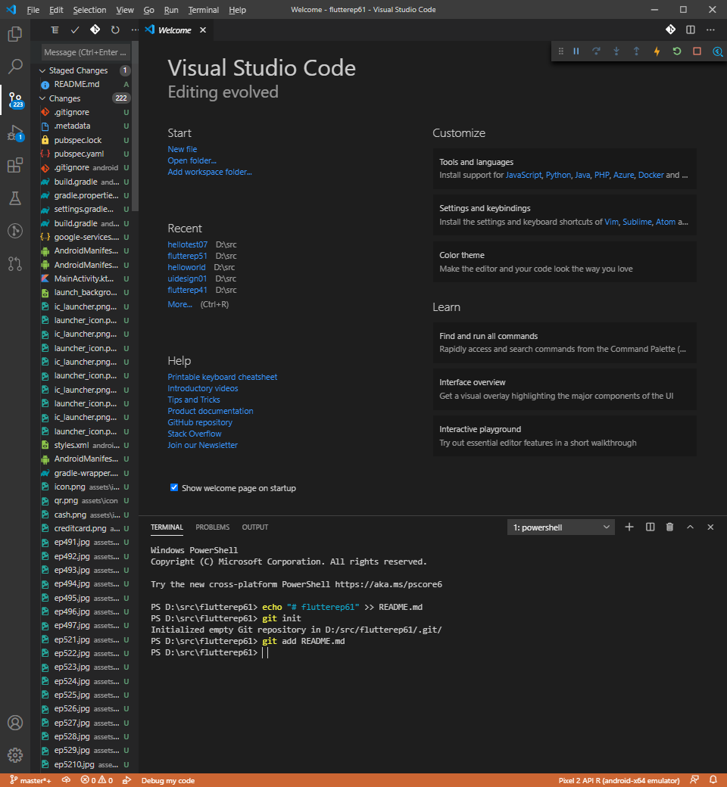
Main Steps to upload code to GitHub
Commit code in VSCode (internal)
Push Commited Code to GitHub Cloud
Commit code in VSCode

Slide 10
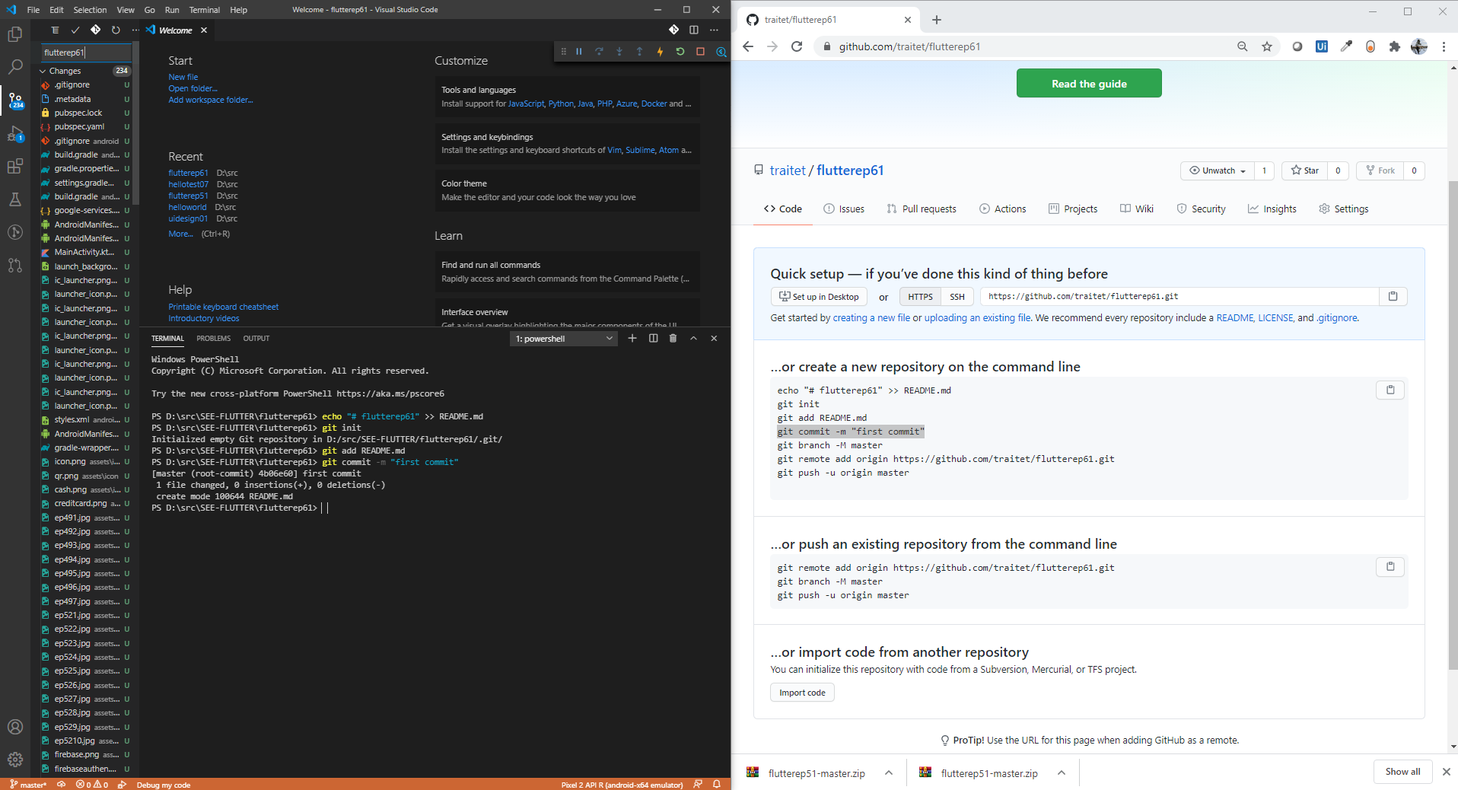
Upload Code to GitHub

Slide 11
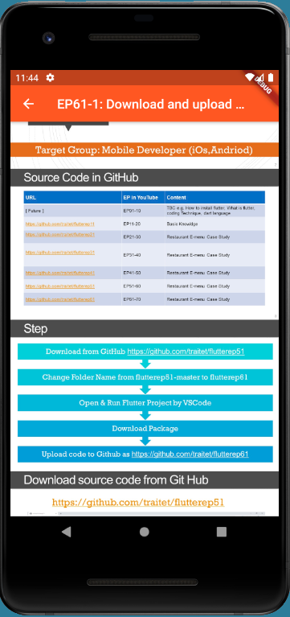
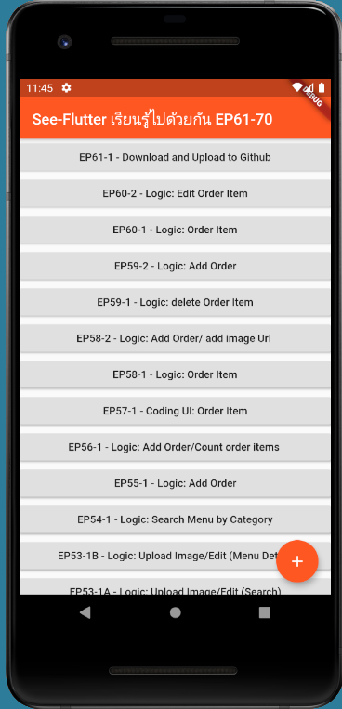
Final UI

Slide 12
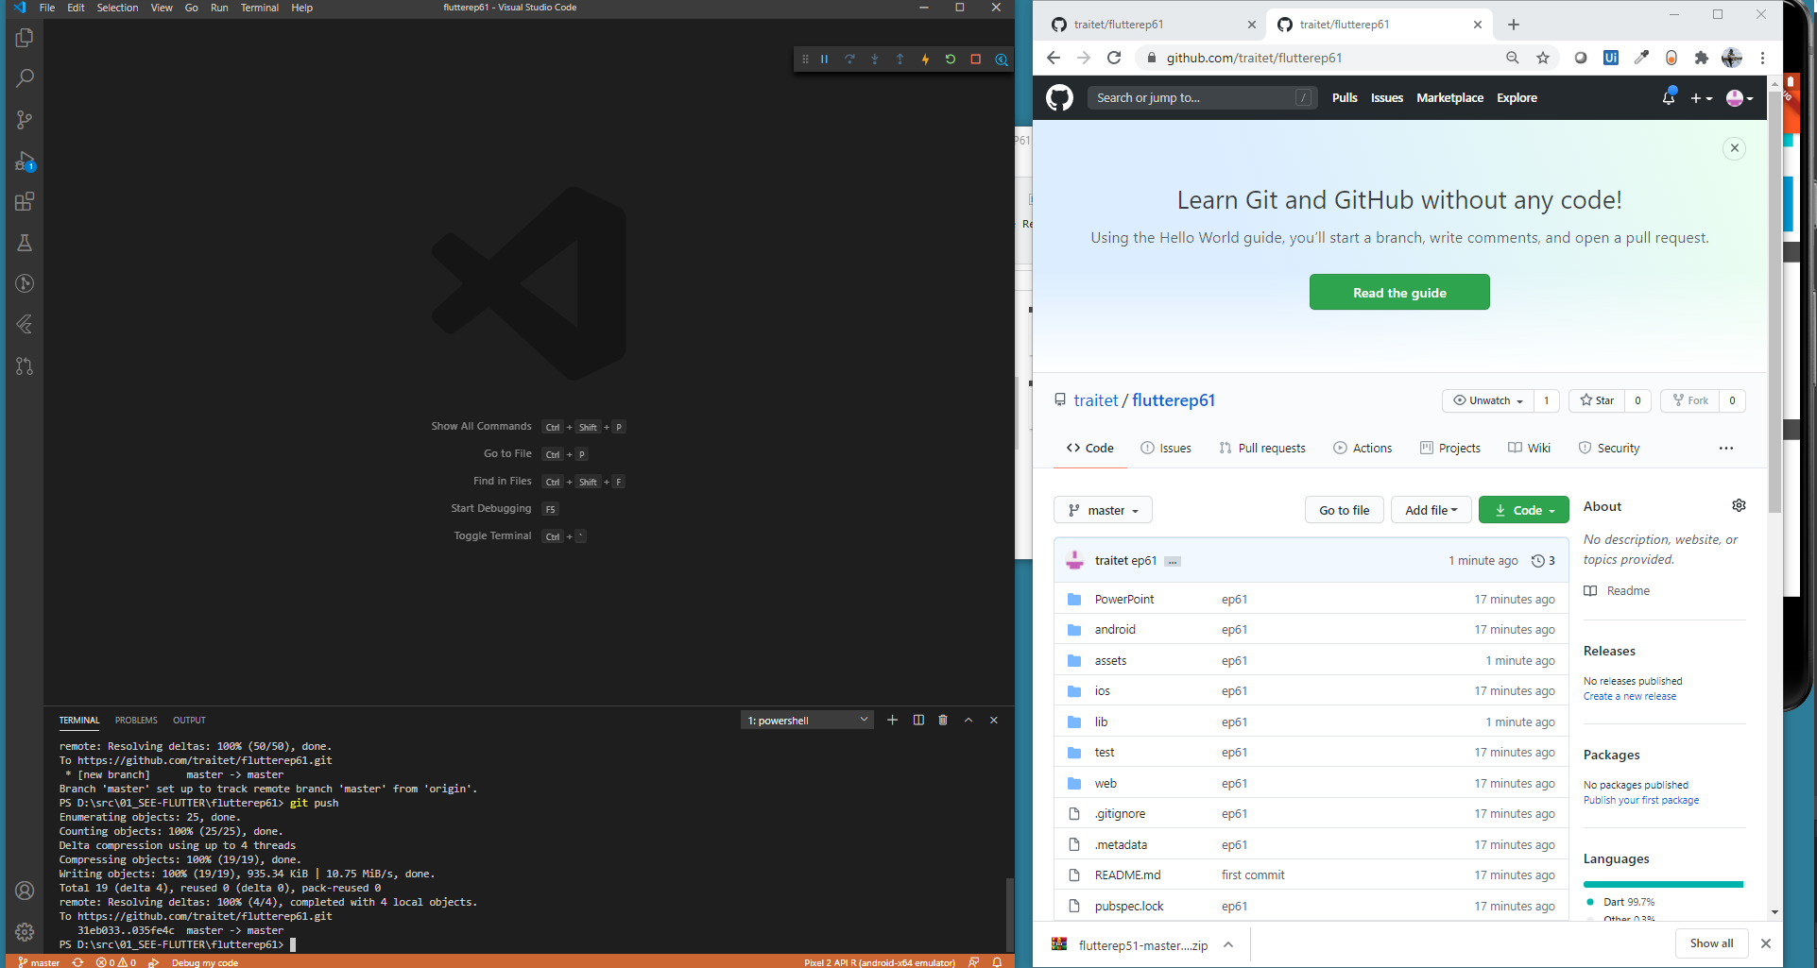
Upload Code to GitHub

