Slide 1
EP62 Update Order Item to Database Google Firebase & FireStore Case Study “Restaurant E-menu” ระบบสั่งอาหารผ่านมือถือ
See-Flutter เรียนรู้ไปด้วยกัน เรียนฟรี พร้อม Source Code
10 Sep 2020
Day#51

Slide 2
CONTENT เนื้อหาวันนี้
Use Case (Review)
Summary update,insert,delete, get data from/to DB
UI Design (Review)
Fixed Error in EP59 (When not send Doc ID)
Coding
Target Group: Mobile Developer

Slide 3
Knowledge ความรู้วันนี้
Update data to database (FireStore)
Summary code for insert,update,delete,getdata with Database
Update Database
Check If condition by using ?? (See slide 8)
SnackBar
Target Group: Mobile Developer

Slide 4
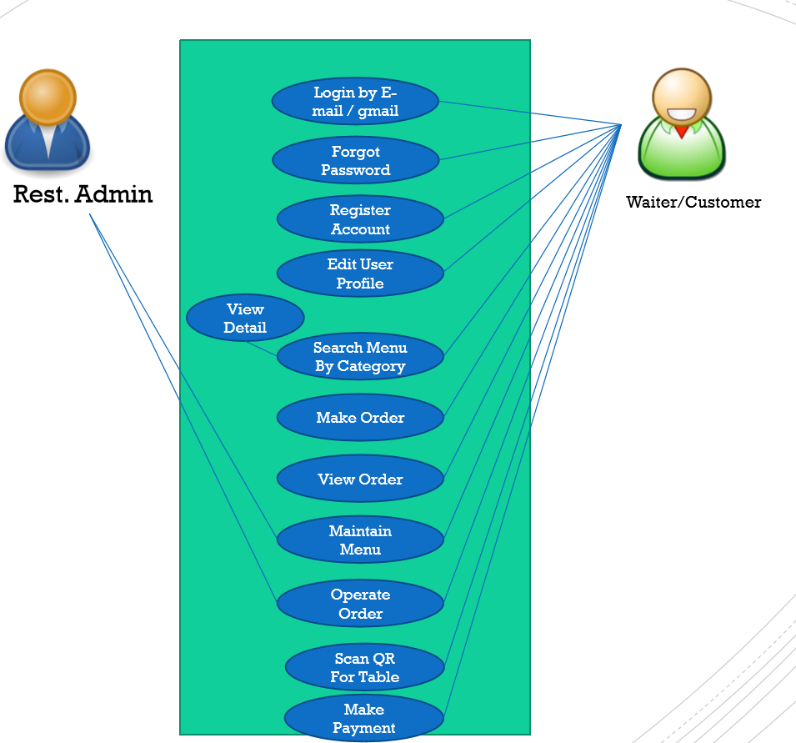
Use Case
OK
OK
OK
Count Order Item
OK
Order Item
Delete Item
Edit Order Item
OK: EP59
EP60,62

Slide 5
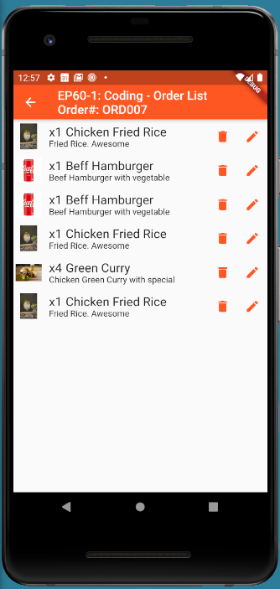
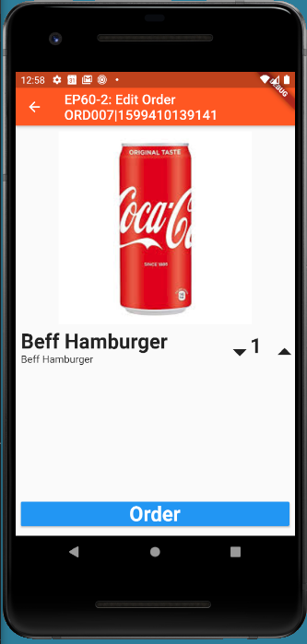
UI Design (Review)
Save

Slide 6
Insert, Delete, update, Getdata with Database (FireStore)
Insert and Update Data into Database
Firestore.instance.collection('TT_ORDERS').document(orderNo + '|' + DateTime.now().millisecondsSinceEpoch.toString()).setData({'menuId': menuId,'menuNameEng': title, })
Update Data to Database by Document ID
Firestore.instance.collection('TT_ORDERS').document(snapshot.data.documents[index].documentID).update({‘qty': 3,‘remark': ’Test’, })
Firestore.instance.collection('TT_ORDERS').document(snapshot.data.documents[index].documentID).child(‘orderNo’).update({‘qty': 3,‘remark': ’Test’, })
Get Data from Database by Document ID
Firestore.instance.collection('TT_ORDERS').document(widget.documentId).get().then((value)
Get List of Data from Database by Condition
Firestore.instance.collection('TT_ORDERS').where('orderNo', isEqualTo: ’ORD007’).snapshots()
Firestore.instance.collection('TM_MENUS').where('menuCategoryValue',isEqualTo: ’Foods’).snapshots()
Delete Data from Database by Document ID
Firestore.instance.collection('TT_ORDERS').document(snapshot.data.documents[index].documentID).delete()

Slide 7
Coding Concept
Click Save
1. Update Data into Database
2. Show Update Complete in SnackBar
Save

Slide 8
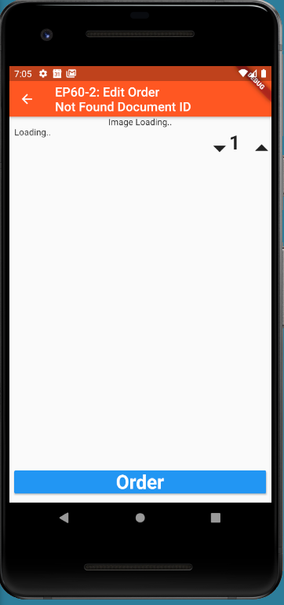
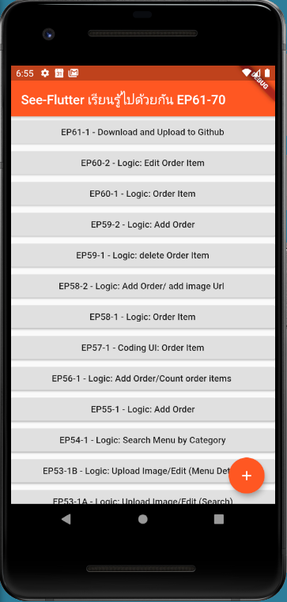
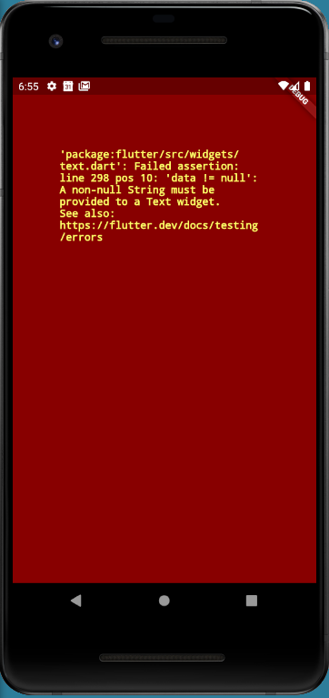
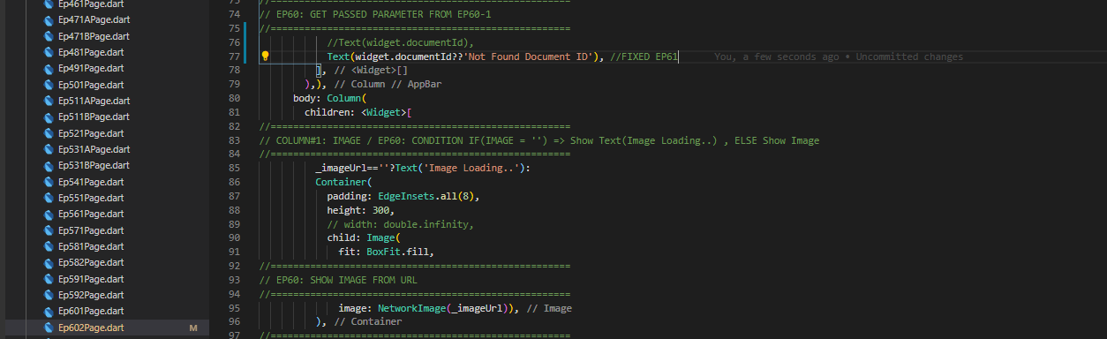
Fixed Problem
Reason
No pass Document ID
Text Widget cannot show null
Solution
Check Null
If Null, Show Not Found Document ID

Slide 9
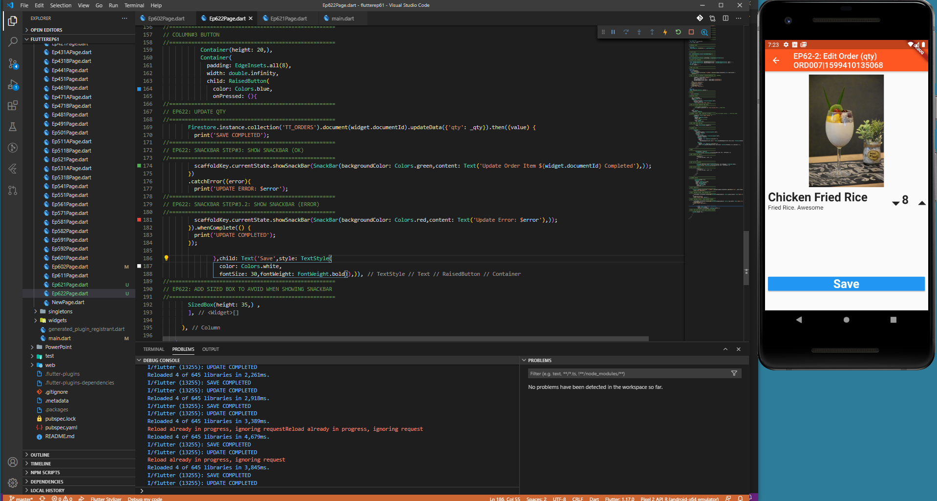
Coding

Slide 10
SnackBar
//=====================================================
// SNACKBAR STEP#1
//=====================================================
final GlobalKey<ScaffoldState> scaffoldKey = GlobalKey<ScaffoldState>();
//=====================================================
// SNACKBAR STEP#2
//=====================================================
key: scaffoldKey,
//=====================================================
// EP622: SNACKBAR STEP#3: SHOW SNACKBAR (OK)
//=====================================================
scaffoldKey.currentState.showSnackBar(SnackBar(backgroundColor: Colors.green,content: Text('Update Order Item ${widget.documentId} Completed'),));

Slide 11
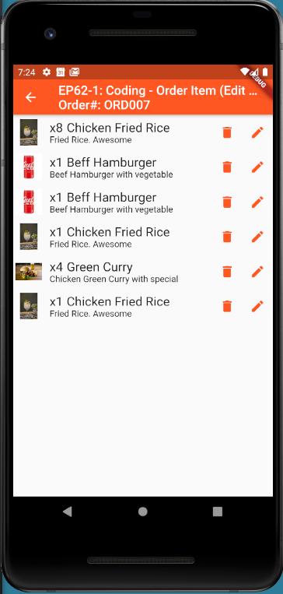
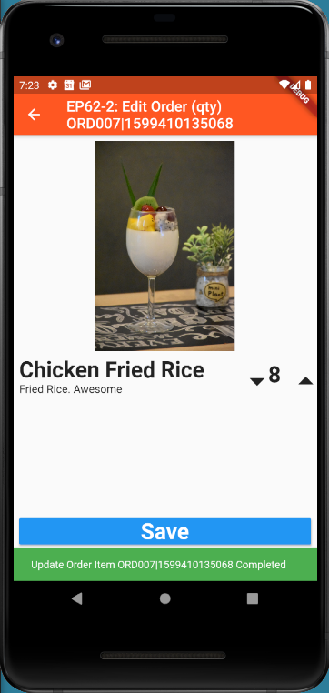
Final UI

