Slide 1
EP63 Add Order Item to Database using Model Class (Separate Logic and UI) Google Firebase & FireStore Case Study “Restaurant E-menu” ระบบสั่งอาหารผ่านมือถือ
See-Flutter เรียนรู้ไปด้วยกัน เรียนฟรี พร้อม Source Code
11 Sep 2020
Day#52

Slide 2
CONTENT เนื้อหาวันนี้
Concept of Model Class
Coding
Target Group: Mobile Developer

Slide 3
Knowledge ความรู้วันนี้
Use data model to insert data to database
How to separate Business Logic and UI
Write Model Class
Target Group: Mobile Developer (iOS,Andriod)

Slide 4
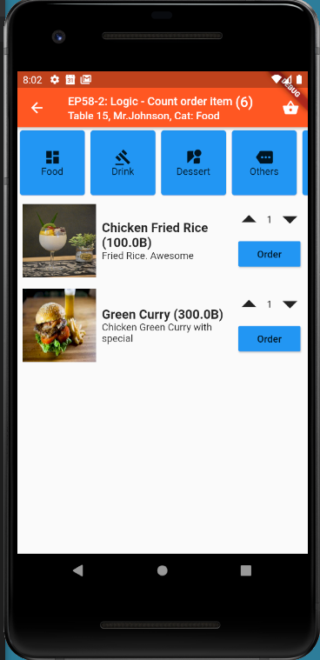
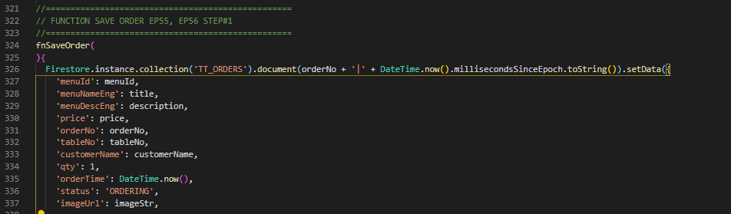
Coding Concept
<< Business Logic >>
<< UI >>
Order Model
(1) Final Property
(Database Column)
Business Login is in UI
(2) Constucture
Steps for save Order
Import OrderModel
Declare & Prepare _orderModel
Call saveOrder
For Insert data to database
(3) Map<String, dynamic>
toFireStore() ➔ {}
(4) SaveOrder
Benefits
Separate UI and Business Logic
Protect coding incorrect column name
Able to set default value in model e.g. orderTime,status
Apply for using with WEBAPI (Json format)
<< UI >>
TT_ORDERS

Slide 5
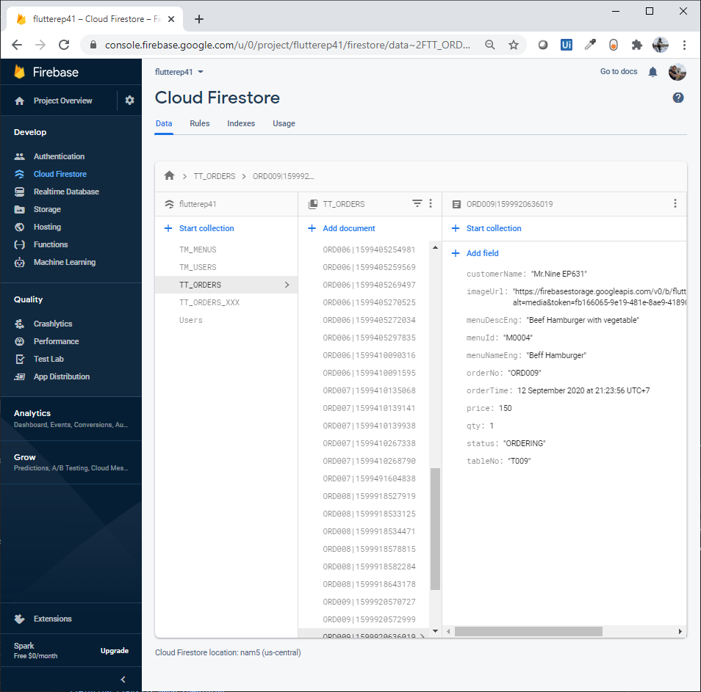
Firestore Data

Slide 6
Coding

Slide 7
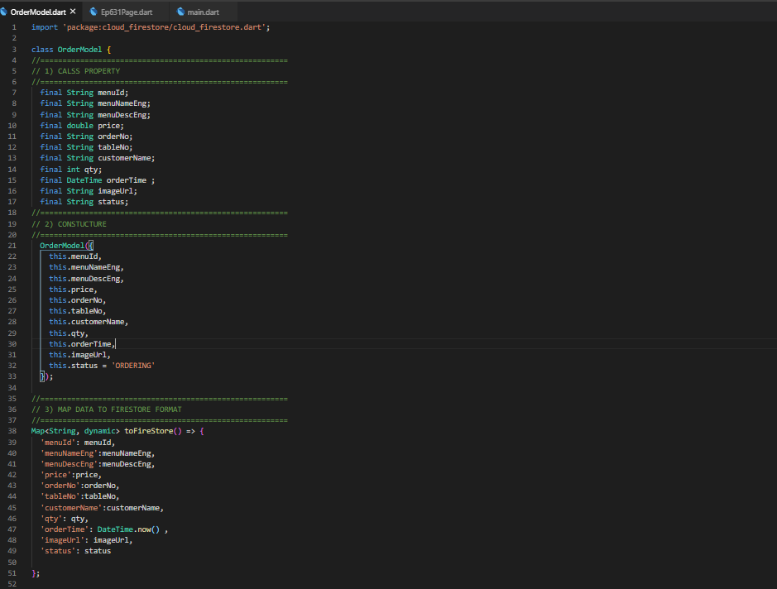
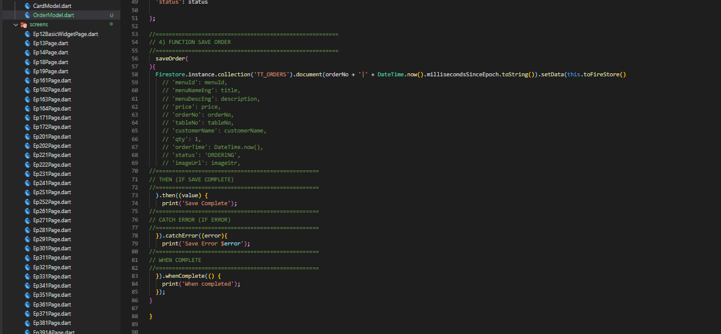
Final UI
Property
Save Order Function
Constucture
Map toFireStore Method

Slide 8

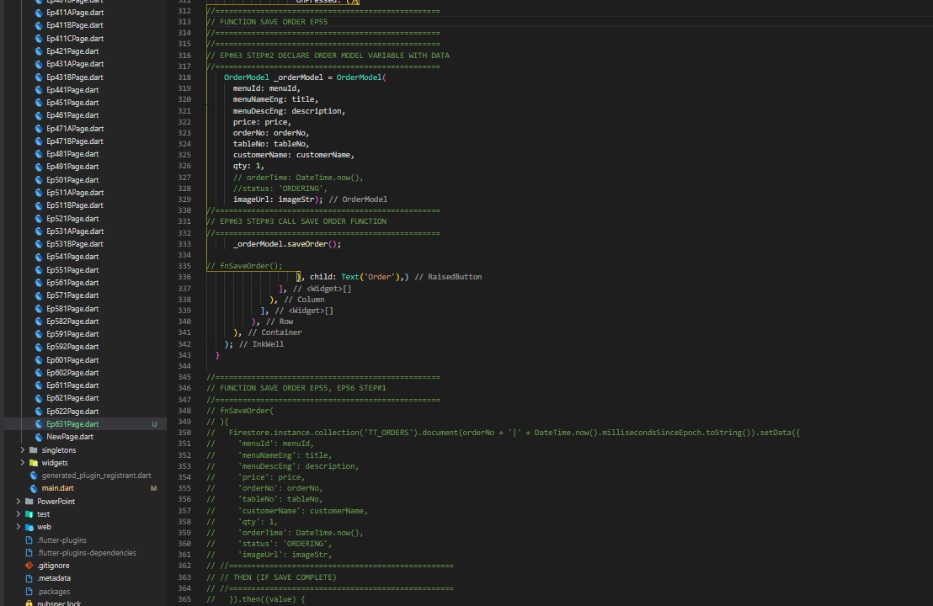
Coding – EP631 (Call SaveOrder)
Step#1: Import Order Model
Step#2: Delcare _orderModel
Step#3: call saveOrder

