Slide 1
EP64 Get Menu from Database using Model Class (Separate Logic and UI) Google Firebase & FireStore Case Study “Restaurant E-menu” ระบบสั่งอาหารผ่านมือถือ
See-Flutter เรียนรู้ไปด้วยกัน เรียนฟรี พร้อม Source Code
12 Sep 2020
Day#53

Slide 2
CONTENT เนื้อหาวันนี้
Concept of Model Class for get data from Firebase
Coding
Target Group: Mobile Developer

Slide 3
Knowledge ความรู้วันนี้
Use data model to get data from database
How to separate Business Logic and UI
Write Model Class
Factory Method = Method to generate Object
Target Group: Mobile Developer (iOS,Andriod)

Slide 4
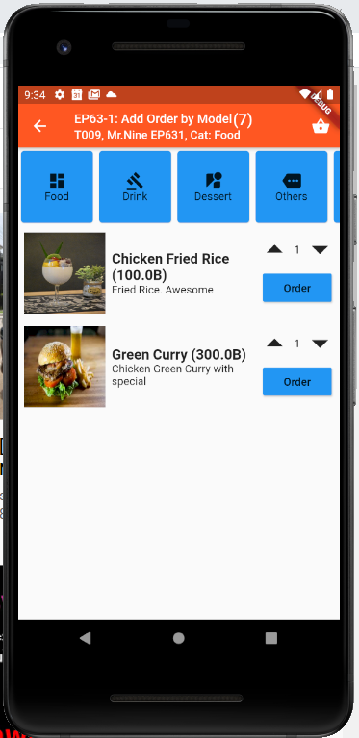
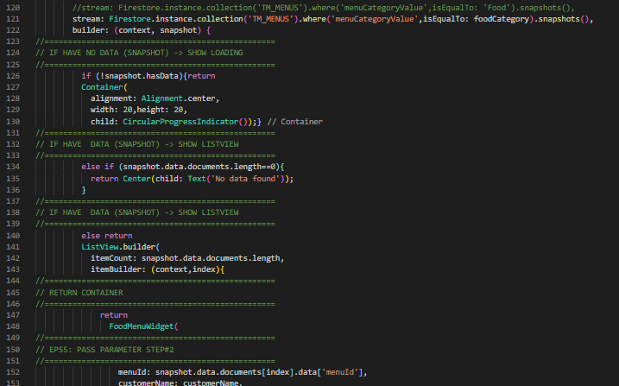
Coding Concept
<< Business Logic >>
<< UI >>
Order Model
(1) Final Property
(Database Column)
(2) Constucture
Business Login is in UI to Get Data from Database
For Insert data to database
(3) factory FoodMenuModel.fromFireStore(DocumentSnapshot doc)
(4) Get Menu
Separate Business Logic & UI
Steps for Get Menu
Import MenuModel
Declare & Prepare _menuModel in state class
SteamBuilder: Call GetMenu Function
Fill data into _menuModel object using fromFireStore Factory Method
Get data from _menuModel object
<< UI >>
TM_MENUS

Slide 5
Benefits of Using Model Class
Separate UI and Business Logic
Protect coding incorrect column name
Apply for using with WEBAPI (Json format)
Separate tasks if have 2 programmers

Slide 6
Firestore Data

Slide 7
Coding

Slide 8
Final UI

Slide 9
Coding – EP641

Slide 10
Final UI

