Slide 1
EP65 Design UI, Data Modelling using Class Diagram (View order for Make Order, Check Status and Payment) Case Study “Restaurant E-menu” ระบบสั่งอาหารผ่านมือถือ
See-Flutter เรียนรู้ไปด้วยกัน เรียนฟรี พร้อม Source Code
13 Sep 2020
Day#54
นอกจากการเขียนโปรแกรมที่ดีแล้ว การออกแบบโปรแกรมก็สำคัญมากเช่นกัน
Apart from good programming, design is very important too!!

Slide 2
CONTENT เนื้อหาวันนี้
Design Design
Use Case
Data Modeling by Class Diagram
Target Group: Mobile Developer

Slide 3
Key Knowledge
Relation between design, database, programming in Flutter (basic condept)
How to design software using;
Use Case
UI Design (Mockup)
Work flow diagram
Data Modelling by Class Diagram (Class in Flutter)
Attributes (Column in database & class property in Flutter)
Operations (Method = function in Flutter )

Slide 4
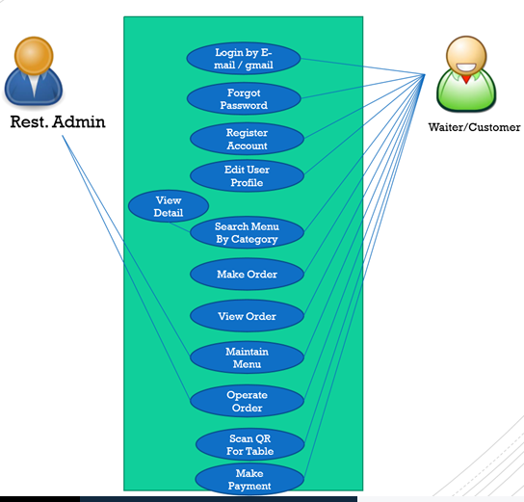

Use Case
View Order
Send Order
Check Order Status
Customer
Payment

Slide 5
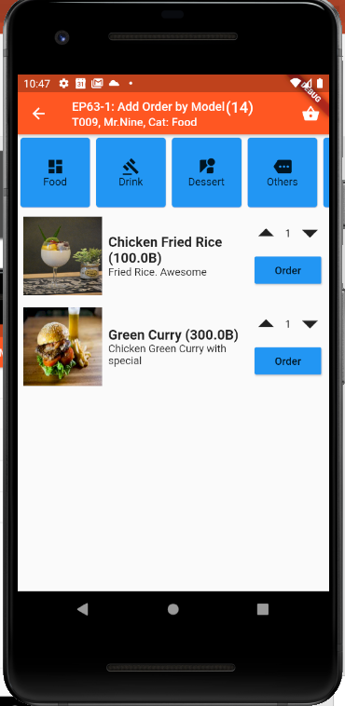
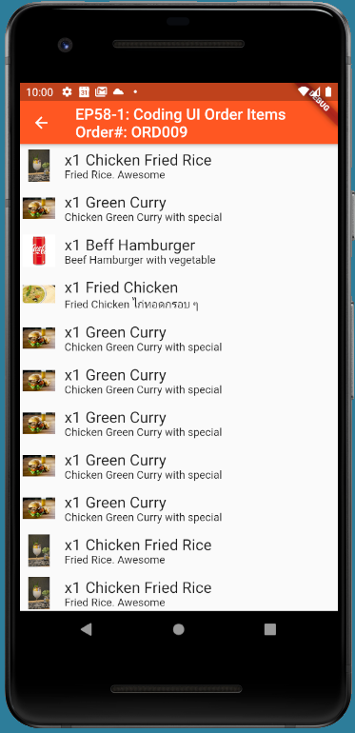
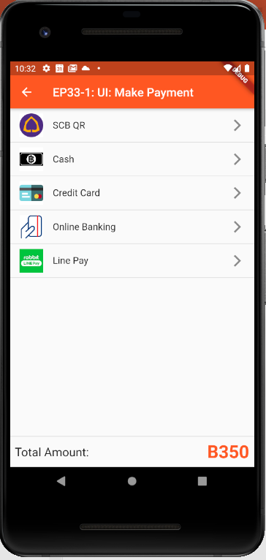
UI Design
Ordering
Customer: Mr.John
Table#: 10
Order#: ORD007
Mobile No: 085-3214234
Time: 10:30am
Register
Member
Ordering
Menu | Price
1) x3 Fired rice | 120
2) x3 Coke | 100
3) x4Green Curry | 100
4) x5 Rice | 30
Sent
Sent
Cooking
Cooking
Served
Served
Served
Total ฿350
Served
Order(14)
Status
Payment
More
Send Order
Served
Pay
Make Order
View Order for
Send Order
View Order for checking
Order Status
View Order for
Payment
Make Payment

Slide 6
Ordering Status & Workflow Diagram
Customer | Kitchen | Waiter
Ordering
Send Order
Cooking
Serve
Close Table
start
Cook
Serve
Open Table
Make Order
Send Order
Make Payment
Close Table

Slide 7
Ordering Status using in Database & Flutter
Ordering
Send Order
Cooking
Serve
Close Table
Status | Description
ORDER | On Orderping process
SEND | Submit Order
QUEUE | Wait for Cook
COOK | Already Cook
SERVE | Already Served food
PAY | Already make payment
COMPLETE | Close Table

Slide 8
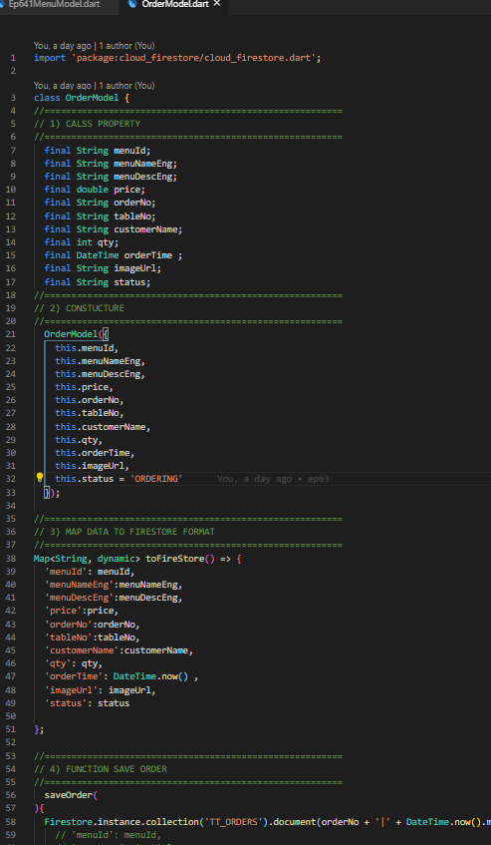
Business & Data Modelling
Class Diagram
Attributes
(Column in Database, Property in Class)
Opertions
(Function = Method in Flutter)
Class: OrderModel
Attribute
Attribute
Flutter
Operations
Operations

Slide 9
Class Attribute = Field in Firebase DB = Property Class in Flutter
documentId | Order No
CustomerInfo
OrderItemInfo
PaymentInfo
tableNo
orderNo | DocumentId
createOrderTime
Ordering
Customer: Mr.John
Table#: 10
Order#: ORD007
Mobile No: 085-3214234
Time: 10:30am
Register
Member
Ordering
Menu | Price
1) x3 Fired rice | 120
2) x3 Coke | 100
3) x4Green Curry | 100
4) x5 Rice | 30
CustomerInfo
customerName
mobileNo
Email
lineID
memberNo
Sent
Sent
Cooking
Create Class & will be field in Firebase Database
Cooking
Served
OrderItemIno
menuId
menuNameEng/Thai
menuDescEng/Thai
qty
price
totalPrice | Calculate Field
Served
Served
Total ฿350
Served
Served
Pay
PaymentInf
paymentType | Cash, Credit Card, QR Code, Line Paymen
amount
vAT
totalAmount
View Order for checking
Order Status
View Order for
Payment

Slide 10
Class Diagram  Operations = Function in Flutter
Class: OrderV1Model
Operation in Class Diagram or Function Name in Flutter
For View Order
OrderV1Model getOrderForSendOrder(documentId)
OrderV1Model getOrderForCheckOrderStatus(documentId)
OrderV1Model getOrderForPayment(documentId)
Order all process from open to close table
openTable(tableNo,mobileNo)
addOrderItem(documentId, menuId, qty)
updateOrderItem(orderItemDocumentId, qty)
deleteOrderItem(orderItemDocumentId)
changeOrderItemStatus(orderItemDocumentId, status)
closeTable(documentId)
makePayment(documentId, paymentInfo)
Attribute
(Last slide)
Operations

Slide 11
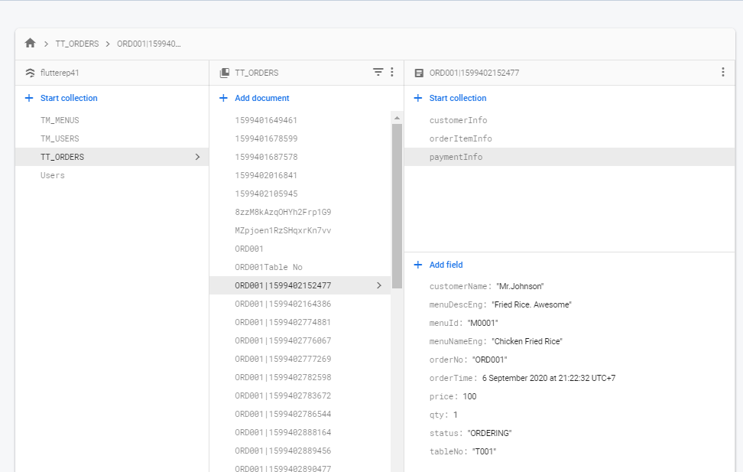
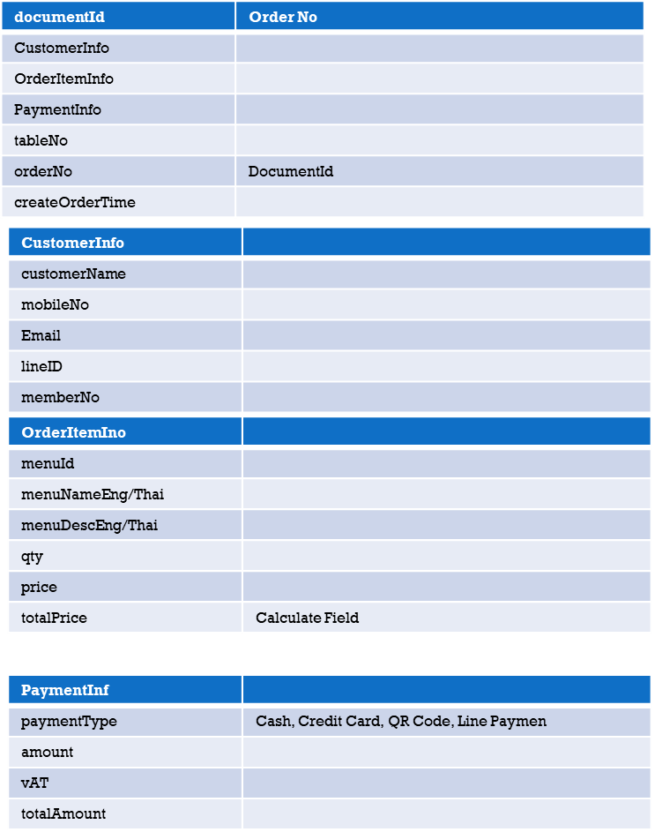
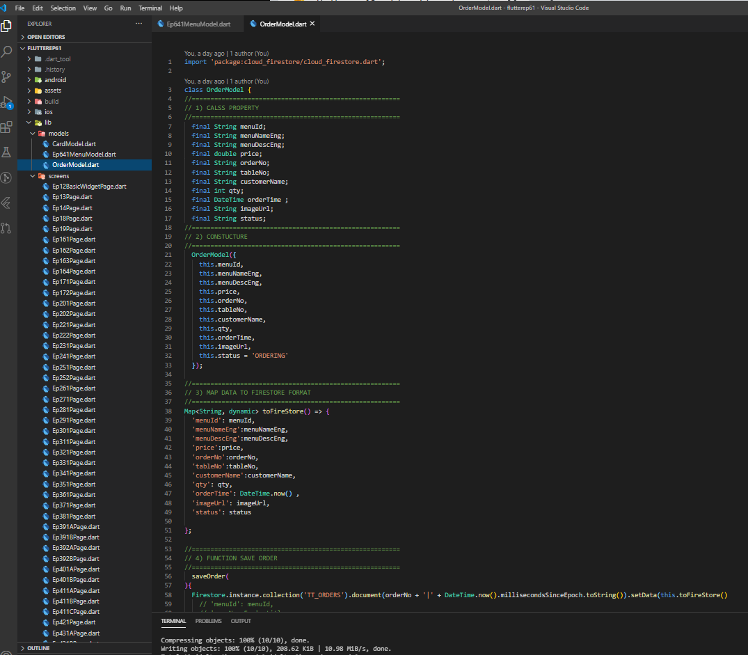
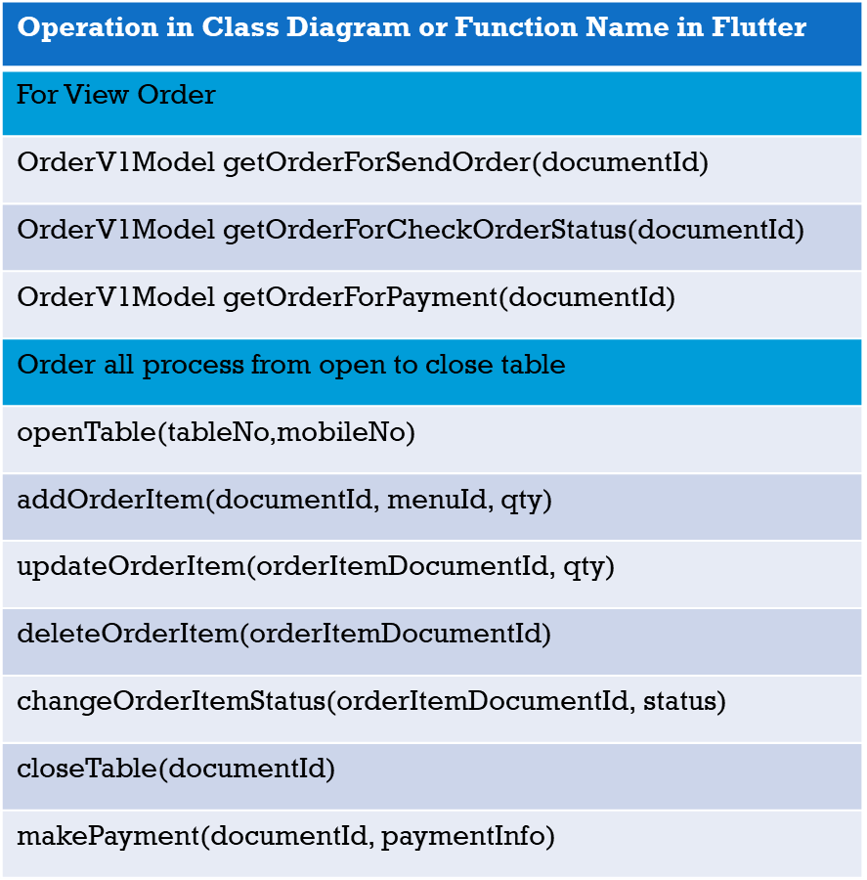
Class Diagram & mapping to DB and Flutter
Class: OrderV1Model
Attribute
Class Model in Flutter
Operations
Firebase Database

Slide 12
Firebase Database (Sample)
Collection: TT_ORDERS
customerInfo (Collection)
orderItemInfo (Collection)
paymentInfo (Collection)

Slide 13
Next EP
To understand relationships between Class Diagram & Database & Class Model in Flutter
Tomorrow → Try to coding and create database
Create Class in Flutter
Create Database in Firebase

Slide 14
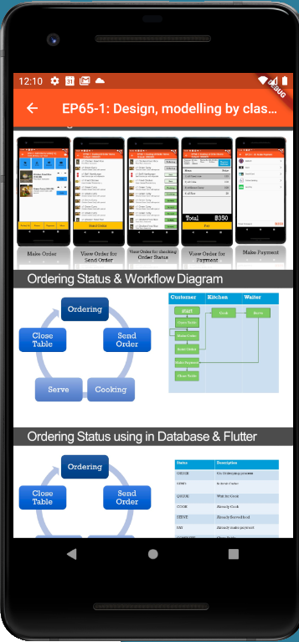
Final UI
Note: This EP just only design no coding

