Slide 1
EP66 Create “Model Class” for Keep Order Data Case Study “Restaurant E-menu” ระบบสั่งอาหารผ่านมือถือ
See-Flutter เรียนรู้ไปด้วยกัน เรียนฟรี พร้อม Source Code
14 Sep 2020
Day#55

Slide 2
CONTENT เนื้อหาวันนี้
Class Diagram (Review)
Coding Concept
Coding
Create Model Class with Add Orders Function
Insert Order data to database (Hard Code Data)
Target Group: Mobile Developer

Slide 3
Key Knowledge
Programming follow the class diagram
Understand relationships among
Design (Class Diagram)
Database in Firebase
Programming in Flutter (basic condept)
Nested Database
List of Order Item Info
Customer Info
Payment Info

Slide 4
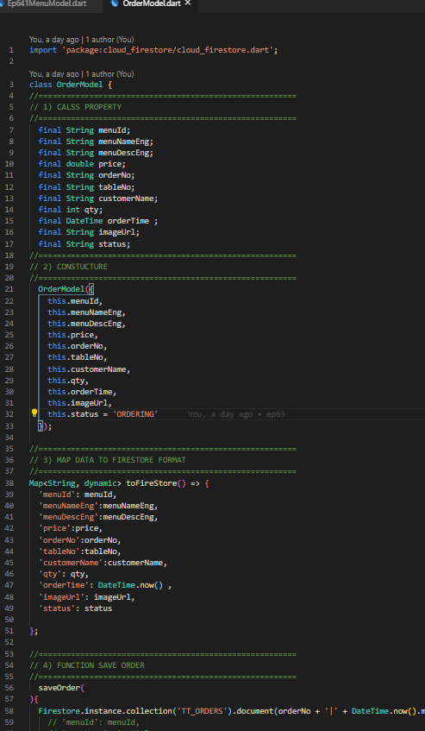
Class Diagram (Review)
Class Diagram
Attributes
(Column in Database, Property in Class)
Opertions
(Function = Method in Flutter)
Class: OrderModel
Attributes
Attributes
Flutter
Operations
Operations
(Today: addOrder)

Slide 5
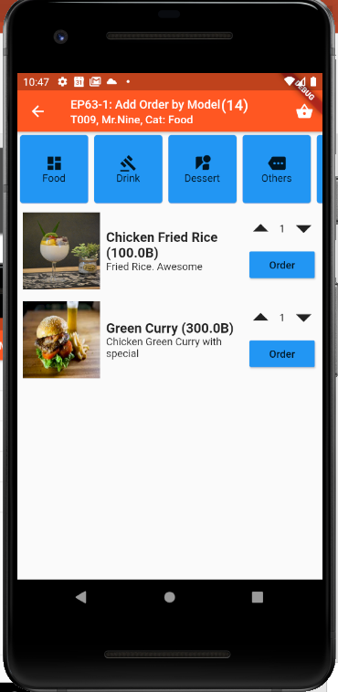
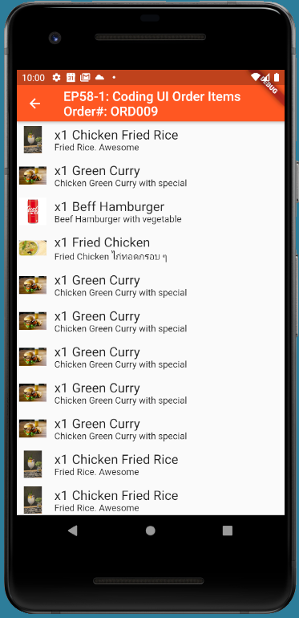
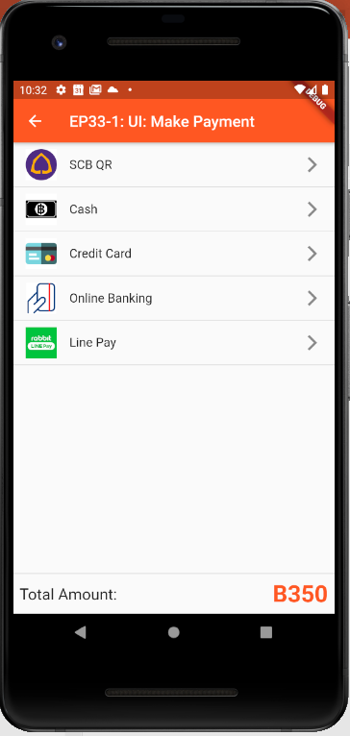
UI Design  Create Class Attributes for UIs
Ordering
Customer: Mr.John
Table#: 10
Order#: ORD007
Mobile No: 085-3214234
Time: 10:30am
Register
Member
Ordering
Menu | Price
1) x3 Fired rice | 120
2) x3 Coke | 100
3) x4Green Curry | 100
4) x5 Rice | 30
Sent
Sent
Cooking
Cooking
Served
Served
Served
Total ฿350
Served
Order(14)
Status
Payment
More
Send Order
Served
Pay
Make Order
View Order for
Send Order
View Order for checking
Order Status
View Order for
Payment
Make Payment

Slide 6
Class Attribute = Field in Firebase DB = Property Class in Flutter
documentId | Order No
CustomerInfo
OrderItemInfo
PaymentInfo
tableNo
orderNo | DocumentId
createOrderTime
Ordering
Customer: Mr.John
Table#: 10
Order#: ORD007
Mobile No: 085-3214234
Time: 10:30am
Register
Member
Ordering
Menu | Price
1) x3 Fired rice | 120
2) x3 Coke | 100
3) x4Green Curry | 100
4) x5 Rice | 30
CustomerInfo
customerName
mobileNo
Email
lineID
memberNo
Sent
Sent
Cooking
Create Class & will be field in Firebase Database
Cooking
Served
OrderItemIno
menuId
menuNameEng/Thai
menuDescEng/Thai
qty
price
totalPrice | Calculate Field
Served
Served
Total ฿350
Served
Served
Pay
PaymentInfo
paymentType | Cash, Credit Card, QR Code, Line Paymen
amount
vAT
totalAmount
View Order for checking
Order Status
View Order for
Payment

Slide 7
Final UI

Slide 8
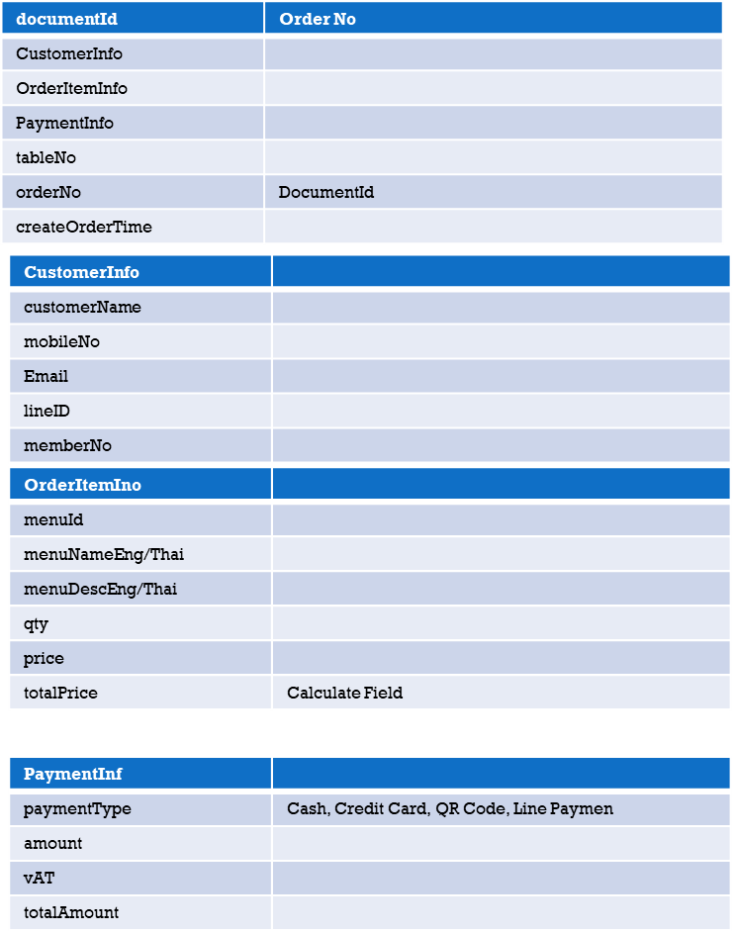
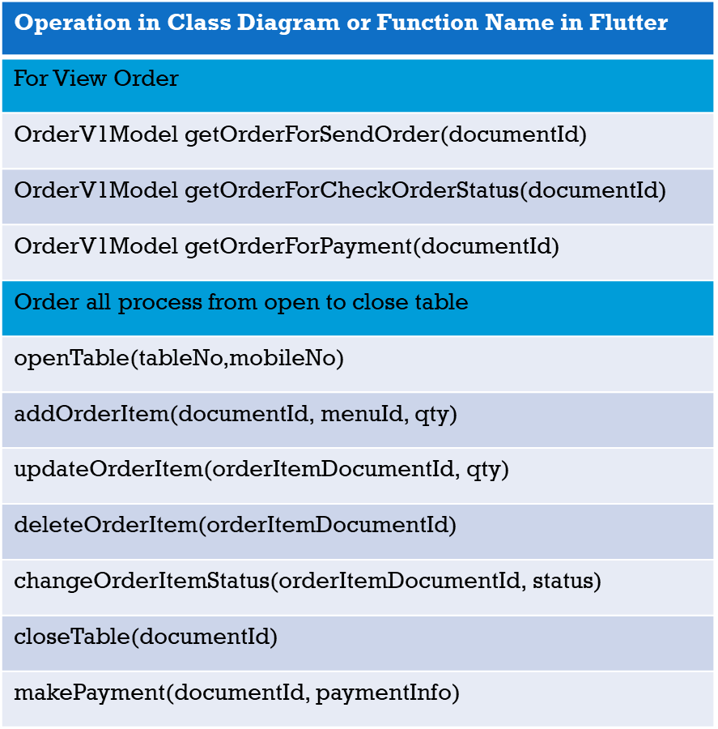
Class Diagram & mapping to DB and Flutter
Class: OrderV1Model
Class Model in Flutter
Firebase Database
Attribute
Operations

Slide 9
Coding Concept
1
2
Order Model Class
(Flutter)
UI
(Flutter)
Add Order (Many Items)
OrderModel
3
FireStore
Database
DATABASE
TM_V1_ORDER
WEBAPI

Slide 10
Insert, Delete, update, Getdata with Database (FireStore)
Insert and Update Data into Database
Firestore.instance.collection('TT_ORDERS').document(orderNo + '|' + DateTime.now().millisecondsSinceEpoch.toString()).setData({'menuId': menuId,'menuNameEng': title, })
Update Data to Database by Document ID
Firestore.instance.collection('TT_ORDERS').document(snapshot.data.documents[index].documentID).update({‘qty': 3,‘remark': ’Test’, })
Firestore.instance.collection('TT_ORDERS').document(snapshot.data.documents[index].documentID).child(‘orderNo’).update({‘qty': 3,‘remark': ’Test’, })
Get Data from Database by Document ID
Firestore.instance.collection('TT_ORDERS').document(widget.documentId).get().then((value)
Get List of Data from Database by Condition
Firestore.instance.collection('TT_ORDERS').where('orderNo', isEqualTo: ’ORD007’).snapshots()
Firestore.instance.collection('TM_MENUS').where('menuCategoryValue',isEqualTo: ’Foods’).snapshots()
Delete Data from Database by Document ID
Firestore.instance.collection('TT_ORDERS').document(snapshot.data.documents[index].documentID).delete()

Slide 11
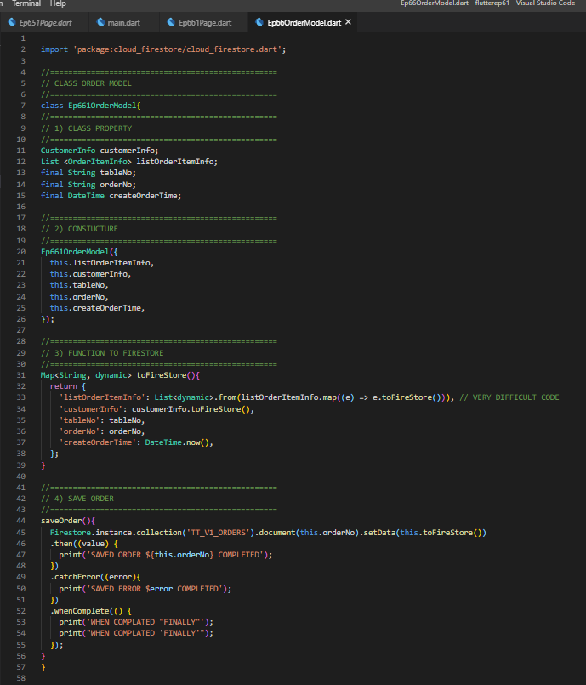
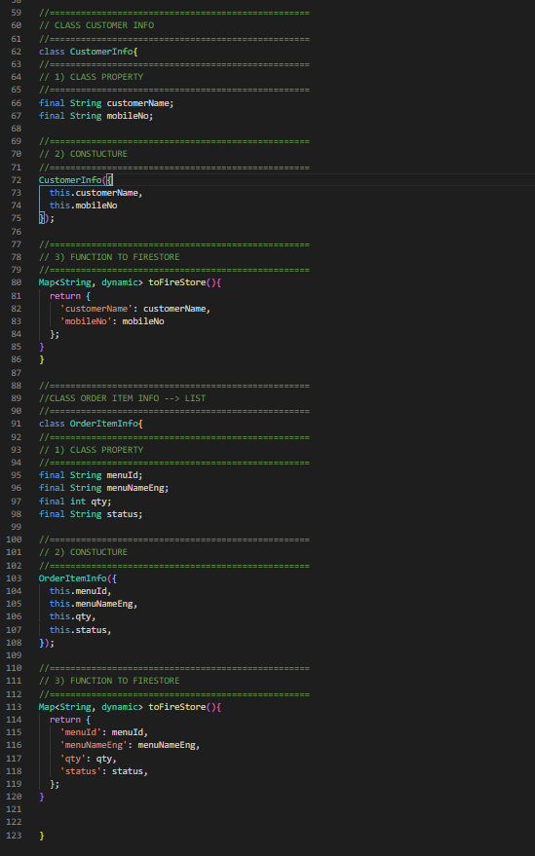
Flutter - Model Class
Class Diagram Design
4. CustomerInfo Class
Class: OrderV1Model
Attribute
Attributes
Constuctures
3. Map to ToFireStore
5. OrderItemInfo Class
Operations
4. Function Save Order
(Operations)

Slide 12
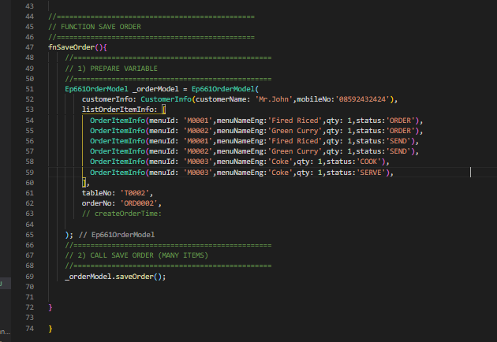
Flutter - Calling Class
Declare Variable (Initiate Class)
2. Call Function Save Order

Slide 13
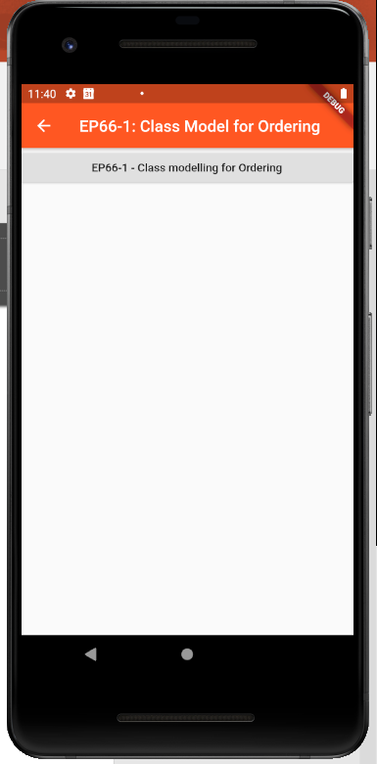
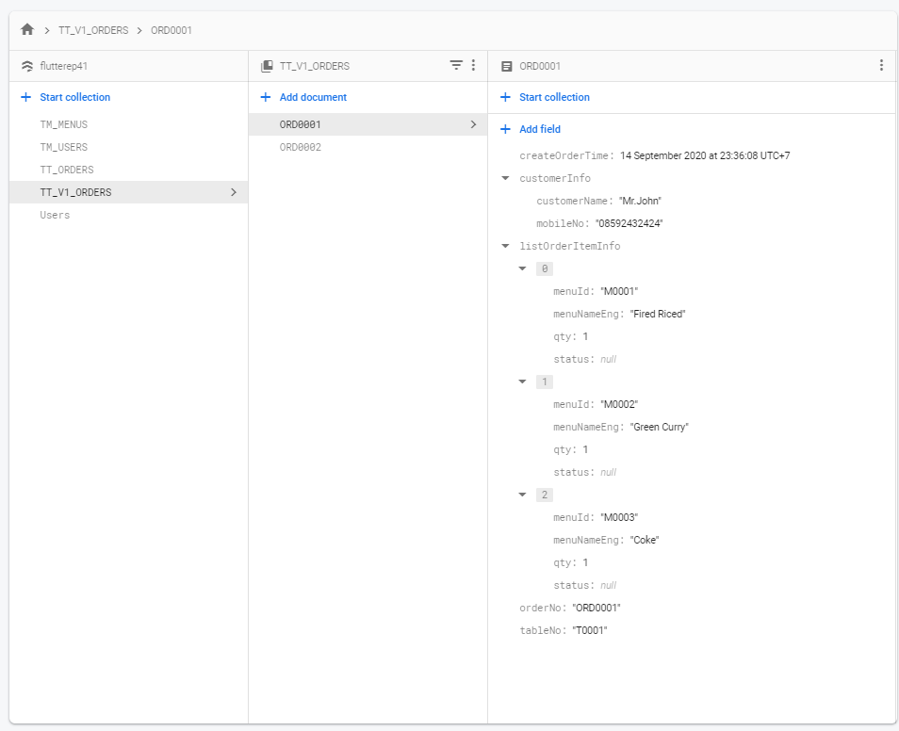
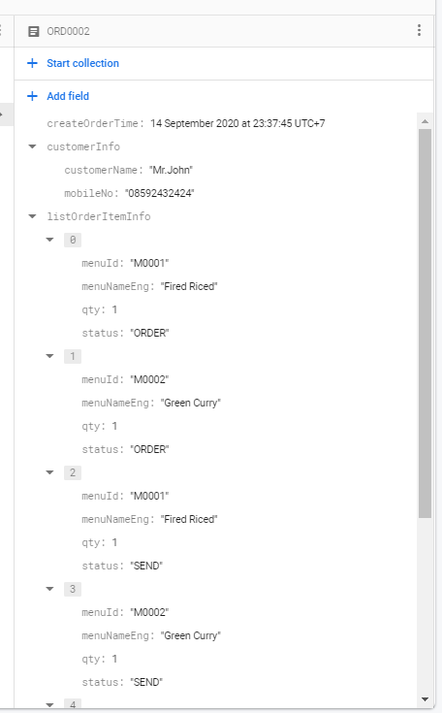
FINAL UI

