Slide 1
EP67 Create “Model Class” for Get Order Data Case Study “Restaurant E-menu” ระบบสั่งอาหารผ่านมือถือ
See-Flutter เรียนรู้ไปด้วยกัน เรียนฟรี พร้อม Source Code
15 Sep 2020
Day#56

Slide 2
CONTENT เนื้อหาวันนี้
Review UI
Concept of Model mapping (DB Scheme & Class)
Coding
Factory Method ( Create Model  Object )
Order
CustomerInfo
OrderItemInfo
Function getOrder(orderNo)
Target Group: Mobile Developer

Slide 3
Key Knowledge
How to get data from database
Factory Method for create model
Nested Database Tables
Nested Classes
Print Object for debugging

Slide 4
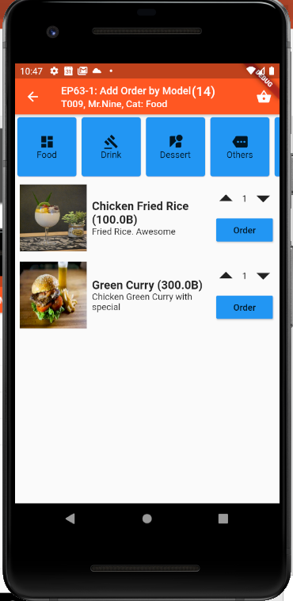
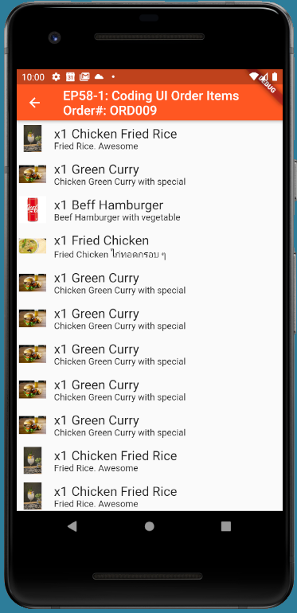
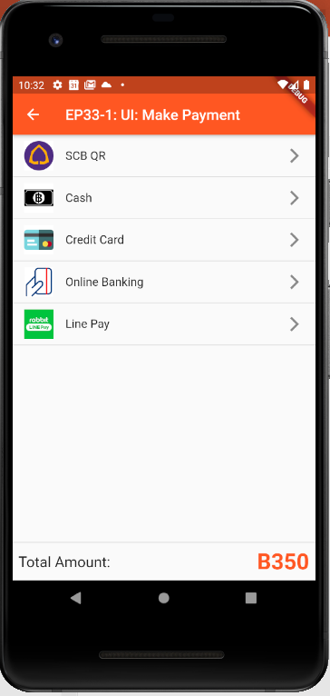
UI Design  Create Class Attributes for UIs
Ordering
Customer: Mr.John
Table#: 10
Order#: ORD007
Mobile No: 085-3214234
Time: 10:30am
Register
Member
Ordering
Menu | Price
1) x3 Fired rice | 120
2) x3 Coke | 100
3) x4Green Curry | 100
4) x5 Rice | 30
Sent
Sent
Cooking
Cooking
Served
Served
Served
Total ฿350
Served
Order(14)
Status
Payment
More
Send Order
Served
Pay
Make Order
View Order for
Send Order
View Order for checking
Order Status
View Order for
Payment
Make Payment

Slide 5
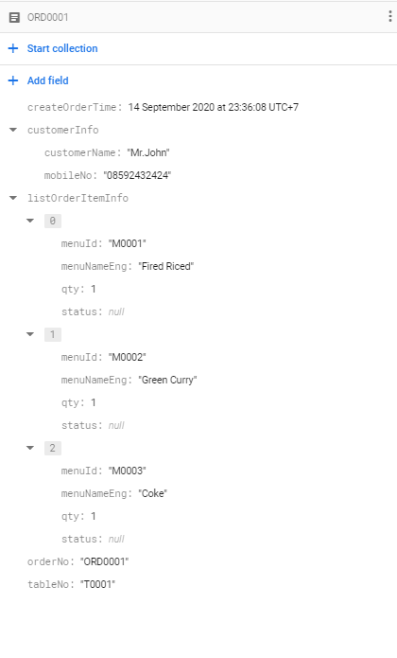
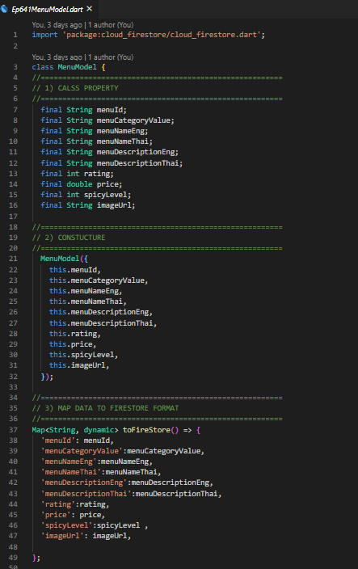
Data Model Mapping (DB & Class)
Database
Class
UI
Object

Slide 6
Data Model Mapping (DB & Class)
Class “Order”
Database
Method = Function
Method (Factory)
Model
AddOrder(Order)
toFireStore (Order)
Object “Order”
Open Table
AddOrderItem(OrderNo,OrderItemInfo)
toFireStore (OrderItemInfo)
Object “OrderItemInfo”
AddOrder
FireStore Database
Method = Function
Method = Function
GetOrder(documentId)
fromFireStore
Object “Order”
Mapping between Database Schema & Class

Slide 7
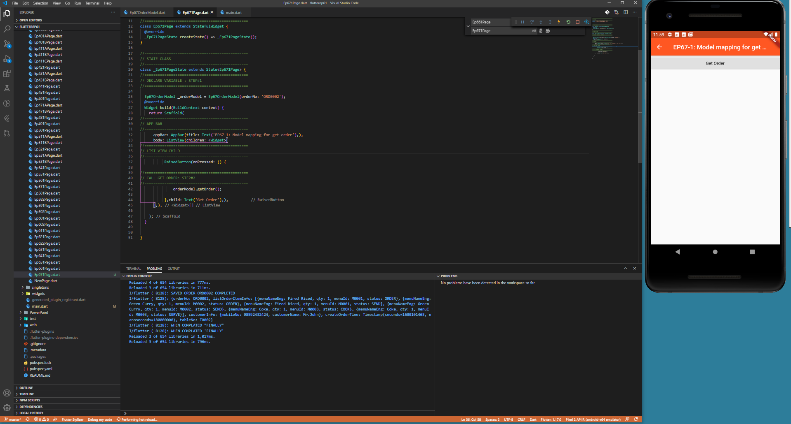
FINAL UI

Slide 8
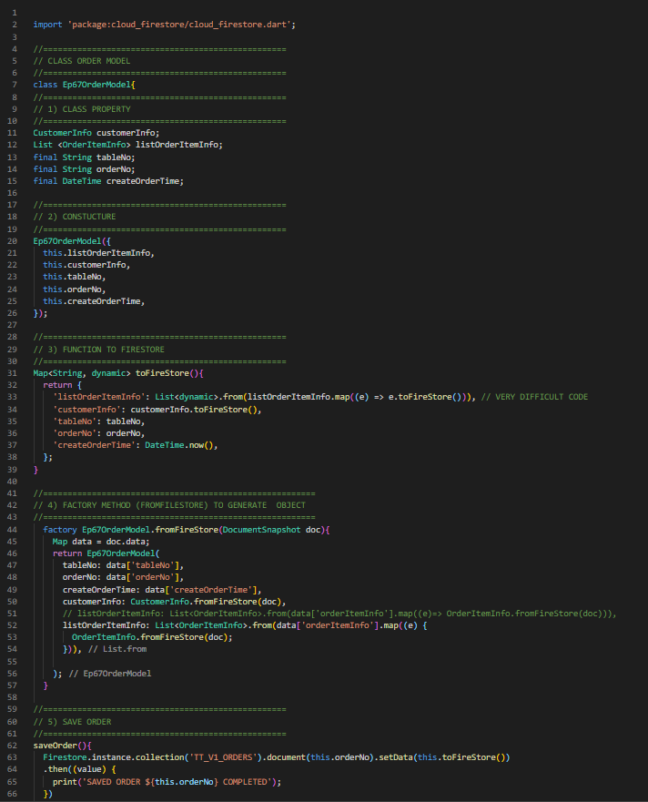
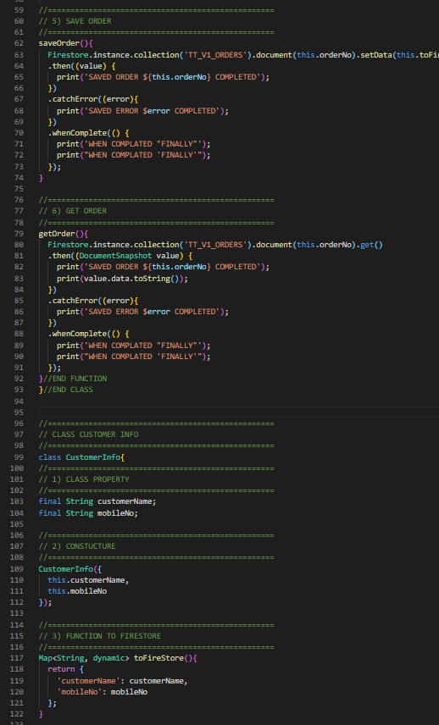
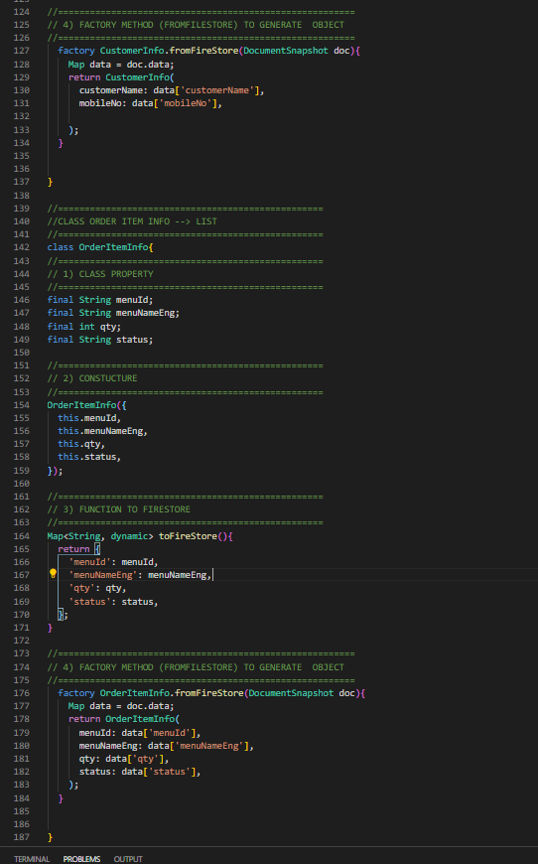
Code

Slide 9
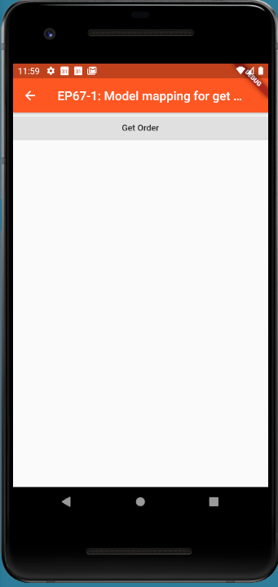
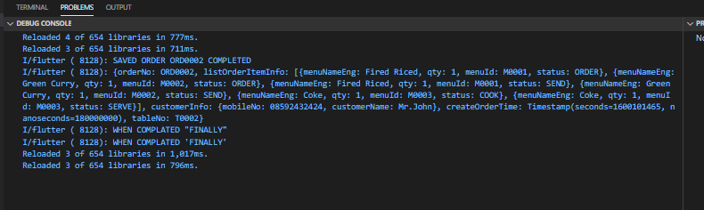

FINAL UI

