Slide 1
EP68 How to develop software ? “E-menu for restaurant” Case Study “Restaurant E-menu” ระบบสั่งอาหารผ่านมือถือ
See-Flutter เรียนรู้ไปด้วยกัน เรียนฟรี พร้อม Source Code
16 Sep 2020
Day#57
Good Design & Processes are needed to Make High Quality of software

Slide 2
CONTENT เนื้อหาวันนี้
Explain how to develop software ?
Review Use Case
Review UI Design
Design UI for Customer
Open Table  Go out
Target Group: Mobile Developer

Slide 3
Key Knowledge
How to develop software ?
Keyword: Agile, Sprint, CI/CD, MosCow
How to design UI and Functions in Flutter ?
Use Case Diagram
NoSQL and Relational Database

Slide 4
How to develop app ?
Use Case
UI Mock up
Database Design
Class Diagram
Coding
Requirement
List
Test
Release
MoSCoW = Must, Should, Could, Would
Release  For use
Who is users ?
Features ?
AGILE
SPRINT
2-4 weeks
Unit Test
Integration Test
UAT (User Acceptant test)
UI Design
E.g.
UI (screens, widget)
Class Model (models)
Shared Variable (singletons)
Database Design
(NoSQL)
Design: Class Diagram
Steps might swap or loop to improve products

Slide 5
Agile & CI/CD
CI/CD = Continuous Integration
and Delivery/Development
“Workable Software & Continuous Improve Feature”
Agile = Development Methodology
[ Get Feedback & Continuous Improve ]
Sprint = Timing e.g. 2-4 Weeks to release features

Slide 6
NoSQL and Relational Database
No SQL e.g. Firebase
“Keep data as documents, collection”
Relational DB e.g. MySQL, SQL, Oracle

Slide 7
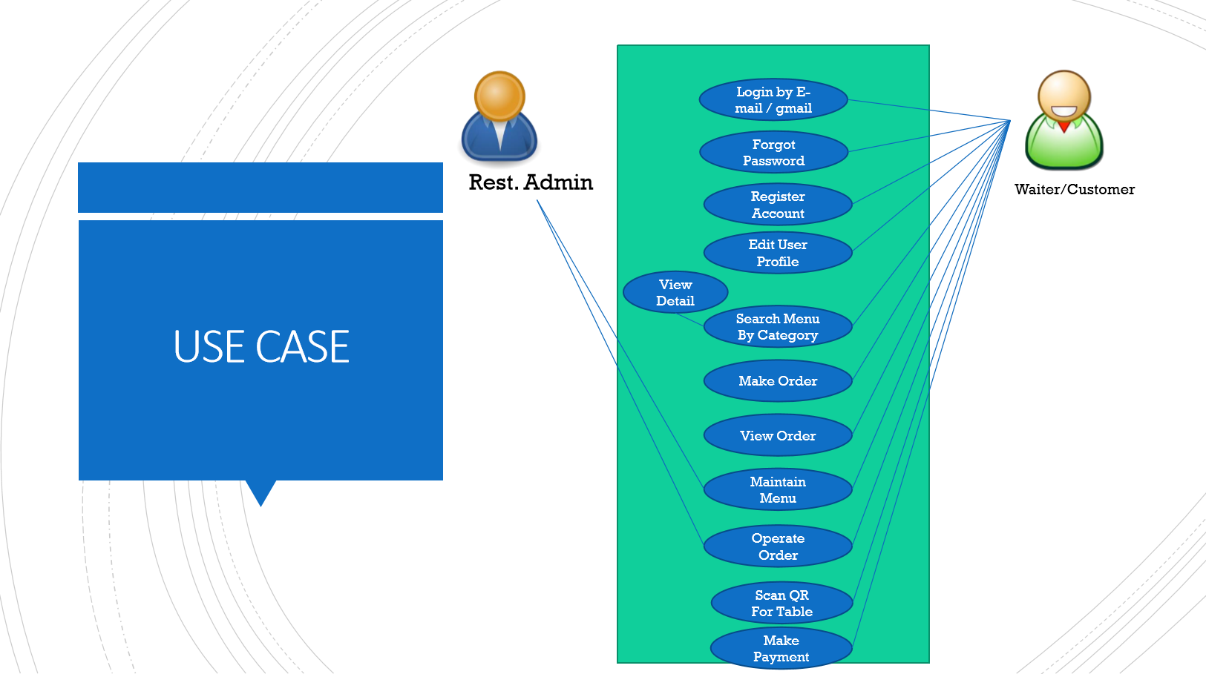

Slide 8
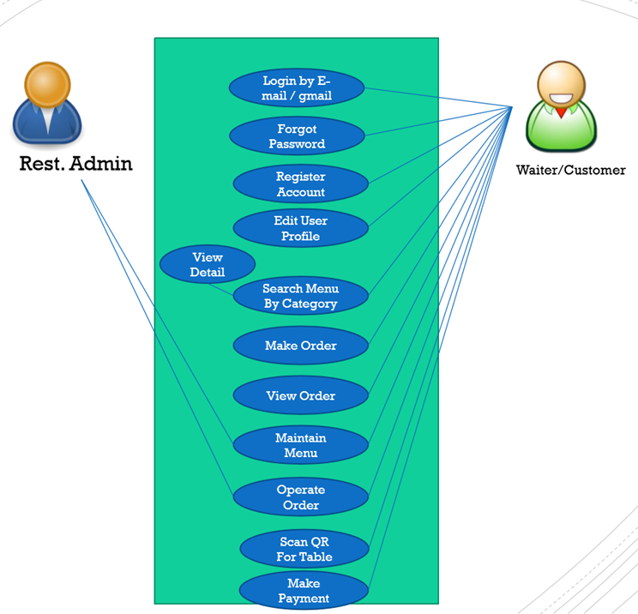


Refine Use Case
Open Table using QR
View Menu Details
View Menu
Restaurant
Admin
Make Order
Submit Order
View Order
Check Status
Customer
Waiter
View Order for Payment
Payment
Chief

Slide 9
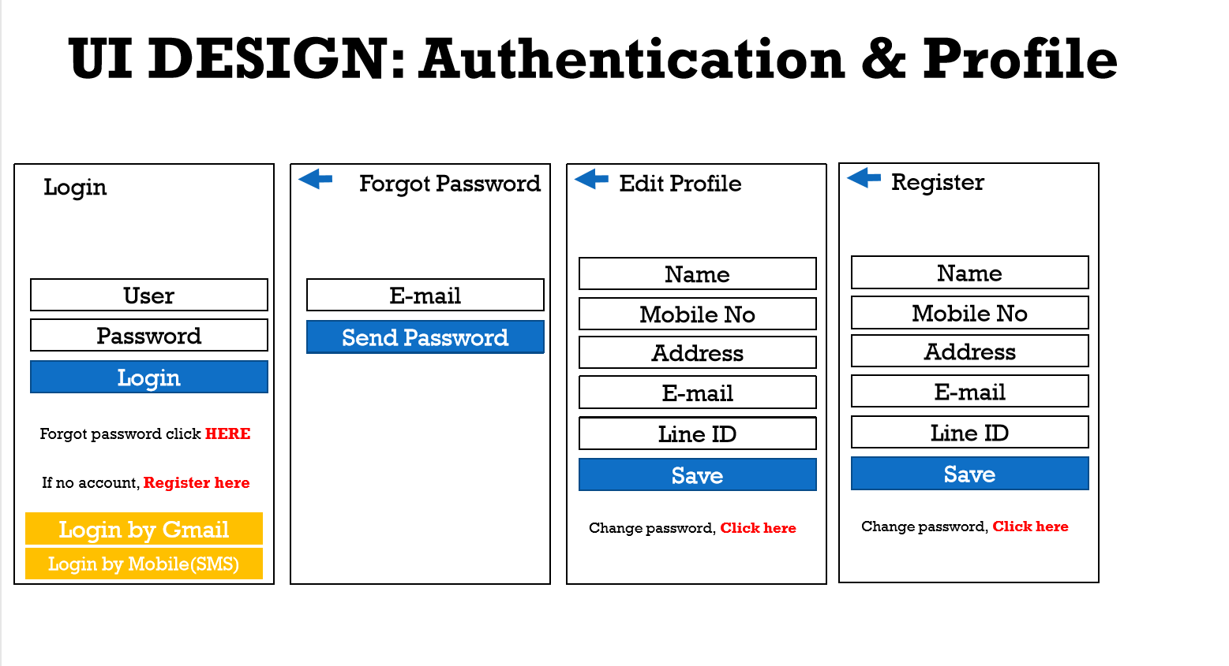
UI Design (for Restaurant Admin)

Slide 10
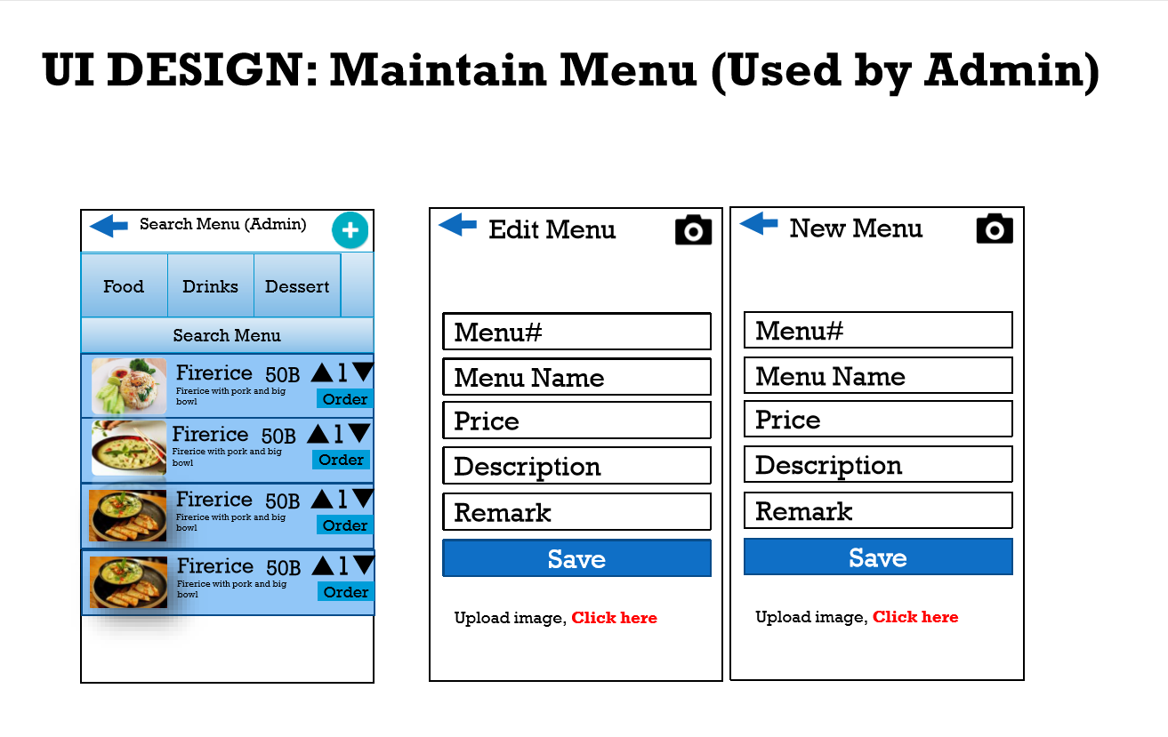
UI Design (for Restaurant Admin)

Slide 11
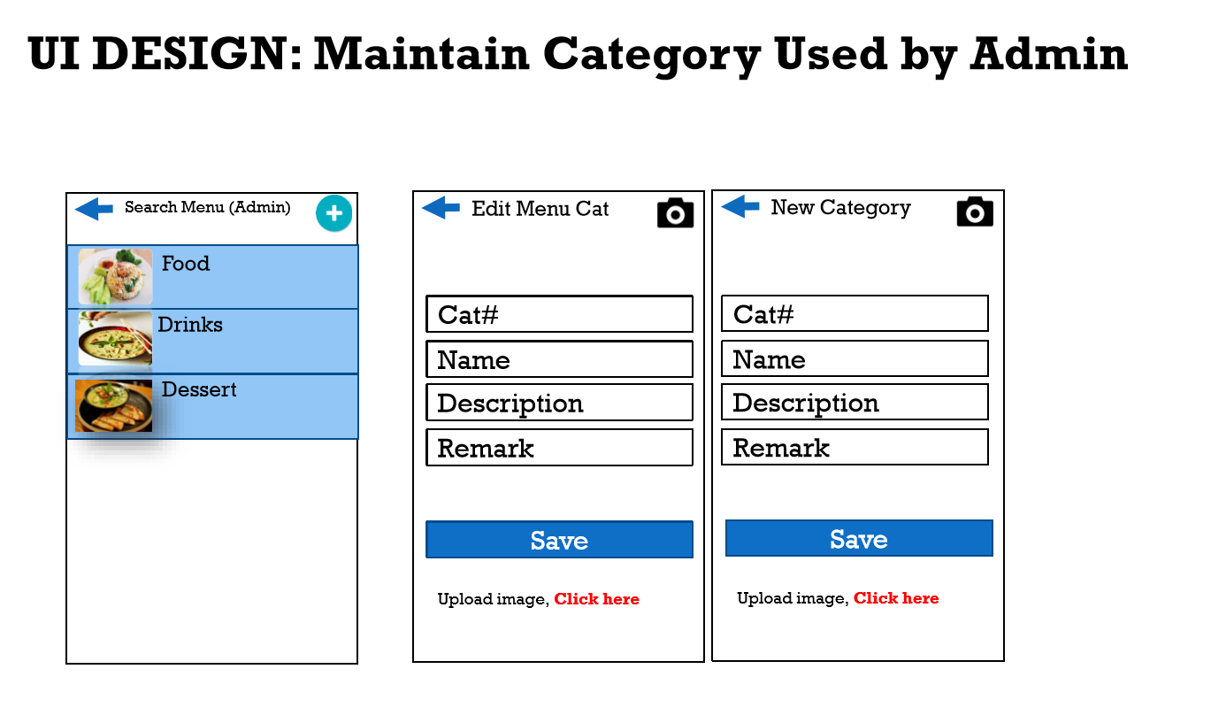
UI Design (for Admin)

Slide 12
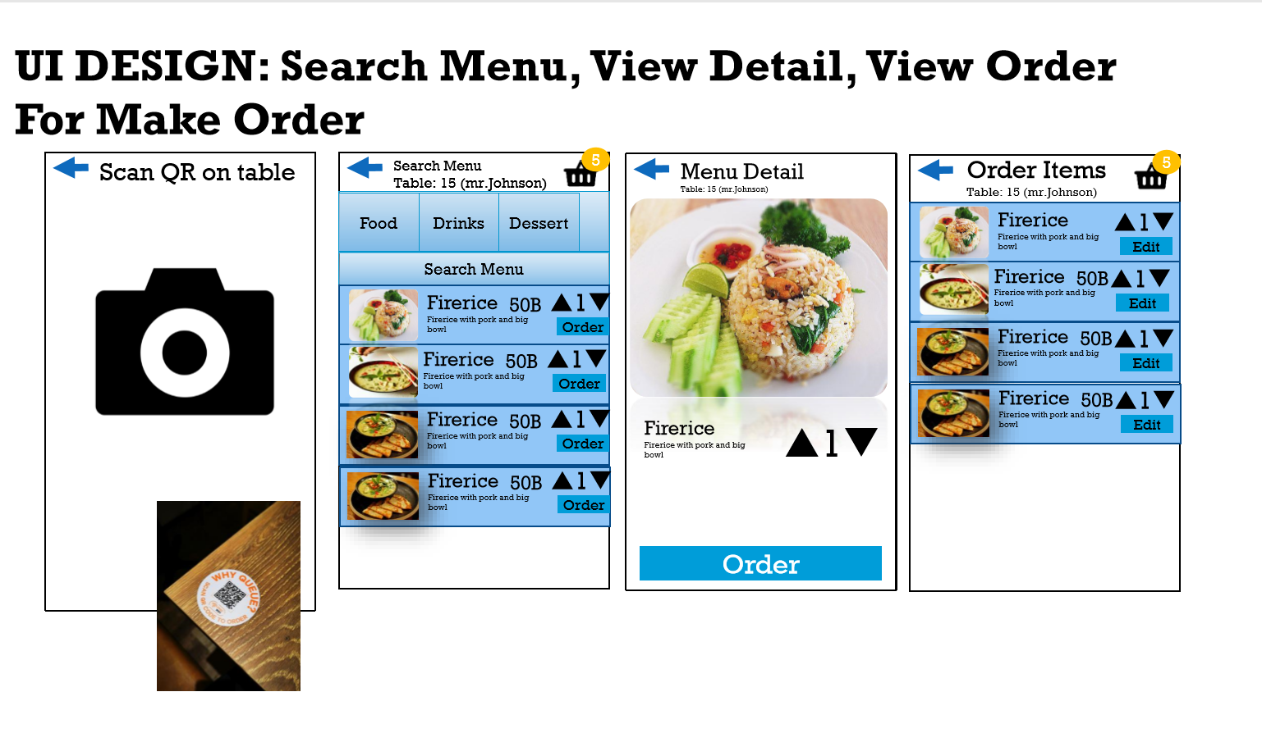
UI Design (for Customers)
Cust Name
Remark
Phone
View Order
Check Status
Payment
View Order
Check Status
Payment
Save

Slide 13
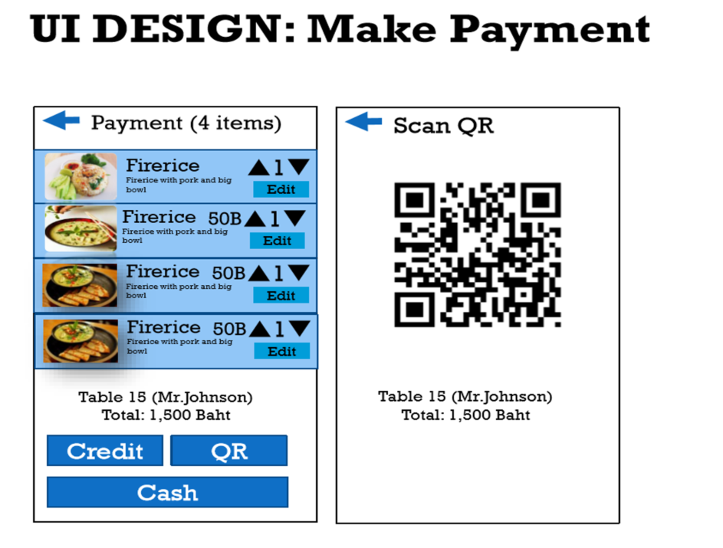
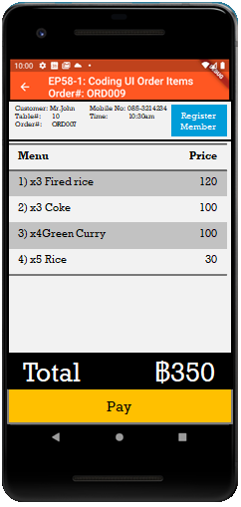
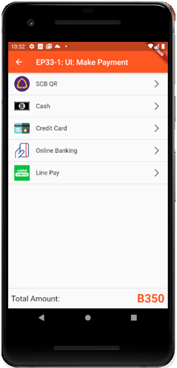
UI Design (for Customers)

Slide 14
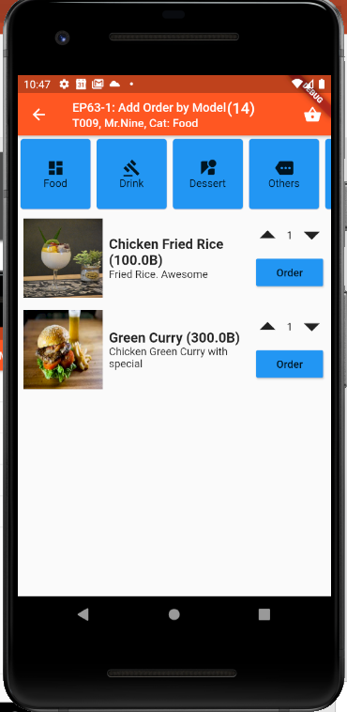
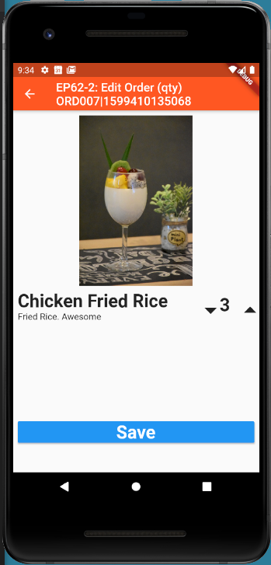
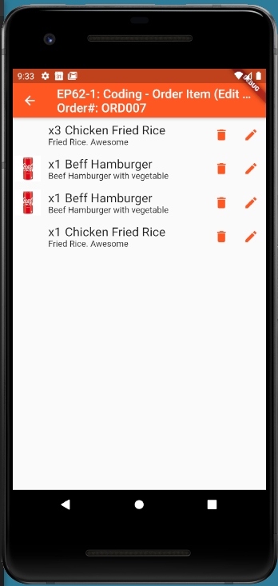
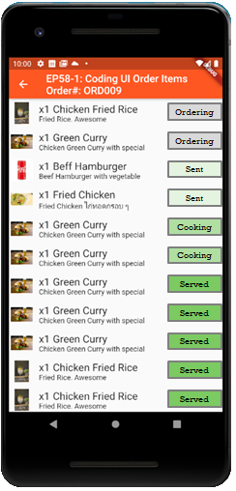

UI process
Operations = Function List (Customer)
S1: OpenTableByQR(qrCode)
S2: RegisterTable(qR,custName,mobileNo)
S3: MenuModel GetMenuList
S3: AddOrderItem(menuId, qty, remark)
S4: OrderItemModel GetMenuDetail(menuId)
S5: GoTable(qR,password)
S6: OrderModel ViewOrder(orderNo)
S6: DeleteOrderItem(orderItemNo)
S6: UpdateOrderItem(orderItemNo)
S7: OrderModel CheckOrderStatus(orderNo)
S8: OrderModel ViewPayment(orderNo)
S9: MakePayment(paymentType)
Scan QR
Fill Cust Info e.g. Name, mobile
Search Menu
Menu Detail
1
2
3
4
v
c
p
Edit
View Order
View
Payment
9
Fill Password or Mobile No
6
Check Status
Payment Type
5
7
8
Set Order
Submit Order
Pay
v
c
p
v
c
p
v
c
p
Global Variable (Singleton)
- OrderNo
Send Order

Slide 15
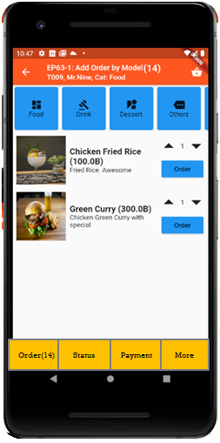
Refine UI developed by Flutter
Send Order

Slide 16
Refine UI developed by Flutter

