Slide 1
EP69 Design UI and Operations for Open Table Feature Case Study “Restaurant E-menu” ระบบสั่งอาหารผ่านมือถือ
See-Flutter เรียนรู้ไปด้วยกัน เรียนฟรี พร้อม Source Code
17 Sep 2020
Day#58

Slide 2
CONTENT เนื้อหาวันนี้
Review Use Case
Design UI and Operations
UI and Flow
Indentify Collection (Table) in FireStore Database
Indentify Shared (Global) Variable
QR Code for Scan at Dinning Table
Target Group: Mobile Developer

Slide 3
Only Code but NO good design
→ Cannot make good Product
Refine & Improve
Only Design but Not Start to coding
 Cannot make product

Slide 4


Refine Use Case
Open Table using QR
EP69
design
EP70
Code ui
View Menu Details
View Menu
Restaurant
Admin
Make Order
Submit Order
View Order
Check Status
Customer
Waiter
View Order for Payment
Payment
Chief

Slide 5
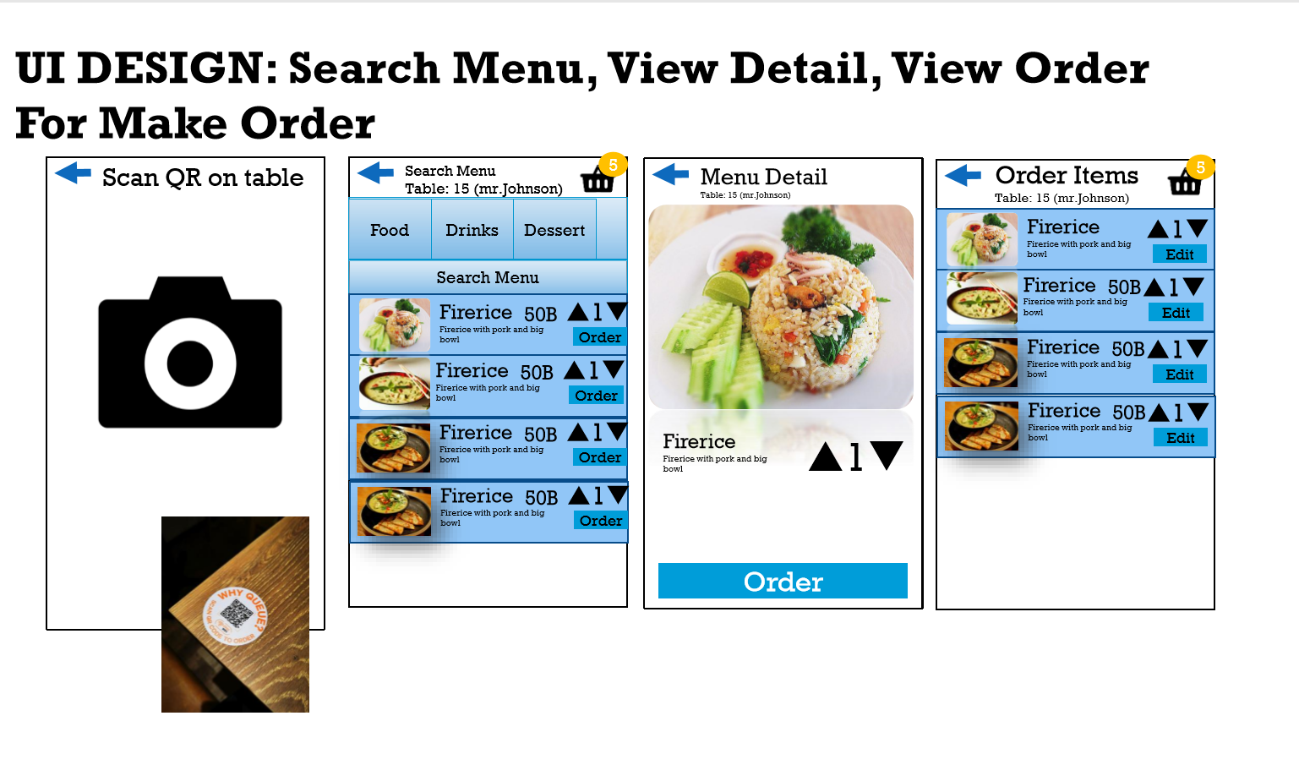
UI Design (for Customers)
Cust Name
Remark
Phone
View Order
Check Status
Payment
View Order
Check Status
Payment
Save
Refine details in next slides

Slide 6
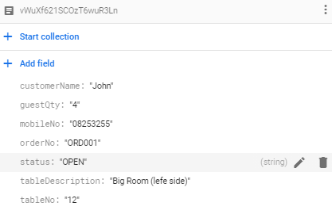
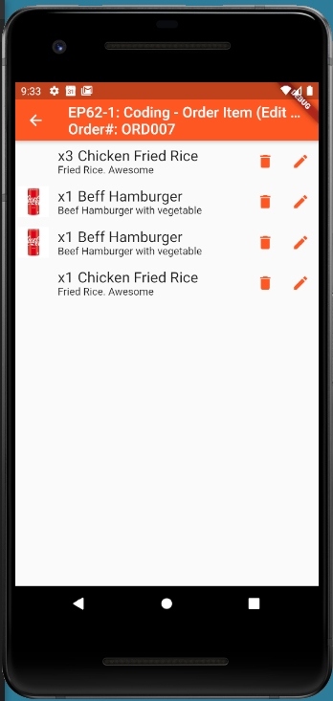
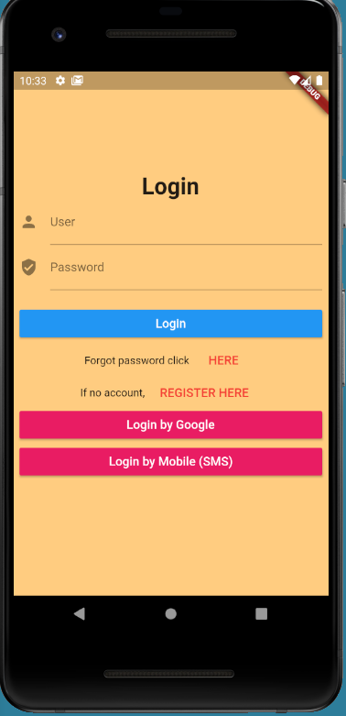

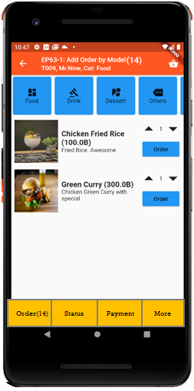
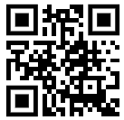
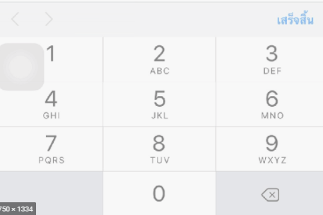
UI Design – Flow & UI
2.1
3.2
FireStore Database
Error
TM_TABLES
1
Not Found
Scan
Camera
→ Web
Customer Info
TM_TABLES
Customer
Order#
No of Guest
Mobile#
(PassCode)
TT_ORDERS
Order#
CustomerInfo
OrderItemInfo
PaymentInfo
www.seefood/T001
Already open table
Name
NO
Status=CLOSE
Mobile#
No of Guest
App
(iOS,Andriod)
Next
1
Yes
Status=OPEN
TT_ORDERS
2.2
TM_TABLES
SEE-FOOD
2
SEE-FOOD
3.2
SEE-FOOD
3
See Food
No 1 Street Food
Order
Passcode
4
Sign-in
TM_TABLES
Next
SharedVariable (Global)
UserName
TableNo
OrderNo
Order
Scan
Sign-in
Sign-up
TT_ORDERS

Slide 7
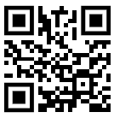
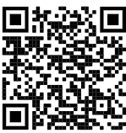

QR Code Scan Design at Restaurant Table
SEE-FOOD
NO.1 STREET FOOD
SEE-FOOD
NO.1 STREET FOOD
Scan to open table here
Download App Here
Table: 12
www.seeflutter.com
www.seeflutter.com

Slide 8
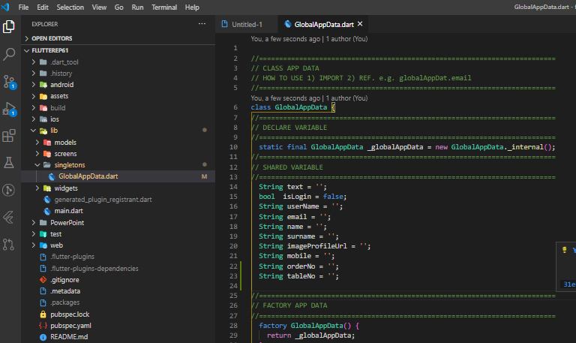
Flutter – Shared Variable Code
Shared (Global) Variables → Singleton Class “GlobalAppData.dart”

Slide 9
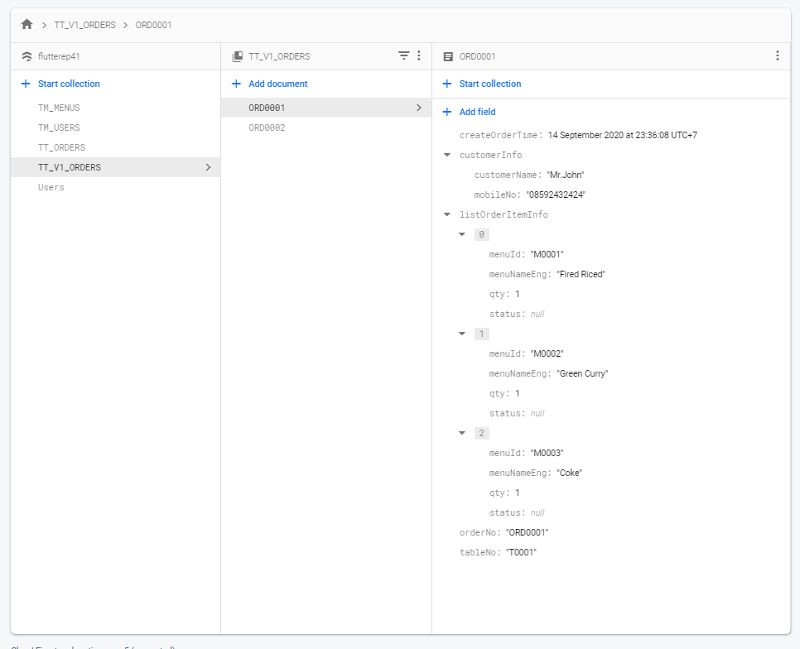
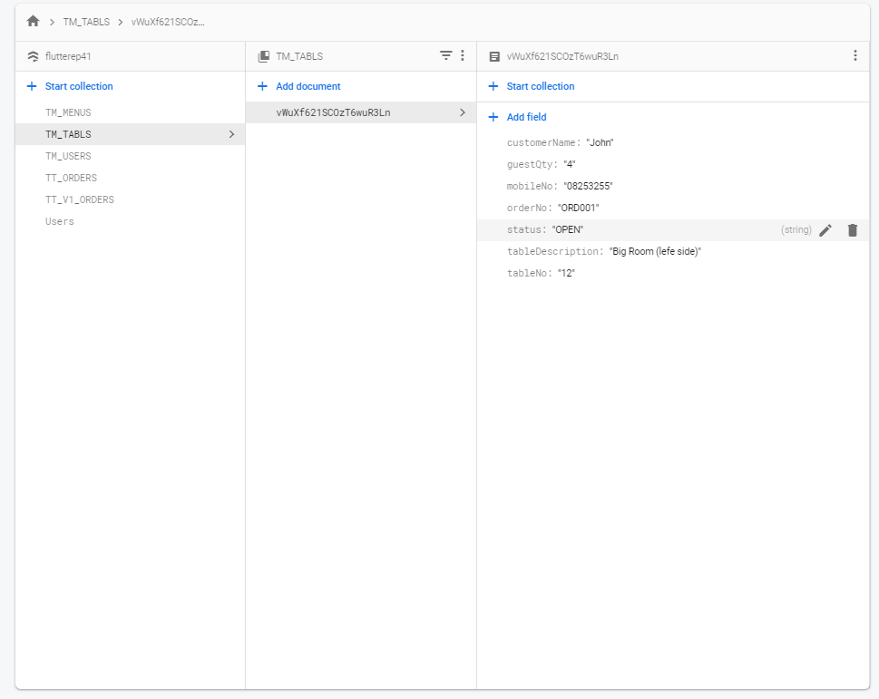
FireStore / Database Design
TT_ORDERS Collection (Table)
TM_TABLES Collection (Table)
orderNo
TT: Table Transaction
TM: Table Master

