Slide 1
Practical Knowledge Agile,Scrum, Jira Case Study “Restaurant E-menu” ระบบสั่งอาหารผ่านมือถือ
EP70
See-Flutter เรียนรู้ไปด้วยกัน เรียนฟรี พร้อม Source Code
18 Sep 2020
Day#60

Slide 2
CONTENT เนื้อหาวันนี้
Review Use Case
Review UI and DB Design
Plan to Develop
Agile/Scrum
Jira for control project
Target Group: Mobile Developer

Slide 3
Key Knowlege
Agile and Scrum
Practical for Agile and Scrum using Jira software
How to create user story ?

Slide 4


Use Case (Review)
Open Table using QR
EP69
design
View Menu Details
View Menu
Restaurant
Admin
Make Order
Target
EP71-80
Within 1 week
Submit Order
View Order
Check Status
Customer
Waiter
View Order for Payment
Payment
Chief
Plan to finish within 1 week

Slide 5
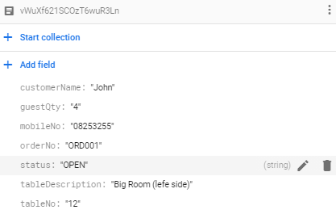
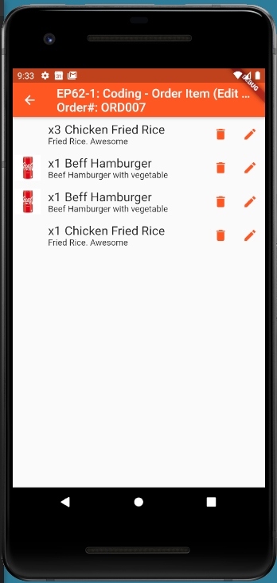
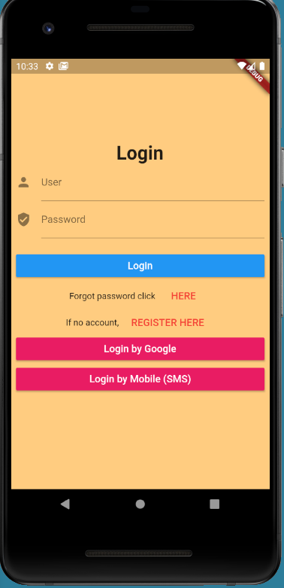

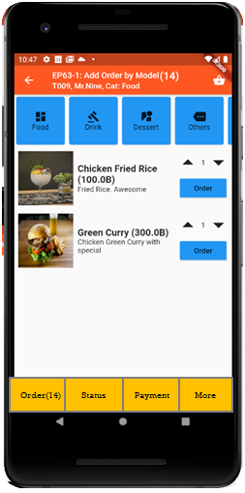
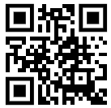
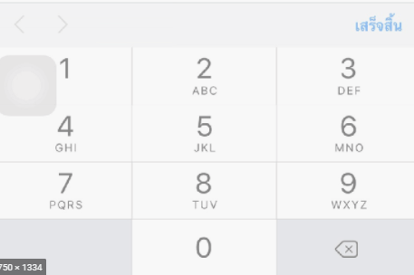
UI Design – Flow & UI (Review)
2.1
3.2
FireStore Database
Error
TM_TABLES
1
Not Found
Scan
Camera
→ Web
Customer Info
TM_TABLES
Customer
Order#
No of Guest
Mobile#
(PassCode)
TT_ORDERS
Order#
CustomerInfo
OrderItemInfo
PaymentInfo
www.seefood/T001
Already open table
Name
NO
Status=CLOSE
Mobile#
No of Guest
App
(iOS,Andriod)
Next
1
Yes
Status=OPEN
TT_ORDERS
2.2
TM_TABLES
SEE-FOOD
2
SEE-FOOD
3.2
SEE-FOOD
3
See Food
No 1 Street Food
Order
Passcode
4
Sign-in
TM_TABLES
Next
SharedVariable (Global)
UserName
TableNo
OrderNo
Order
Scan
Sign-in
Sign-up
TT_ORDERS

Slide 6
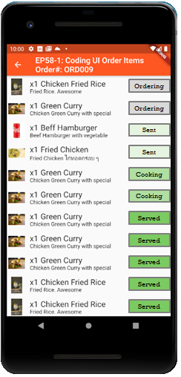
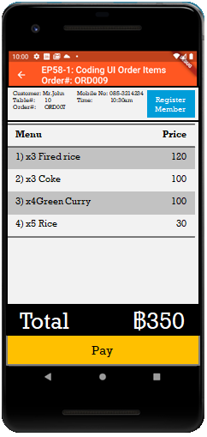
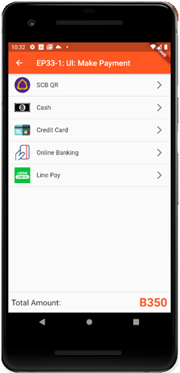

UI Design (View Menu)
Send Order

Slide 7
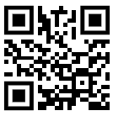
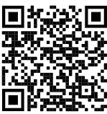

QR Code Scan Design at Restaurant Table
SEE-FOOD
NO.1 STREET FOOD
SEE-FOOD
NO.1 STREET FOOD
Scan to open table here
Download App Here
Table: 12
www.seeflutter.com
www.seeflutter.com

Slide 8
Requirements
Requirements /Use Case | Story Point (1,2,3,5,8) | Day | Use Story As a <Roles>, I want <Feature>, so that <Benefits)
Open Table (Scan QR) | 2 | Day 1 | As a PO, I want to open table using QR, so that easy to make order without waiter
Customer Info | 1 | Day 2 | As a PO, I want to fill customer info when open table, so that using mobile no as password for other guests in same table can make order together
Make Order | 2 | Day 3 | As a PO, I want to make order online, so that easy to send order to kitchen without waiter
View Order Items for sending order | 2 | Day 4 | As a PO, I want to view order items for sending order, so that can confirm order before submit
View Order for check status | 1 | Day 5 | As a PO, I want to view order for check status, so that can check order status e.g. ORDER,COOK,SERVE
View Order for make payment | 2 | Day 6 | As a PO, I want to view order for make payment, so that customer can check total price and call for payment
Make Payment | 5 | Day 7 | As a PO, I want to make payment by cash and promppay, so that can reduce time for billing

Slide 9
Story Point = Poker
Traditional software teams give estimates in a time format: days, weeks, months. Many agile teams, however, have transitioned to story points. Story points rate the relative effort of work in a Fibonacci-like format: 0, 0.5, 1, 2, 3, 5, 8, 13, 20, 40, 100. It may sound counter-intuitive, but that abstraction is actually helpful because it pushes the team to make tougher decisions around the difficulty of work. Here are few reasons to use story points:
“Story Point เป็นตัวกำหนดความยากง่ายในแต่ละงาน ซึ่งสามารถ Vote ใน Team เป็นคะแนน เพื่อใส่ใน งานแต่ละงานได้
การ Vote ก้อสามารถใช้ตัวเลขเช่น 1,2,3,5,8 เมื่อทำไปเรื่อย ๆ ในแต่ละ Sprint ความแม่นยำใน Team ในการประเมินก้อจะดีขึ้น
สามารถใช้ Story Point เช่น % งานที่เสร็จ โดยใช้ BurnDown Chart”
Story points and planning poker = VOTING STORY POINTS
Teams starting out with story points use an exercise called planning poker. At Atlassian, planning poker is a common practice across the company. The team will take an item from the backlog, discuss it briefly, and each member will mentally formulate an estimate. Then everyone holds up a card with the number that reflects their estimate. If everyone is in agreement, great! If not, take some time (but not too much time–just couple minutes) to understand the rationale behind different estimates. Remember though, estimation should be a high level activity. If the team is too far into the weeds, take a breath, and up-level the
(https://www.atlassian.com/agile/project-management/estimation, no date)

Slide 10
Today Keyword related to Agile & Scrum
Agile
XP
Agile = Modern Project Management Methodology
Scrum = Subset of Agile methodology
User Story = Requirements
Product Backlog
Product Owner = ผู้ให้ Requirements / Developer / Scrum Master = คนวางแผนงาน
Sprint = Time frame for development in each sprint e.g. 4 weeks
Scrum
jira
User Story คือ รายละเอียดของงานก่อนที่จะเริ่มพัฒนา ทีมพัฒนาจะใช้ User Story บันทึกข้อมูลความต้องการของลูกค้า เพื่อเป็นตัวกำหนดขอบเขตของการทำงาน ผู้ที่เขียน User Story ไม่ได้เป็นหน้าที่ของใครคนใดคนหนึ่ง แต่เป็นหน้าที่ของคนในทีมทุกคนที่จะช่วยกันวางแผนการทำงาน องค์ประกอบที่สำคัญของ User (https://medium.com/swiftlet-tech/2019)

Slide 11
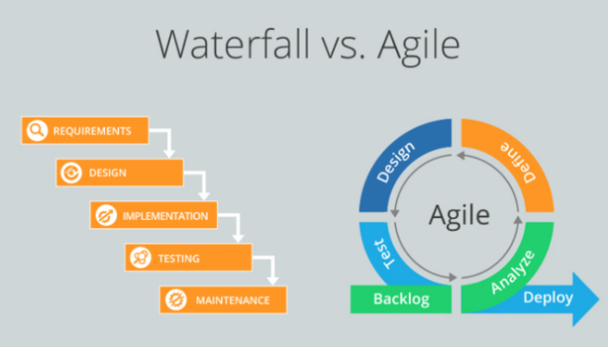
Agile and Waterfall
Agile: Get Customer Feedback, Contineous Improvement
Ref (http://ouriken.com/blog/which-one-is-right-for-you-waterfall-or-agile/, no date)

Slide 12
Business Requirements
Business Requirements = Customer Requirements
Use Case = Feature = Functionalities
Fucntional Requirements
User Story
Product Backlog
Customer
Requirements = ความต้องการของลูกค้า

Slide 13
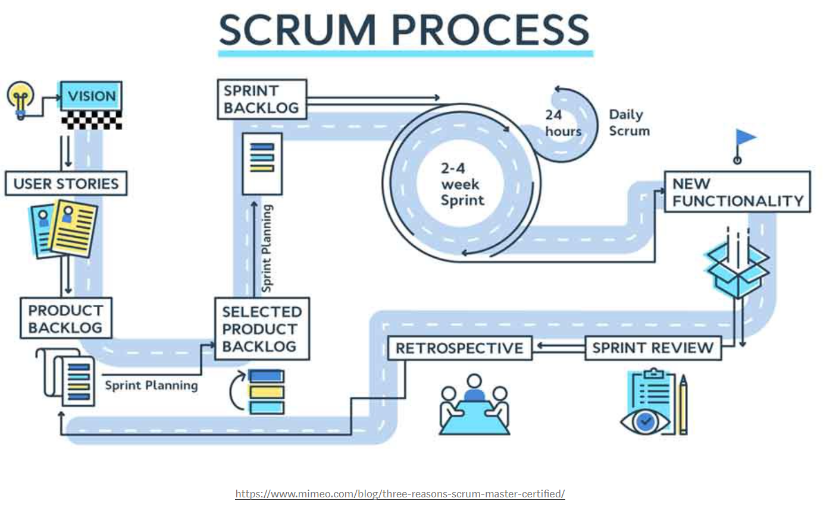
Scrum Process
Restaurant E-menu
Standup Meeting
Everyday (15 min)
To update status
What did you do yesterday?
What will you do today?
What is problem to get help?

Slide 14
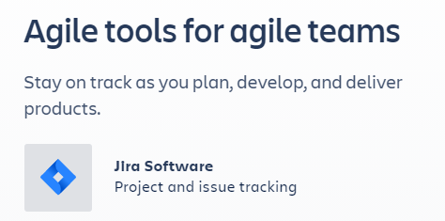
Jira Software (Atlassian)
https://www.atlassian.com/
Ref. NO 1: https://geekbot.com/blog/scrum-tools/?k_id=dsa-19959388920&adgroup_id=73039967424&campaign_name_ad=1697251819&gclid=CjwKCAjw-5v7BRAmEiwAJ3DpuI2f6p36PJZmfCcPbMUaaOrPNAGvq9B2HfN5y2Gc63xJ4fzuj92cExoCfiYQAvD_BwE

Slide 15
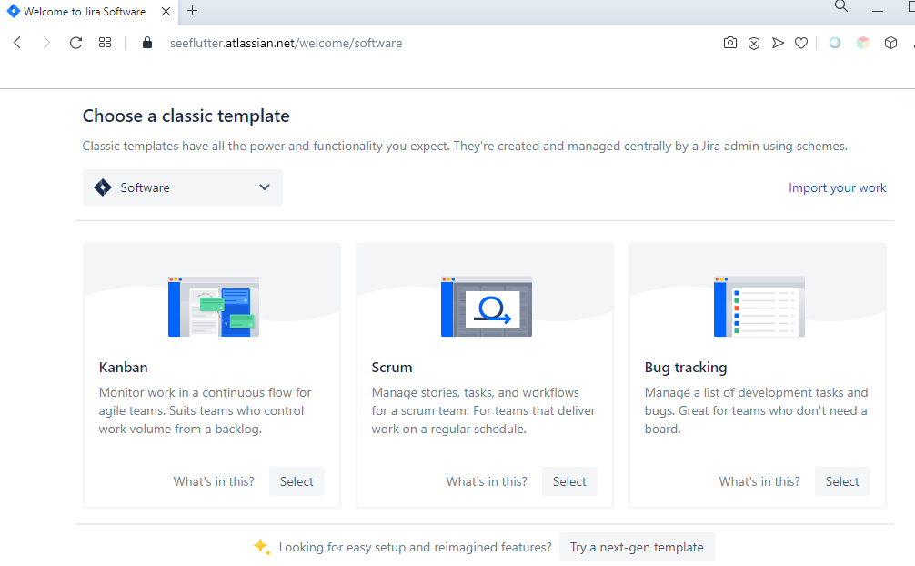
Scrum

Slide 16
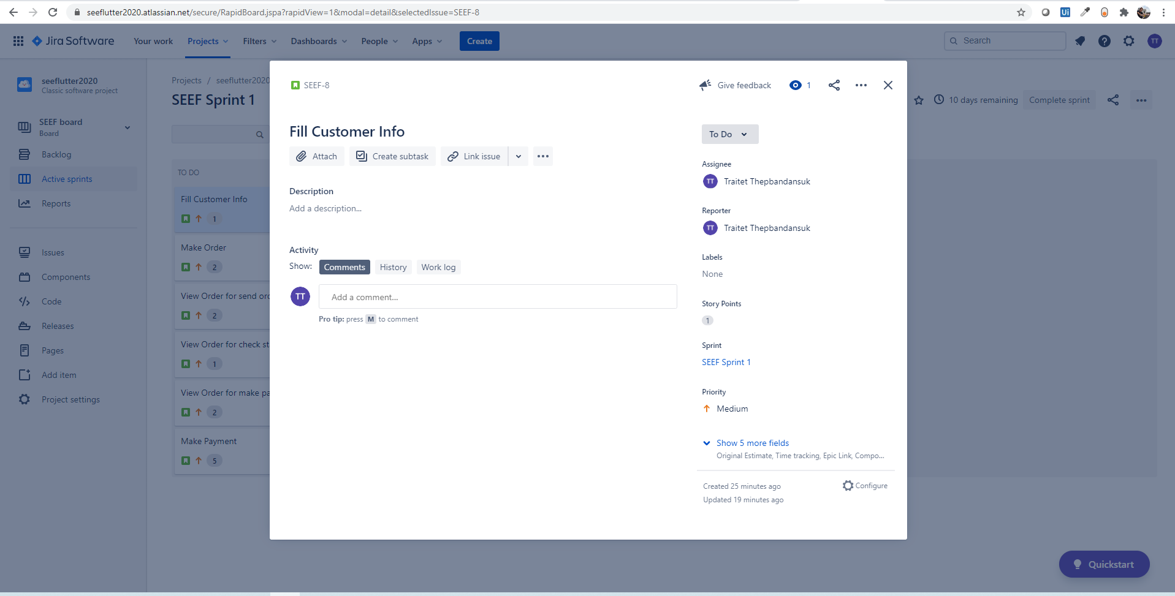
User Story ( Issue in Jira)
Sprint#1
Person-in-charge (Developer)
Story Points

Slide 17
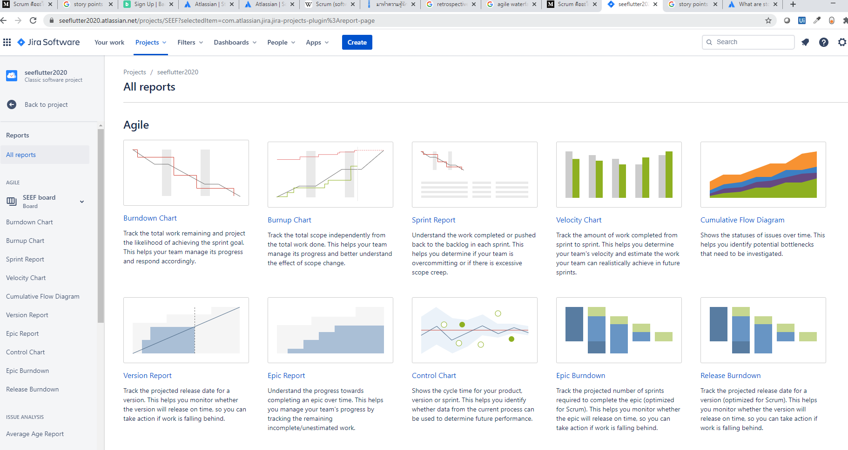
Report from Jira
Burndown Chart using Story Point

Slide 18
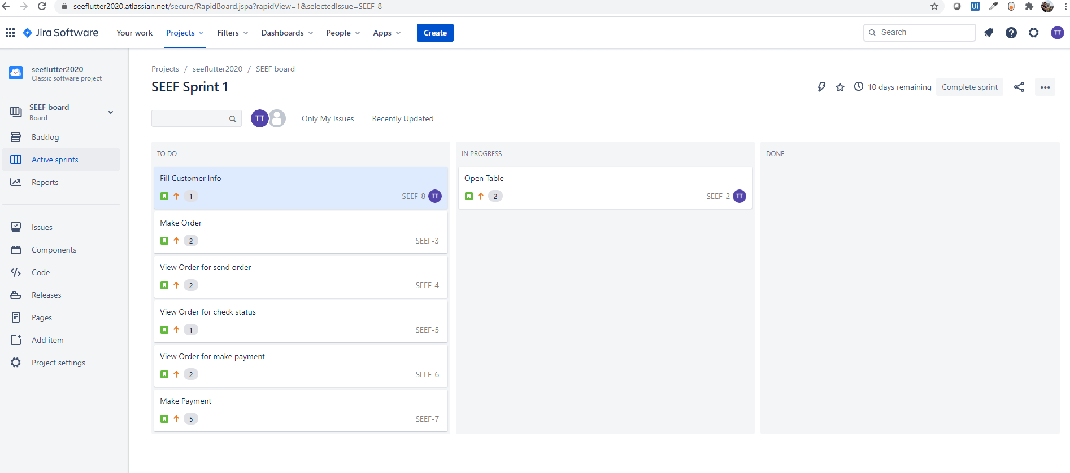
Jira – Visualize update status

Slide 19
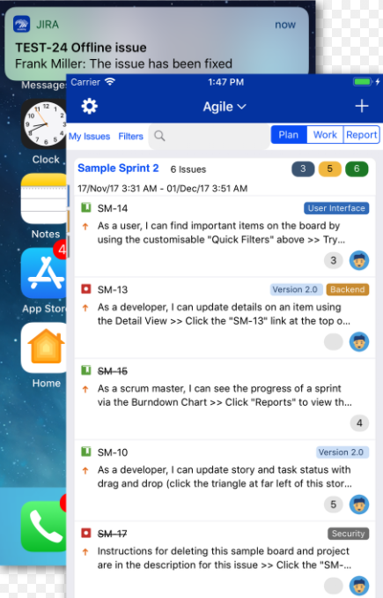
Jira on mobile
(https://marketplace.atlassian.com/apps/1211459/mobility-for-jira-mobile-jira-team, no date)

Slide 20
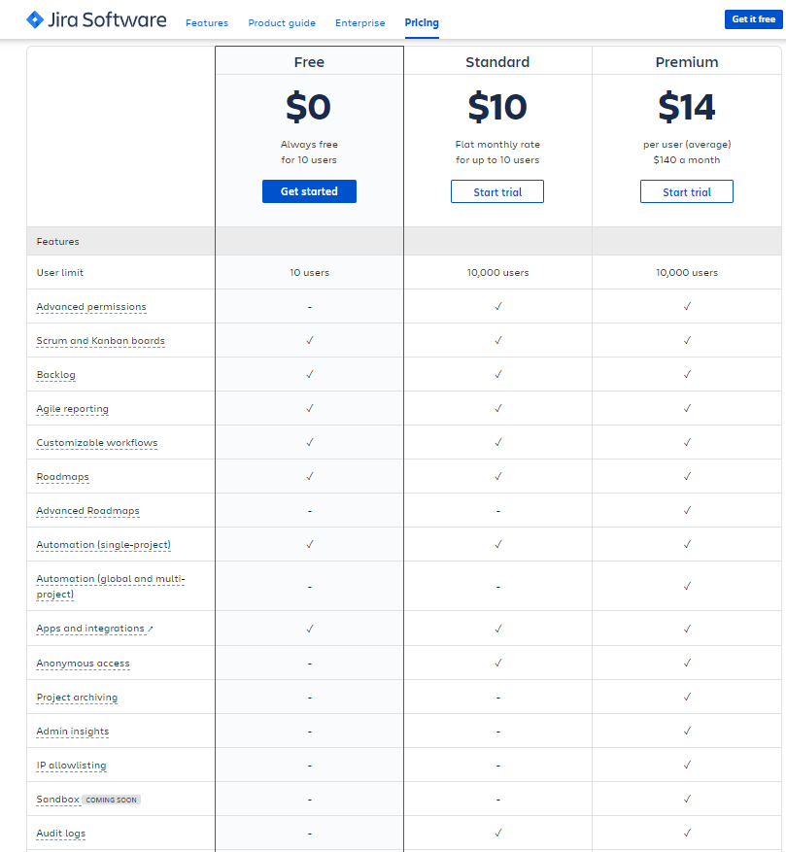
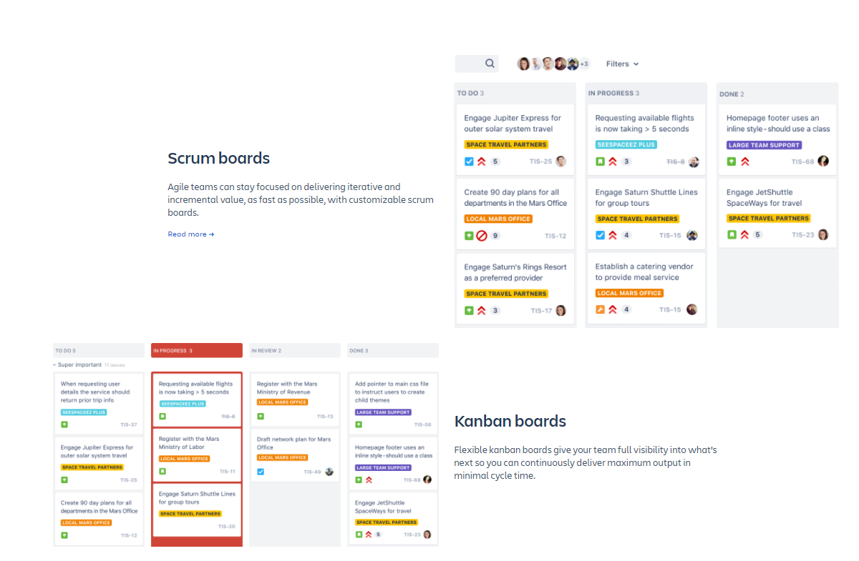
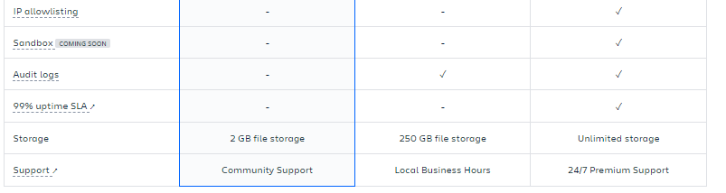
Jira - Freemium
(https://www.atlassian.com/software/jira/pricing#feature-comparison, no date)

