Slide 1
EP71 Coding UI: Open Table – Home Page Case Study “Restaurant E-menu” ระบบสั่งอาหารผ่านมือถือ
See-Flutter เรียนรู้ไปด้วยกัน เรียนฟรี พร้อม Source Code
19 Sep 2020
Day#60

Slide 2
CONTENT เนื้อหาวันนี้
Review Use Case
Design Widget
Coding: UI
Target Group: Mobile Developer

Slide 3
Key Knowldge
Scaffold
AppBar
Image
AssetImage
RaisedButton
RoundedRectangleBorder
Style, TextStyle
Row,Column (Multiple Child Layout Widget)
Expanded (Single Child Layout Widget)
flex
Target Group: Mobile Developer

Slide 4


Use Case (Review)
Fill Cus Info
Fill Passcode (mobileNo)
Open Table using QR
EP71: UI
Restaurant
Admin
View Menu Details
View Menu
Make Order
Submit Order
Waiter
View Order
Check Status
Customer
Chief
View Order for Payment
Payment

Slide 5
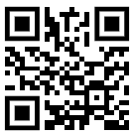
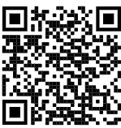

QR Code Scan Design at Restaurant Table
SEE-FOOD
NO.1 STREET FOOD
SEE-FOOD
NO.1 STREET FOOD
Scan to open table here
Download App Here
Table: 12
www.seeflutter.com
www.seeflutter.com

Slide 6
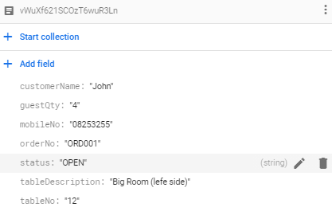
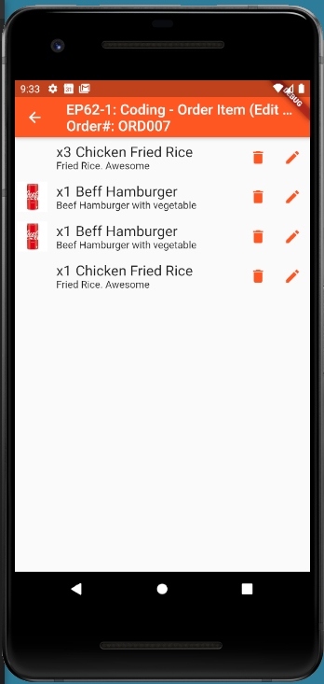
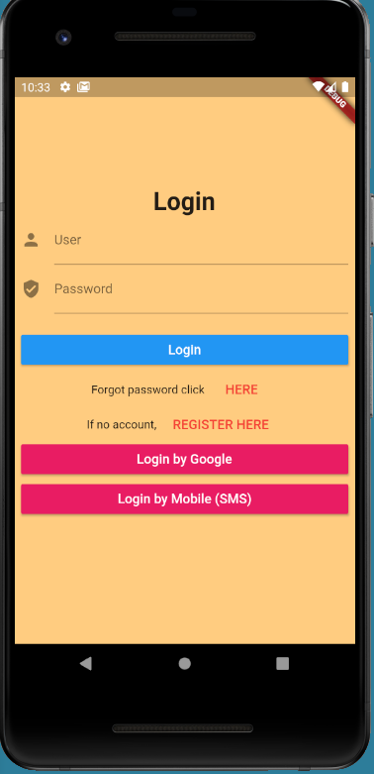

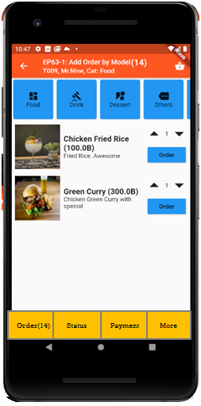

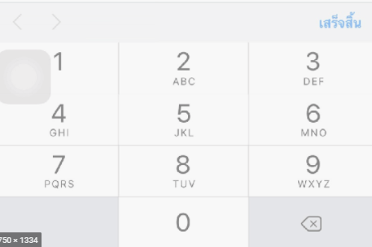
UI Design – Flow & UI (Review)
2.1
3.2
FireStore Database
Error
TM_TABLES
1
Not Found
Scan
Camera
→ Web
Customer Info
TM_TABLES
Customer
Order#
No of Guest
Mobile#
(PassCode)
TT_ORDERS
Order#
CustomerInfo
OrderItemInfo
PaymentInfo
www.seefood/T001
Already open table
Name
NO
Status=CLOSE
Mobile#
No of Guest
App
(iOS,Andriod)
Next
1
EP71: UI
Yes
Status=OPEN
TT_ORDERS
2.2
TM_TABLES
SEE-FOOD
2
SEE-FOOD
3.2
SEE-FOOD
3
See Food
No 1 Street Food
Order
Passcode
4
Sign-in
TM_TABLES
Next
SharedVariable (Global)
UserName
TableNo
OrderNo
Order
Scan
Sign-in
Sign-up
TT_ORDERS

Slide 7
UI Design ( Identify Widget )
Column#1: Text
Column#2: RaisedButton
Column#3
Row#1: RaisedButton
Row#2: RaisedButton
SEE-FOOD
4
See Food
No 1 Street Food
1
Order
1
Sign-in
Sign-up
Expaned
Flex=4,1,1

Slide 8
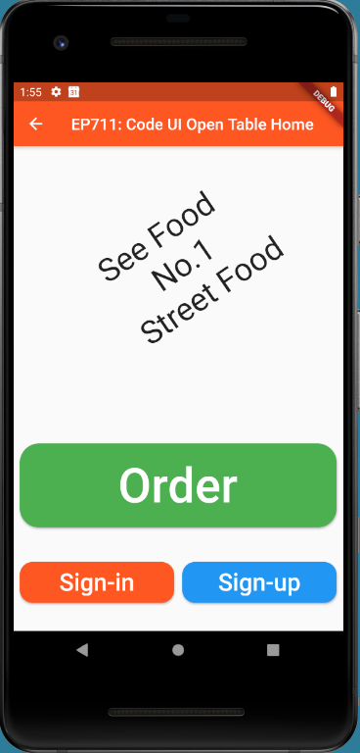
Final UI

