Slide 1
EP72 Coding UI: Open Table by QR Code using Mobile Camera for scanning Case Study “Restaurant E-menu” ระบบสั่งอาหารผ่านมือถือ
See-Flutter เรียนรู้ไปด้วยกัน เรียนฟรี พร้อม Source Code
20 Sep 2020
Day#62

Slide 2
CONTENT เนื้อหาวันนี้
Review Use Case
Review UI Design
Coding: Barcode Scanner on mobile camera
Target Group: Mobile Developer

Slide 3
Key Knowledge
PlatformException
How to add barcode_scan in project (a bit difficult)
Coding with barcode_scan
Keywords: Future asyn await
Try Catch & PlatformException
Target Group: Mobile Developer

Slide 4


Use Case (Review)
Fill Cus Info
Fill Passcode (mobileNo)
Open Table using QR
EP71: UI
EP72: UI + Scanner
Restaurant
Admin
View Menu Details
View Menu
Make Order
Submit Order
Waiter
View Order
Check Status
Customer
Chief
View Order for Payment
Payment

Slide 5
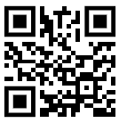
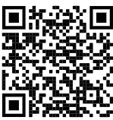

QR Code Scan Design at Restaurant Table
SEE-FOOD
NO.1 STREET FOOD
SEE-FOOD
NO.1 STREET FOOD
Scan to open table here
Download App Here
Table: 12
www.seeflutter.com
www.seeflutter.com

Slide 6
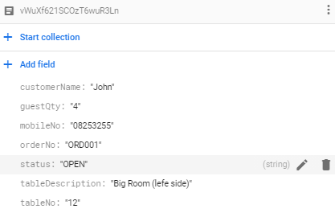
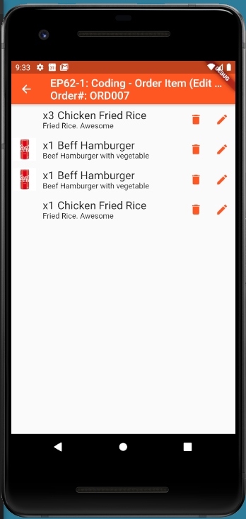
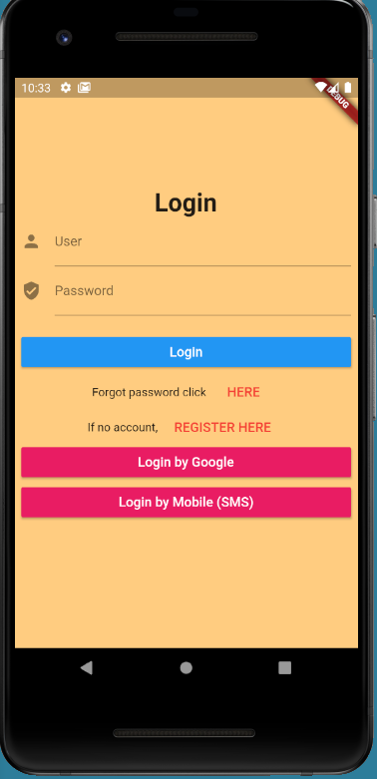

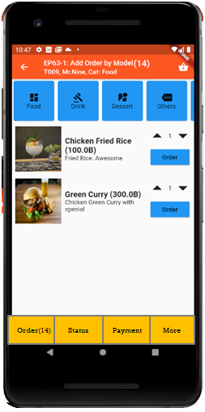

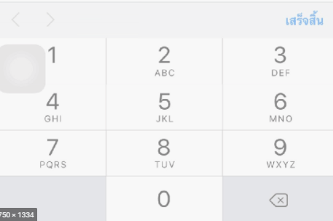
UI Design – Flow & UI (Review)
2.1
3.2
FireStore Database
Error
TM_TABLES
1
Not Found
Scan
Camera
→ Web
Customer Info
TM_TABLES
Customer
Order#
No of Guest
Mobile#
(PassCode)
TT_ORDERS
Order#
CustomerInfo
OrderItemInfo
PaymentInfo
www.seefood/T001
Already open table
Name
NO
Status=CLOSE
Mobile#
No of Guest
App
(iOS,Andriod)
Next
1
EP71: UI
Yes
Status=OPEN
TT_ORDERS
2.2
TM_TABLES
SEE-FOOD
2
SEE-FOOD
3.2
SEE-FOOD
3
See Food
No 1 Street Food
Order
Passcode
4
Sign-in
TM_TABLES
Next
SharedVariable (Global)
UserName
TableNo
OrderNo
Order
Scan
Sign-in
Sign-up
TT_ORDERS
Merge (1) & (2)

Slide 7
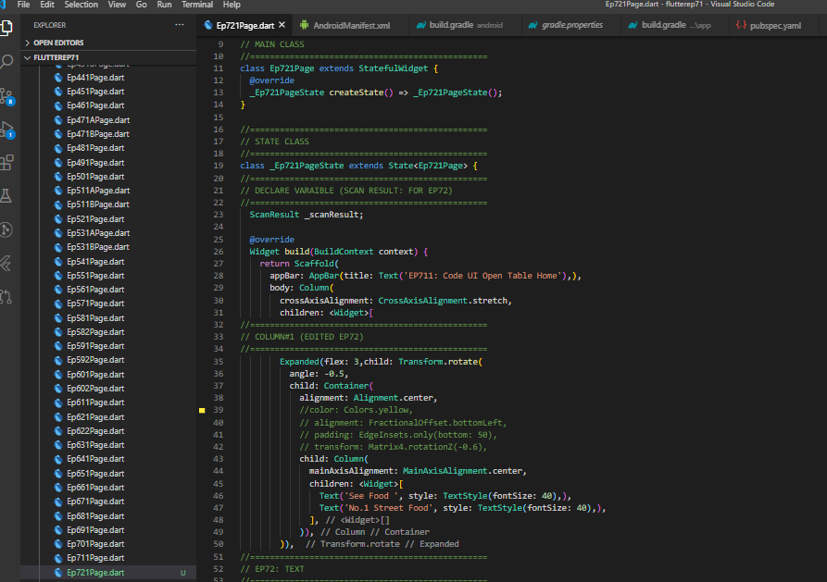
UI Design & Code
SEE-FOOD
Transform.rotate (Single Child Layout Widget) + Column
See Food
No 1 Street Food
Scan QR
Sign-in
Sign-up

Slide 8
Coding Steps : Barcode Scan (QR) Config
Andriod: Build.gradle
ext.kotlin_version
Pubspec.ymal
barcode_scan: ^3.0.1
Andriod: AndroidManifest.xml
<uses-permission android:name="android.permission.CAMERA" />
IOS: Plist
<dict><!-- ... --><key></key><string></string><!-- ... --></dict>
https://pub.dev/packages/barcode_scan

Slide 9
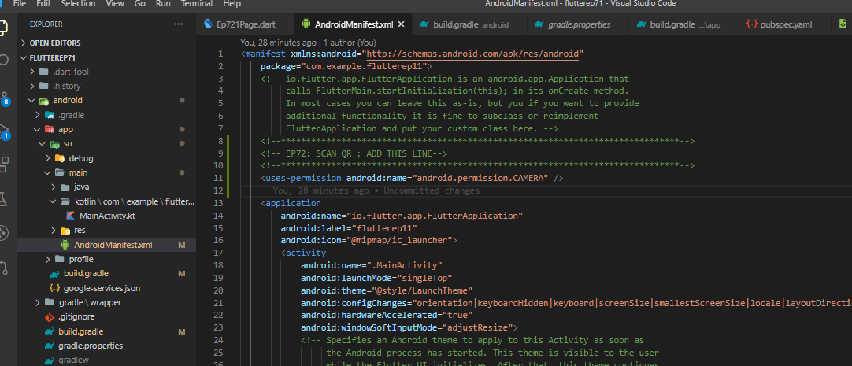
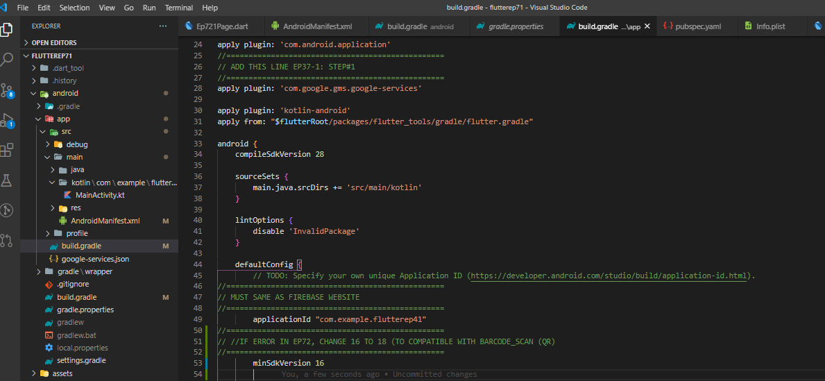
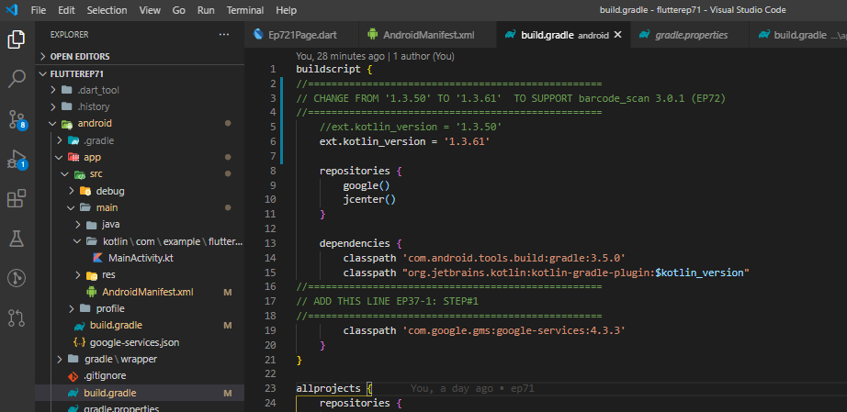
Coding – Config for Andriod Device
AndriodManifext.xml
Build.gradle (App-level)
** If have error about minSdkVersion, change from 16 to 18 ***
Build.gradle (in Project Level)
Change Kotlin version to 1.3.61 to support scan_barcode

Slide 10
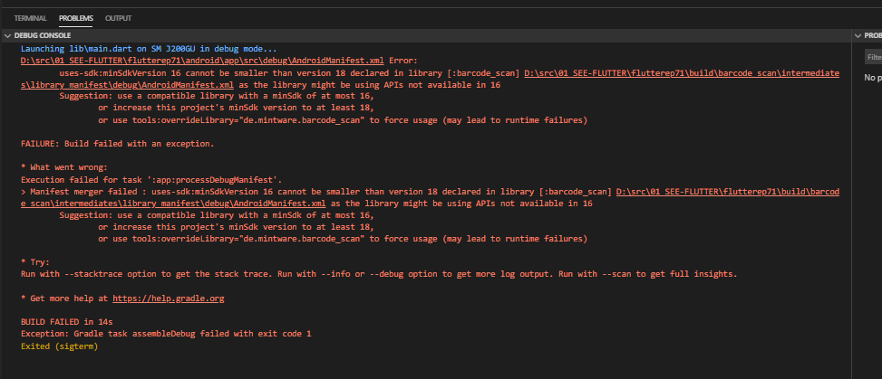
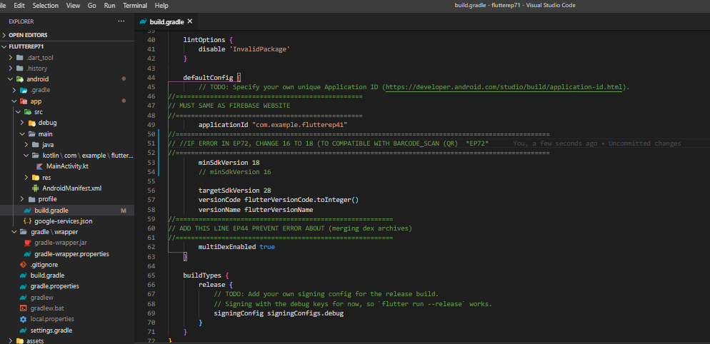
Fix Error by Config build.gradle
ERROR
HOW TO FIX
16 -> 18
Change from 16 to 18
Build.gradle (App-level)
** If have error about minSdkVersion, change from 16 to 18 ***
Reason: Barcode_scan is new version

Slide 11
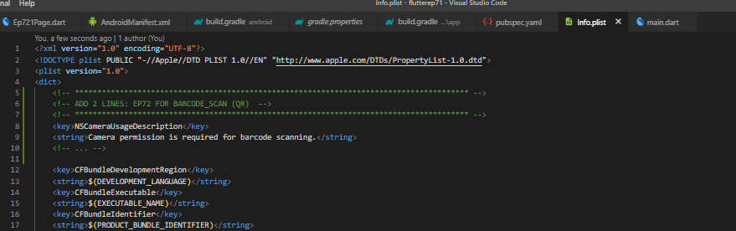
Coding – Config for IOS Device
For Open Camera on iOS mobile

Slide 12
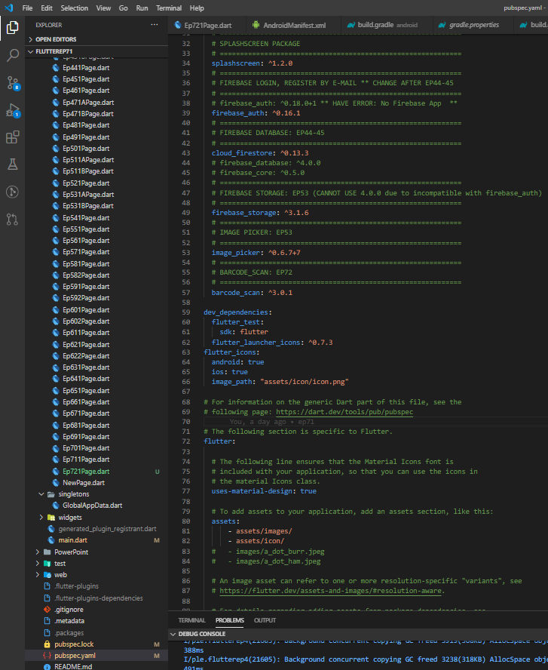
Coding – Pubspec file

Slide 13
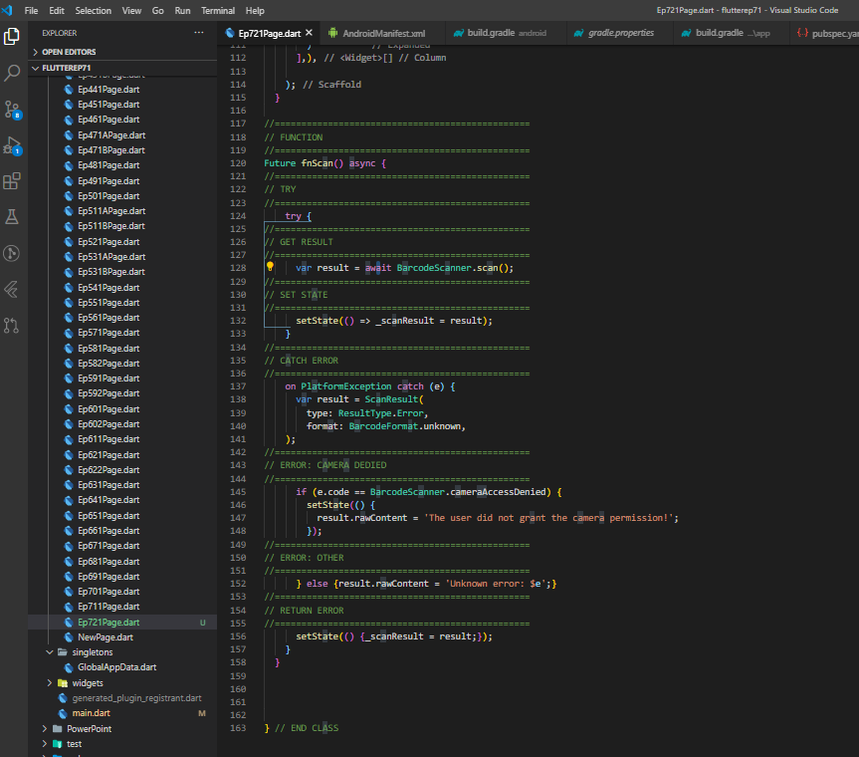
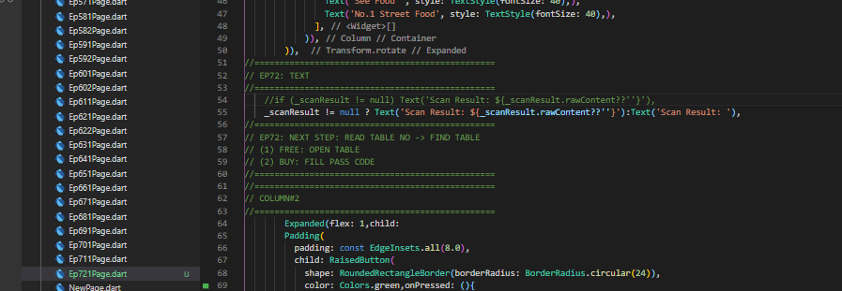
Code – Scan QR Function
Show data after scan (Sample)
Function Scan (QR)

Slide 14
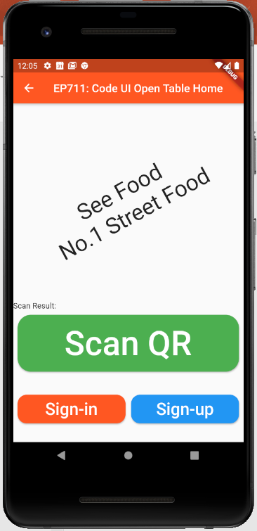
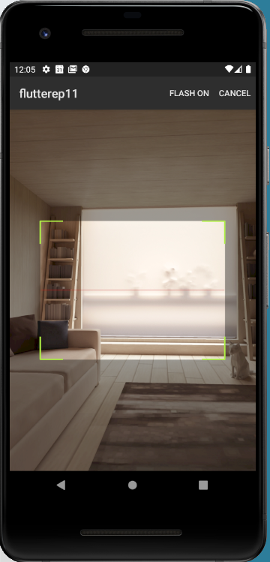
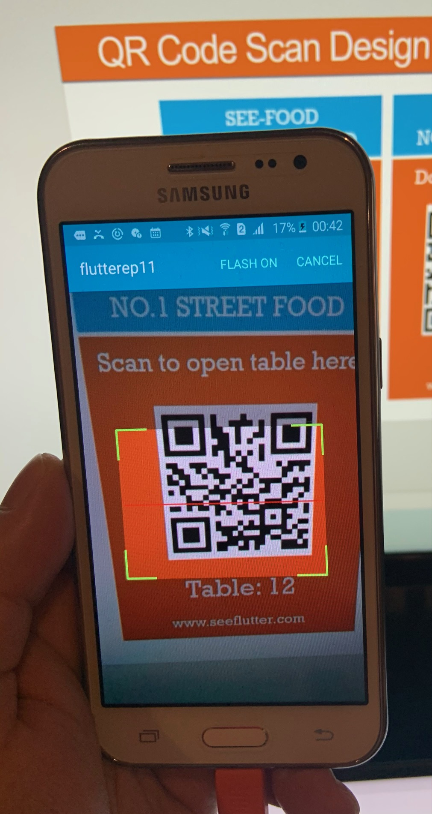
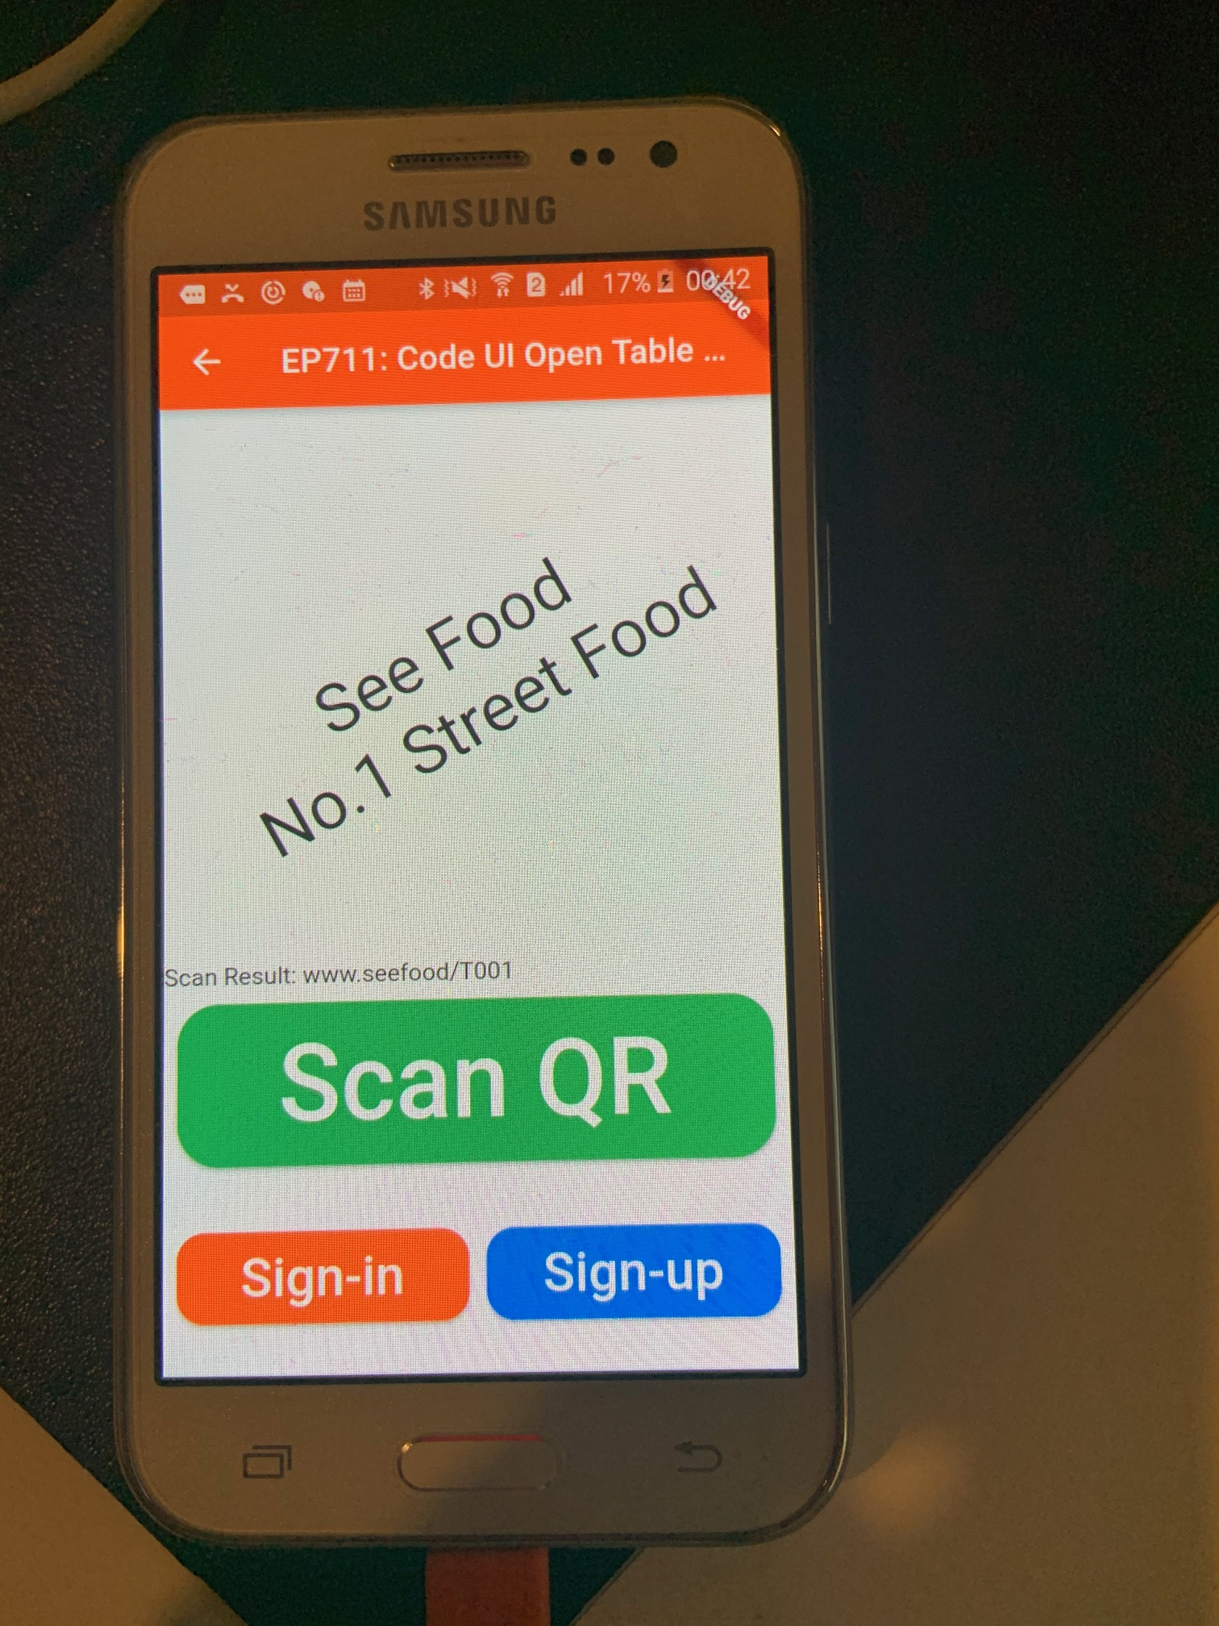
Final UI
Pixel R Emulator
Andriod

Slide 15
Summary Keywords (if have times)
Kotlin = Language to develop Andriod
Asynchronous & Synchronous functions
Future = function that is result of Asyn operation (Asyn function)
Await = Wait until asyn function finish

