Slide 1
EP74 Coding UI: Fill Customer Infomation for Open Table Case Study “Restaurant E-menu” ระบบสั่งอาหารผ่านมือถือ
See-Flutter เรียนรู้ไปด้วยกัน เรียนฟรี พร้อม Source Code
22 Sep 2020
Day#64

Slide 2
CONTENT เนื้อหาวันนี้
Review Use Case
Review UI Design
Coding
Target Group: Mobile Developer

Slide 3
Key Knowledge
PlatformException
Layout Widget: Padding, Column
Widget: TextFormField
Widget: RaisedButton
Target Group: Mobile Developer

Slide 4


Use Case (Review)
Fill Cus Info
EP74 (UI)
Fill Passcode (mobileNo)
EP73 (UI)
Open Table using QR
EP71: UI
EP72: UI + Scanner
Restaurant
Admin
View Menu Details
View Menu
Make Order
Submit Order
Waiter
View Order
Check Status
Customer
Chief
View Order for Payment
Payment

Slide 5
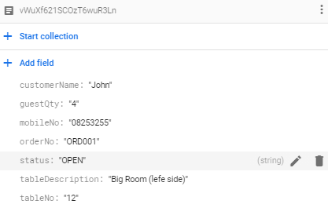
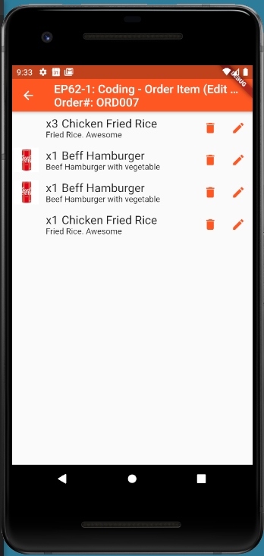
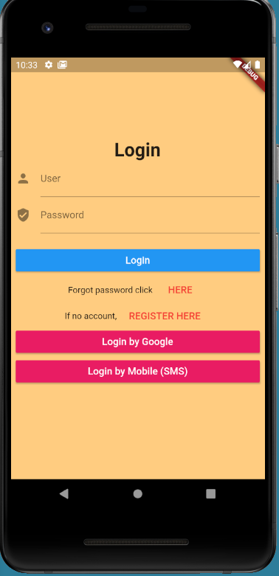

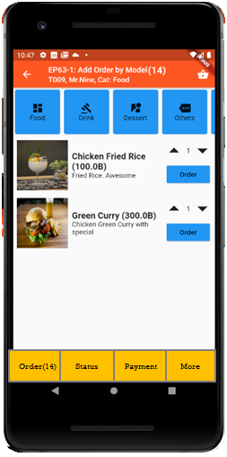
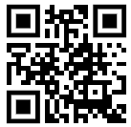
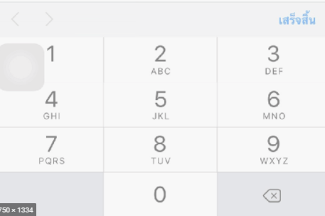
UI Design – Flow & UI (Review)
2.1
3.2
FireStore Database
Error
TM_TABLES
1
Not Found
Scan
Camera
→ Web
Customer Info
TM_TABLES
Customer
Order#
No of Guest
Mobile#
(PassCode)
TT_ORDERS
Order#
CustomerInfo
OrderItemInfo
PaymentInfo
www.seefood/T001
Already open table
Name
NO
Status=CLOSE
Mobile#
No of Guest
App
(iOS,Andriod)
Next
1
EP71: UI
Yes
Status=OPEN
TT_ORDERS
2.2
TM_TABLES
SEE-FOOD
2
SEE-FOOD
3.2
SEE-FOOD
3
See Food
No 1 Street Food
Order
Passcode
4
Sign-in
TM_TABLES
Next
SharedVariable (Global)
UserName
TableNo
OrderNo
Order
Scan
Sign-in
Sign-up
TT_ORDERS
Merge (1) & (2)

Slide 6
Widget Design
Column
TextFormField: Name
TextFormField: Mobile No
TextFormField: No of Guest
RaisedButton
Customer Info
Name
Mobile#
No of Guest
Next

Slide 7
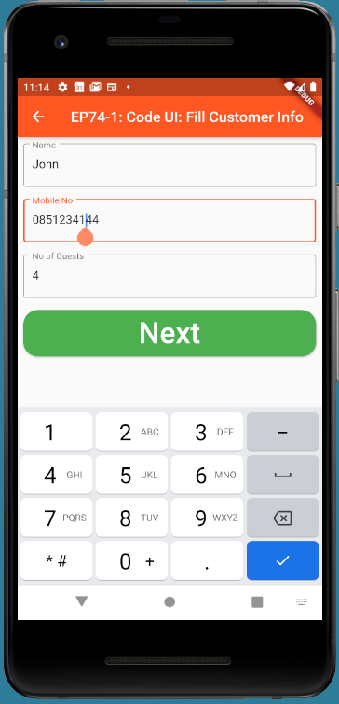
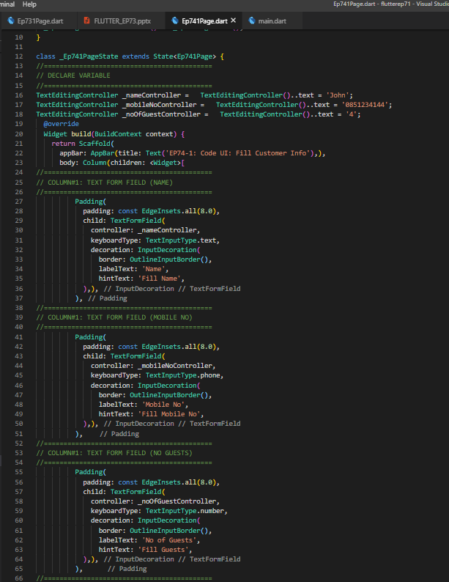
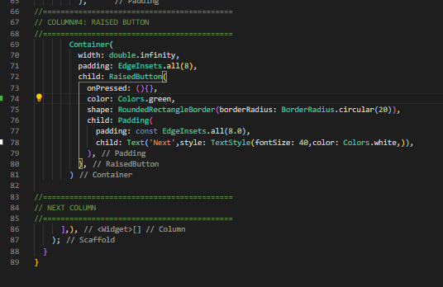
Coding
4
1
2
3
4
1
2
3

Slide 8
Final UI

