Slide 1
EP75 Save Customer Info into Firebase DB using Model Mapping Class Case Study “Restaurant E-menu” ระบบสั่งอาหารผ่านมือถือ
See-Flutter เรียนรู้ไปด้วยกัน เรียนฟรี พร้อม Source Code
23 Sep 2020
Day#65

Slide 2
CONTENT เนื้อหาวันนี้
Review Use Case & UI Design
Coding Concept
Coding
Target Group: Mobile Developer

Slide 3
Key Knowledge
PlatformException
Insert Data into Firebase Database
Model Mapping Class ( easy to save data to DB)
Static Function (Create & Call static function)
Easy to call function from UI (No need to initiate object)
Print Object in Class for checking data
Target Group: Mobile Developer

Slide 4


Use Case (Review)
Fill Cus Info
EP74 (UI)
EP75 (Logic)
Fill Passcode (mobileNo)
EP73 (UI)
Open Table using QR
EP71: UI
EP72: UI + Scanner
Restaurant
Admin
View Menu Details
View Menu
Make Order
Submit Order
Waiter
View Order
Check Status
Customer
Chief
View Order for Payment
Payment

Slide 5
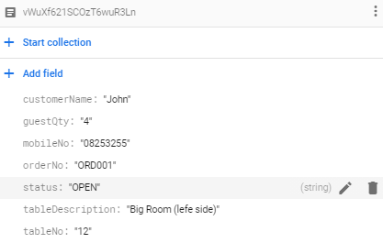
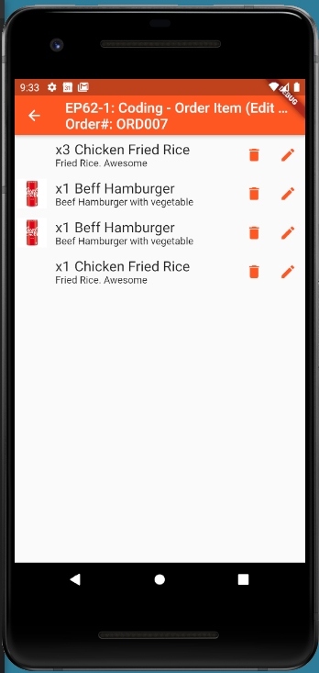
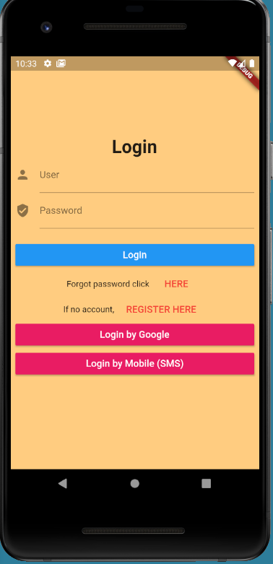

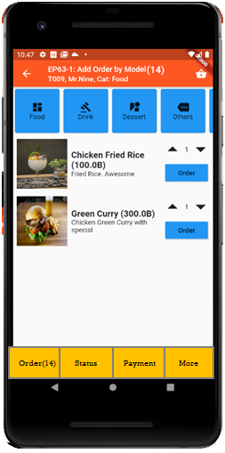

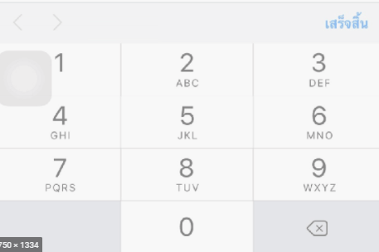
UI Design – Flow & UI (Review)
2.1
3.2
FireStore Database
Error
TM_TABLES
1
Not Found
Scan
Camera
→ Web
Customer Info
TM_TABLES
Customer
Order#
No of Guest
Mobile#
(PassCode)
TT_ORDERS
Order#
CustomerInfo
OrderItemInfo
PaymentInfo
www.seefood/T001
Already open table
Name
NO
Status=CLOSE
Mobile#
No of Guest
App
(iOS,Andriod)
Next
1
EP71: UI
Yes
Status=OPEN
TT_ORDERS
2.2
TM_TABLES
SEE-FOOD
2
SEE-FOOD
3.2
SEE-FOOD
3
See Food
No 1 Street Food
Order
Passcode
4
Sign-in
TM_TABLES
Next
SharedVariable (Global)
UserName
TableNo
OrderNo
Order
Scan
Sign-in
Sign-up
TT_ORDERS
Merge (1) & (2)

Slide 6
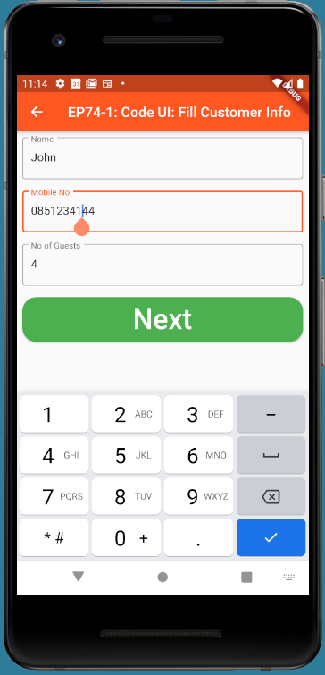
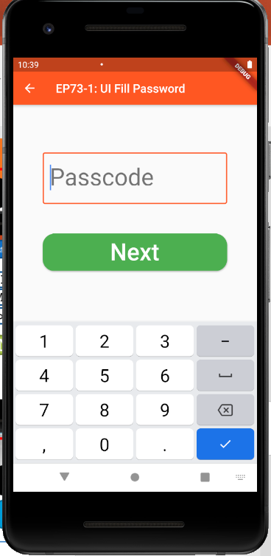
Coding Concept
TM_EP75_TABLES
orderNo: ORD0020
tableNo: T0012
timeStamp
customerInfo
name
mobileNo
noOfGuest
TT_EP75_ORDERS
tableNo: T0012
orderNo
customerInfo
name
mobileNo
noOfGuests
Start
STATUS = COMPLETE
IN TT_TABLES “T0012”
Fill Passcode
NO (Order with friends)
YES (Last Order finished)
GEN ORDER NO FROM TIME STAMP
UPDATE TM_TABLES
Make Order
INSERT DATA TO TT_ORDERS

Slide 7
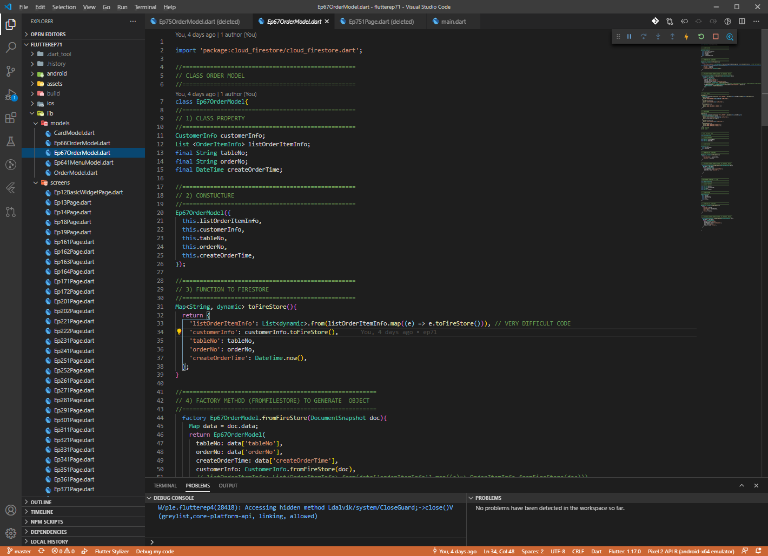
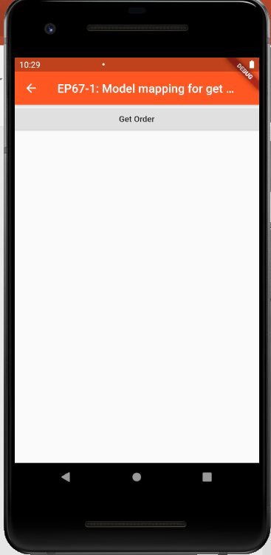
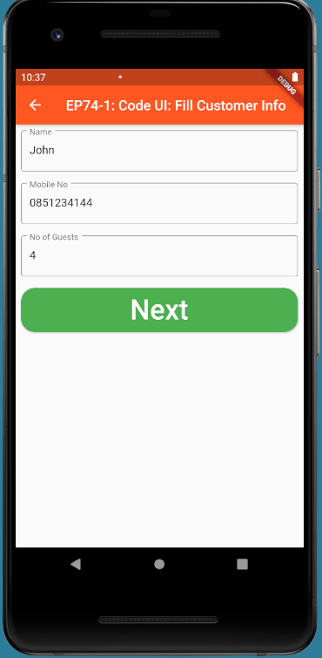
Copy Code from EP67 (Model Mapping) & EP74 (UI)
EP66 & EP67: Create Model Mapping Class for read and write Firebase Database
EP67
EP74

Slide 8
Coding Steps
Copy DB Model Mapping Class from EP67
Copy UI from EP74
Create Class TableModel
Create Class OrderService (keep static functions)
Create function OpenTable()
Call OpenTable() Function
Static Functions = Function that no need to create instance before usage

Slide 9
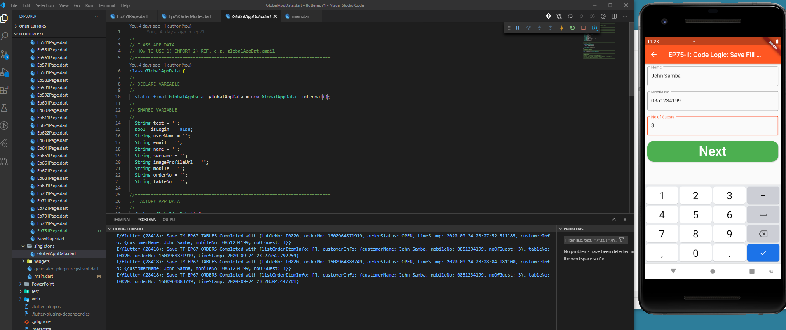
Final UI

Slide 10
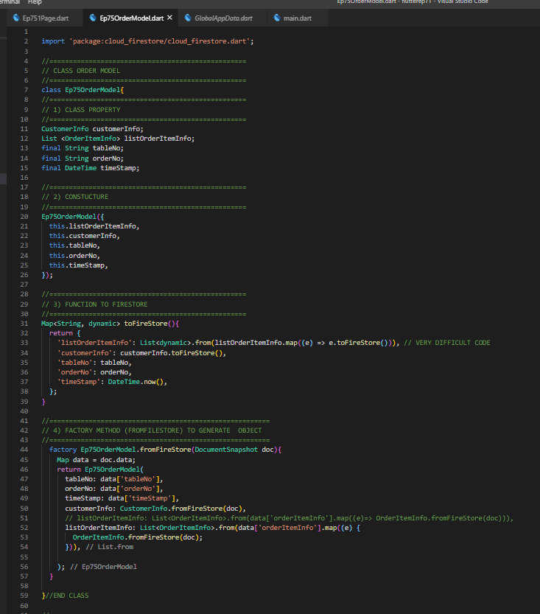
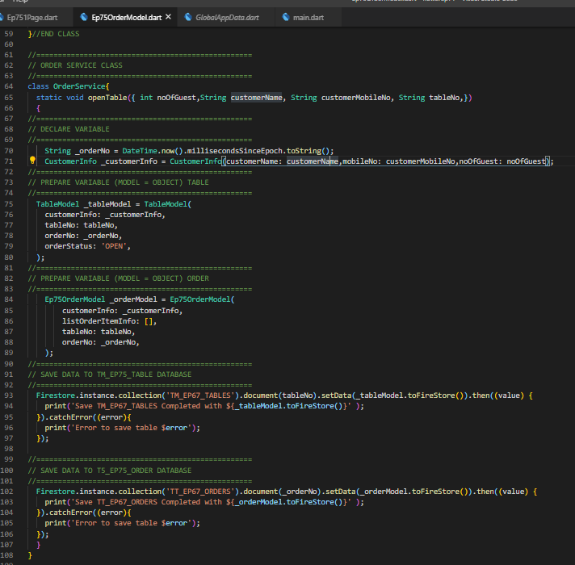
Coding Model Mapping with DB Class
Order Model
Order Service Class & Open Table Function
“Static” Function = No need to create instand when calling + Cannot get value in property in class

Slide 11
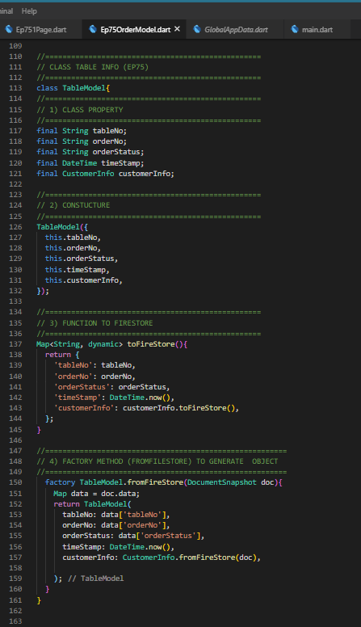
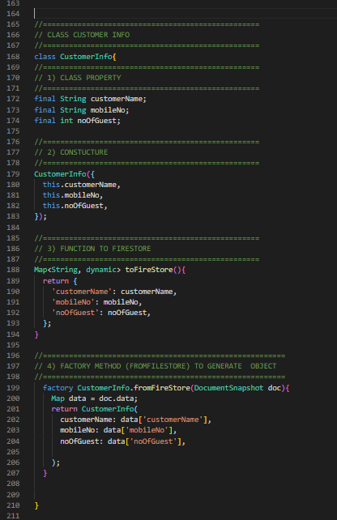
Coding Model Mapping with DB Class
TableModel Class
Customer Info Class

Slide 12
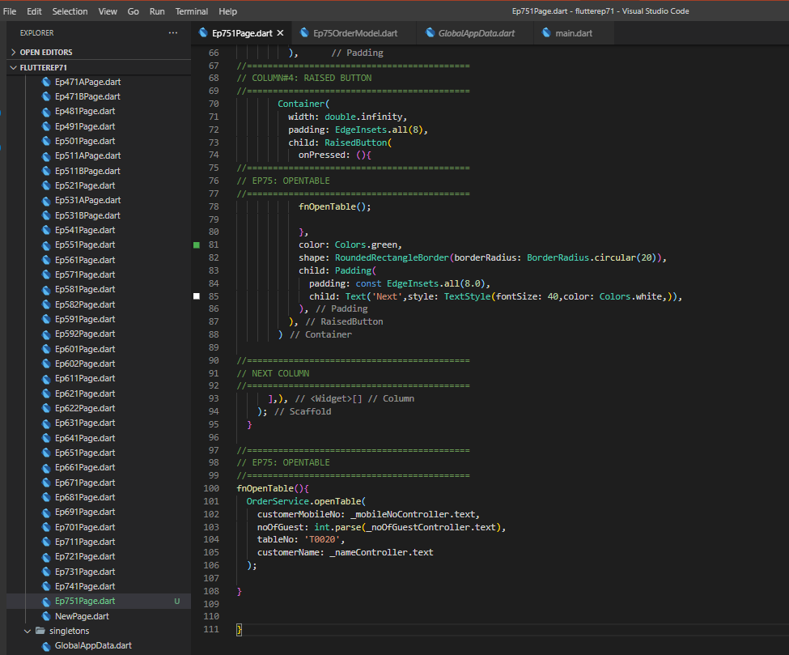
Call Function

Slide 13
Coding Tips
Description | Sample Code
Call Function | fnOpenTable(){ OrderService.openTable( customerMobileNo: _mobileNoController.text, noOfGuest: int.parse(_noOfGuestController.text), tableNo: 'T0020', customerName: _nameController.text );
Save data to Firebase Database | Firestore.instance.collection('TM_EP67_TABLES').document(tableNo).setData(_tableModel.toFireStore()).then((value) Firestore.instance.collection('TT_EP67_ORDERS').document(_orderNo).setData(_orderModel.toFireStore()).then((value)
Create Object (Initiate Class) | TableModel _tableModel = TableModel( customerInfo: _customerInfo, tableNo: tableNo, orderNo: _orderNo, orderStatus: 'OPEN', );
Print Object to check | print('Save TM_EP67_TABLES Completed with ${_tableModel.toFireStore()}' );
Get Unique Key for save as document ID | String _orderNo = DateTime.now().millisecondsSinceEpoch.toString();
Get Current Date | timeStamp: DateTime.now(),
Create Object Customer Info | CustomerInfo _customerInfo = CustomerInfo(customerName: customerName,mobileNo: customerMobileNo,noOfGuest: noOfGuest);

