Slide 1
EP76 Open Table & Make Order Pass Parameter using Global Variable (Singleton Code Pattern) Case Study “Restaurant E-menu” ระบบสั่งอาหารผ่านมือถือ
See-Flutter เรียนรู้ไปด้วยกัน เรียนฟรี พร้อม Source Code
24 Sep 2020
Day#66

Slide 2
CONTENT เนื้อหาวันนี้
Review Use Case & UI Design
Coding Concept
Coding
Target Group: Mobile Developer

Slide 3
Key Knowledge
PlatformException
Singleton Class for Share Global Variable
Target Group: Mobile Developer

Slide 4


Use Case (Review)
Fill Cus Info
EP74 (UI)
EP75 (Logic)
EP76 (Pass Peramter Fill Cus Info -> Make Order)
Fill Passcode (mobileNo)
EP73 (UI)
Open Table using QR
EP71: UI
EP72: UI + Scanner
Restaurant
Admin
View Menu Details
View Menu
Make Order
Submit Order
Waiter
View Order
Check Status
Customer
Chief
View Order for Payment
Payment

Slide 5
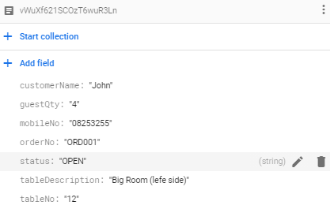
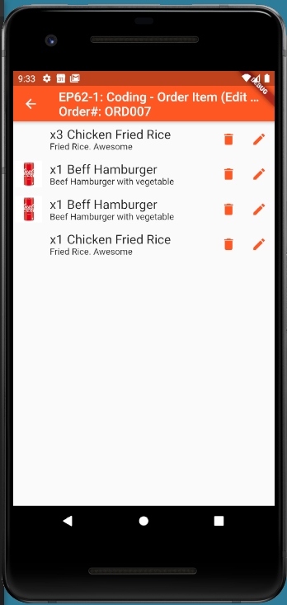
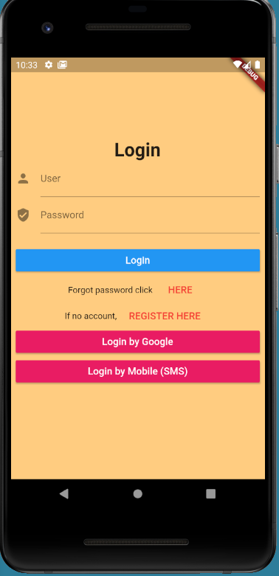

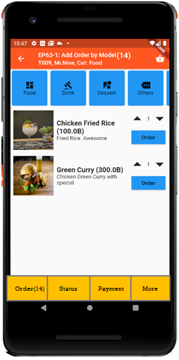

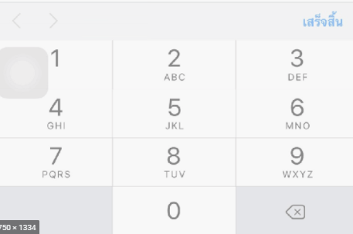
UI Design – Flow & UI (Review)
2.1
3.2
FireStore Database
Error
TM_TABLES
1
Not Found
Scan
Camera
→ Web
Customer Info
TM_TABLES
Customer
Order#
No of Guest
Mobile#
(PassCode)
TT_ORDERS
Order#
CustomerInfo
OrderItemInfo
PaymentInfo
www.seefood/T001
Already open table
Name
NO
Status=CLOSE
Mobile#
No of Guest
App
(iOS,Andriod)
Next
1
EP71: UI
Yes
Status=OPEN
TT_ORDERS
2.2
TM_TABLES
SEE-FOOD
2
SEE-FOOD
3.2
SEE-FOOD
3
See Food
No 1 Street Food
Order
Passcode
4
Sign-in
TM_TABLES
Next
Table#
Order#
SharedVariable (Global)
UserName
TableNo
OrderNo
Order
Scan
Sign-in
Sign-up
TT_ORDERS
Merge (1) & (2)

Slide 6
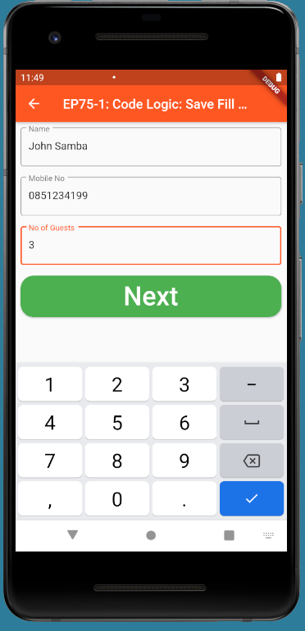
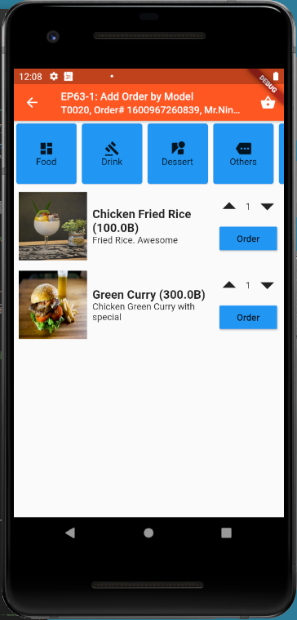
Coding Concept
OrderNo
TableNo
Global Variable = Singleton Class
Navigate

Slide 7
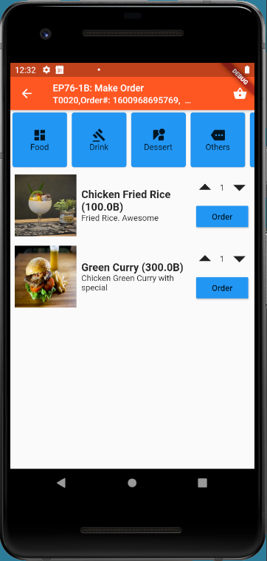
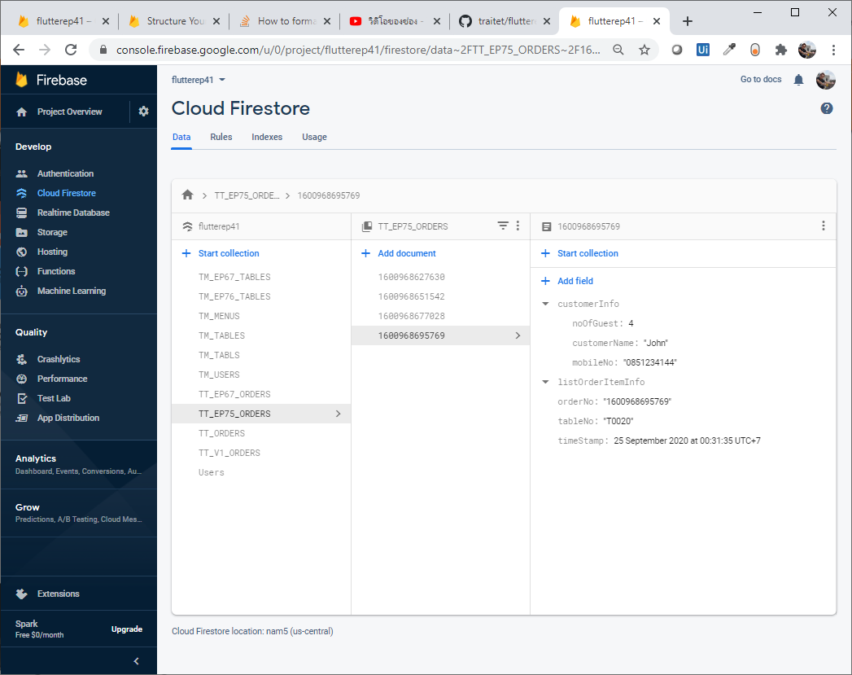
Final UI and Firebase Database

Slide 8
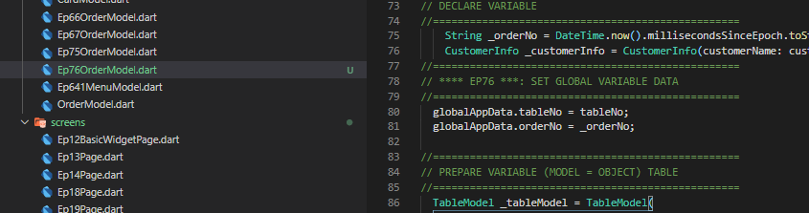
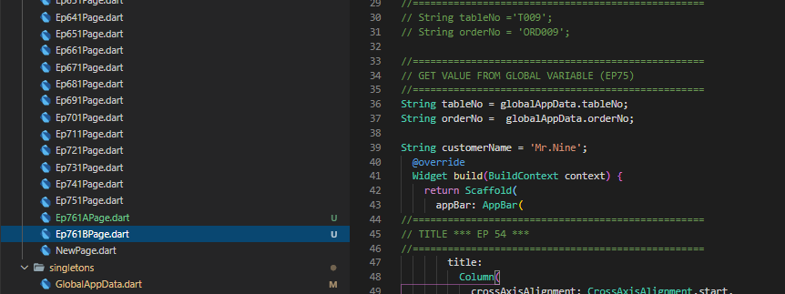
Code
OrderNo
TableNo
Global Variable = Singleton Class
Navigate

Slide 9
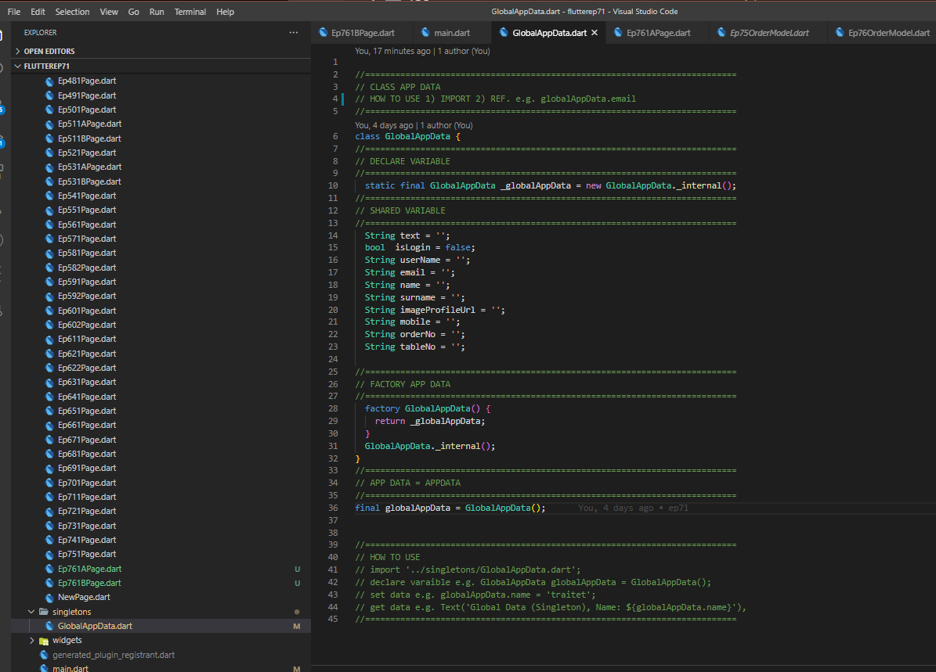
Global Variable = Global App Data = Singleton

