Slide 1
Make Order Save data to Firestore by mapping model class Case Study “Restaurant E-menu” ระบบสั่งอาหารผ่านมือถือ
EP77
See-Flutter เรียนรู้ไปด้วยกัน เรียนฟรี พร้อม Source Code
25 Sep 2020
Day#67

Slide 2
CONTENT เนื้อหาวันนี้
Review Use Case & UI Design
Coding Concept
Coding
Target Group: Mobile Developer

Slide 3
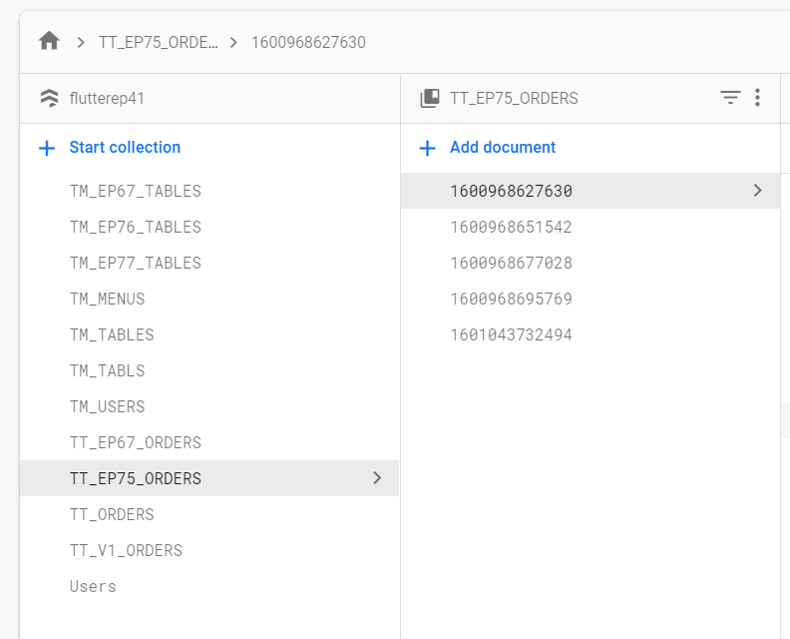
Key Knowledge
PlatformException
Insert Data into Firebase Database inside “document”
Basic knowledge of Firebase (No SQL) database
Collection, Document, Field
Target Group: Mobile Developer

Slide 4


Use Case (Review)
Fill Cus Info
EP74 (UI)
EP75 (Logic)
EP76 (Pass Peramter Fill Cus Info -> Make Order)
Fill Passcode (mobileNo)
EP73 (UI)
Open Table using QR
EP71: UI
EP72: UI + Scanner
Restaurant
Admin
View Menu Details
View Menu
Make Order
EP77 – save Order Item
Submit Order
Waiter
View Order
Check Status
Customer
Chief
View Order for Payment
Payment

Slide 5
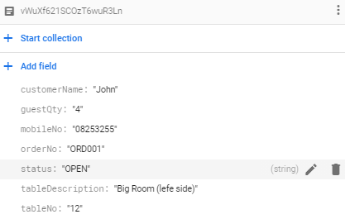
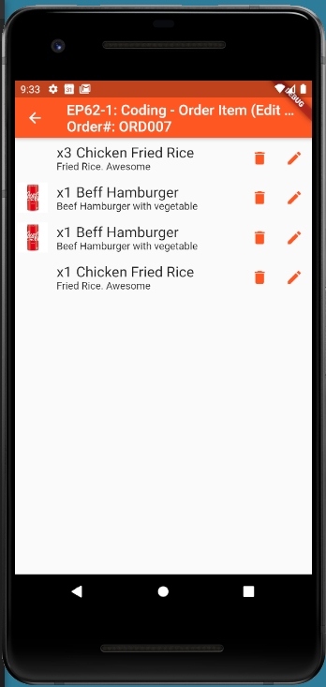
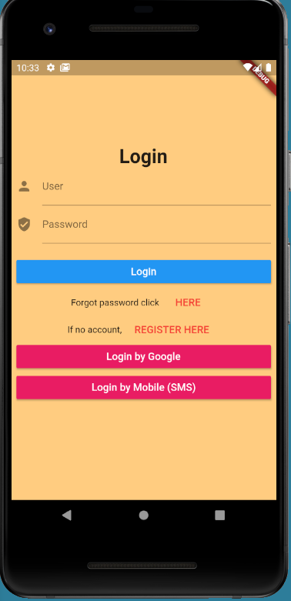

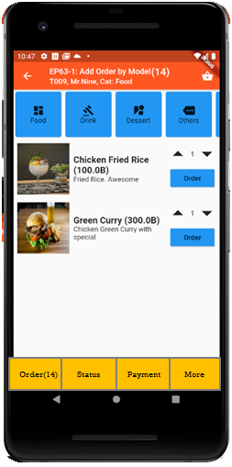

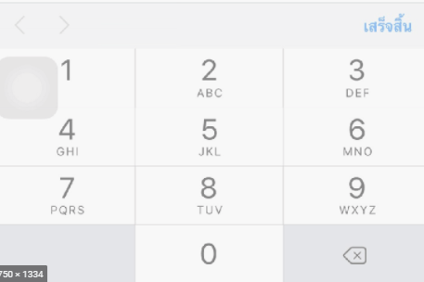
UI Design – Flow & UI (Review)
2.1
3.2
FireStore Database
Error
TM_TABLES
1
Not Found
Scan
Camera
→ Web
Customer Info
TM_TABLES
Customer
Order#
No of Guest
Mobile#
(PassCode)
TT_ORDERS
Order#
CustomerInfo
OrderItemInfo
PaymentInfo
www.seefood/T001
Already open table
Name
NO
Status=CLOSE
Mobile#
No of Guest
App
(iOS,Andriod)
Next
1
EP71: UI
Yes
Status=OPEN
TT_ORDERS
2.2
TM_TABLES
SEE-FOOD
2
SEE-FOOD
3.2
SEE-FOOD
3
See Food
No 1 Street Food
Order
Passcode
4
Sign-in
TM_TABLES
Next
Table#
Order#
SharedVariable (Global)
UserName
TableNo
OrderNo
Order
Scan
Sign-in
Sign-up
TT_ORDERS
Merge (1) & (2)

Slide 6
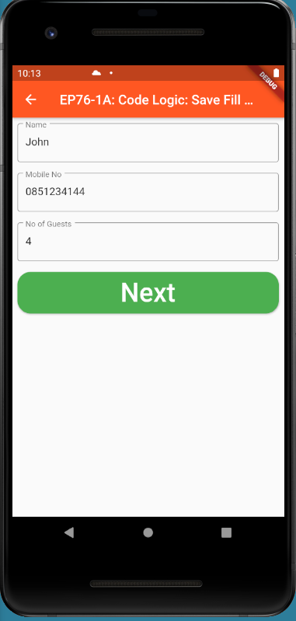
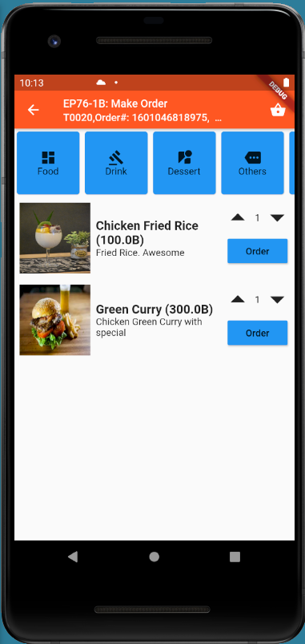
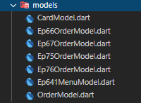
Coding Concept
OrderNo
TableNo
Global Variable = Singleton Class
Steps
Copy EP761A,EP761B.dart ( Change Name )
Copy model from EP76, EP64 (Change Name )
Add function addOrderItem(Order#,OrderItem)
Call Function addOrderItem(Order#,OrderItem)
Check database
Navigate

Slide 7
FireStore (No SQL) Database Keywords
NO SQL | Relational Database | Remark
Collection | Similar to “table” | No SQL: Collection or documents and be inside collection
Document | Similar to “Row in each table” | FireStore (No SQL): Key is Document ID
Document ID =Key of each document | Primary Key
Field | Column
Document
ORDER: ORD001
ORDER
ORDER ITEM
ORDER ITEMS
qty,menuId
TableNo
Qty
menuId
TableNo

Slide 8
Add Order Item to FireStore Database
Firestore.instance.collection('TT_EP77_ORDERS').document(orderNo).collection('listOrderItemInfo').add(orderItemInfo.toFireStore())

Slide 9
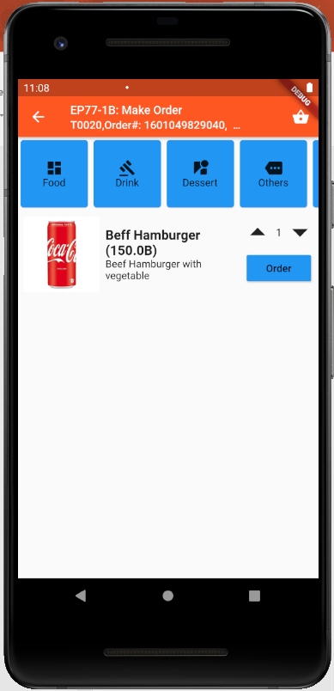
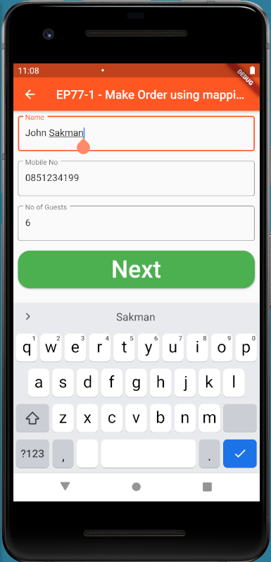
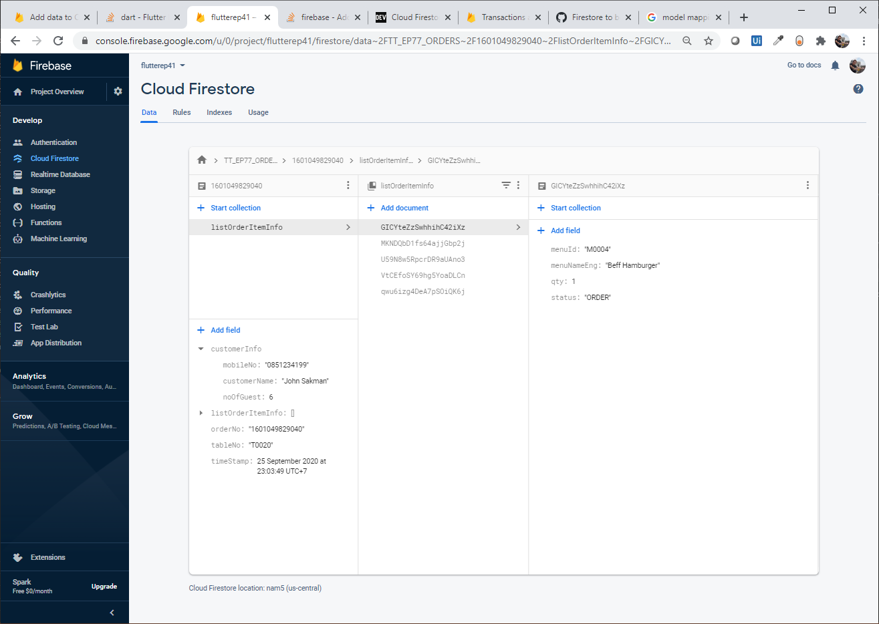
Final UI and Firebase Real-time database (FireStore)

Slide 10
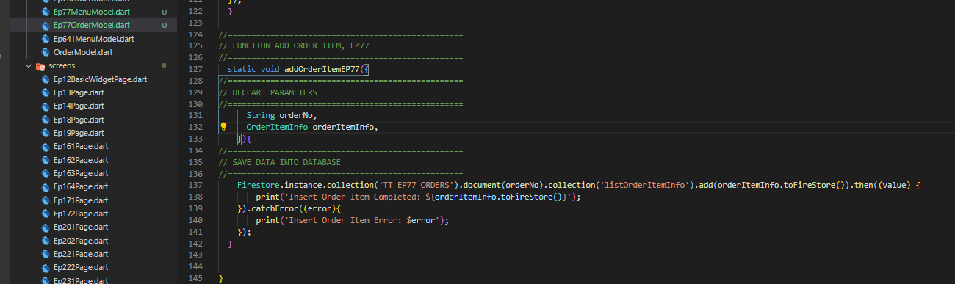
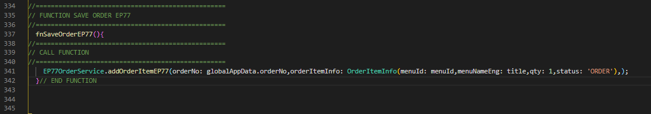
Code
Create Function “addOrder” using with Mapping Model Class
Call Function

