Slide 1
Design Concept Search Menu & Make Order (No Coding) Case Study “Restaurant E-menu” ระบบสั่งอาหารผ่านมือถือ
EP78
See-Flutter เรียนรู้ไปด้วยกัน เรียนฟรี พร้อม Source Code
26 Sep 2020
Day#68
Good Design  Fast Coding and easy to maintain

Slide 2
CONTENT เนื้อหาวันนี้
Review Use Case & UI Design
Design Concept
Target Group: Mobile Developer

Slide 3
Key Knowledge
PlatformException
Concept for design and coding for
Reuse
Separate Business Logic and UI
How to use model class for coding
Relational among database, model class, UI class
Pass parameters
For many Screen (GlobalAppData Class = Singleton Design Pattern)
From a screen to another screen e.g. Menu ID
Target Group: Mobile Developer

Slide 4


Use Case (Review)
Fill Cus Info
EP74 (UI)
EP75 (Logic)
EP76 (Pass Perameter Fill Cus Info -> Make Order)
Fill Passcode (mobileNo)
EP73 (UI)
Open Table using QR
EP71: UI
EP72: UI + Scanner
Restaurant
Admin
View Menu Details
View Menu
Make Order
EP77 – save Order Item
Submit Order
Waiter
View Order
Check Status
Customer
Chief
View Order for Payment
Payment
EP78: Design Concept for View Menu and Make Order

Slide 5
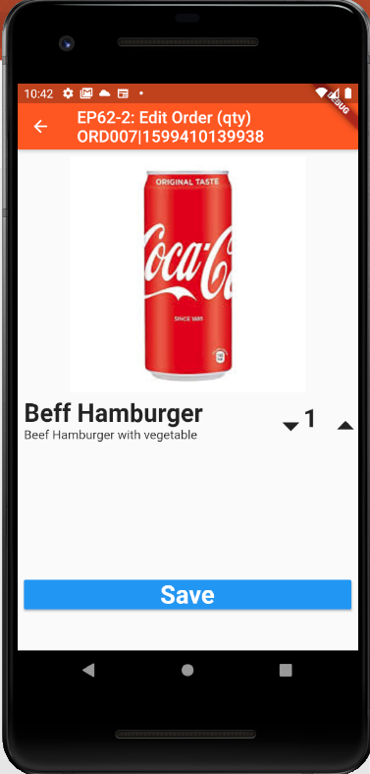
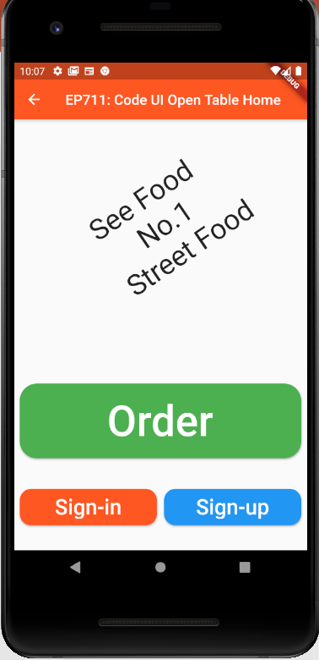
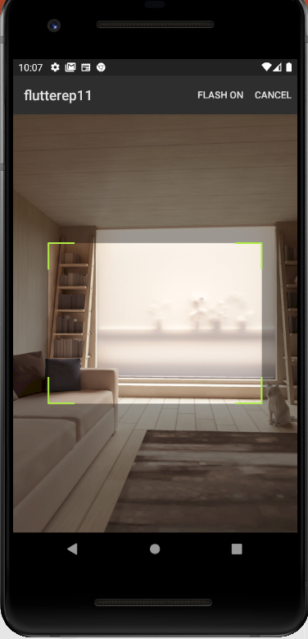
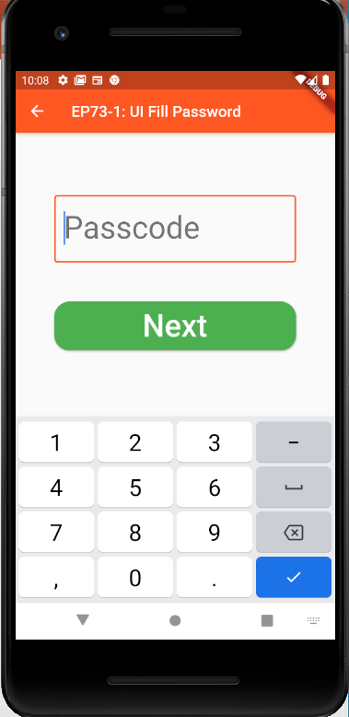
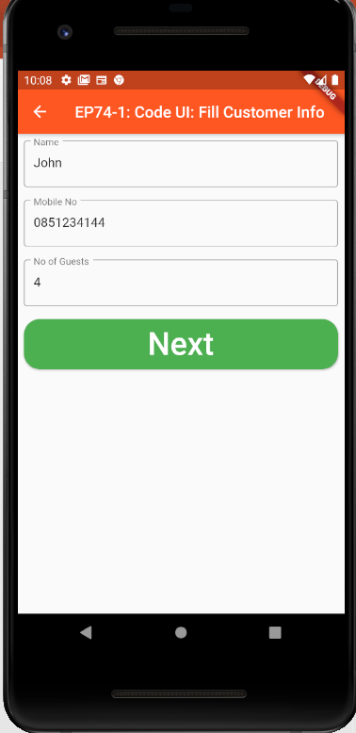
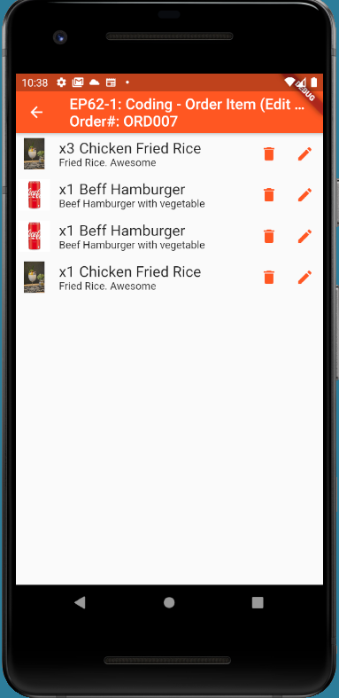
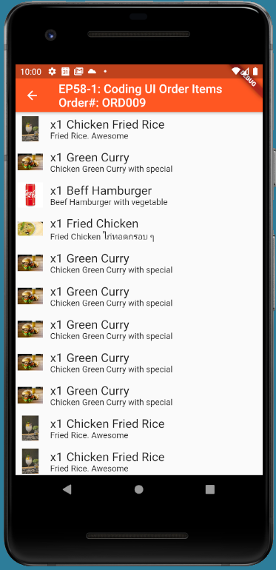
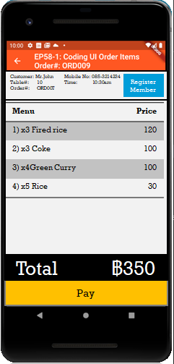
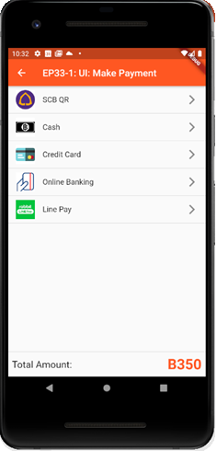
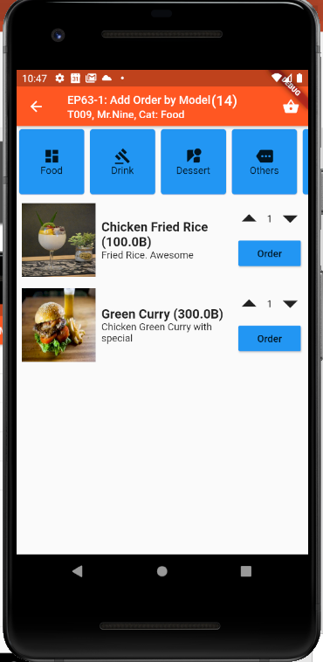
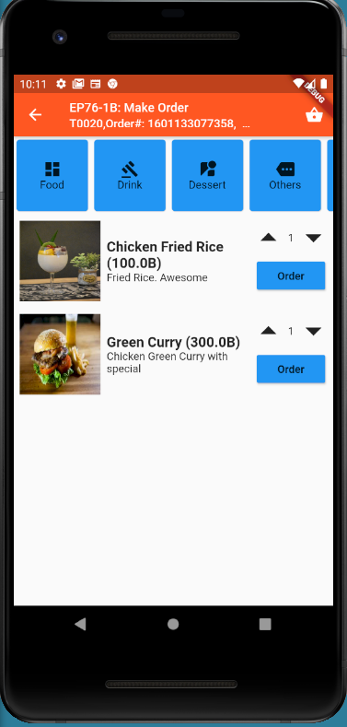
Overall UI Design
TT_ORDERS
SCAN QR
TM_TABLES
Scan QR
EP75
EP71
EP72
EP73
EP74
GlobalAppData (Singleton)
tableNo
orderNo
EP76
Ordering
Menu ID
Ordering
Sent
Sent
Cooking
Cooking
TT_ORDERS
listOrderItem
Served
Served
Served
Order(14)
Status
Payment
More
Order
Send Order
Served
Served
EP77
EP78

Slide 6
Coding Concept for View Menu & Make Order
Business Logic / Model
UI / View & Controller
Mapping Model Class
GlobalAppData Class (Singleton Design Pattern)
tableNo
orderNo
Order Model Class
AddOrderItem(OrderItem)
Field
Property = Object Model
TT_ORDERS
listOrderItem
1
Data Model
3
Menu Model Class
1
GetMenuList(Category)
GetMenu(MenuId)
Menu ID
(Pass Parameter)
TM_MENUS
2
3
2
1
Order
MVC = Model, View, Controller = a Design Pattern
Benefits (1) Reuse (2) Easy to maintain (3) Separate Logic & UI
Note: This design is not exact MVC. Just adapt concept from MVC
Mapping between (1) Data Model in Database / Json (2) Object Model in Class

Slide 7
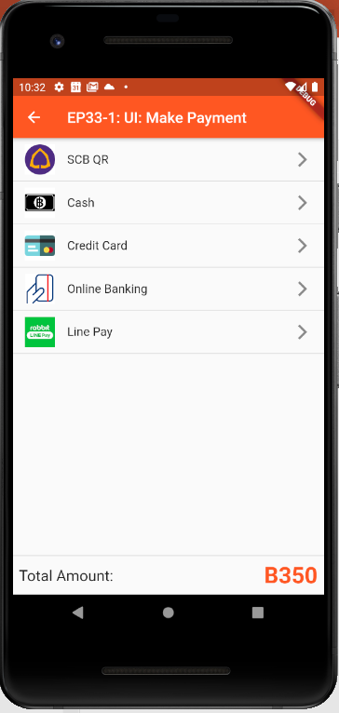
Design UI
Ordering
Customer: Mr.John
Table#: 10
Order#: ORD007
Mobile No: 085-3214234
Time: 10:30am
Register
Member
Ordering
Menu | Price
1) x3 Fired rice | 120
2) x3 Coke | 100
3) x4Green Curry | 100
4) x5 Rice | 30
Sent
Sent
Cooking
Cooking
Served
Served
Served
Total ฿350
Served
Order(14)
Status
Payment
More
Send Order
Served
Pay
Make Order
View Order for
Send Order
View Order for checking
Order Status
View Order for
Payment
Make Payment

Slide 8
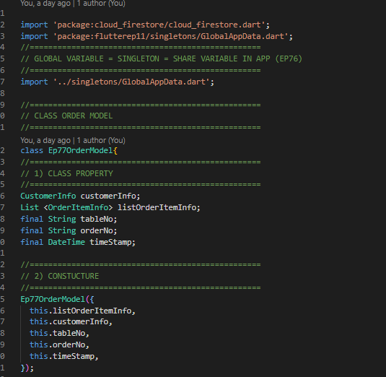
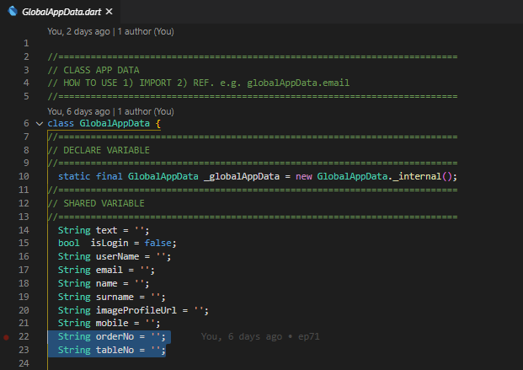
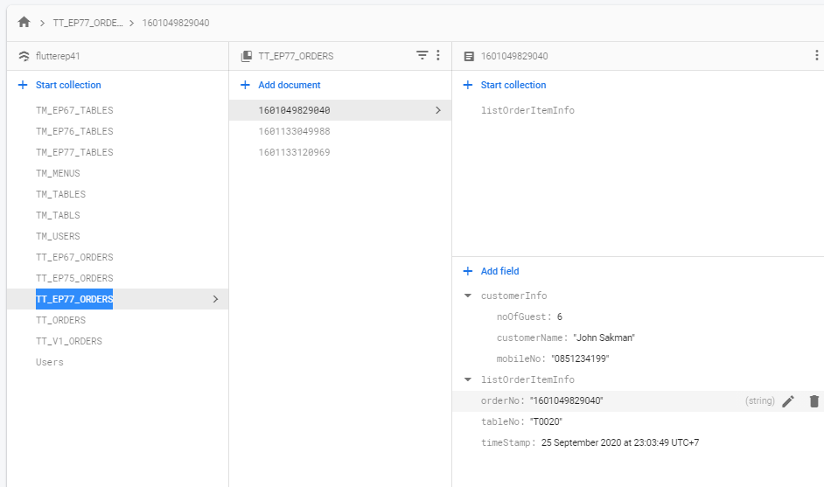
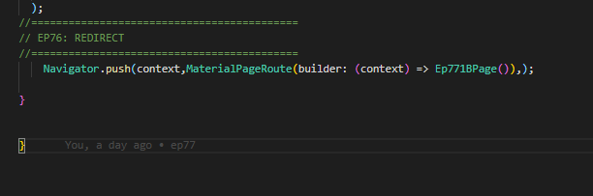
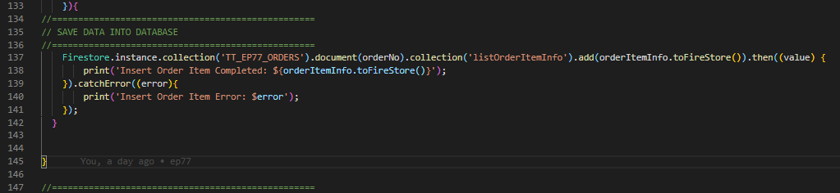
Database, Model Class and UI Class
Object Model
Global App Data Singleton
(OrderNo,TableNo)
Data Model
Field
Mapping Model
Property
TT_ORDERS
listOrderItem
Call Function
Reused Function
Database
Catalog=Order
Model Class (Order)
UI

