Slide 1
Coding: Search Food Menu from Database using Mapping Model Class Case Study “Restaurant E-menu” ระบบสั่งอาหารผ่านมือถือ
EP79
See-Flutter เรียนรู้ไปด้วยกัน เรียนฟรี พร้อม Source Code
27 Sep 2020
Day#69

Slide 2
CONTENT เนื้อหาวันนี้
Review Use Case
Review UI Design
Coding Concept
Coding
Target Group: Mobile Developer

Slide 3
Key Knowledge
PlatformException
Search Data from Firebase
Mapping Model Class
Static Function
Target Group: Mobile Developer

Slide 4


Use Case (Review)
Fill Cus Info
EP74 (UI)
EP75 (Logic)
EP76 (Pass Perameter Fill Cus Info -> Make Order)
Fill Passcode (mobileNo)
EP73 (UI)
Open Table using QR
EP71: UI
EP72: UI + Scanner
Restaurant
Admin
View Menu Details
View Menu
EP79 – Search Menu
Make Order
EP77 – save Order Item
Submit Order
Waiter
View Order
Check Status
Customer
Chief
View Order for Payment
Payment
EP78: Design Concept for View Menu and Make Order

Slide 5
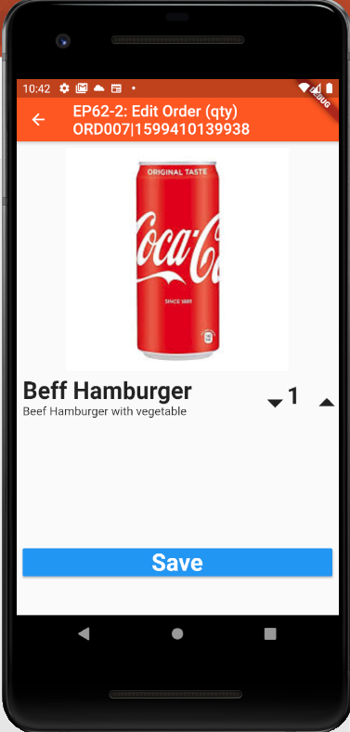
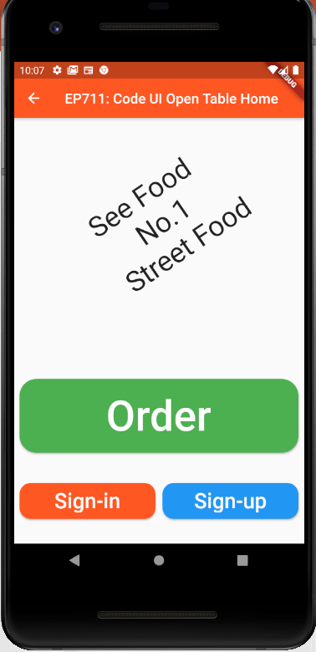
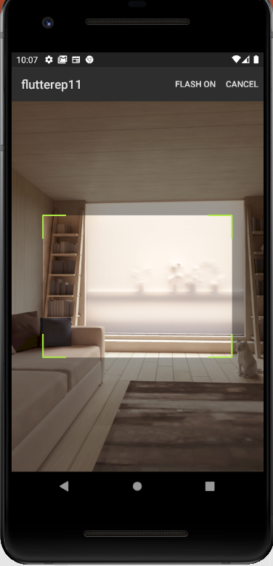
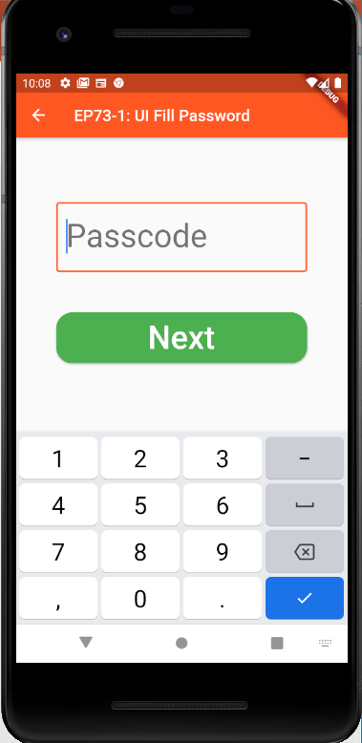
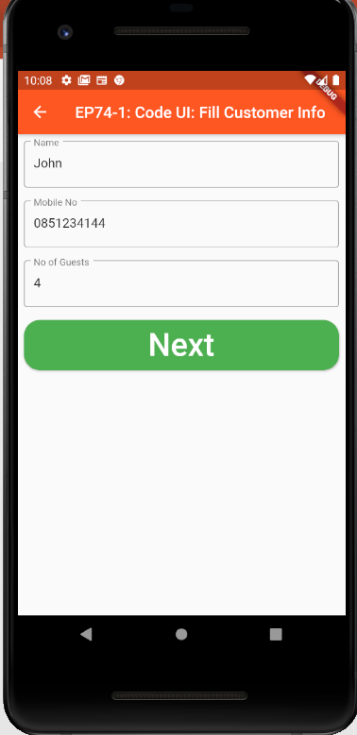
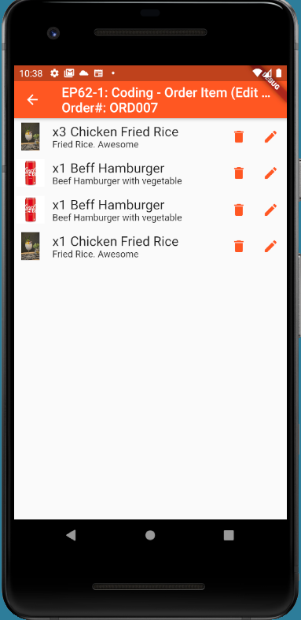
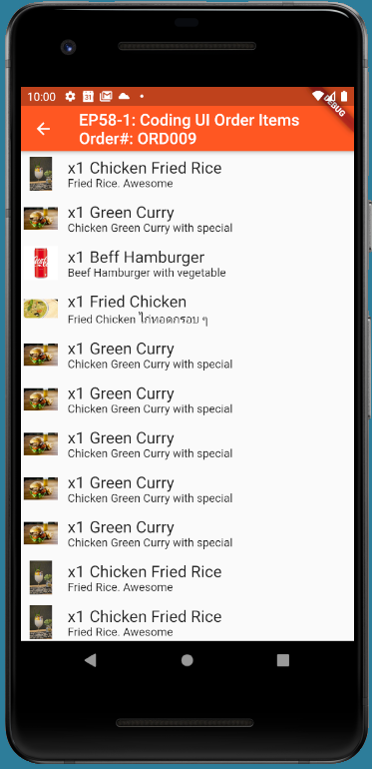
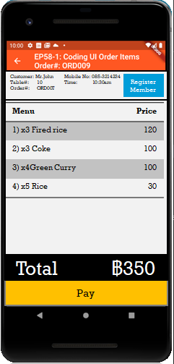
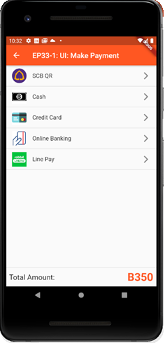
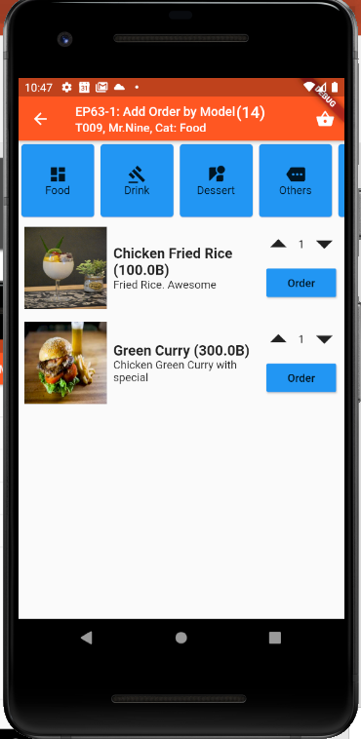
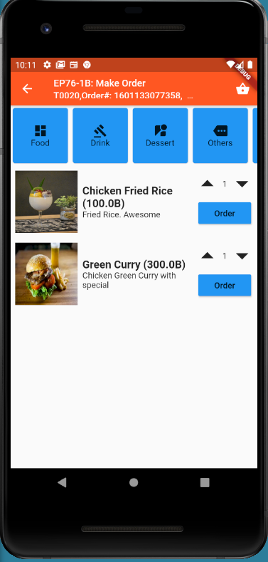
Overall UI Design
TT_ORDERS
SCAN QR
TM_TABLES
Scan QR
EP75
EP71
EP72
EP73
EP74
GlobalAppData (Singleton)
tableNo
orderNo
EP76
Ordering
Menu ID
Ordering
Sent
Sent
Cooking
Cooking
TT_ORDERS
listOrderItem
Served
Served
Served
Order(14)
Status
Payment
More
Order
Send Order
Served
Served
EP77
EP78

Slide 6
Coding Concept for View Menu & Make Order
Business Logic / Model
UI / View & Controller
Mapping Model Class
GlobalAppData Class (Singleton Design Pattern)
tableNo
orderNo
Order Model Class
AddOrderItem(OrderItem)
Field
Property = Object Model
TT_ORDERS
listOrderItem
1
Data Model
3
Menu Model Class
1
GetMenusByCategory(Category)
GetMenu(MenuId)
Menu ID
(Pass Parameter)
TM_MENUS
2
3
2
1
Order
MVC = Model, View, Controller = a Design Pattern
Benefits (1) Reuse (2) Easy to maintain (3) Separate Logic & UI
Note: This design is not exact MVC. Just adapt concept from MVC
Mapping between (1) Data Model in Database / Json (2) Object Model in Class

Slide 7
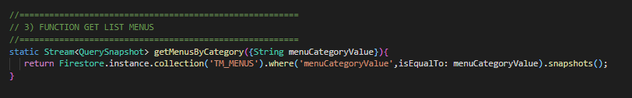
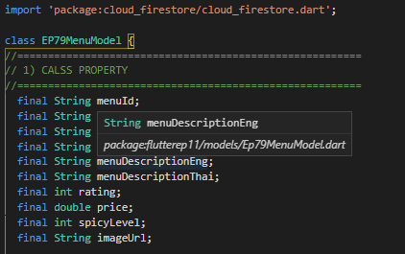

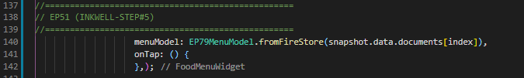
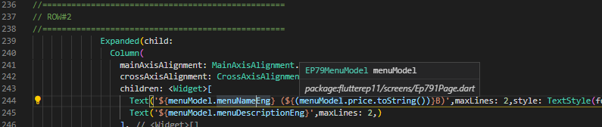
FUNCTION
Static Function
MenuModel
Call Function
Change to Model (Object)
Use Menu Model e.g. menuModel.menuNameEnd

Slide 8
Coding Steps
Copy Model Class from EP77OrderModel, EP77MenuModel
Copy Code from EP76-1B
Call Open Table (Order Model Class)
Create Static Function getMenuByCategory(Category)
Call Function getMenuByCategory(Category)
Change return function to Model (Object)

Slide 9
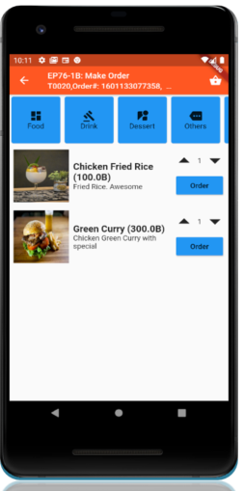
FINAL UI

