Slide 1
Coding: View Food Menu Detail from Database using Mapping Model Class Case Study “Restaurant E-menu” ระบบสั่งอาหารผ่านมือถือ
EP80
See-Flutter เรียนรู้ไปด้วยกัน เรียนฟรี พร้อม Source Code
28 Sep 2020
Day#70

Slide 2
CONTENT เนื้อหาวันนี้
Review Use Case
Review UI Design
Coding Concept
Coding
Target Group: Mobile Developer

Slide 3
Key Knowledge
PlatformException
Pass Parameter
Global Variable (Singleton Class)
Get Data from Database
Return Snapshot
Return Model (Object)
Target Group: Mobile Developer

Slide 4


Use Case (Review)
Fill Cus Info
EP74 (UI)
EP75 (Logic)
EP76 (Pass Perameter Fill Cus Info -> Make Order)
Fill Passcode (mobileNo)
EP73 (UI)
Open Table using QR
EP71: UI
EP72: UI + Scanner
Restaurant
Admin
View Menu Details
EP80: View Menu
View Menu
EP79 – Search Menu
Make Order
EP77 – save Order Item
Submit Order
Waiter
View Order
Check Status
Customer
Chief
View Order for Payment
Payment
EP78: Design Concept for View Menu and Make Order

Slide 5
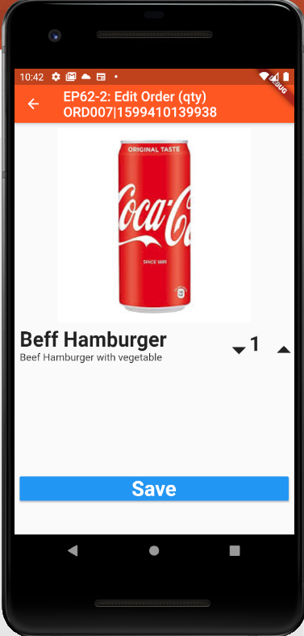
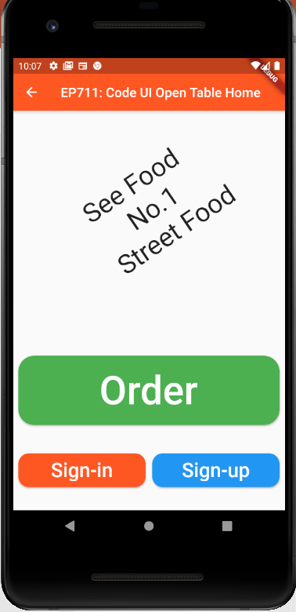
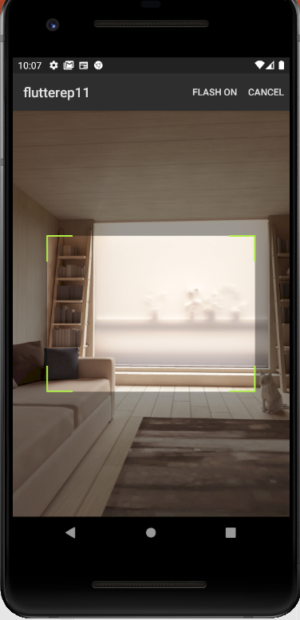
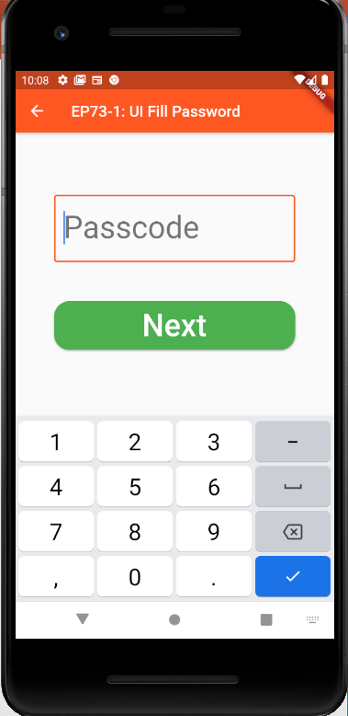
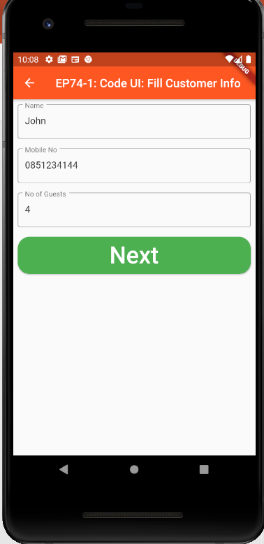
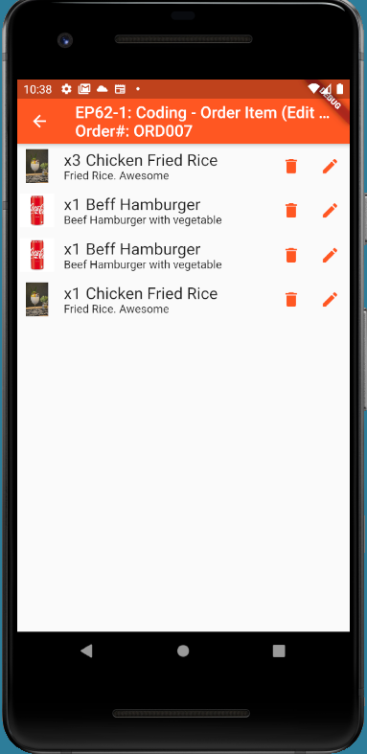
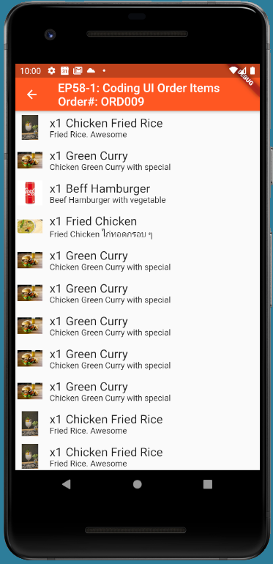
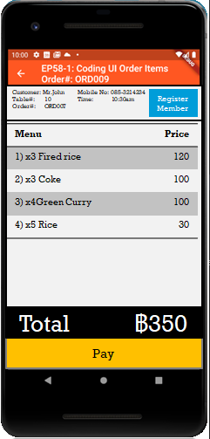
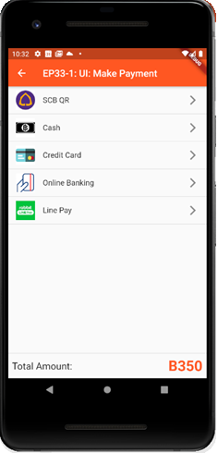
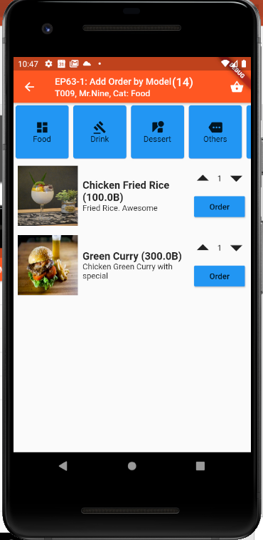
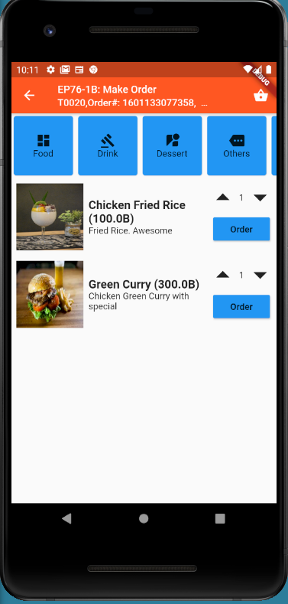
Overall UI Design
TT_ORDERS
SCAN QR
TM_TABLES
Scan QR
EP75
EP71
EP72
EP73
EP74
GlobalAppData (Singleton)
tableNo
orderNo
EP76
Ordering
Menu ID
Ordering
Sent
Sent
Cooking
Cooking
TT_ORDERS
listOrderItem
Served
Served
Served
Order(14)
Status
Payment
More
Order
Send Order
Served
Served
EP77
EP78
EP79
EP80

Slide 6
Coding Concept for View Menu & Make Order
Business Logic / Model
UI / View & Controller
Mapping Model Class
GlobalAppData Class (Singleton Design Pattern)
tableNo
orderNo
Order Model Class
AddOrderItem(OrderItem)
Field
Property = Object Model
TT_ORDERS
listOrderItem
1
Data Model
3
Menu Model Class
1
GetMenusByCategory(Category)
GetMenu(MenuId)
Menu ID
(Pass Parameter)
TM_MENUS
2
3
2
1
Order
EP79
EP80
MVC = Model, View, Controller = a Design Pattern
Benefits (1) Reuse (2) Easy to maintain (3) Separate Logic & UI
Note: This design is not exact MVC. Just adapt concept from MVC
Mapping between (1) Data Model in Database / Json (2) Object Model in Class

Slide 7
Coding Steps
Copy Model Class from EP79OrderModel, EP79MenuModel
Copy Code from EP79
Create Static Function getMenu(MenuID)
Call Function getMenu(MenuID)

Slide 8
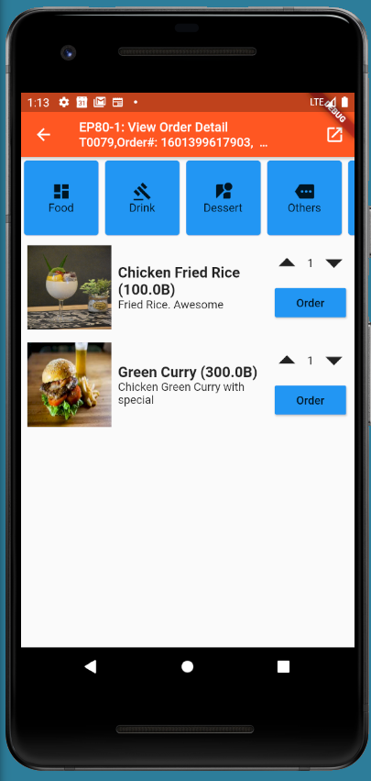
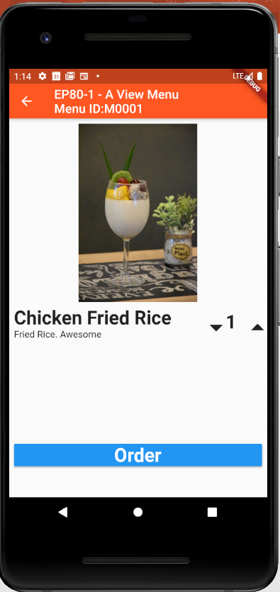
FINAL UI

Slide 9
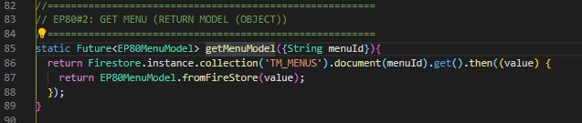
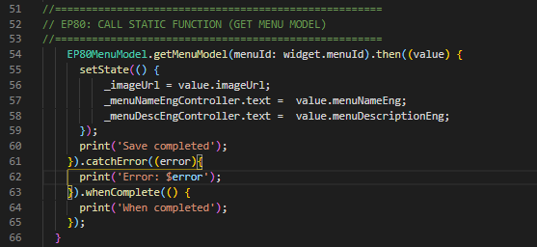
Code for create and call the GetMenu function
Create Function “GetMeuModel (MenuID):
Create Function in Model Class
Call Static Function “GetMenuModel” & Get Data
Call Function
Get Data

Slide 10
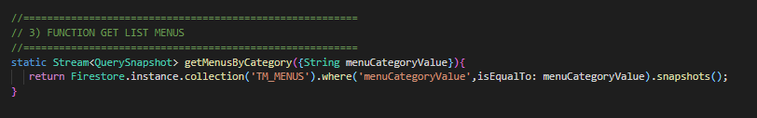
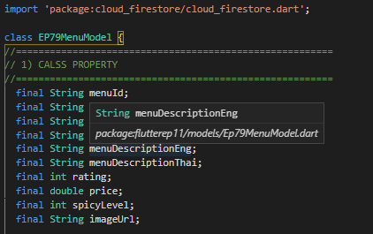

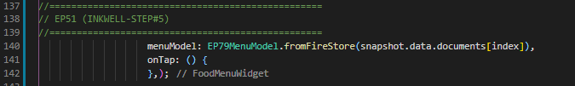
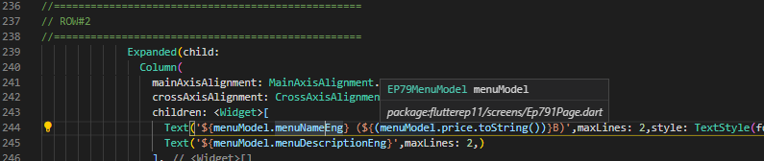
Sample Function (Create & Calling)
Static Function
MenuModel
Call Function
Change to Model (Object) from Return Function
Use Menu Model e.g. menuModel.menuNameEng
Get Data

