Slide 1
EP81 Download Code from Tutorial Github & Upload Code to your own GitHub Case Study “Restaurant E-menu” ระบบสั่งอาหารผ่านมือถือ
See-Flutter เรียนรู้ไปด้วยกัน เรียนฟรี พร้อม Source Code
29 Sep 2020
Day#71

Slide 2
CONTENT เนื้อหาวันนี้
How to download source code from github
Upload source code to github cloud
Note: Similar to EP61
Target Group: Mobile Developer (iOs,Andriod)

Slide 3
Source Code in GitHub
URL | EP in YouTube | Content
[ Future ] | EP01-10 | TBC e.g. How to install flutter, What is flutter, coding Technique, dart language
https://github.com/traitet/flutterep11 | EP11-20 | Basic Knowldge
https://github.com/traitet/flutterep21 | EP11-30 | Restaurant E-menu Case Study
https://github.com/traitet/flutterep31 | EP11-40 | Restaurant E-menu Case Study
https://github.com/traitet/flutterep41 | EP11-50 | Restaurant E-menu Case Study
https://github.com/traitet/flutterep51 | EP11-60 | Restaurant E-menu Case Study
https://github.com/traitet/flutterep61 | EP11-70 | Restaurant E-menu Case Study
https://github.com/traitet/flutterep71 | EP11-80 | Restaurant E-menu Case Study
https://github.com/traitet/flutterep81 | EP11-81 | Restaurant E-menu Case Study

Slide 4
Step
Download from GitHub https://github.com/traitet/flutterep71
Change Folder Name from flutterep71-master to flutterep81
Open & Run Flutter Project by VSCode
Download Package
Upload code to Github as https://github.com/traitet/flutterep81

Slide 5
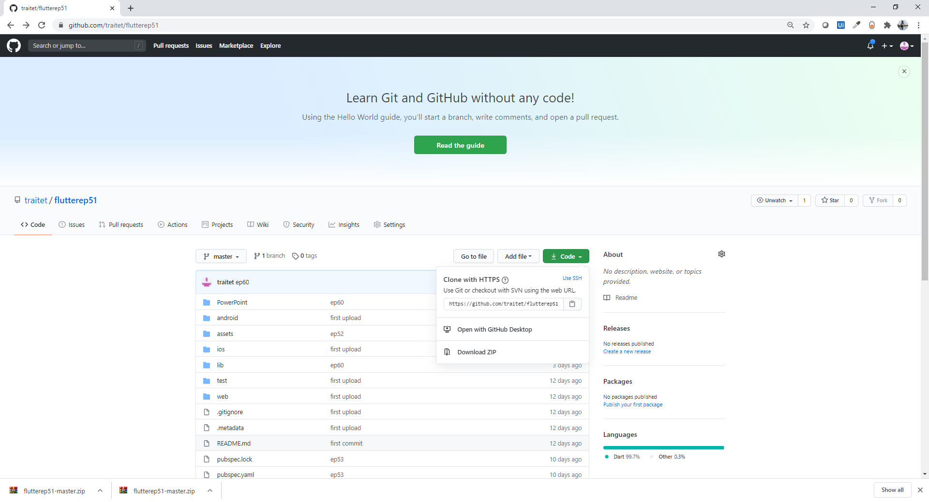
Download source code from Git Hub
https://github.com/traitet/flutterep71

Slide 6
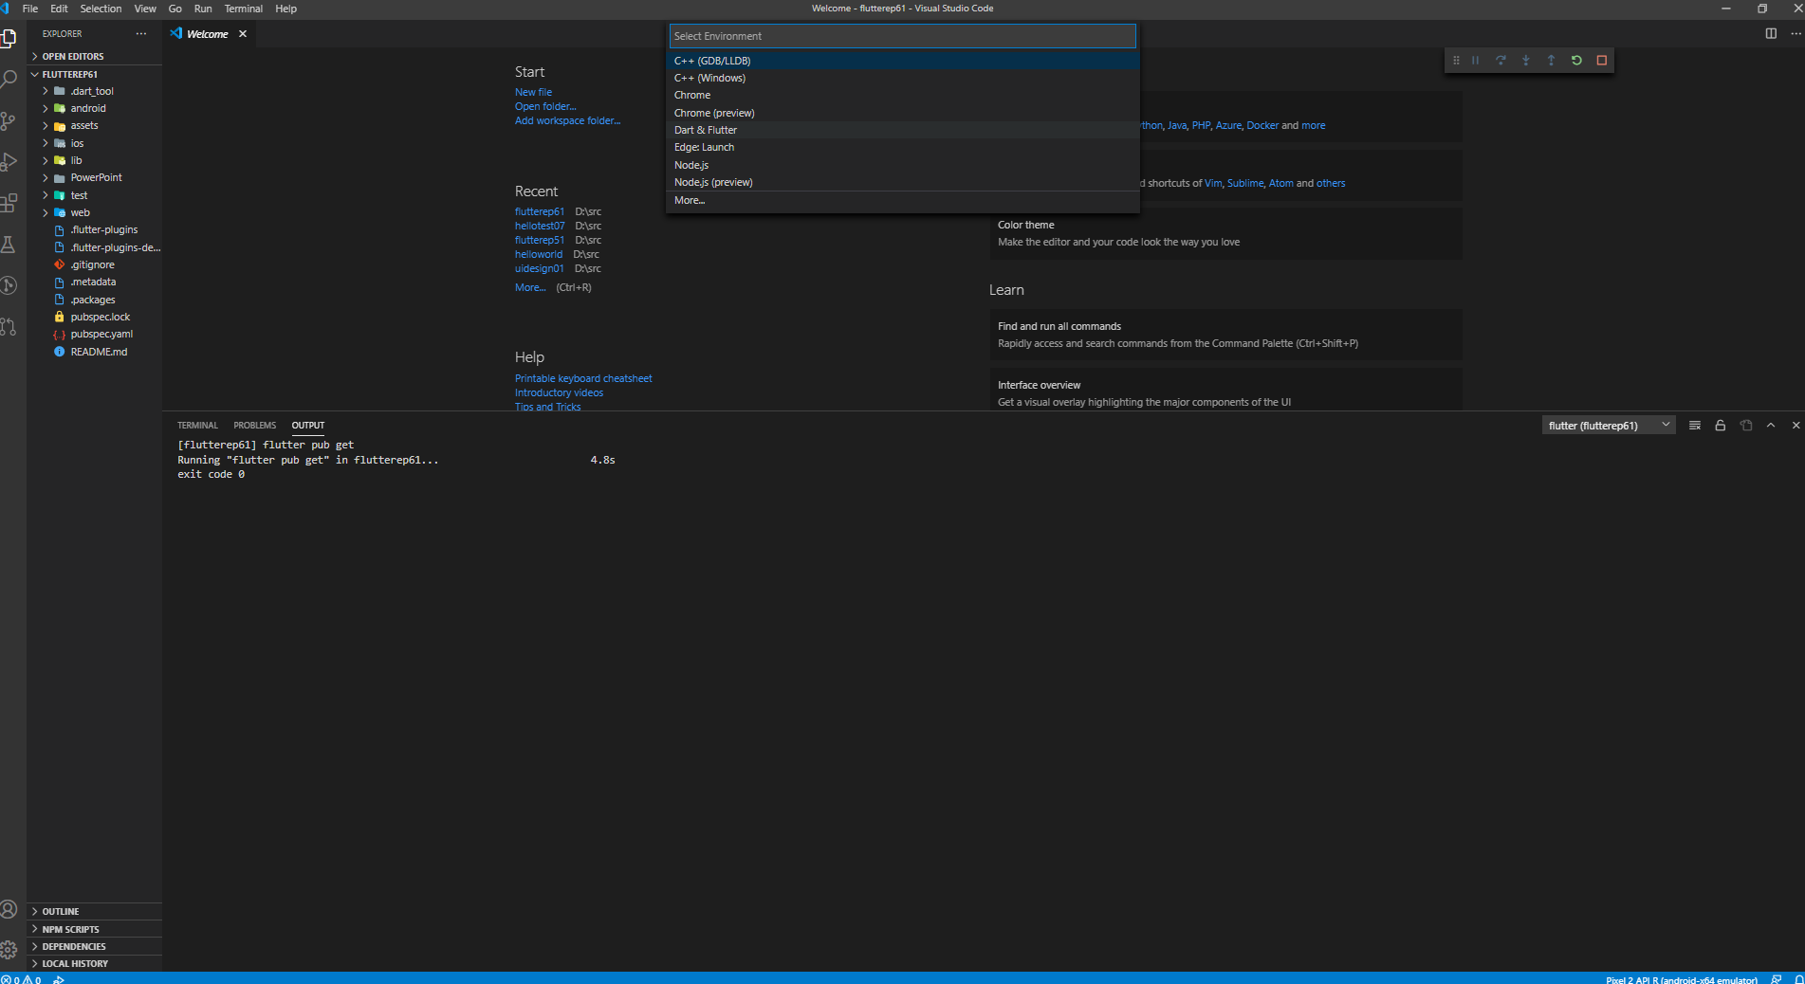
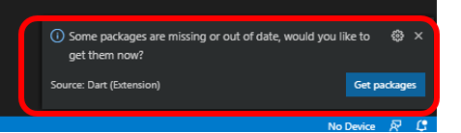
Open Flutter Project, Download Package, Run Flutter
1
3.2
3.3
File, Open Folder, Flutterep81
Download Package (see next screen)
Run, Dart & Flutter (Select Pixel API R for Emulator)
Wait around 5 min for build and run
2
3.1

Slide 7
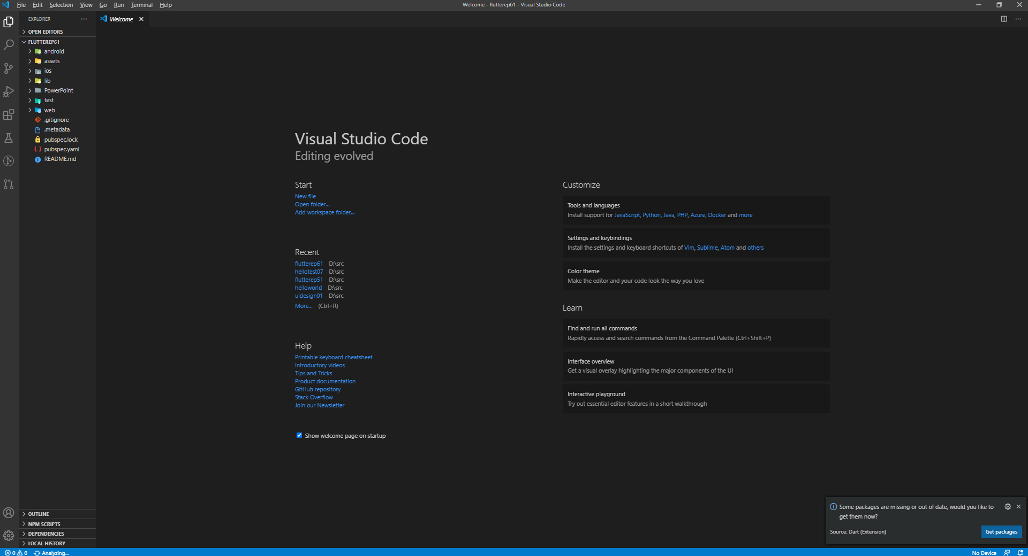
Download Flutter Package

Slide 8
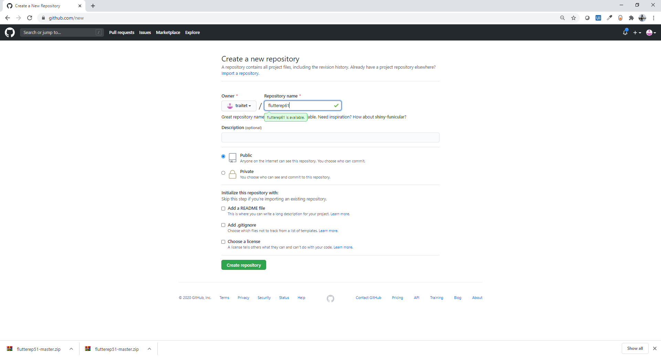
Create New Project on GitHub Web
https://github.com/traitet/flutterep81

Slide 9
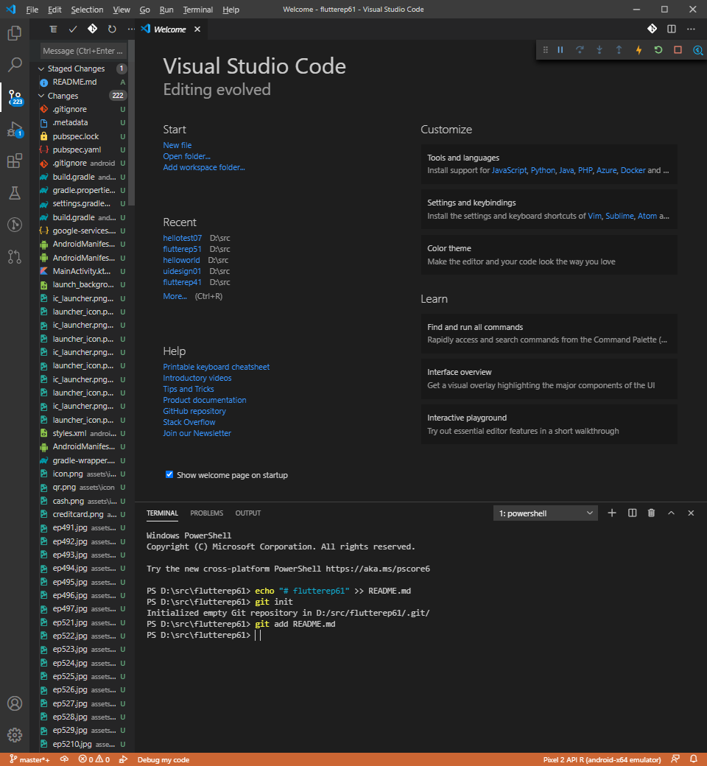
Main Steps to upload code to GitHub
Commit code in VSCode (internal)
Push Commited Code to GitHub Cloud
Commit code in VSCode

Slide 10
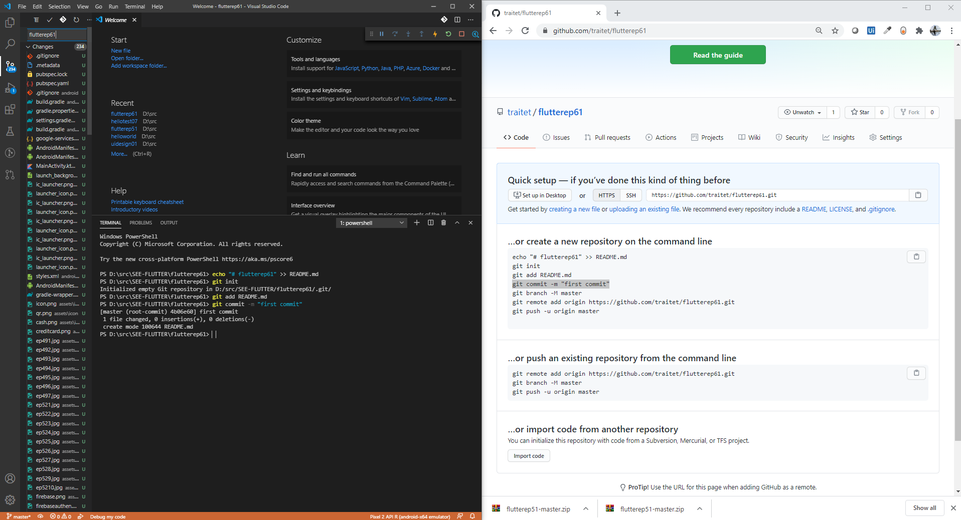
Upload Code to GitHub

Slide 11
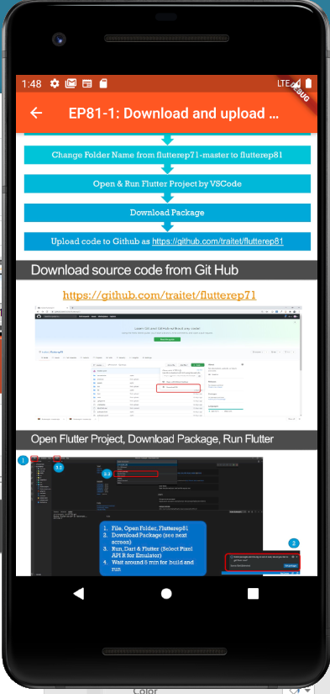
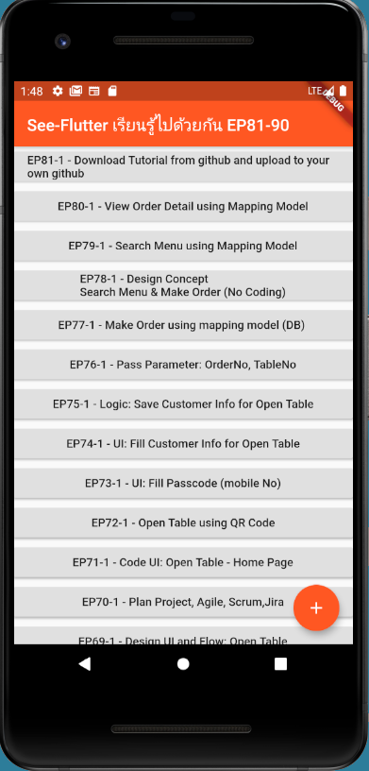
Final UI

Slide 12
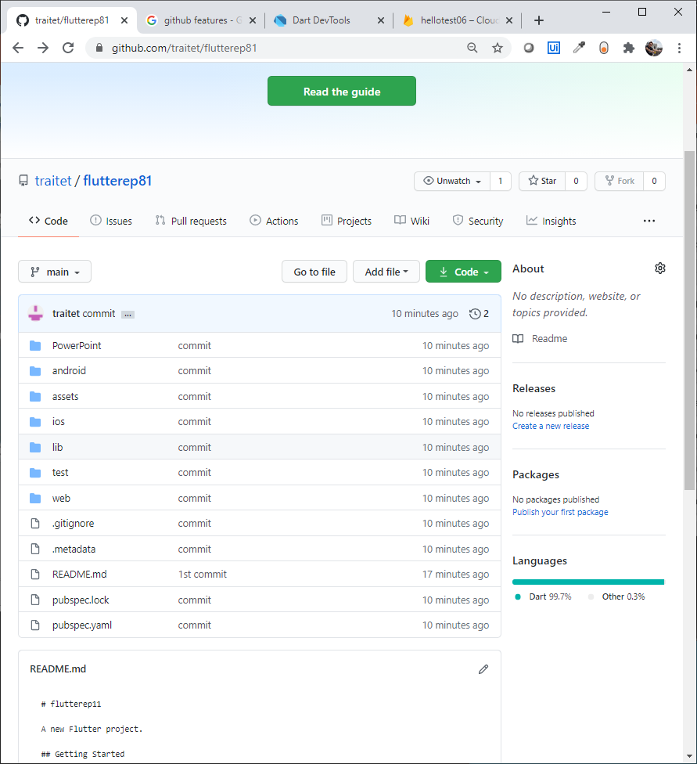
Upload Code to GitHub

Slide 13
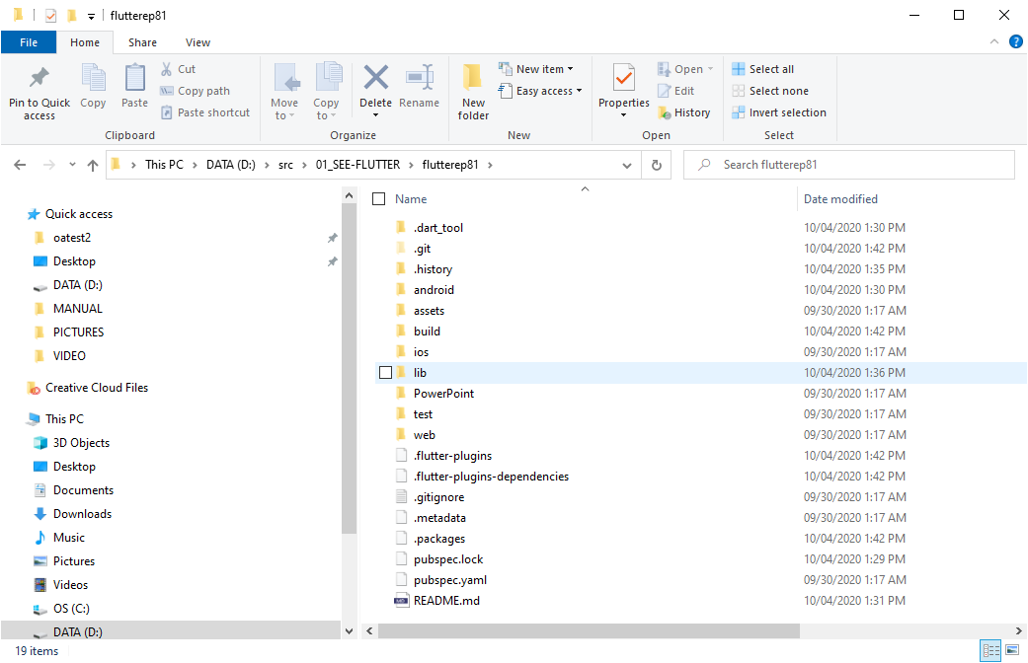
Git Folder
Info for source control and connect to github cloud
Git Folder keep all information to connect to GitHub Cloud
If would like to change GitHub Cloud Project, (1) delete git folder (2) create Github project (3) upload again

Slide 14
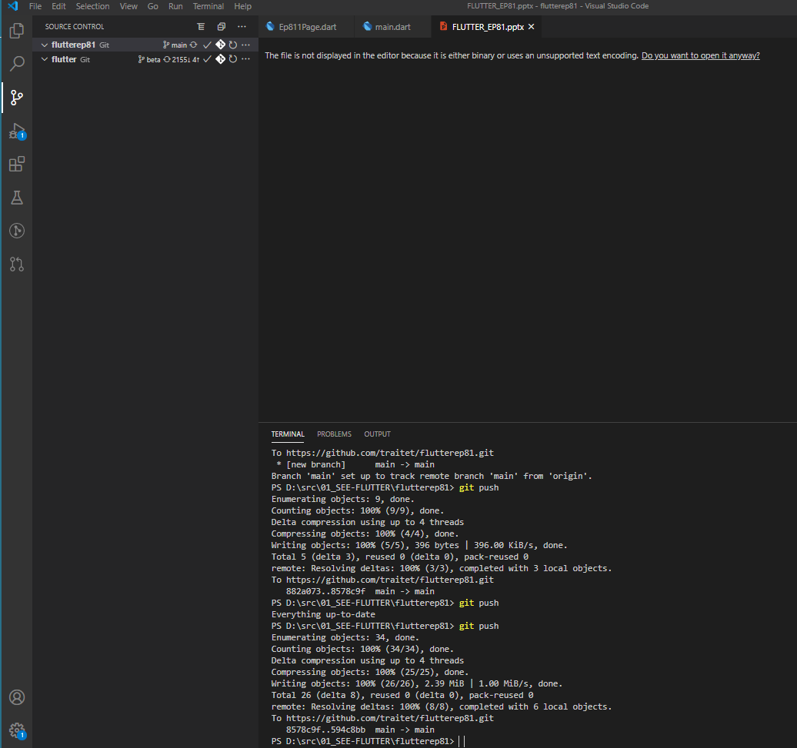
Git push to upload commited code to Github Cloud
Git push

