Slide 1
EP83 Review: EP82: Create Firebase Project and Connect Firebase from Flutter (1) Authentication (2) FireStore DB (3) Firestorage (keep image) Case Study “Restaurant E-menu” ระบบสั่งอาหารผ่านมือถือ
See-Flutter เรียนรู้ไปด้วยกัน เรียนฟรี พร้อม Source Code
1 Oct 2020
Day#73

Slide 2
CONTENT
Setup Firebase Cloud
Authen
Storage
Firebase Database
Config Flutter
Build.gradle (2 files)
Google-service.json
Pubspec.yaml

Slide 3
Main Steps (Firebase Website)
Register
Create Project
Add Andriod App
Download google-services.json
Enable Function
Enable Authentication
Enable authen by e-mail
Enable FireStore Database
Change rule (Permission) for everyone
Enable Firebase Storage
Change rule (Permission) for everyone

Slide 4
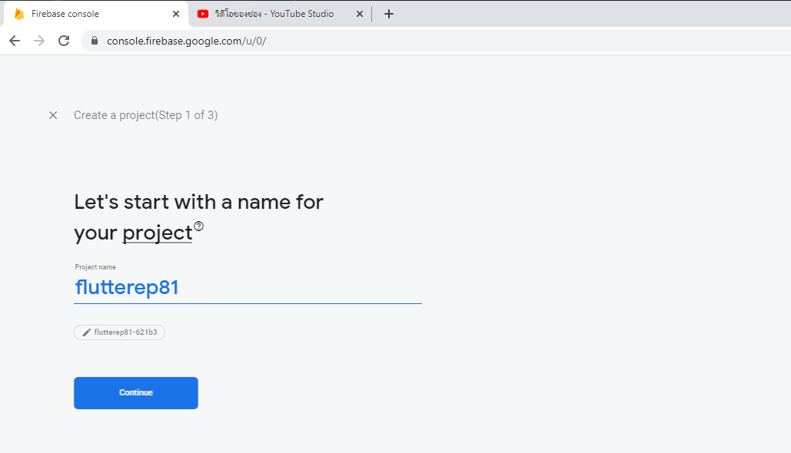
1.1) New Firebase Project
https://firebase.google.com/

Slide 5
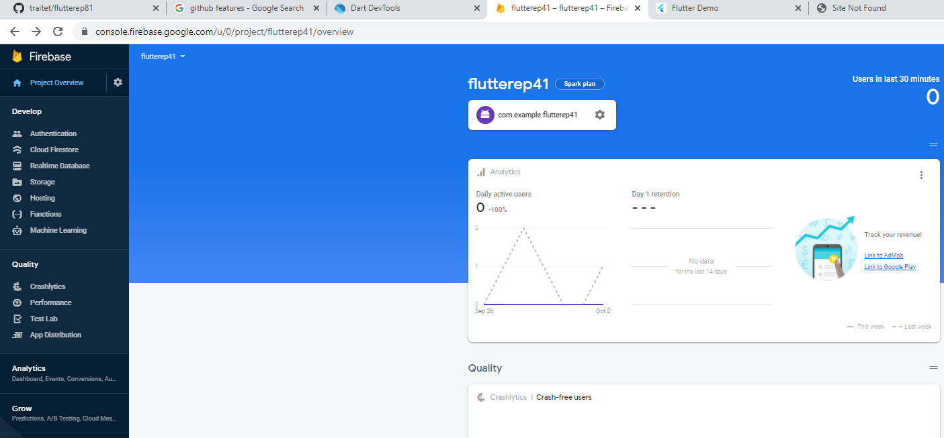
1.2) Add App (Andriod)

Slide 6
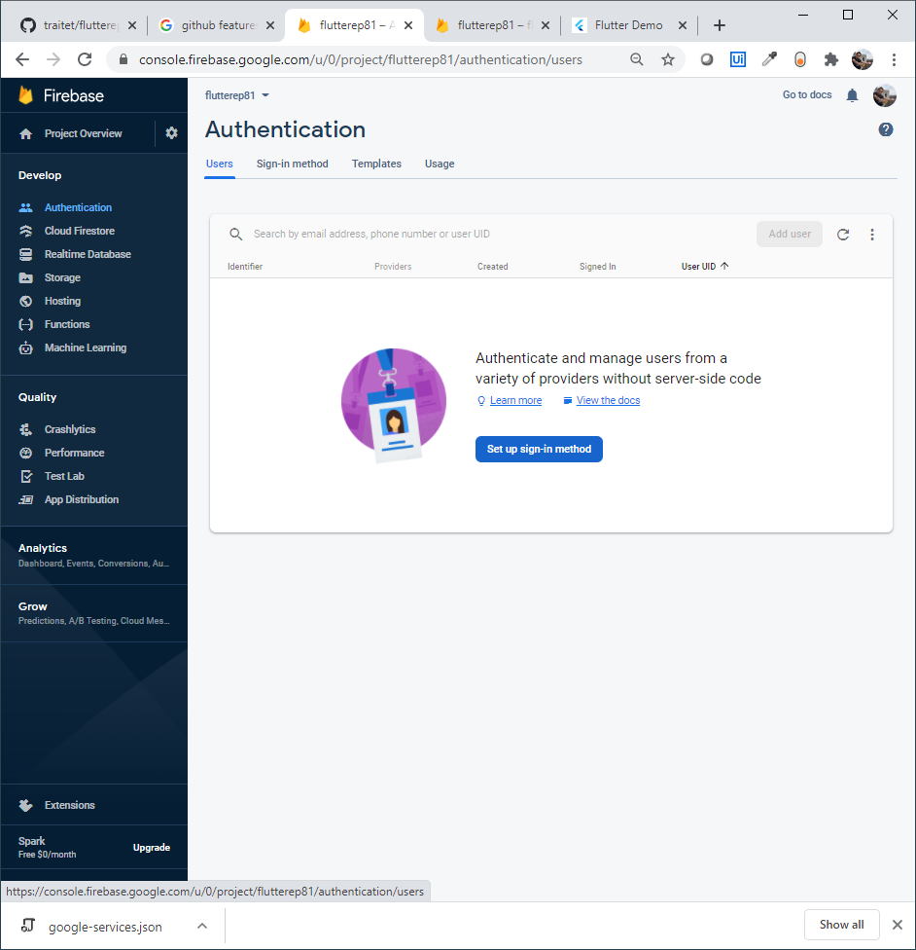
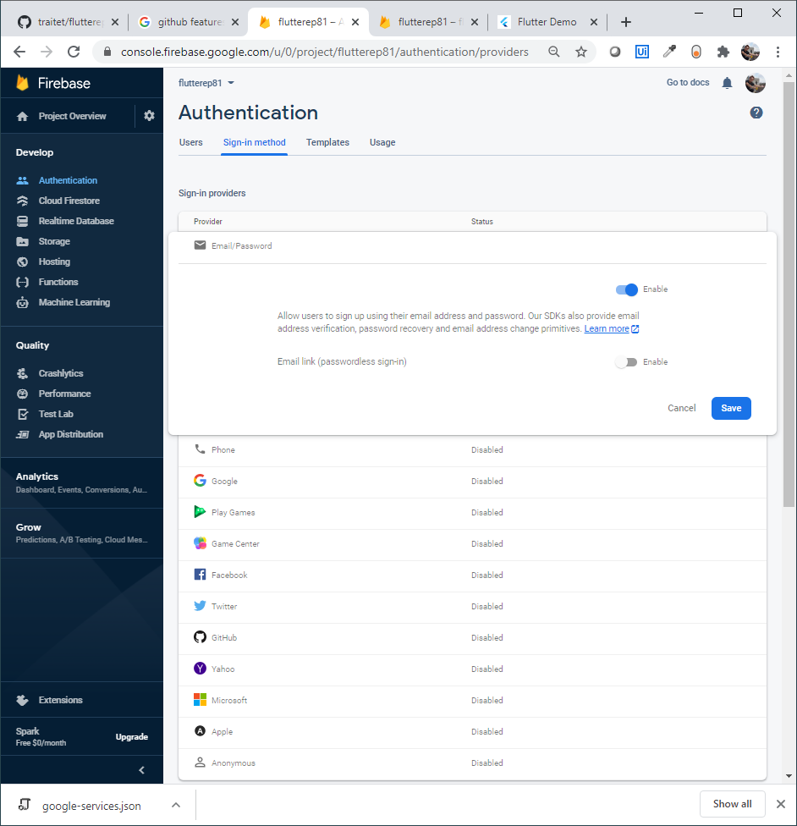
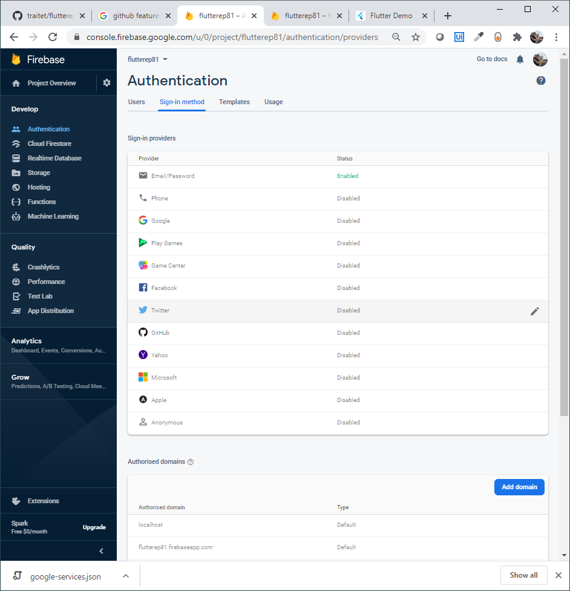
(2)-4-1: Enable authen services in Firebase

Slide 7
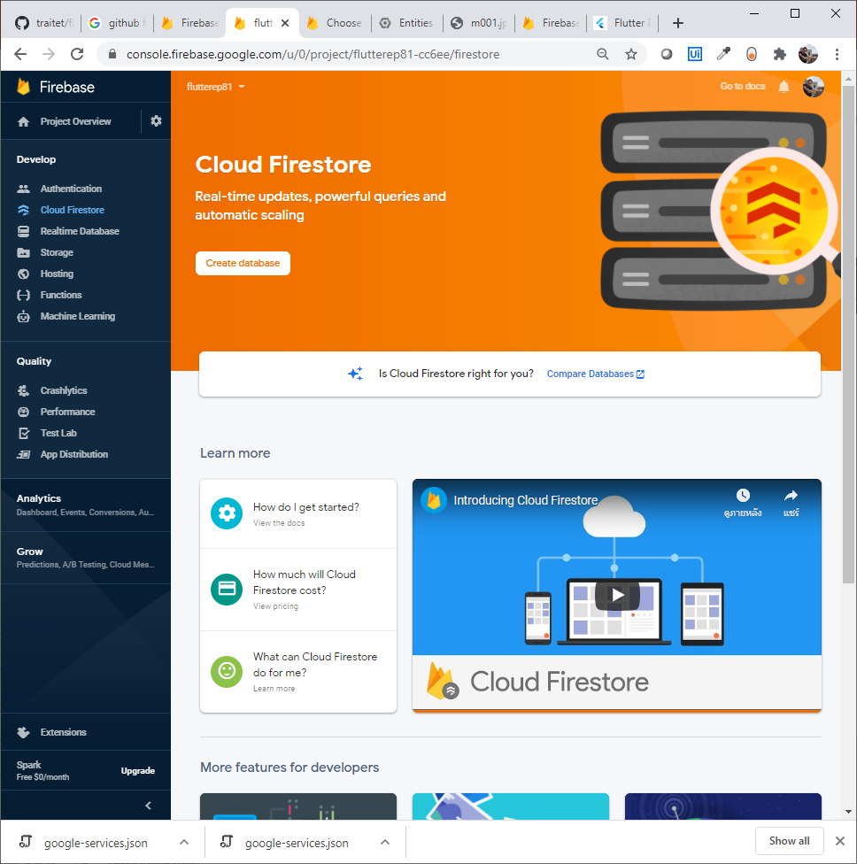
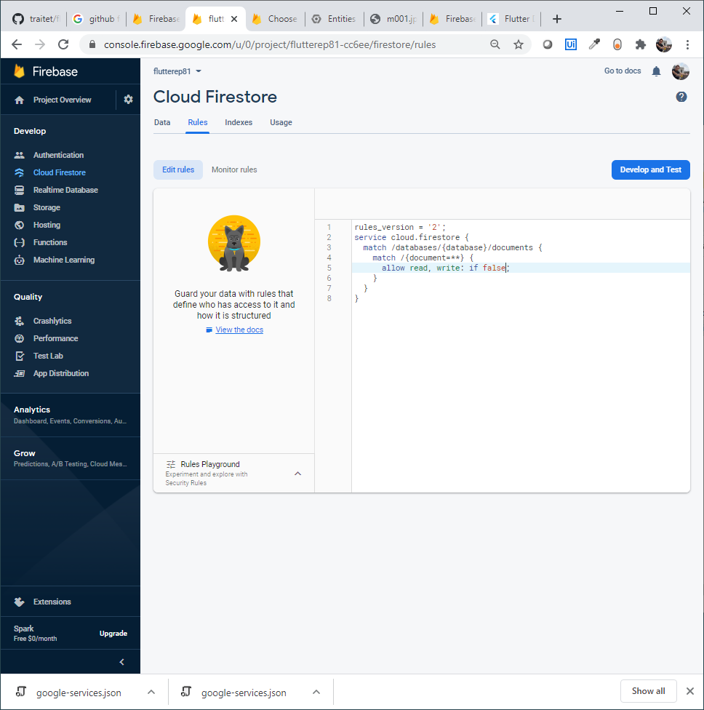
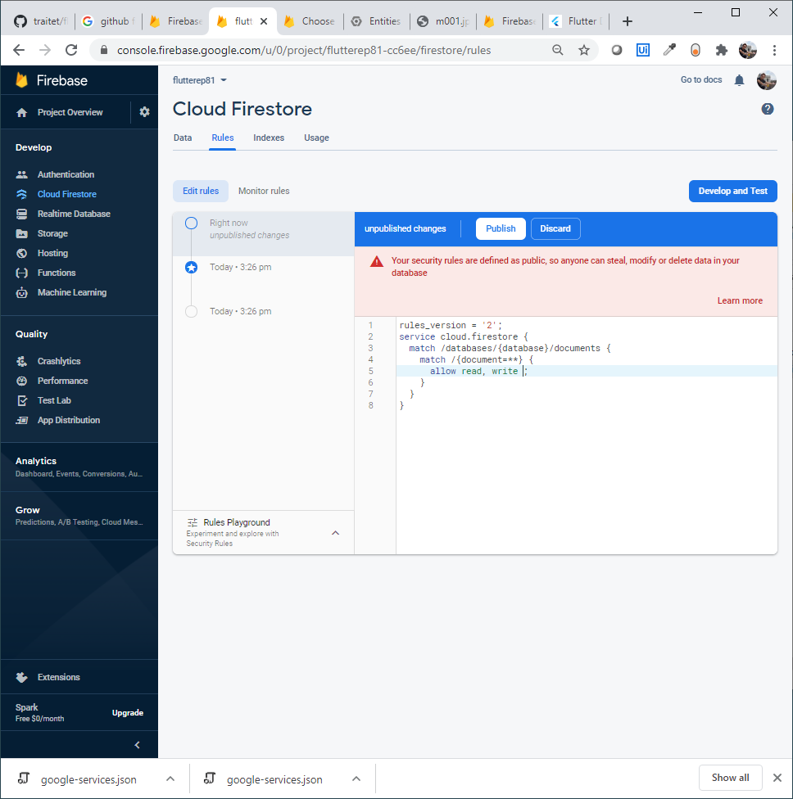
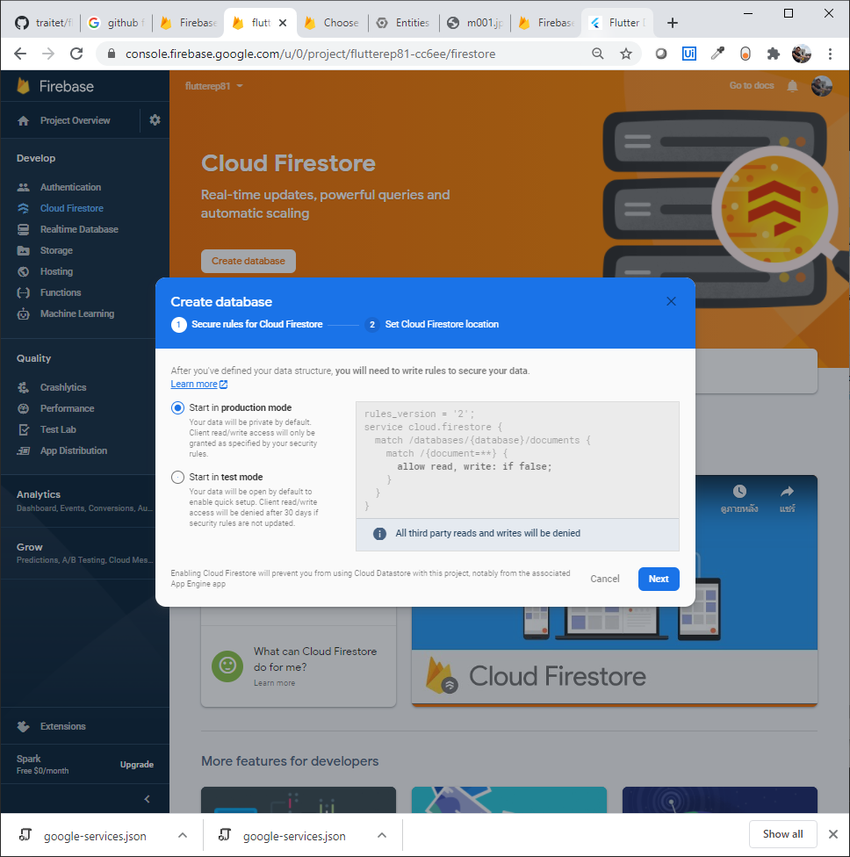
1.3-(1) Enable Cloud FireStore Database
Remove
click “Publish”
Delete if false
Click “Publish”
Note: For anybody can access out DB without checking permission

Slide 8
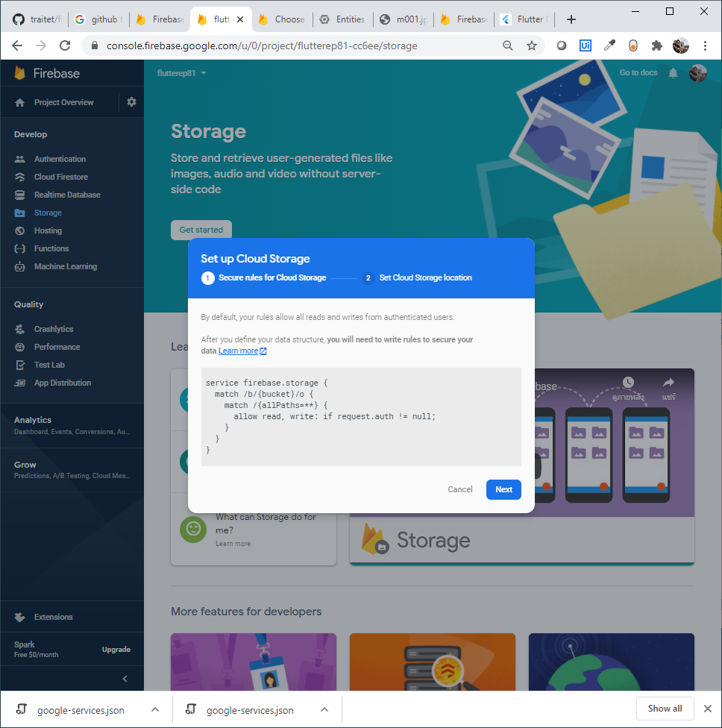
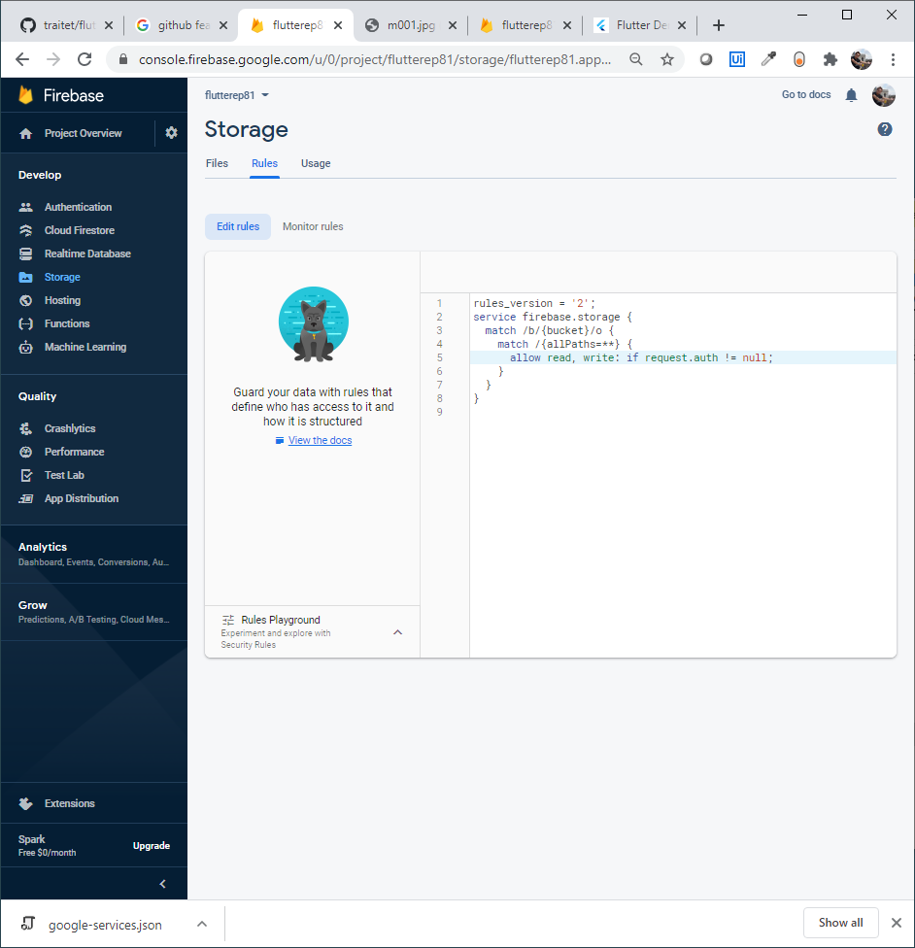
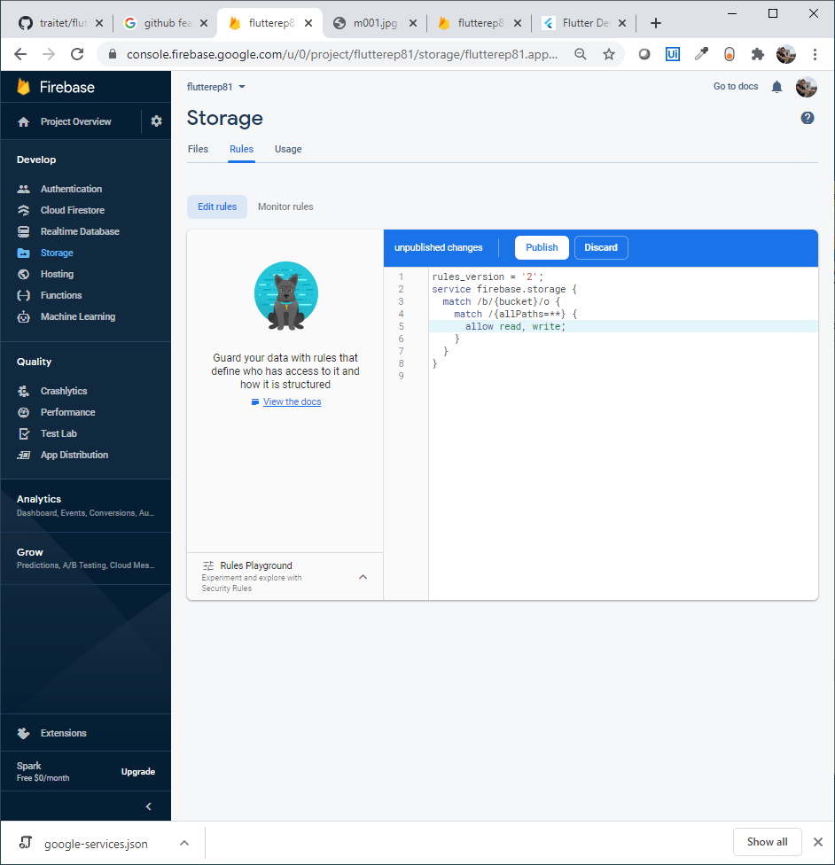
1.3-(2) Enable Storage services in Firebase
Remove
click “Publish”
Delete if false
Click “Publish”
Note: For anybody can access out DB without checking permission

Slide 9
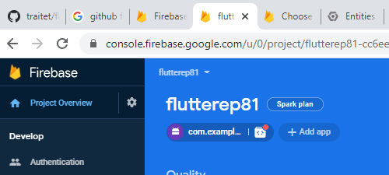
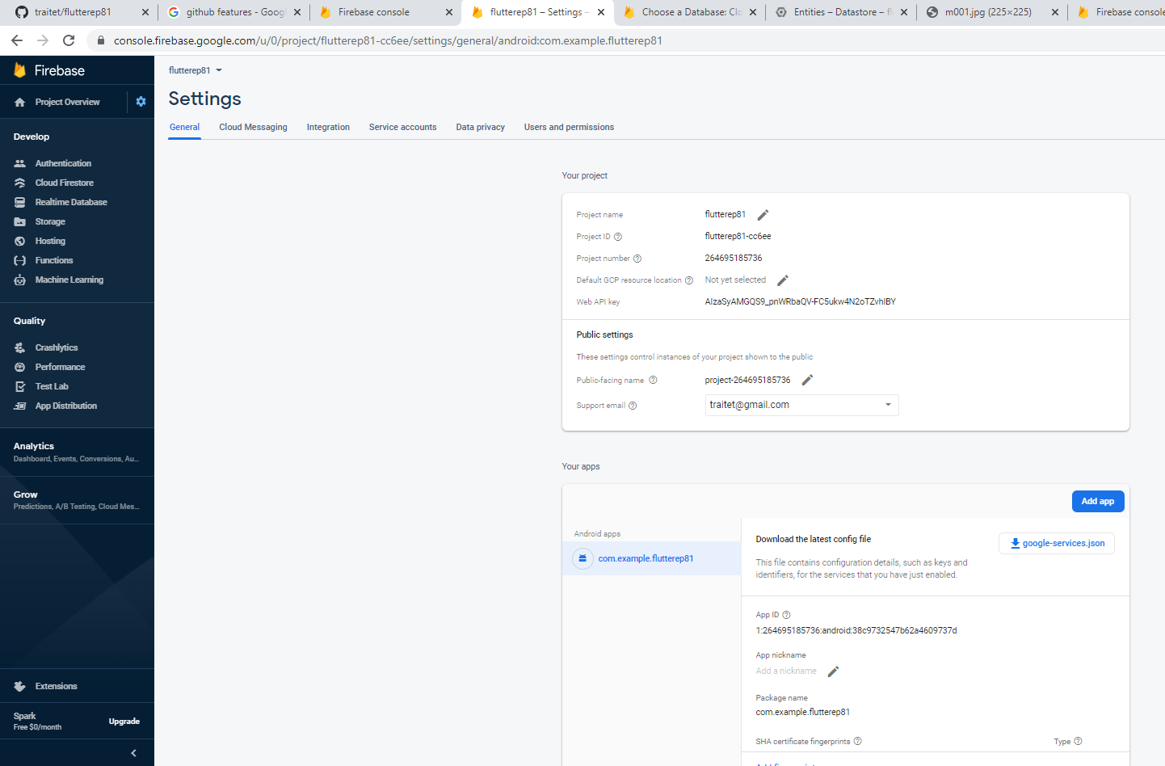
Additional Configure Project & download json file (Android)
File your email
Can download json file here

Slide 10
Diagram connecting between Cloud & Flutter app
FIREBASE
TRAITET
FLUTTER
FIREBASE
Tranee
GOOGLE-SERVICE.JSON
APP ID e.g.
com.example.flutterep81

Slide 11
Config Flutter
Download google-services.json from Firebase web and copy to andriod/app path
Edit /andriod/app/build.gradle
Edit /andriod/build.gradle
Add packages in pubspec.yaml
firebase_authen
cloud_firestore
firebase_storage

Slide 12
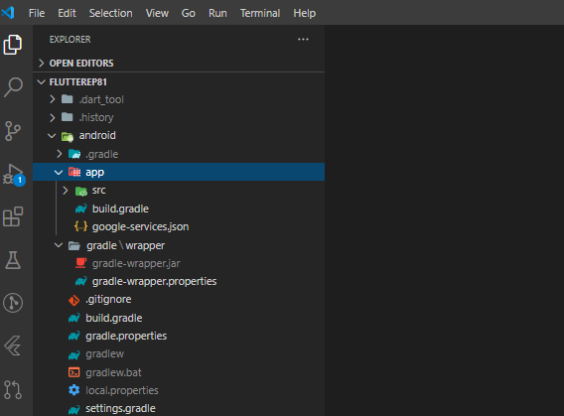
Config Flutter (Andriod)
Download google-services.json from Firebase web and copy to andriod/app path
Edit /andriod/app/build.gradle
Edit /andriod/build.gradle
Add packages in pubspec.yaml
firebase_authen
cloud_firestore
firebase_storage
2
1
3
4

Slide 13
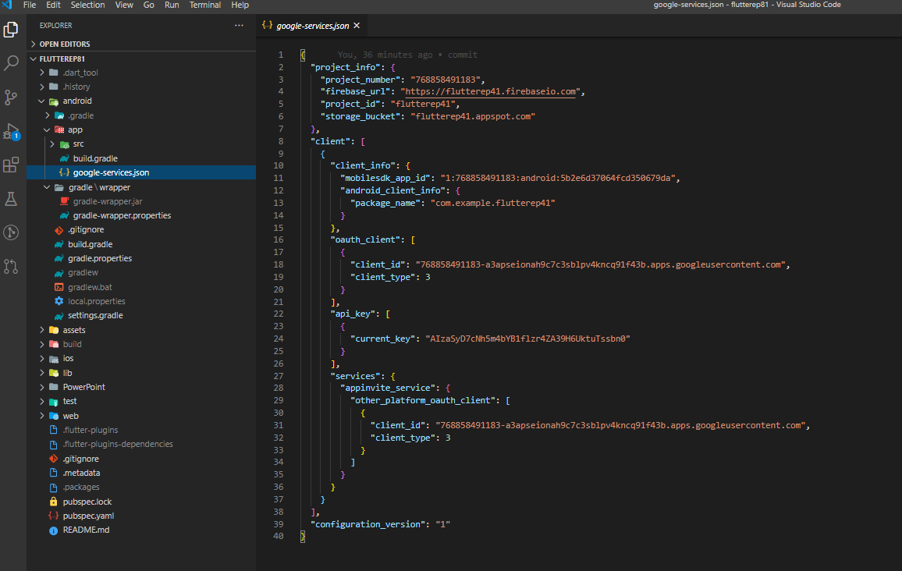
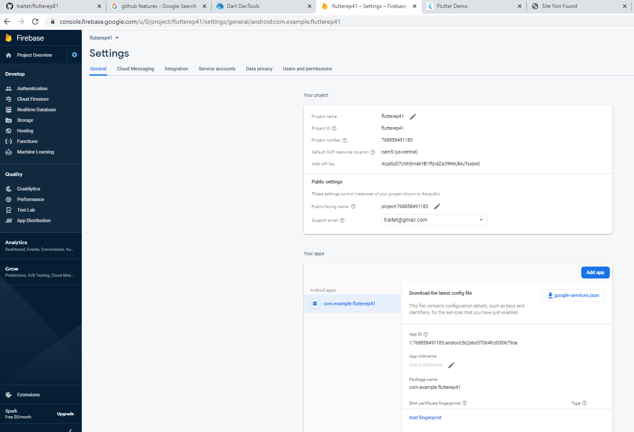
Edit /andriod/build.gradle

Slide 14
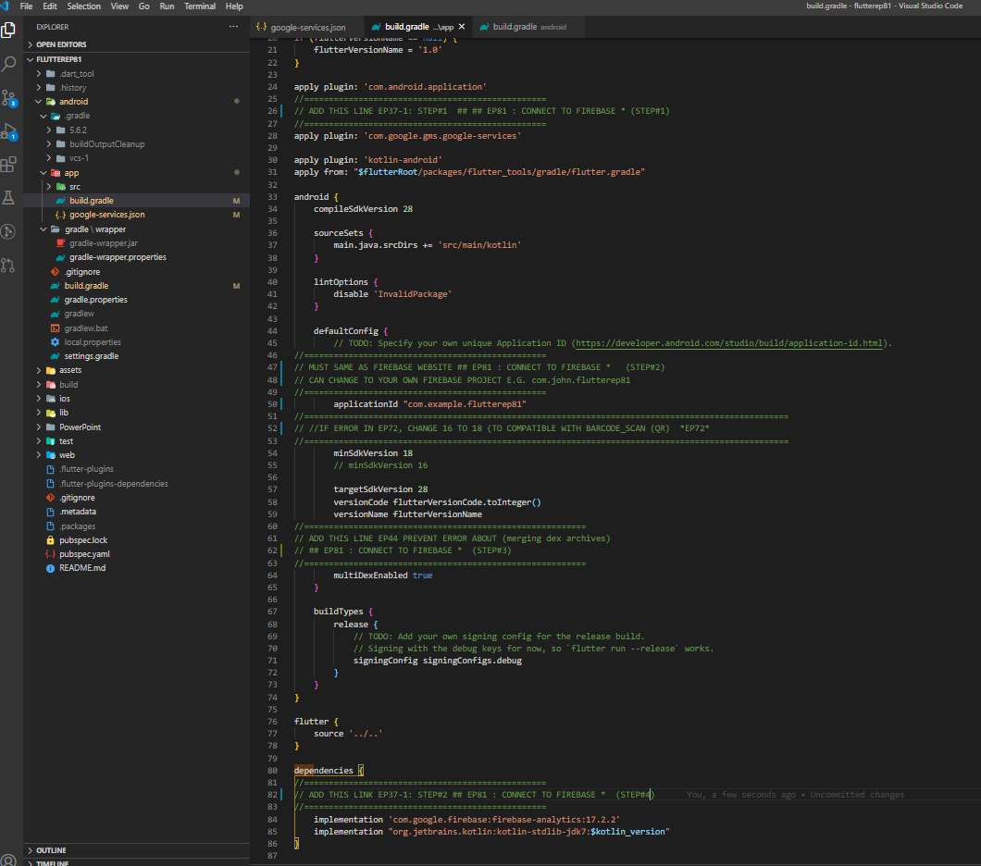
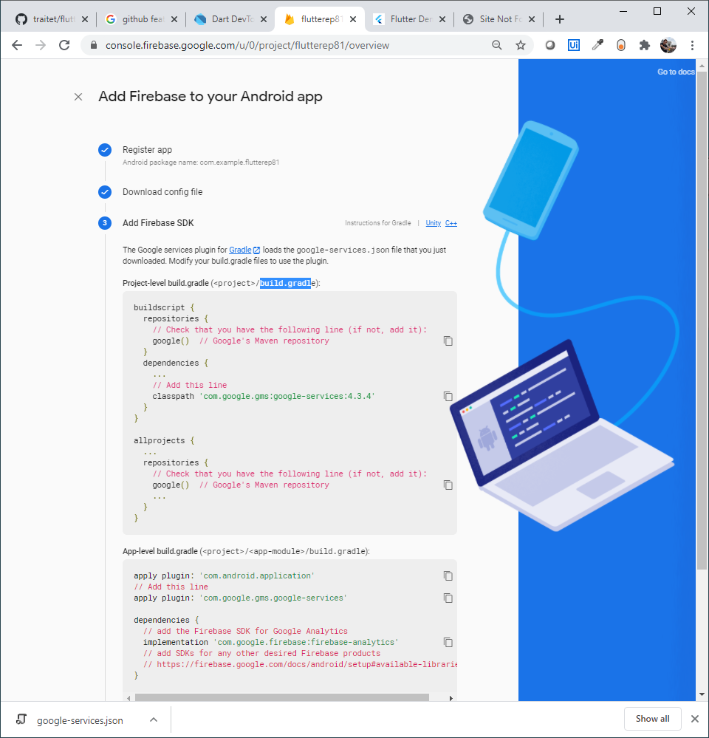
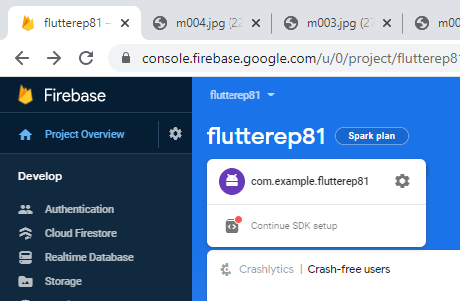
Edit /andriod/app/build.gradle
1
2
Must same as AppName in Firebase
3
4

Slide 15
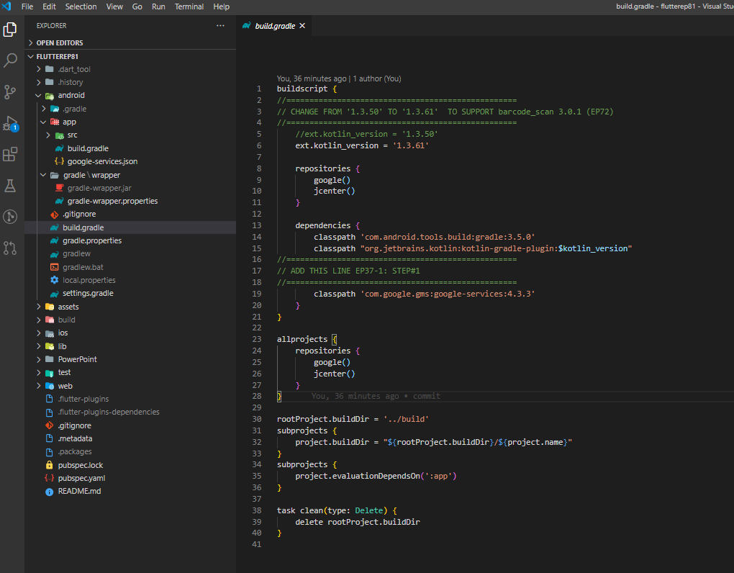
Edit /andriod/build.gradel

Slide 16
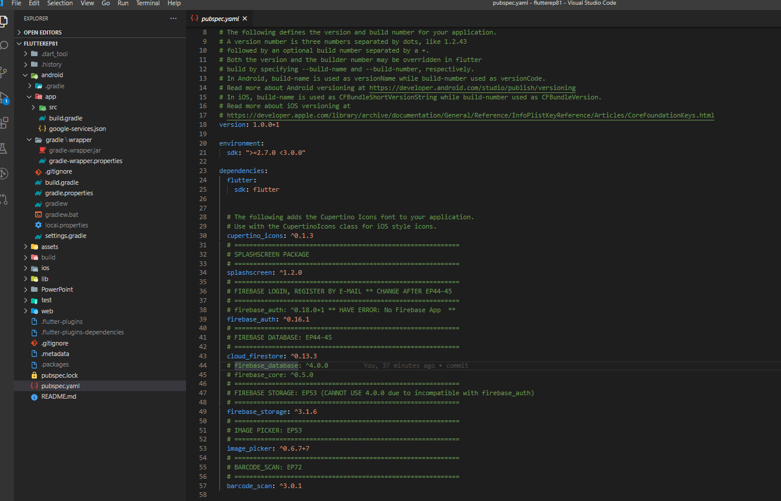
Add packages in pubspec.yaml
Add packages in pubspec.yaml
firebase_authen
cloud_firestore
firebase_storage

Slide 17
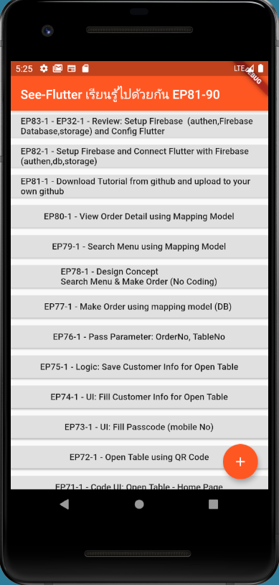
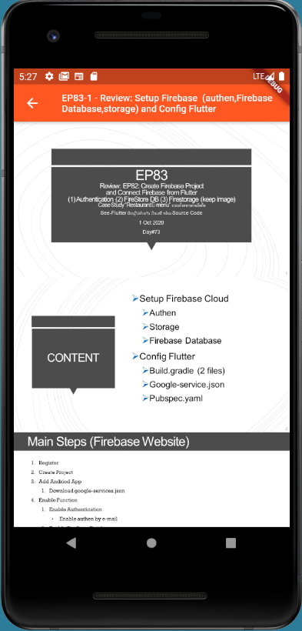
Final UI

