Slide 1
EP84 Test connection: Firebase & Flutter (Authentication Services: Register, Login, SendEmailResetPassword) Case Study “Restaurant E-menu” ระบบสั่งอาหารผ่านมือถือ
See-Flutter เรียนรู้ไปด้วยกัน เรียนฟรี พร้อม Source Code
2 Oct 2020
Day#74

Slide 2
CONTENT
Check Flutter Config
Build.gradle
Google-services.json
Pubspec.yaml
Check Firebase Config
Project, app, authen services
Coding to test Firebase Authentication with Flutter
Check Results
On Flutter
On Firebase Cloud

Slide 3
Key Knowledge
Firebase Cloud
Authentication
Flutter
Create Class
Create static function
Print (OK, error massage)

Slide 4
Coding Steps
Create Services Folder
Create AuthenServices Class
Create Function
registerEmailAccount
loginByEmail
sendEmailResetPassword

Slide 5
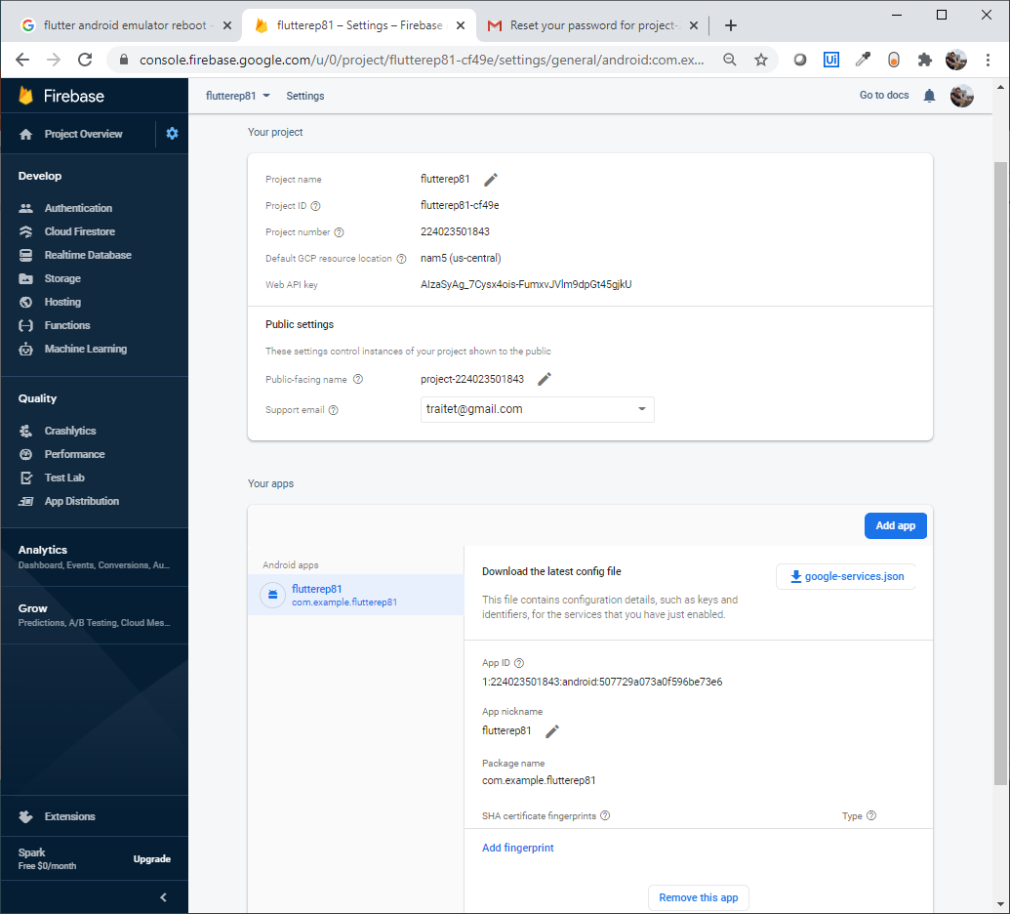
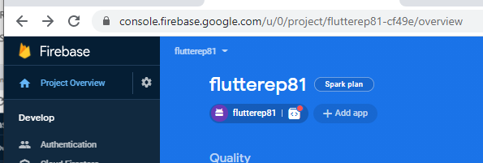
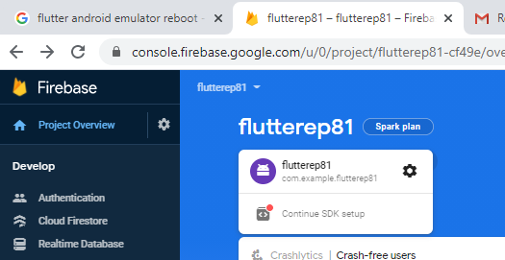
Check config at Firebase Cloud
1. Select your Prject
4. Click Authentication
2. Click here
Check#1 Download and place in flutter
Check#2 Must same in Flutter
3. Click here

Slide 6
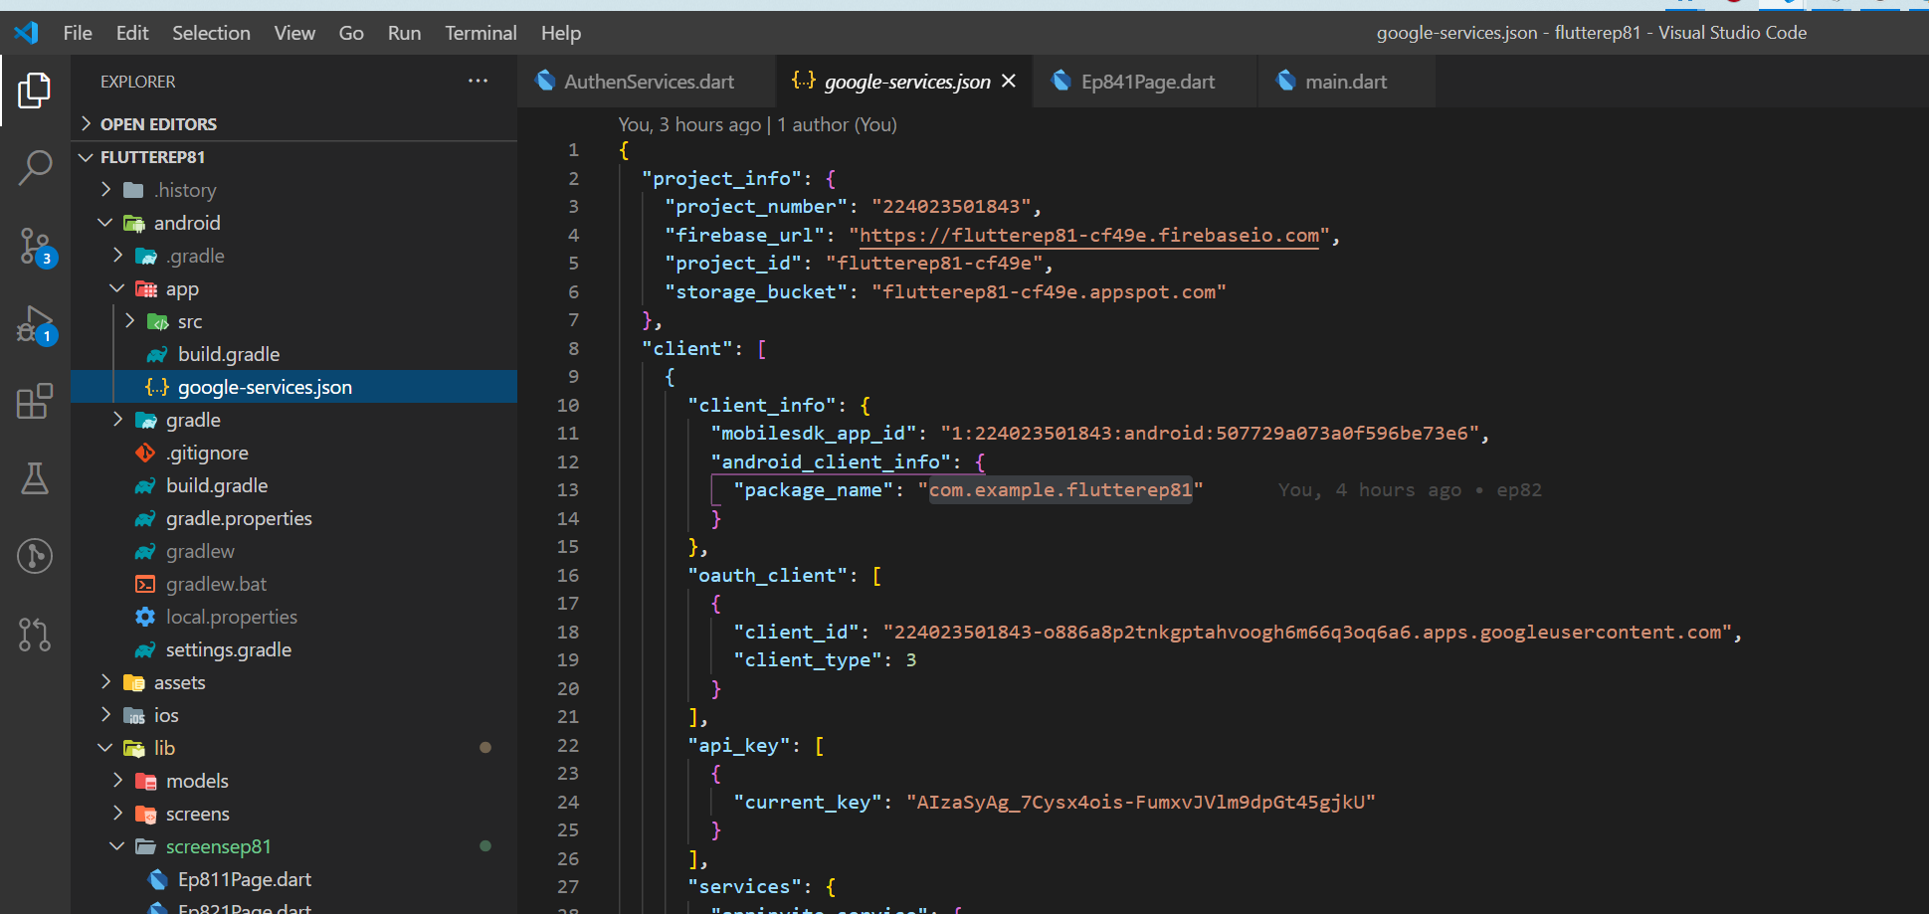
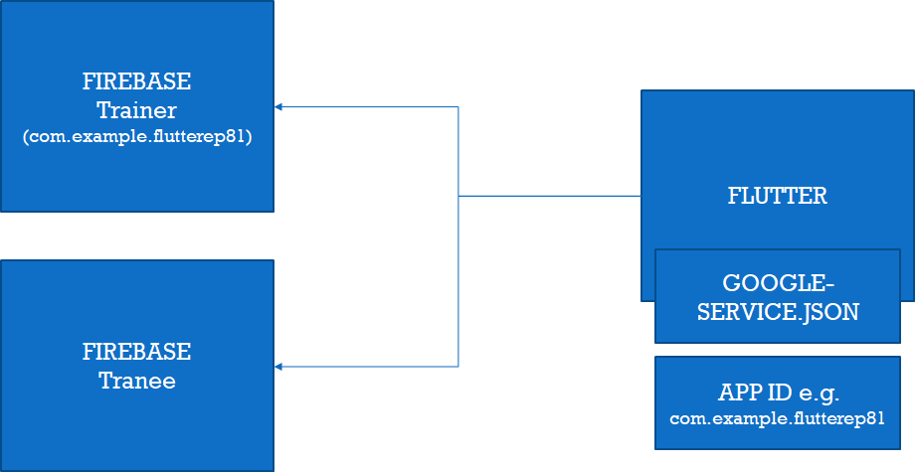
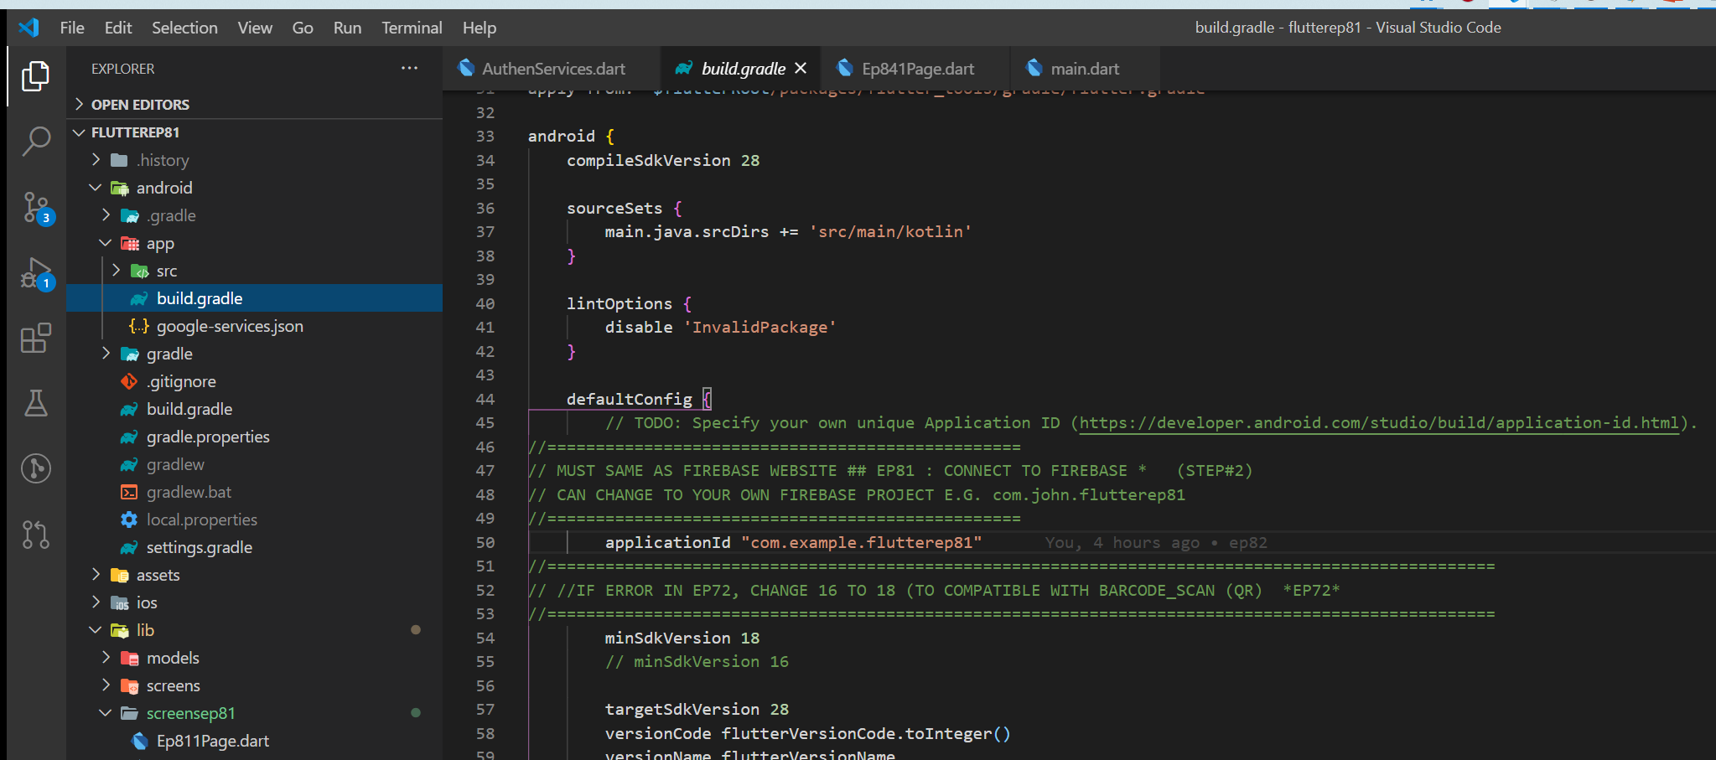
Check config at Flutter
Note
If connect to com.example.flutterep81, data will go to Trainer’s Cloud
If connect to yours, data will go to your cloud
Same in Firebase Cloud
1
2
Same in Firebase Cloud

Slide 7
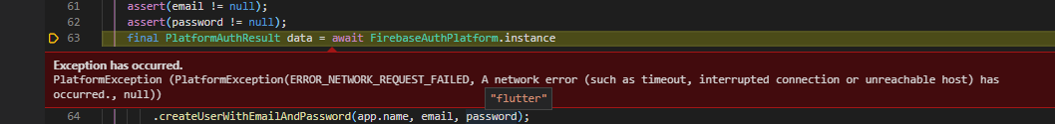
Error “ERROR_NEXTWORK_REQUEST_FAILED)
Solutions
Check google-services file (ok)
Try to run on Andriod device (ok)
Return run on Emulator (error)
Run flutter clean
Turn off and turn on emulator
Build again (ok)

Slide 8
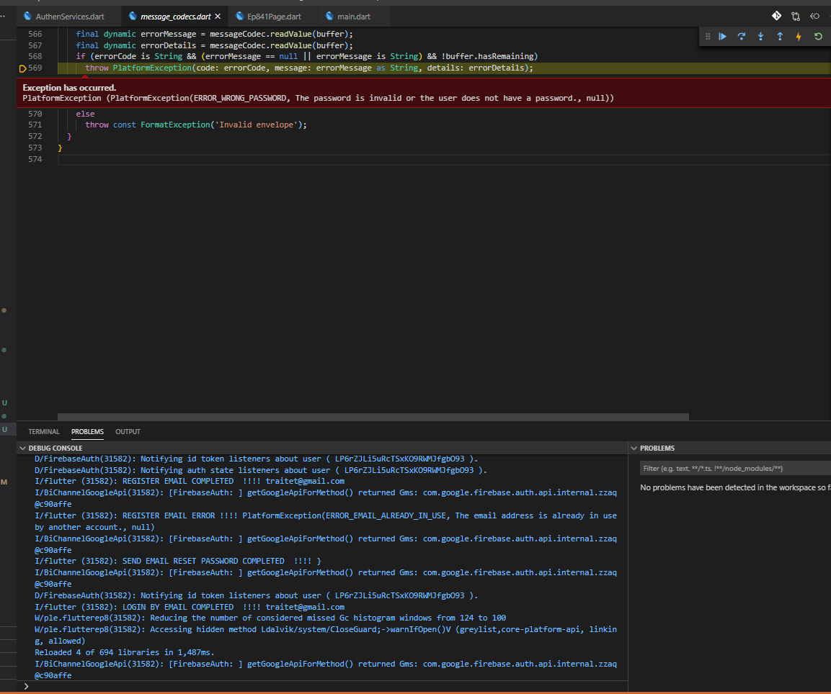
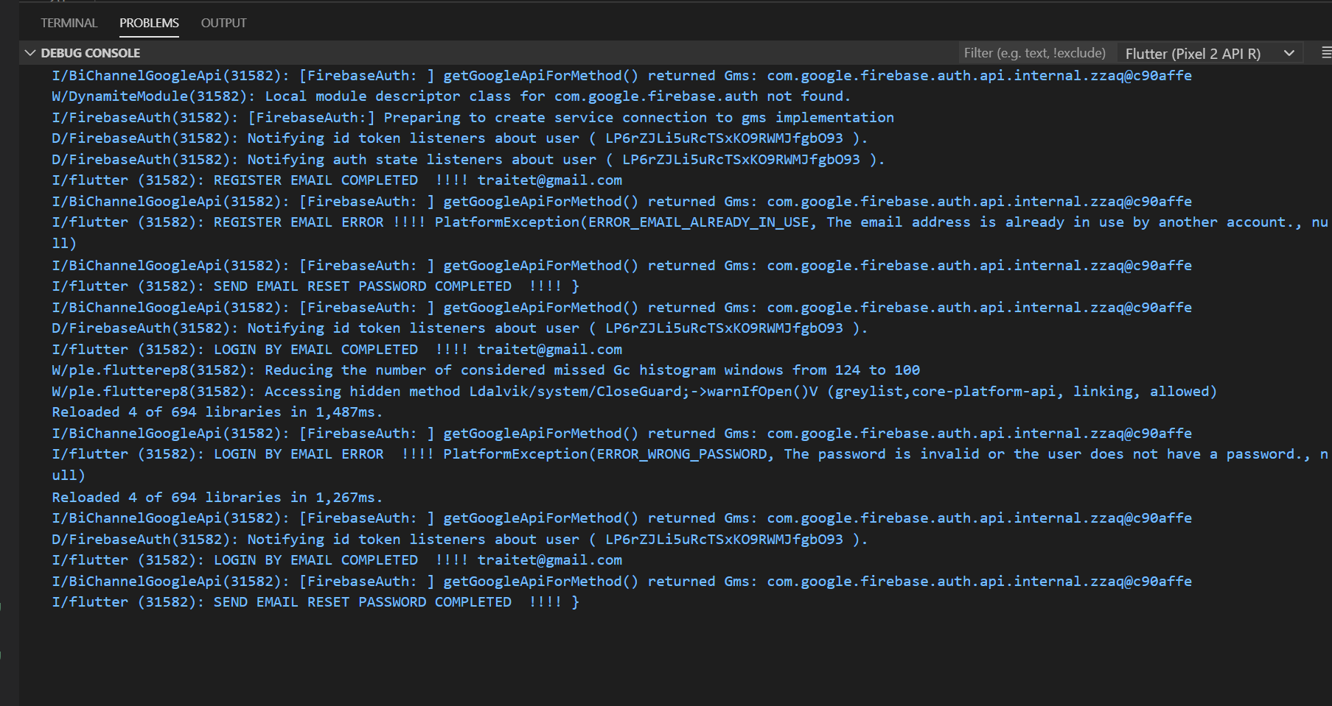
Check Flutter

Slide 9
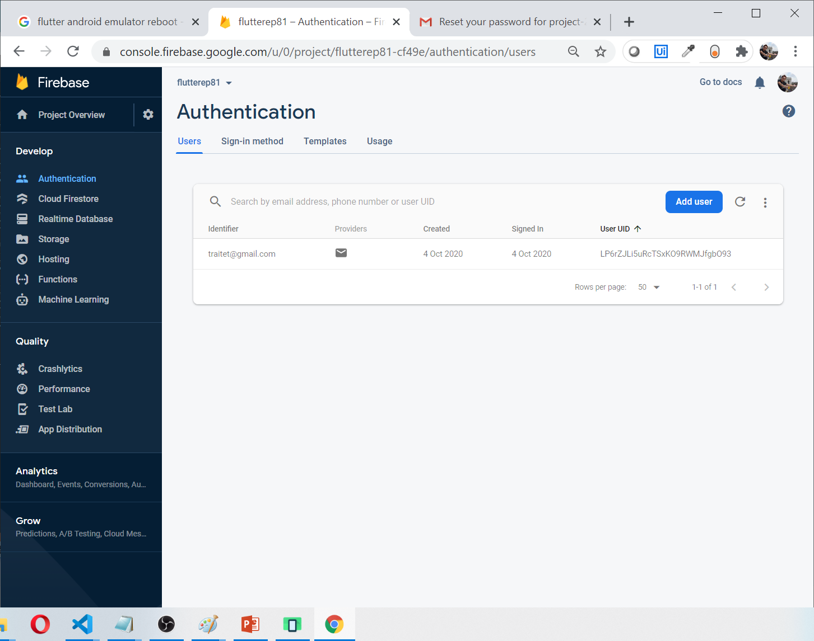
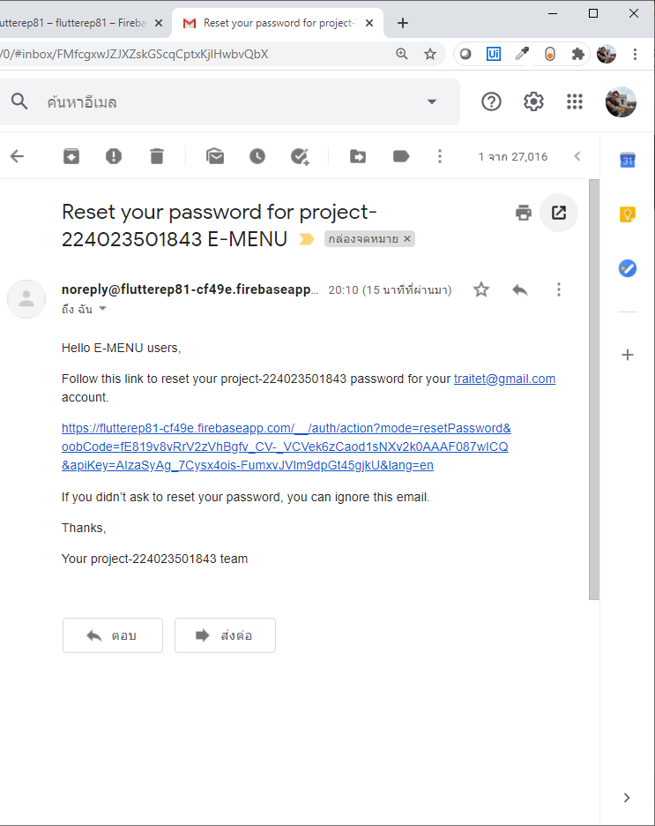
Check Result at Firebase & Your e-mail

Slide 10
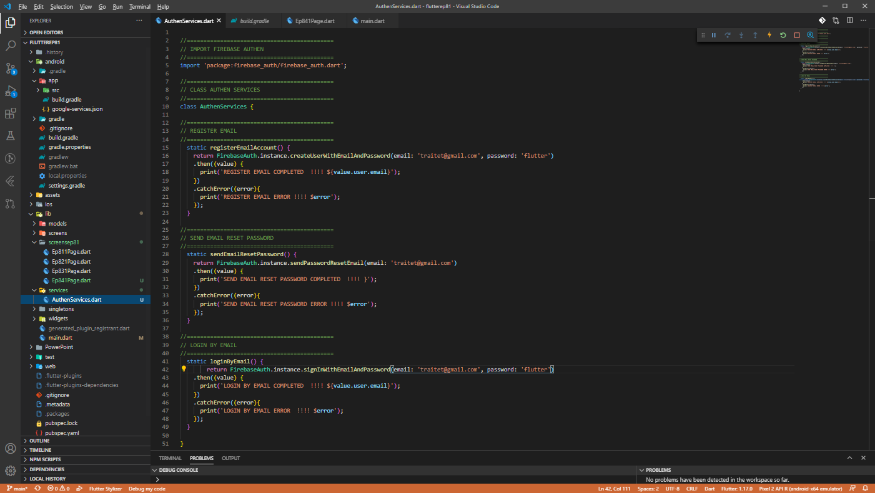
Coding

Slide 11
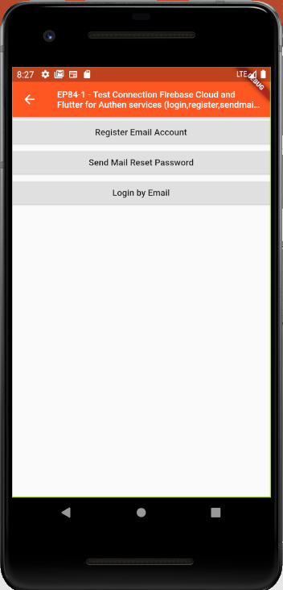
Final UI

