Slide 1
EP85 Test connection: Firebase & Flutter (FireStore Database: Write Data and Read Data) Case Study “Restaurant E-menu” ระบบสั่งอาหารผ่านมือถือ
See-Flutter เรียนรู้ไปด้วยกัน เรียนฟรี พร้อม Source Code
3 Oct 2020
Day#75

Slide 2
CONTENT
Coding to mantipulate database (Write and Read Data to Database)
Check Results
On Flutter
On Firebase Cloud

Slide 3
Key Knowledge
Firebase Cloud
FireStore Database
Flutter
Create Class
Create static function
Print (OK, error massage)

Slide 4
Coding Steps
Create DatabaseServices Class in Services folder
Create Function
writeDB
readDB

Slide 5
Coding
Write data to FireStore Database
Firestore.instance.collection('TT_TESTS').document('D001').setData({'id':001, 'name':'traitet'})
Read data from FireStore Database
Firestore.instance.collection('TT_TESTS').document('D001').get().then((value)

Slide 6
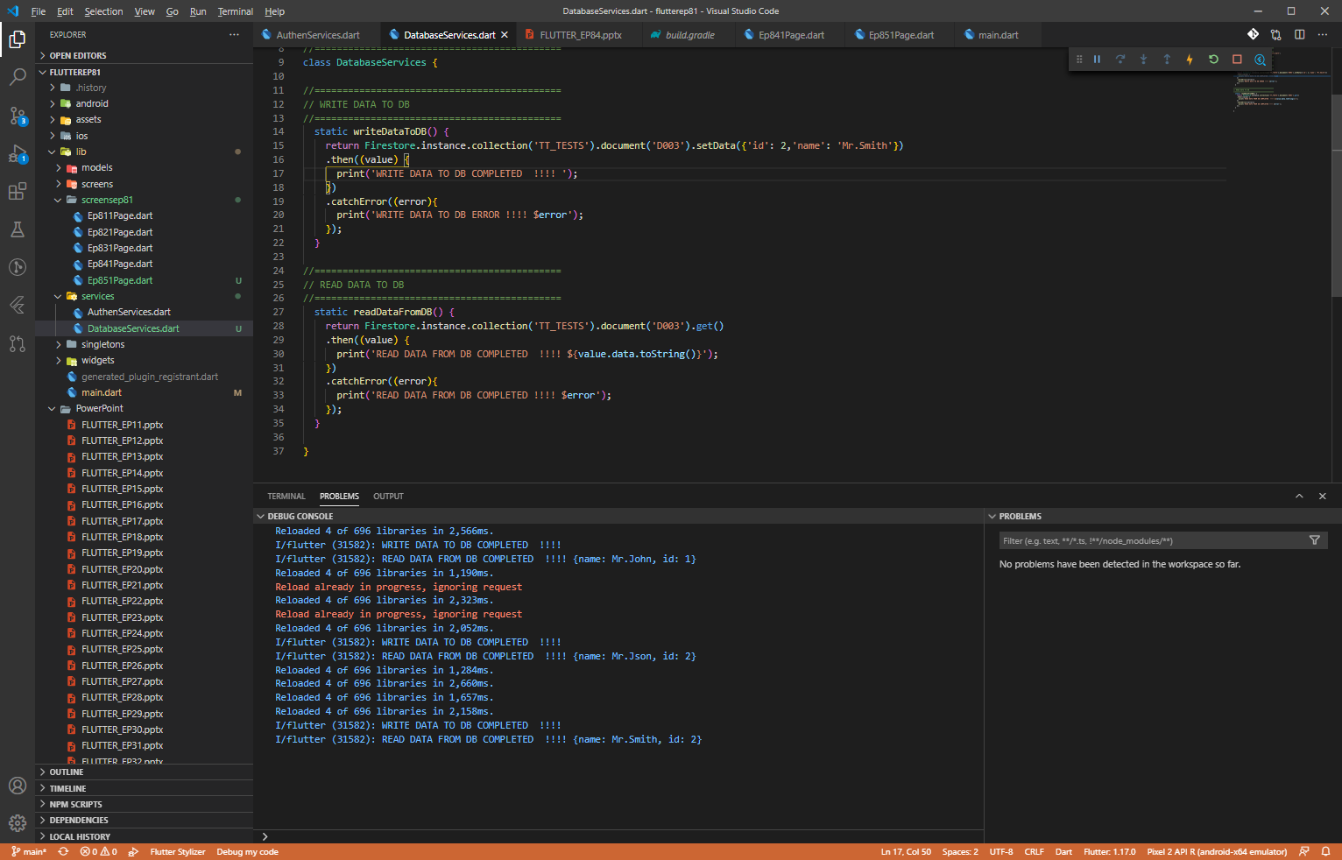
Coding

Slide 7
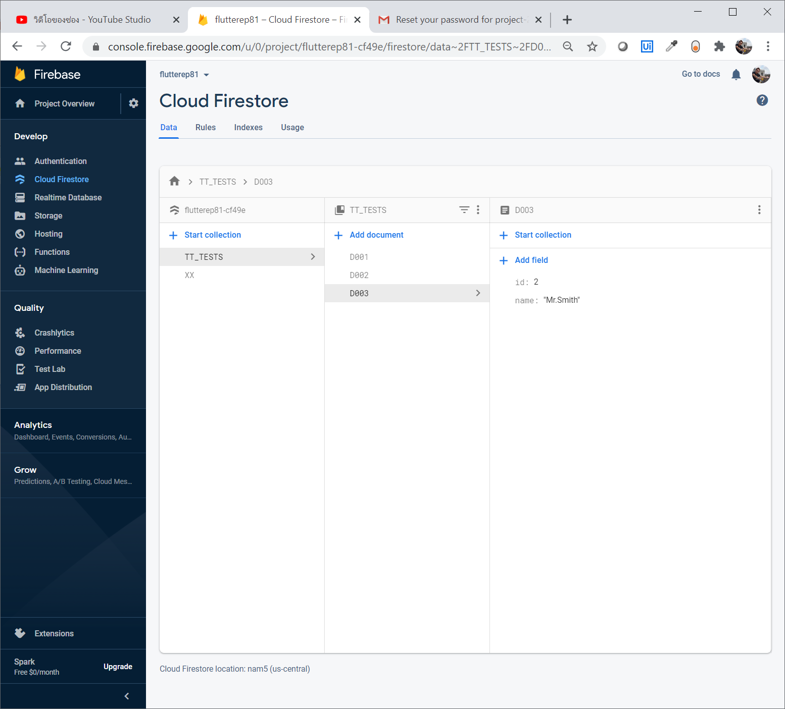
Check data in Firebase Cloud (FireStore)

Slide 8
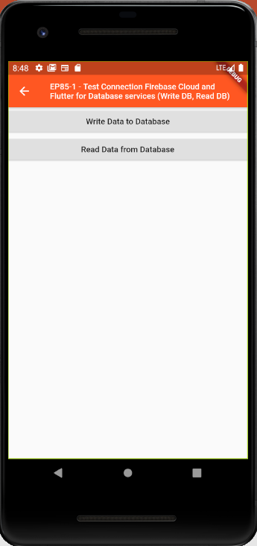
Final UI

