Slide 1
EP86 Test connection: Firebase & Flutter (Firebase -Storage: upload file) Case Study “Restaurant E-menu” ระบบสั่งอาหารผ่านมือถือ
See-Flutter เรียนรู้ไปด้วยกัน เรียนฟรี พร้อม Source Code
4 Oct 2020
Day#76

Slide 2
CONTENT
Coding to upload file to Google Firebase Storage
Check Results
On Flutter
On Firebase Cloud

Slide 3
Key Knowledge
Firebase Cloud
Firebase Storage Services
Flutter
Image Picker
File (dart.io)
Create Class
Create static function
Print (OK, error massage)

Slide 4
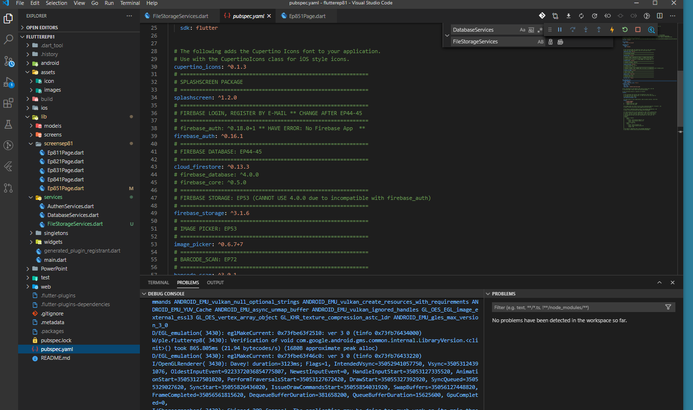
Pubspec.yaml
FIREBASE_STORAGE
IMAGE_PICKER

Slide 5
Coding Steps
Create FileStorageServices Class in Services folder
Create Function
writeFile

Slide 6
Coding
Function
static writeFileToStorage({File file}) async {
StorageReference storageRerference = FirebaseStorage.instance.ref().child('testimage').child(myPath.basename(_image.path));
StorageUploadTask uploadTask = storageRerference.putFile(file);
await uploadTask.onComplete;
await storageRerference.getDownloadURL().then((value) {
print(value.toString());
});

Slide 7
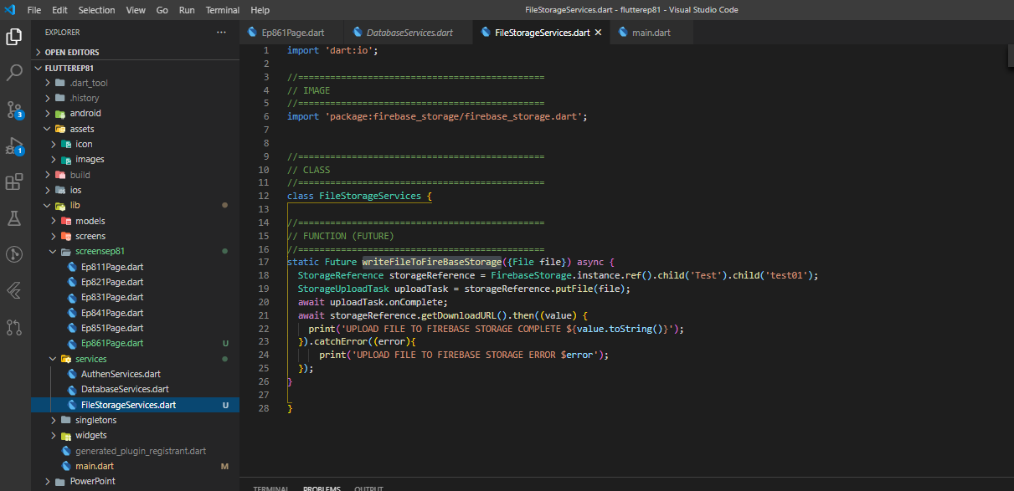
Coding – File Storage Services

Slide 8
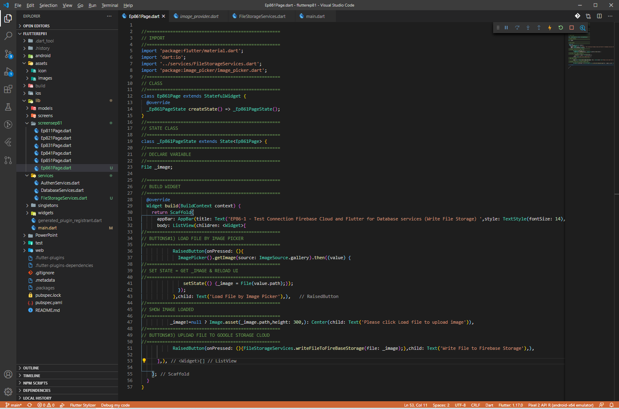
Coding – IMAGE PICKER

Slide 9
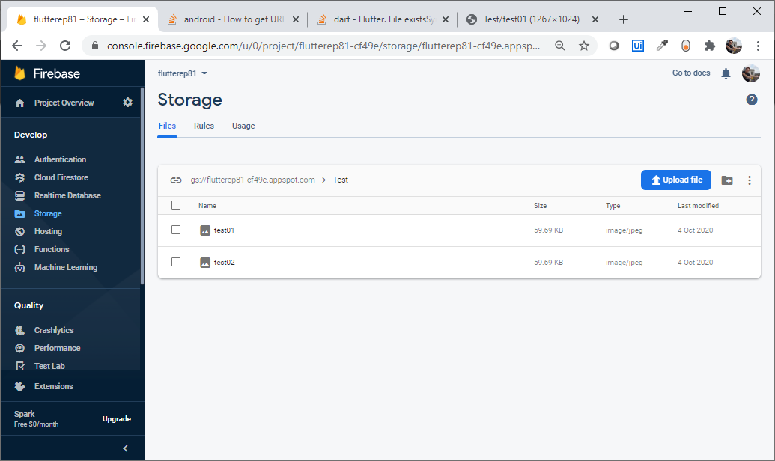

Check data in Firebase Cloud (Storage)
UPLOAD FILES

Slide 10
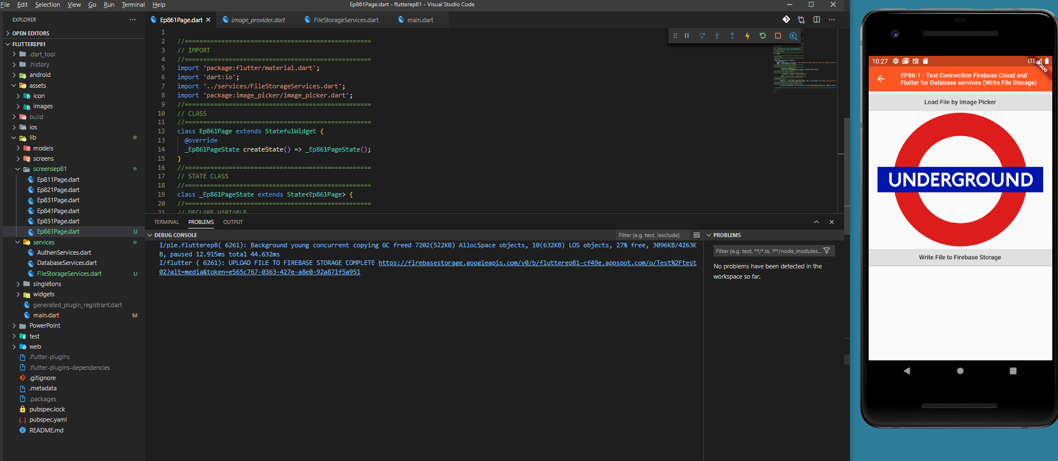
Check Upload in Flutter
UPLOAD FILES COMPLETED AND RETURN URL

Slide 11
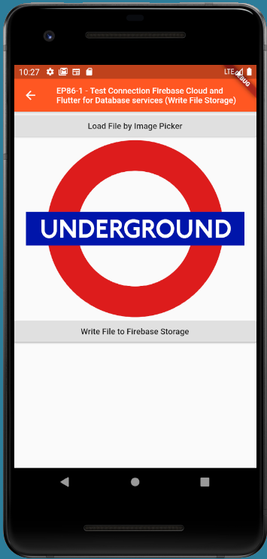
Final UI

