Slide 1
EP87 Save and Search Food Menu to DB using model mapping Case Study “Restaurant E-menu” ระบบสั่งอาหารผ่านมือถือ
See-Flutter เรียนรู้ไปด้วยกัน เรียนฟรี พร้อม Source Code
5 Oct 2020
Day#77

Slide 2
CONTENT
Coding MenuModel
Coding MenuServices
saveMenu(menuModel)
getMenusByCategory(menuCategoryValue)
getMenu(menuId)

Slide 3
Key Knowledge
Write data to Firestore (DB)
Get data from Firestore (DB)
Snapshot -> many documents (records)
Object (Model) -> one document (record)
Make services class with static functions
Coding static function
Coding calling static function

Slide 4
Coding Step
MODEL
Menu Model
Properties
Constucture
ToFireStore
FromFireStore
UI
SERVICES
Static Function#1
Static Function#2
Static Function#3

Slide 5
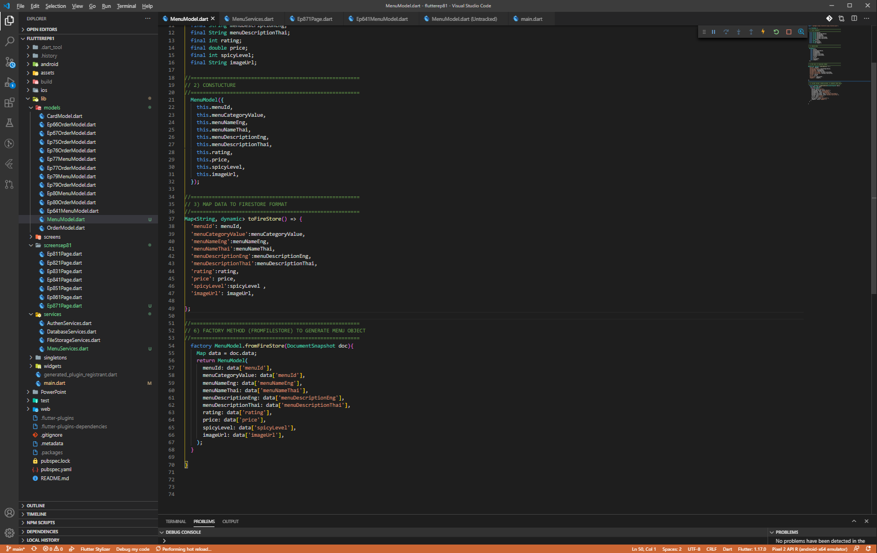
Mapping Model (Flutter-object & Firestore-data)

Slide 6
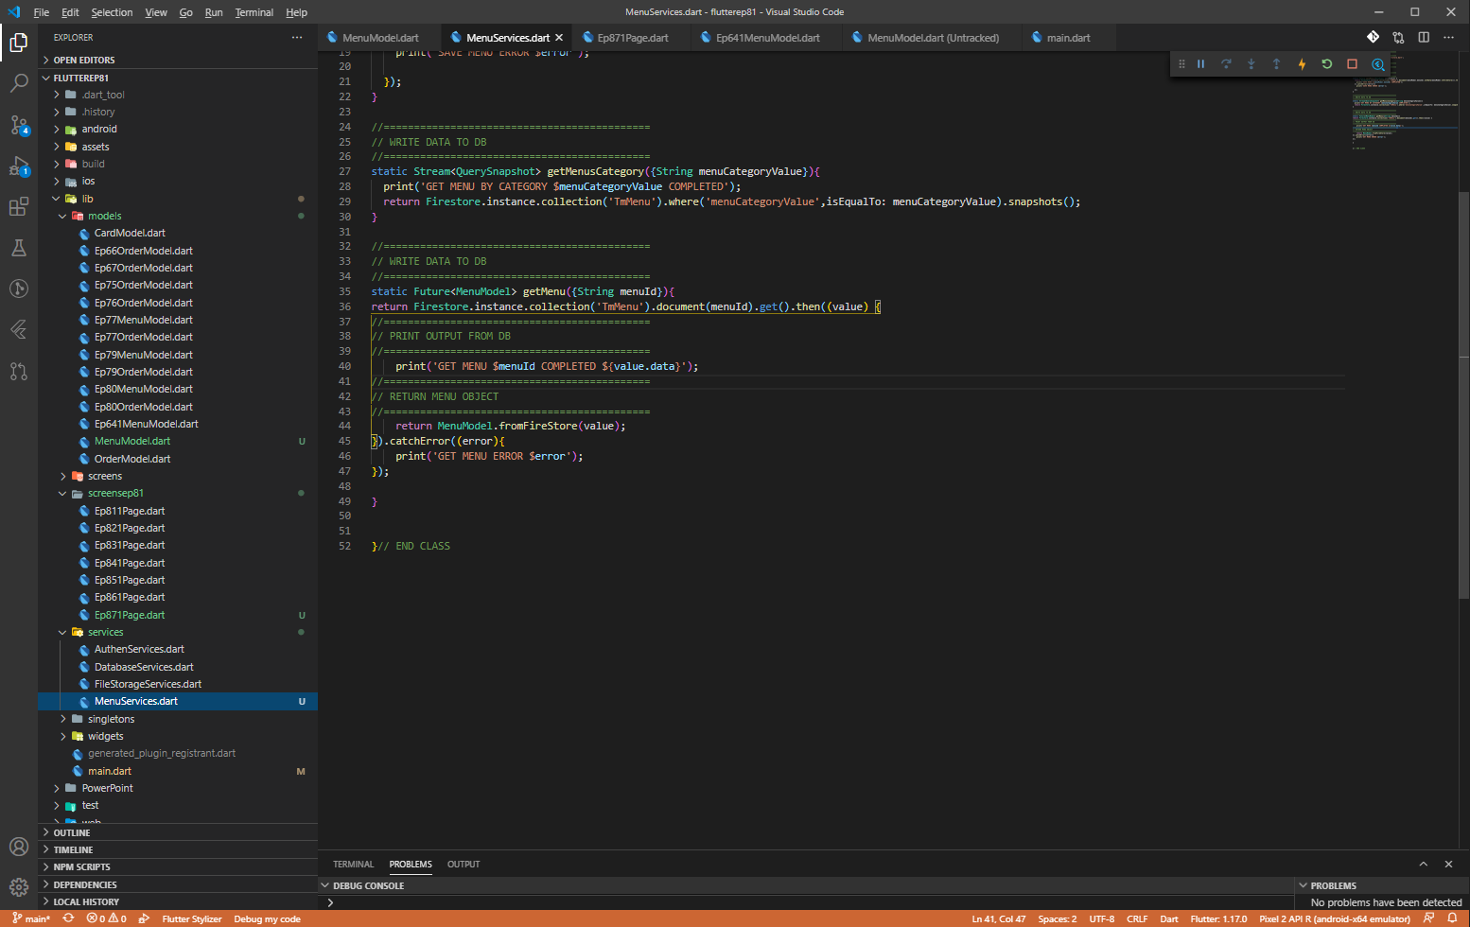
Services (MenuServices)

Slide 7
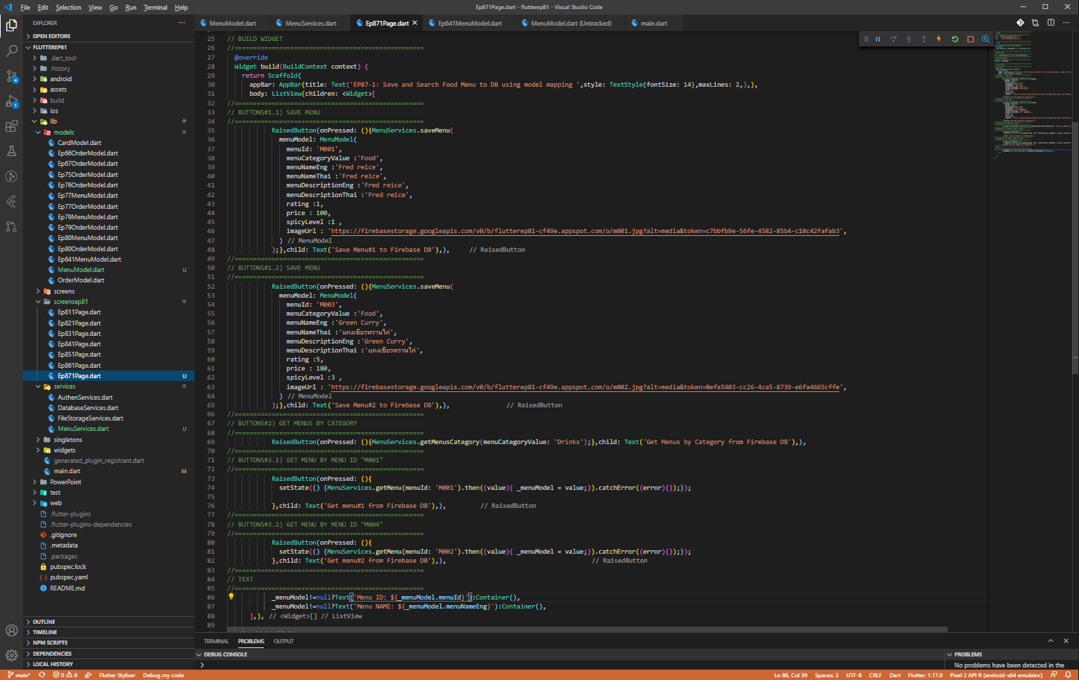
UI

Slide 8
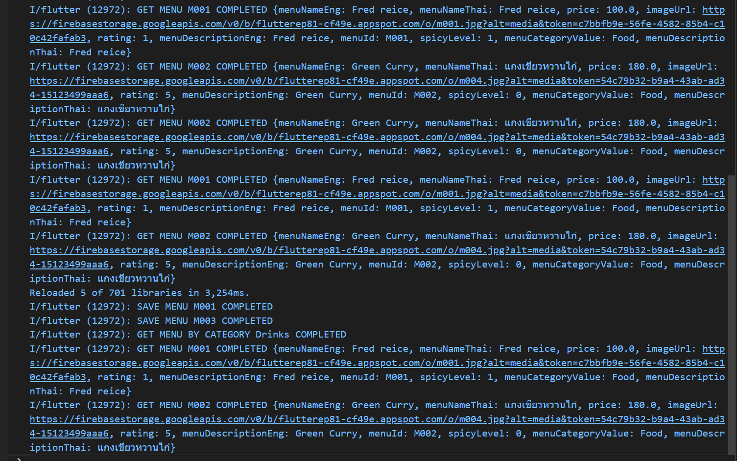
Print Output
VS Code View, Teminal

Slide 9
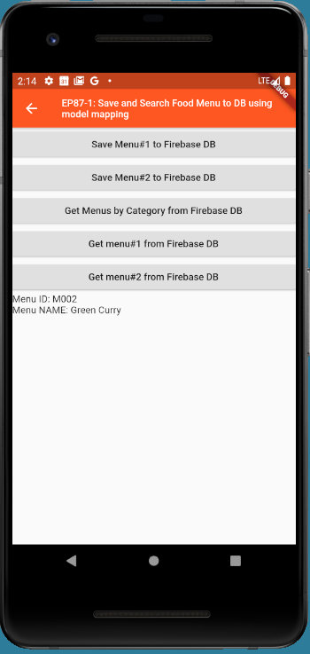
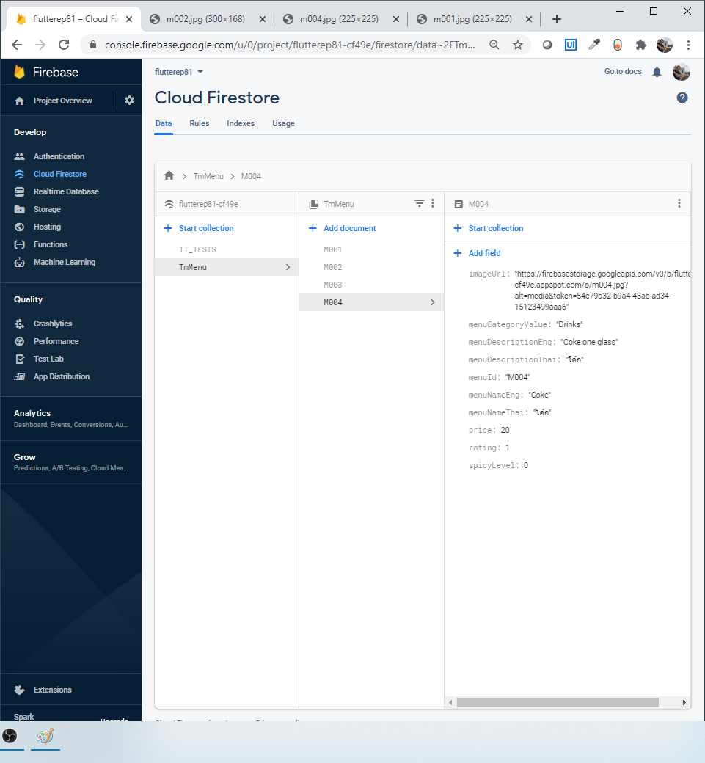
Final UI & Database

