Slide 1
EP88 BottomNavigationBar in Make Order Screen Case Study “Restaurant E-menu” ระบบสั่งอาหารผ่านมือถือ
See-Flutter เรียนรู้ไปด้วยกัน เรียนฟรี พร้อม Source Code
6 Oct 2020
Day#78

Slide 2
CONTENT
Review UI
Coding Concept
Coding

Slide 3
Key Knowledge
BottomNavigationBar
StatefulWidget
SetState
StatelessWidget

Slide 4
Stateless and Stateful Widget
Compared | Stateless Widgets | Stateful Widgets | Remark
Can change state | No (build UI one time) | Yes (can rebuild) | Use setState to rebuild UI
Dynamic UI (Redraw UI) | No | Yes
setState | No | Yes | Run command inside & reload UI
initState | Cannot | Can | 1st Run
Stateless Widget e.g. Text, Row, Column -> Only show & No interaction
Stateful Widget e.g. dropdown, TextField, CheckBox

Slide 5
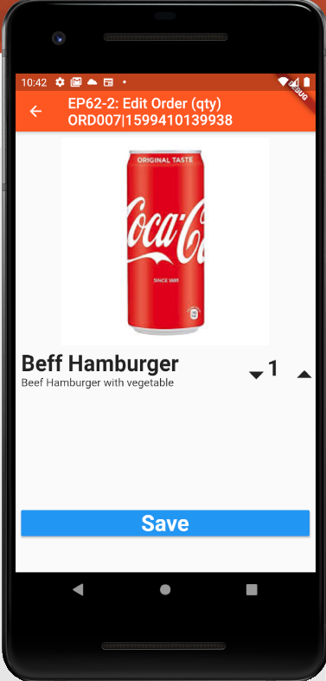
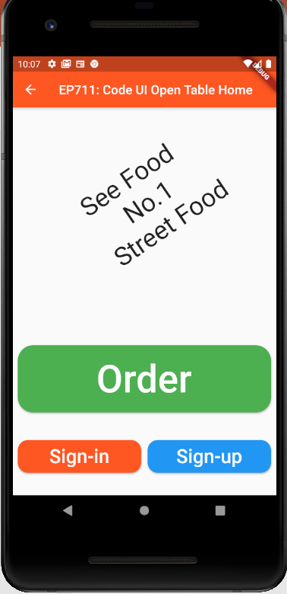
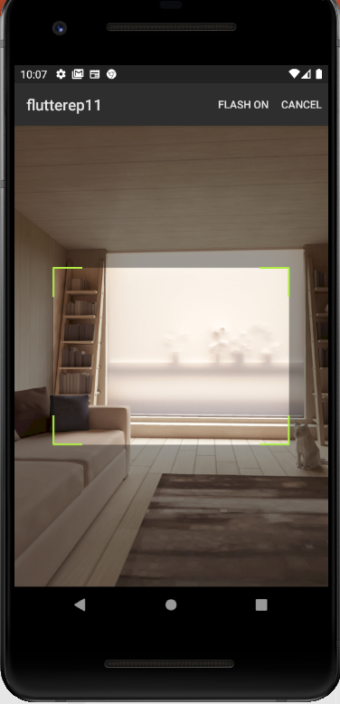
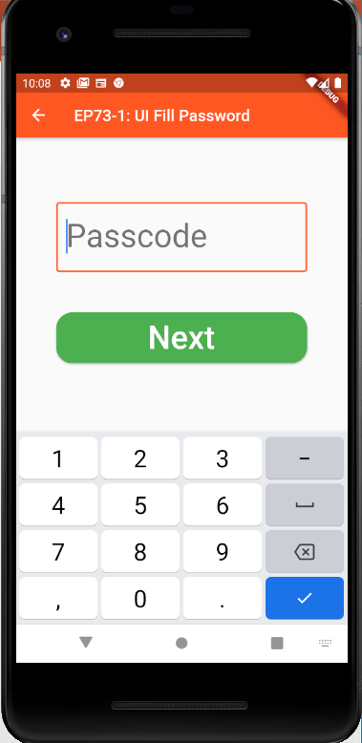
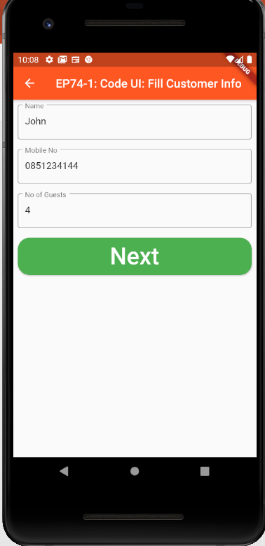
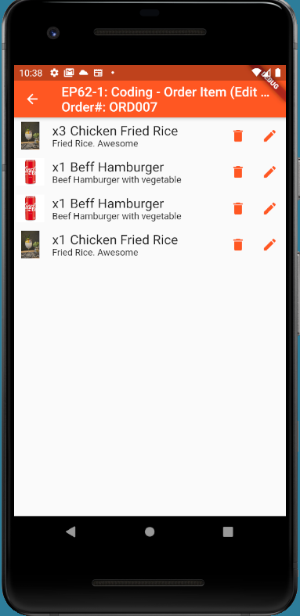
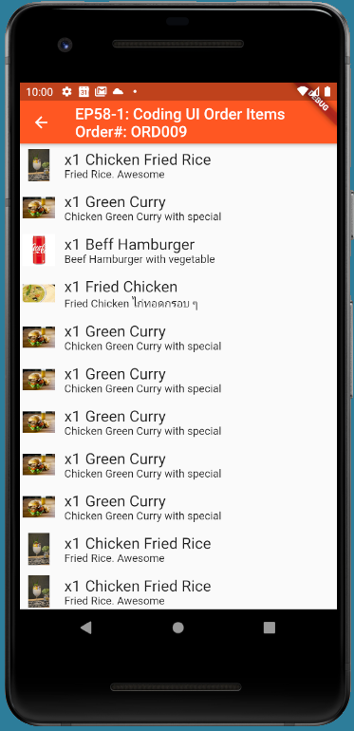
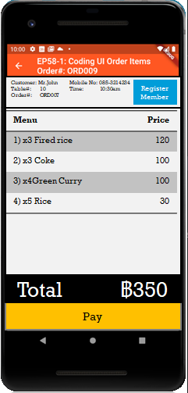
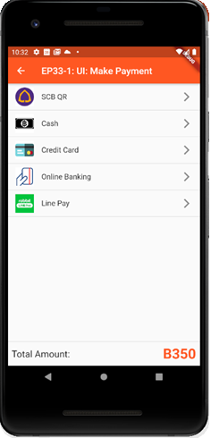
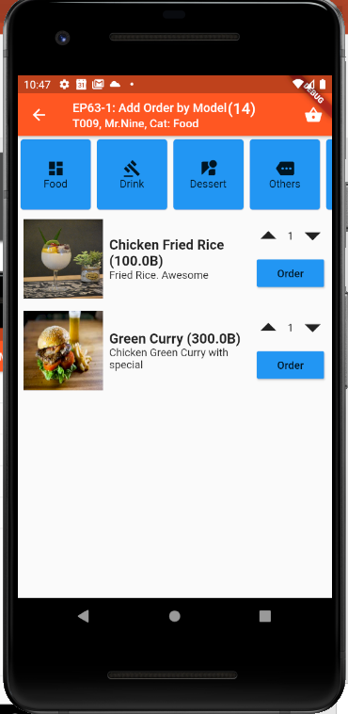
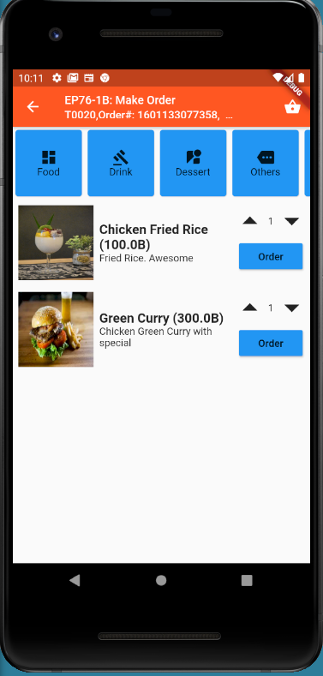
Overall UI Design
TT_ORDERS
SCAN QR
TM_TABLES
Scan QR
EP75
EP71
EP72
EP73
EP74
GlobalAppData (Singleton)
tableNo
orderNo
EP76
Ordering
Menu ID
Ordering
Sent
Sent
Cooking
Cooking
EP87
TT_ORDERS
listOrderItem
Served
Served
Served
Order(14)
Status
Payment
More
Order
Send Order
Served
Served
EP77
EP78
EP79
EP80

Slide 6
UI Design & Coding Steps
Scaffold
AppBar
BottomNavigationBar
Type: ButtomNavigationBar.fixed
onTab  change _tabIndex
currentIndex: 0,1,2,3
Items: [Tab#1, Tab#2, Tab#3, Tab#4]
Body
_tabIndex == 0 ? Tab#1
_tabIndex == 1 ? Tab#2
_tabIndex == 2 ? Tab#3
_tabIndex == 3 ? Tab#4
StatelessWidget
Tab#1
Tab#2
Tab#3
Tab#4
Order(14)
Status
Payment
More

Slide 7
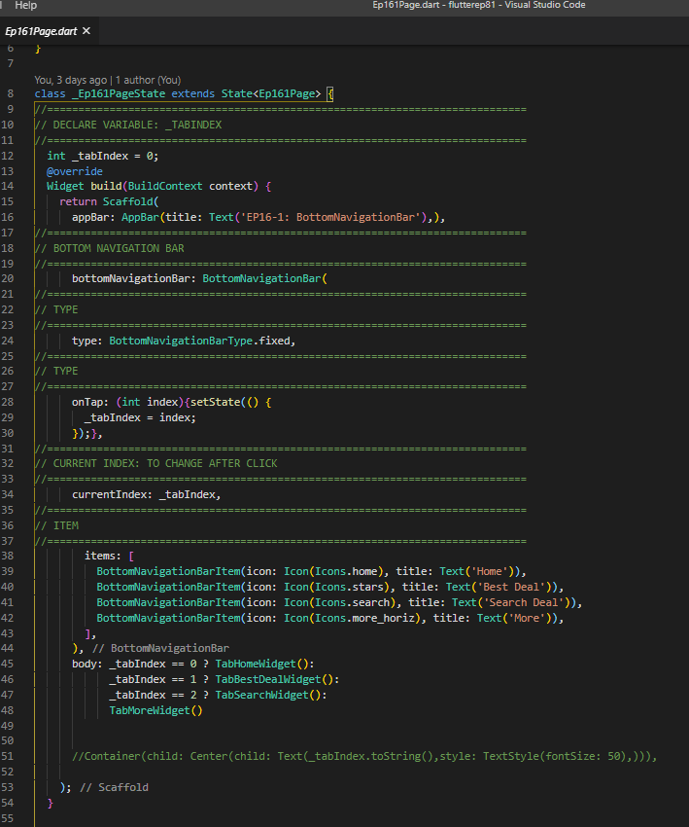
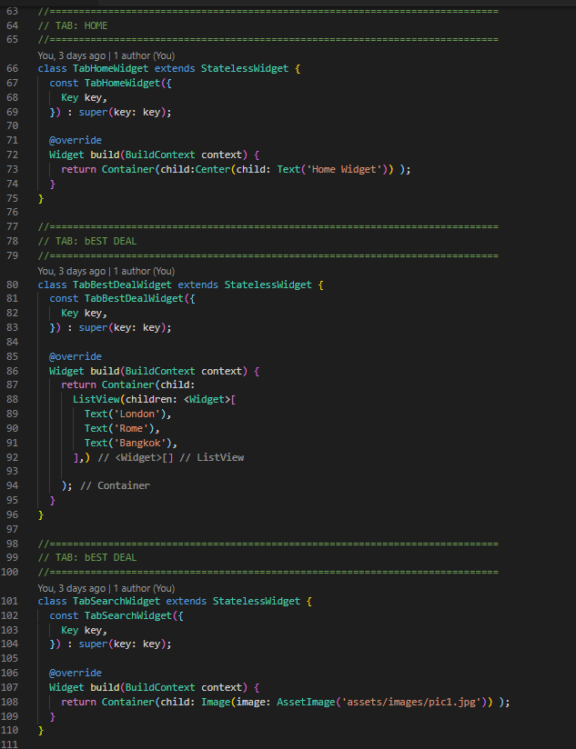
Coding
buttomNavigationBar in scaffold
Stateless Widget

Slide 8
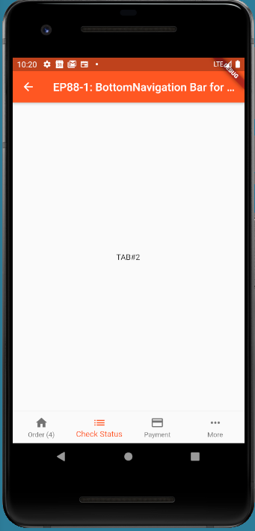
Final UI
Order(14)
Status
Payment
More

