Slide 1
EP89 UI maintain Food Menu (new,update) & Save Menu to Firestore Database by MenuServices class Case Study “Restaurant E-menu” ระบบสั่งอาหารผ่านมือถือ
See-Flutter เรียนรู้ไปด้วยกัน เรียนฟรี พร้อม Source Code
7 Oct 2020
Day#79

Slide 2
CONTENT
Review UI
Coding Concept
Coding: UI, Logic (Save Menu to DB)

Slide 3
Key Knowledge
Widget
Column, Row, ListView, Expanded
Image
Variable
TextEditController
Generate code by VS Code
Generate Widget Class
Pass parameter to Widget Class
Wrap column, row

Slide 4
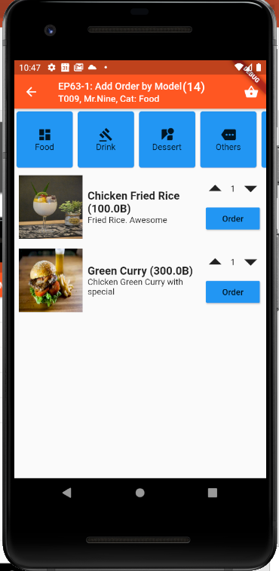
UI Design
Column
Column#1: Expand: ListView
Column#1
Row#1: Image
Row#2
Column#1
Column#2
Column#2
Column#3
Column#4
Column#5
Column#2: Button
Menu#
Price
Menu Category
Name Eng
Name Thai
Desc Eng
Desc Thai
New Menu
Submit

Slide 5
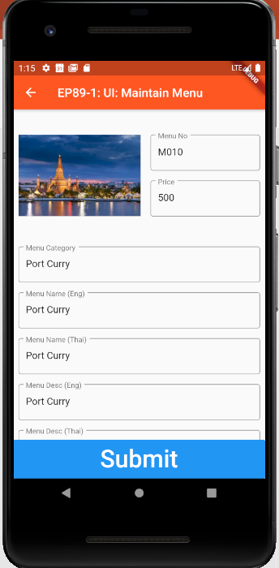
Final UI

Slide 6
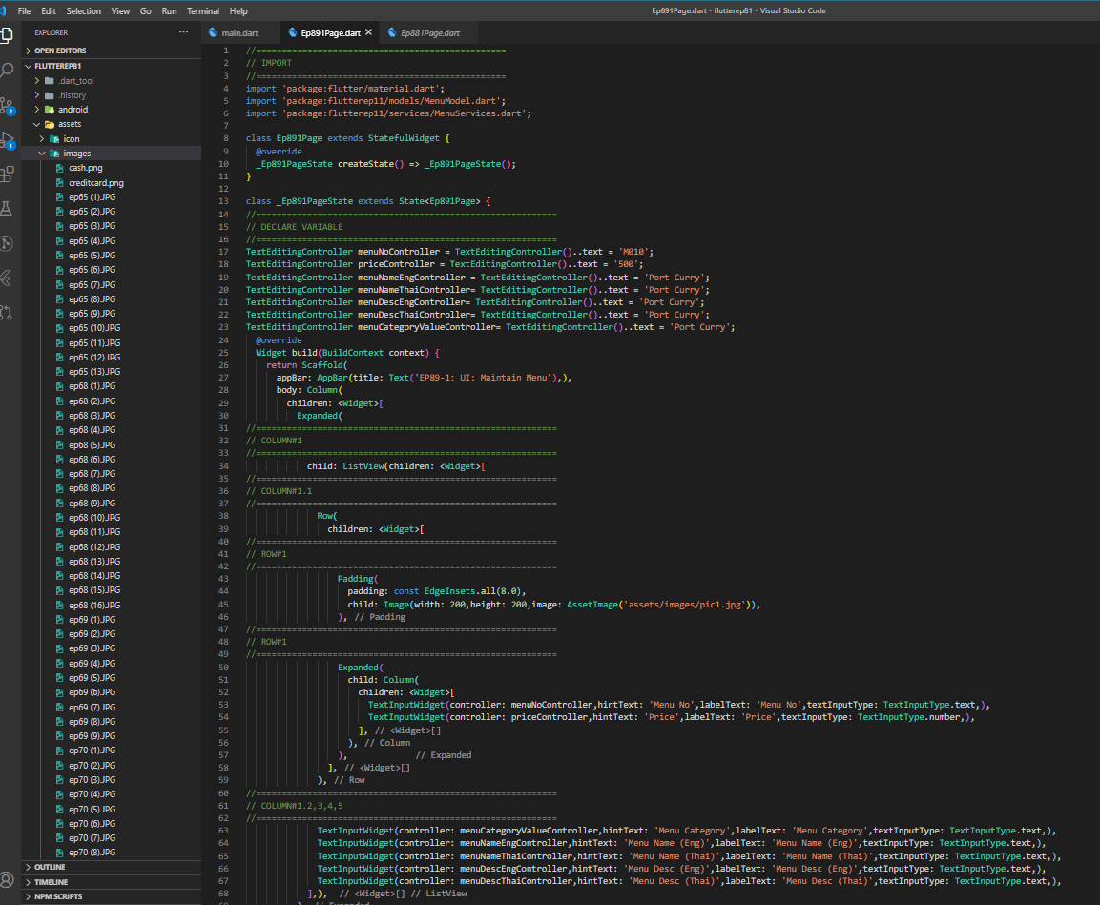
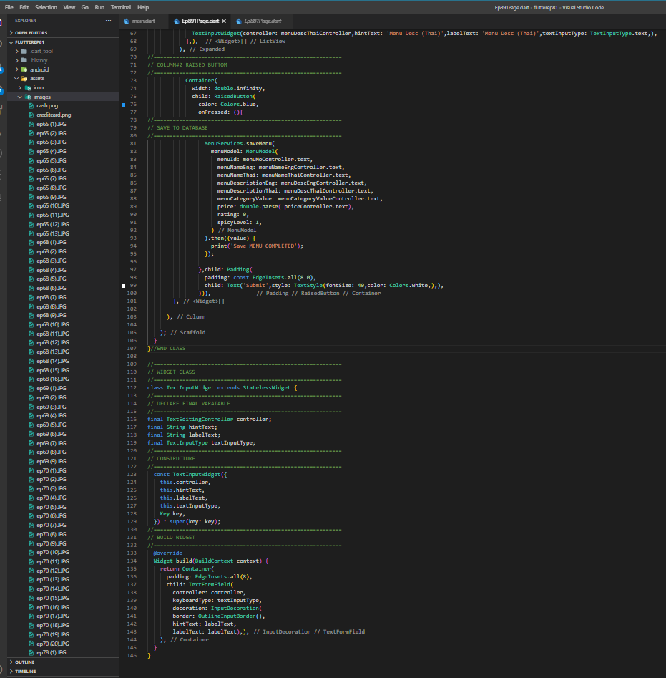
Coding UI and Call Service to save menu
Create UI
Widget Class
“Call Menu Services Class”
“Call Widget”
“Widget Class”

Slide 7
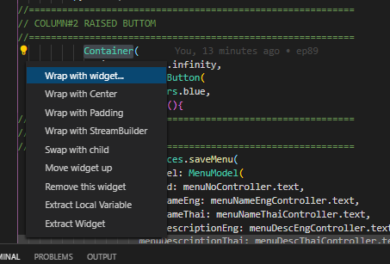
Auto generate Code and remove code
Right click at yellow light

