Slide 1
EP90 UI maintain Food images & upload to Firebase Storage and Firestore database Case Study “Restaurant E-menu” ระบบสั่งอาหารผ่านมือถือ
See-Flutter เรียนรู้ไปด้วยกัน เรียนฟรี พร้อม Source Code
8 Oct 2020
Day#80

Slide 2
CONTENT
Review UI
Coding Concept
Coding: UI
Coding Logic (Save image & database)

Slide 3
Key Knowledge
Widgets
Row, Column, Stack
BoxDecoration, DecorationImage
ImagePicker
FlatButtom
Upload data to Firebase Storage
Upload data to FireStore
Return Future Function
Await & Async

Slide 4
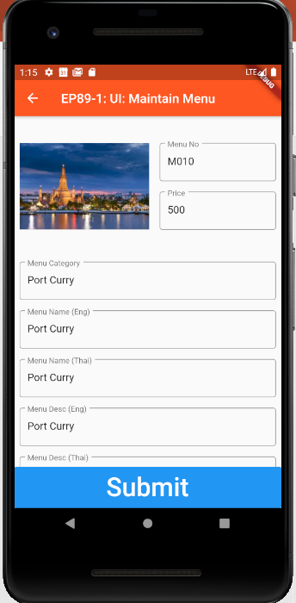


Coding Concept (UI)
File _image = null
No Image
Container
BoxDecoration
Column
Column#1: IconButton
Column#2: Text
Delete
Change
Have Image
Alread Pick
Stack
Alignment = bottomCenter
Stack#1: Image
Stack#2: Row
Row#1: FlatButtom:Delete
Row#2: FlatButtom:Change
File _image != null

Slide 5
Coding Concept (Flutter)
Submit | Description
SetState | Run command inside and reload UI
BoxDecoration in Container | border borderRadius Image
DecorationImage | Image borderRadius
Future<String> | Asyn Function & return String
Await | Wait until finish
.then | After Future function finished

Slide 6
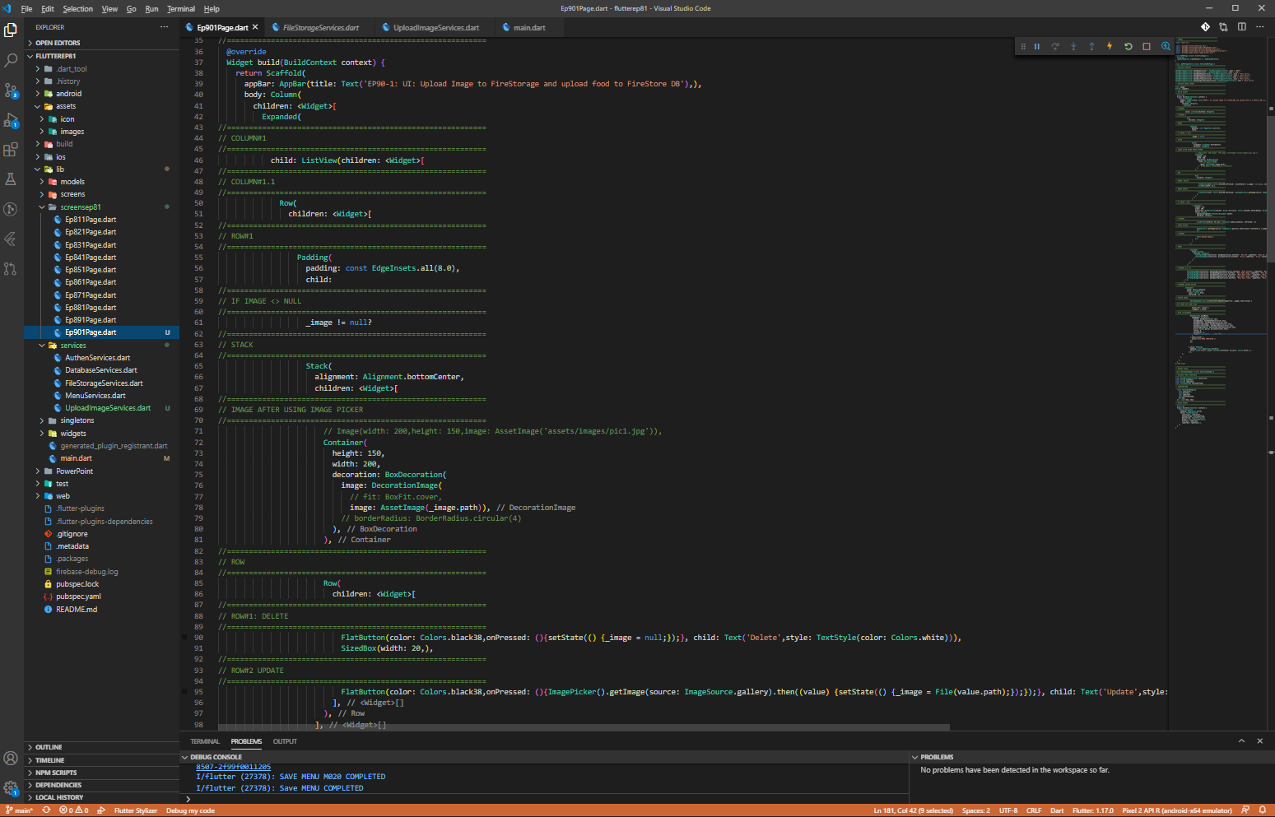
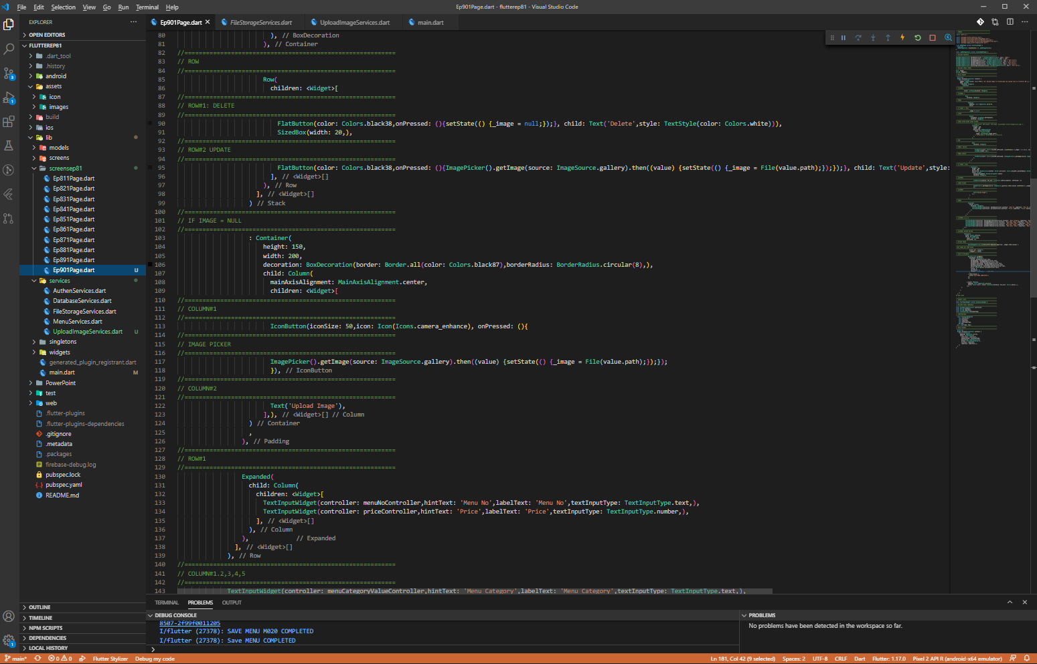
Source Code (UI)
ImagePicker
Stack
Stack#1
Stack#2

Slide 7
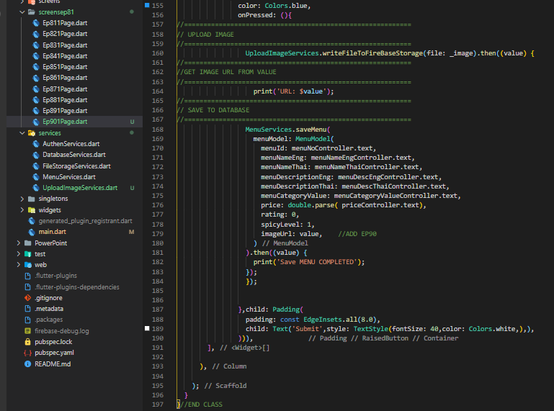
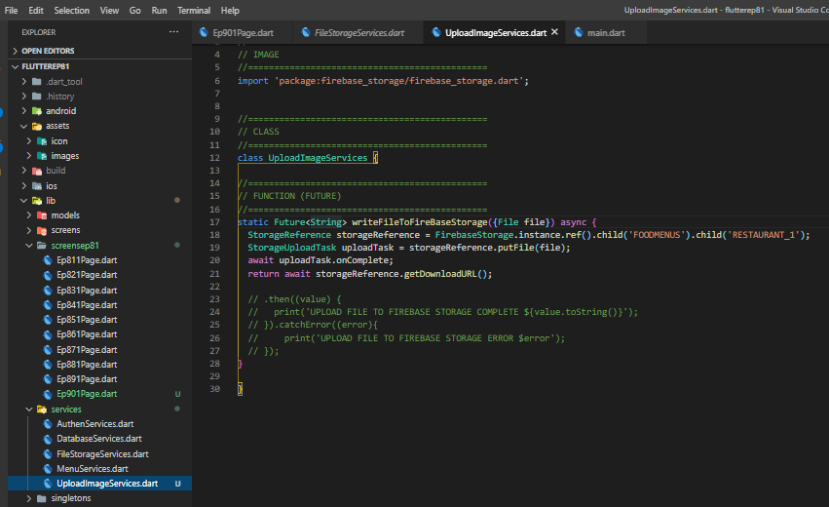
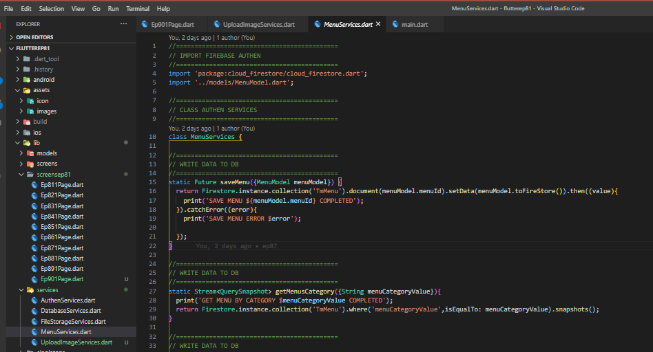
Coding Logic
1
2
3
4
Function UploadImage (Future = Asyn Function)
Upload File -> Save to DB

Slide 8
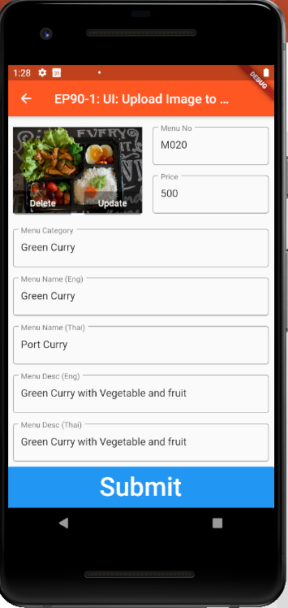
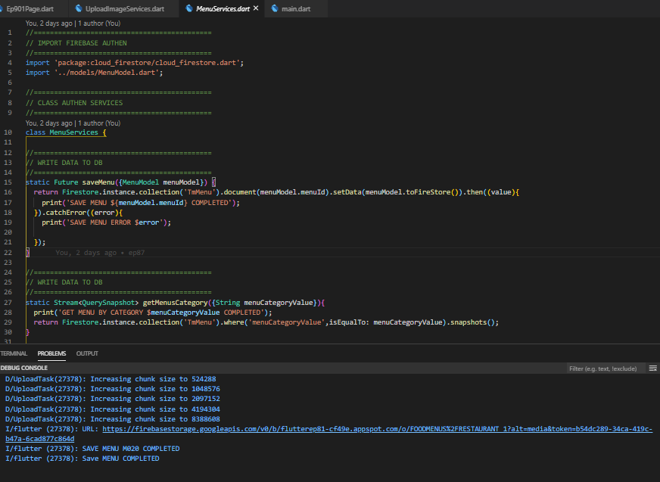
Final UI
Upload Image (completed -> Save to Database with image URL )

Slide 9
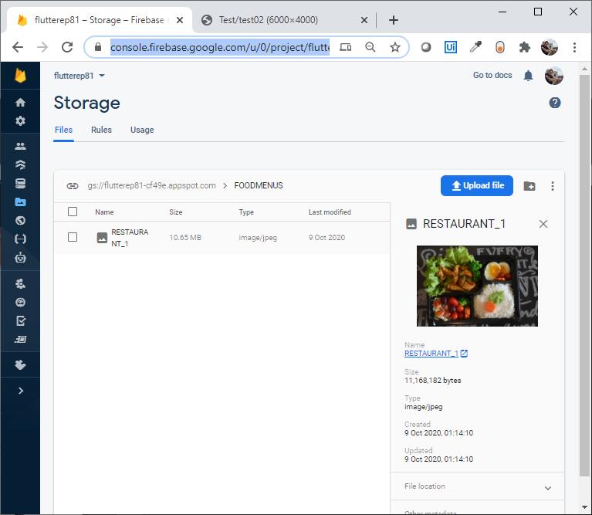
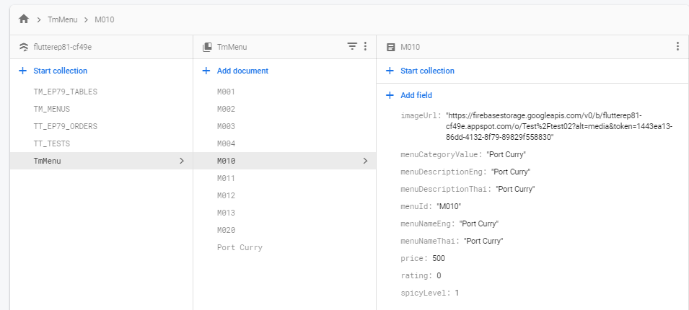
FireStorage & Firestore Database
FireStore Database
Firebase Storage

