Slide 1
Download GitHub by Command Line & Upload to your own github Case Study “Restaurant E-menu” ระบบสั่งอาหารผ่านมือถือ
EP91
See-Flutter เรียนรู้ไปด้วยกัน เรียนฟรี พร้อม Source Code
9 Oct 2020
Day#81

Slide 2
CONTENT เนื้อหาวันนี้
Download flutterep81 code using CLI (Command Line)
Open, modify and commit code by VScode
Upload Code to your own git hub using CLI
Target Group: Mobile Developer

Slide 3
Key Knowledge
PlatformException
Download (Clone) code from github using “git clone https://github.com/traitet/flutterep81 flutterep91”
Create new project on your github
Upload code to your own github using CLI (Command Line)
Target Group: Mobile Developer

Slide 4
Download Code
git clone https://github.com/traitet/flutterep81 flutterep91
You can chang flutterep91 to your name e.g.
git clone https://github.com/traitet/flutterep81 JohnFlutter
Set your own name

Slide 5
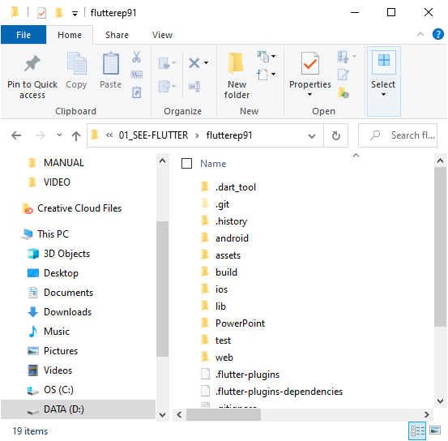
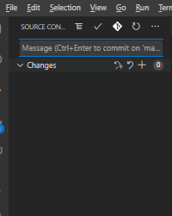
Upload Code to your own GitHub Cloud
** Delete Folder .git
echo "# flutterep91" >> README.md
git init
git add README.md
git commit -m "first commit"
** Type Message e.g. flutterep91, Tick Commit in VSCode
git branch -M main
git remote add origin https://github.com/traitet/flutterep91.git
git push -u origin main
1
1
2
2
…
…
Show many files here After commit, all files would be disapperred
Your own file

Slide 6
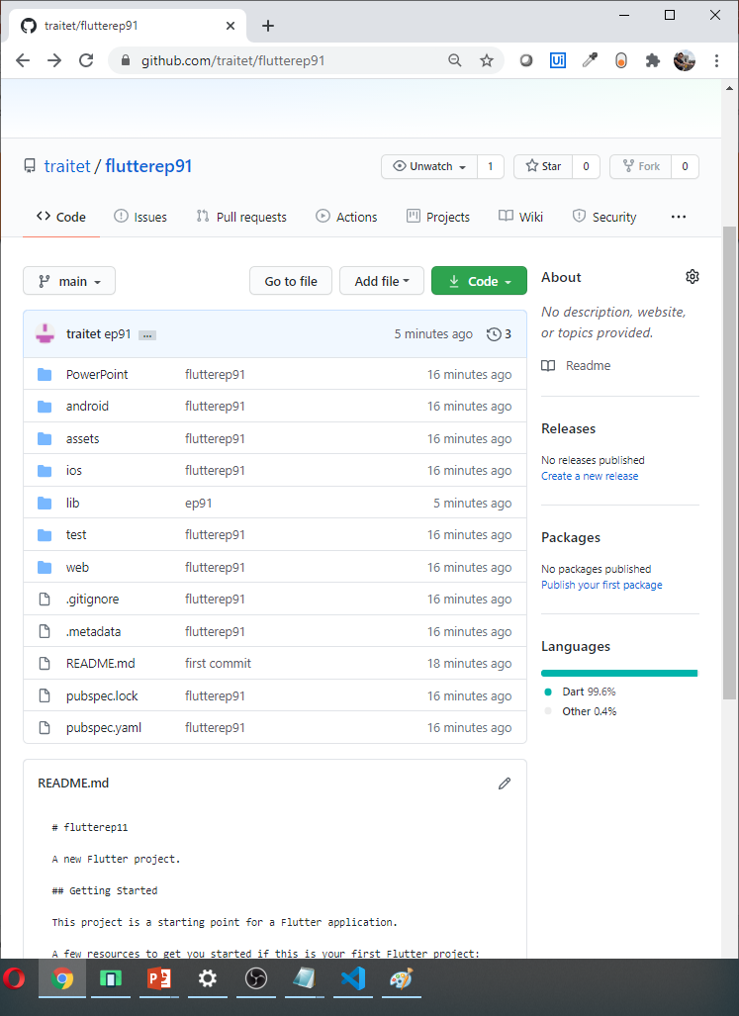
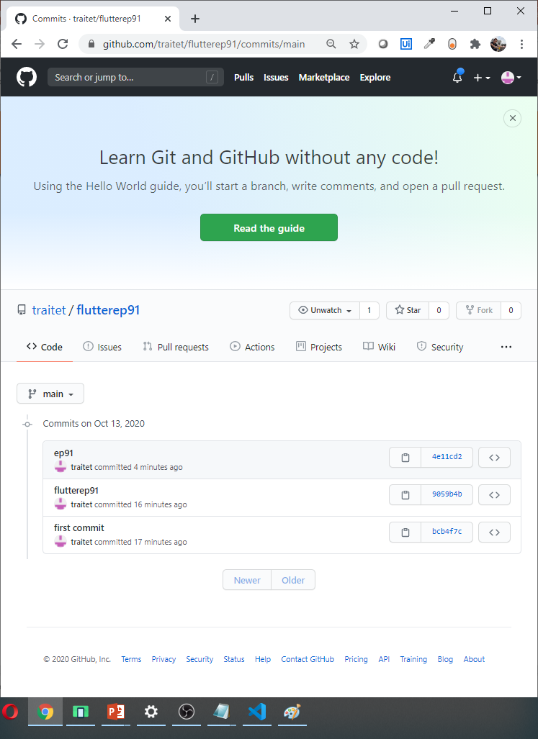
Github
After upload code to your own github
Check commit message written on Vscode

