Slide 1
Model Mapping FireStore DB and Flutter Class Case Study “Restaurant E-menu” ระบบสั่งอาหารผ่านมือถือ
EP92
See-Flutter เรียนรู้ไปด้วยกัน เรียนฟรี พร้อม Source Code
10 Oct 2020
Day#82

Slide 2
CONTENT เนื้อหาวันนี้
Developing Concept
Database (FireStore)
Flutter: Service Class, Model Class, UI Class
Model Mapping
RestCustomerModel
RestMenuModel
RestOrderItemModel
RestOrderModel
RestTableModel
Target Group: Mobile Developer

Slide 3
Key Knowldge
Modelling Mapping Class
How to develop for separate logic and UI
How to convert data from database structure to object (fromFileStore)
How to convert data from object to database structure (toFileStore)

Slide 4
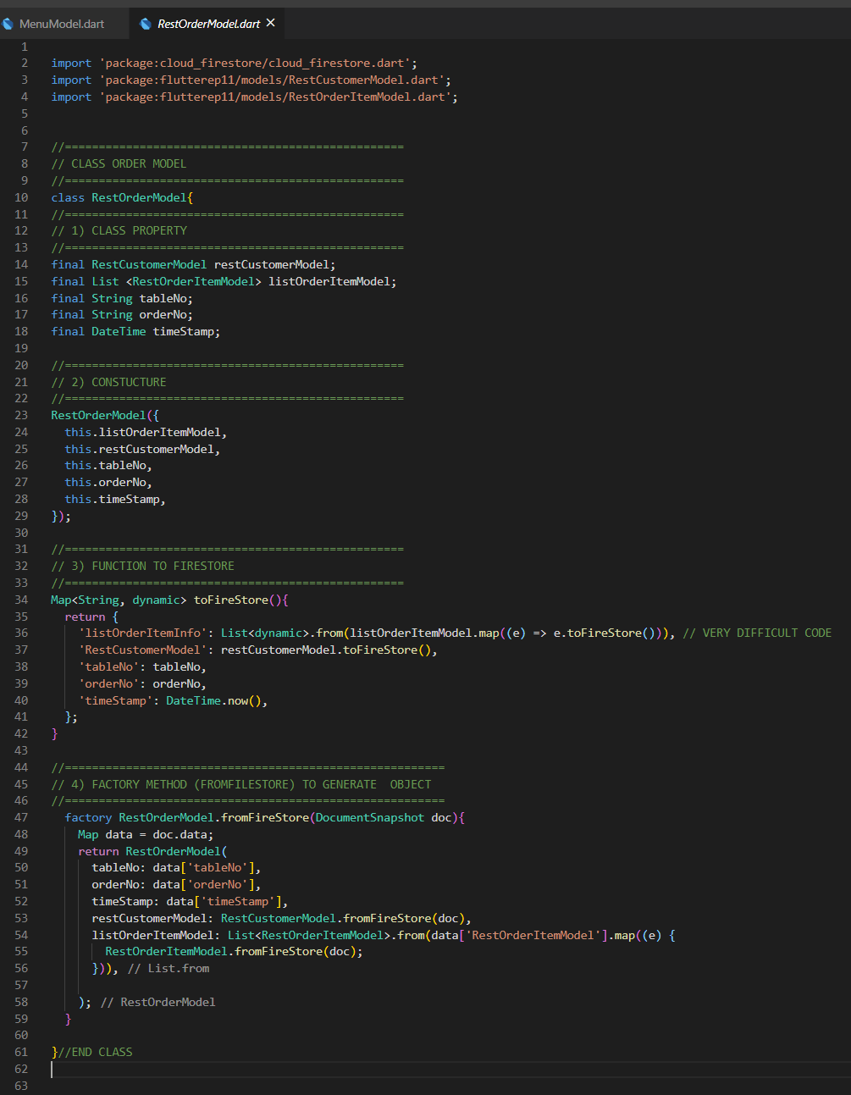
Model Class Stucture
Import
1
2
Property
1
3
Constucture
2
4
toFireStore
3
fromFireStore
4

Slide 5
Developing Concept
Database
(FireStore)
Business Logic
(Folder: services)
Model Mapping
(Folder: models)
UI
(Folder: screens)
Firebase
Service Class
Model Class
UI Class
RestMenuService
RestMenuModel
Home Tab
RestOrderModel
Make Order
(search menu)
RestTableService
1
REST_TM_MENUS
Order Item Detail
(update, delete)
RestOrderItemModel
RestOrderService
1
RestOrderItemModel
REST_TM_TABLE
View Order Status
RestTableModel
2
2
REST_TT_ORDERS
View Order Price
3
RestCustomerModel
3
REST_TT_ORDER_ITEMS
Make Payment
4
No SQL DB FileStore | Relational DB e.g. MySQL
Catalog | Table
Field | Column
Service Class has
Static Functions for manipulate database though model class
Database Fields = Properties in Model Class
Database Fields = Properties in Model Class

Slide 6
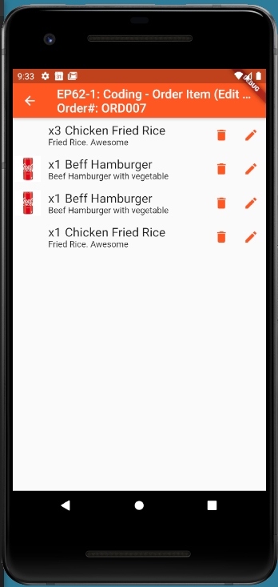
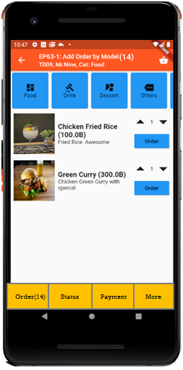
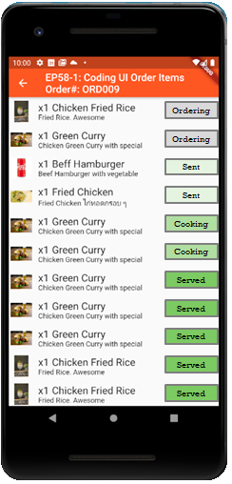
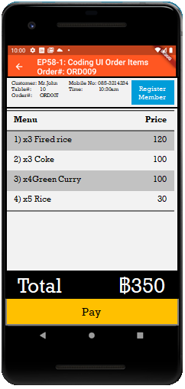
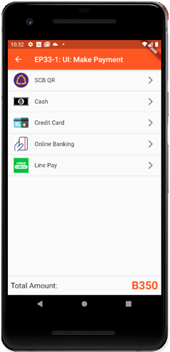
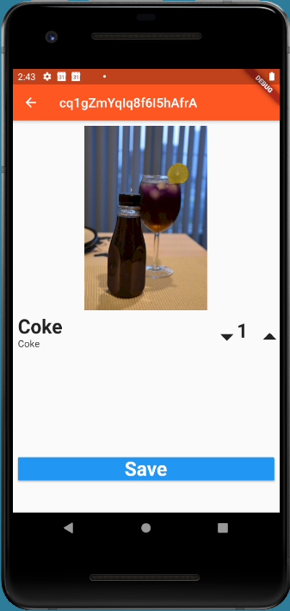

UI Design
Send Order

Slide 7
Benefits of Model Mapping
Separate Business Logic and UI
Easy to maintain code
Easy to add fields in database
Less Coding in UI
Can separate tasks for many programmers
Reduce impact when change database sturucture

Slide 8
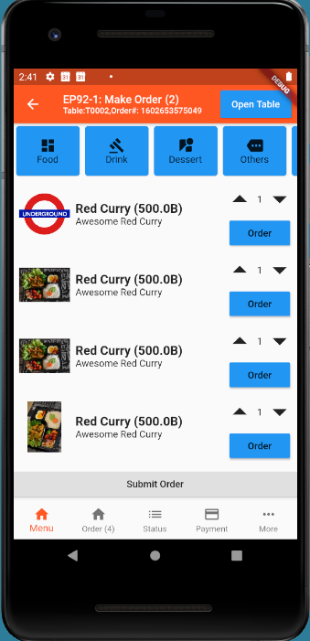
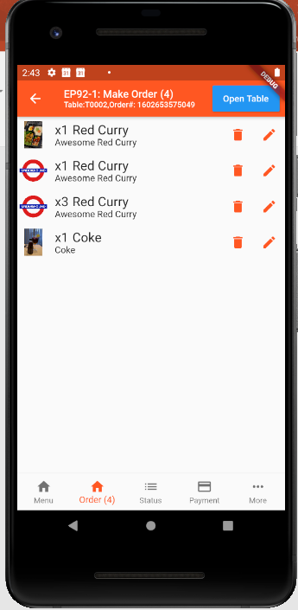
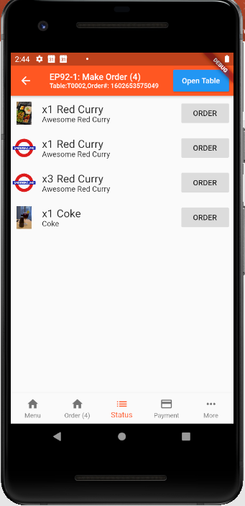
Sample UI

