Slide 1
FUTTER EP12
22 July 2020

Slide 2
WIDGET
Row & Column (ok)
Expanded (ok)
ListView (Horizontal, Vetical) (ok)
Container: Single Child Widget
Center (ok)
Padding (ok) (1) Wrap widget (2) container
Network Image (URL)
LIstView
Row1
Row2 (Column 1,2)
Text
test
$5
Row3

Slide 3
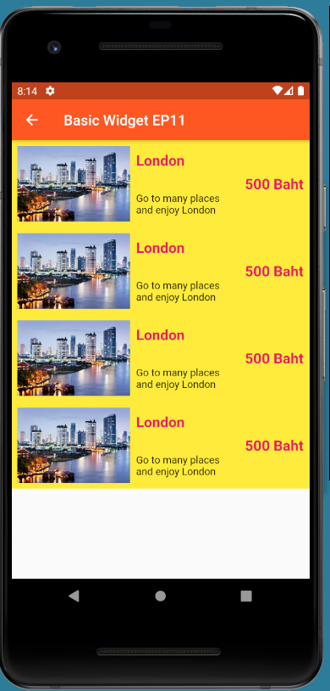
Row2 (Column 1,2)
Scaffold, AppBar, Text
Row1
Row3
Class: ListViewItemWidget
Source Code: Lib/screens/BasicWidgetEp11Page.dart
Download: https://github.com/traitet/uidesign01.git

