Slide 1

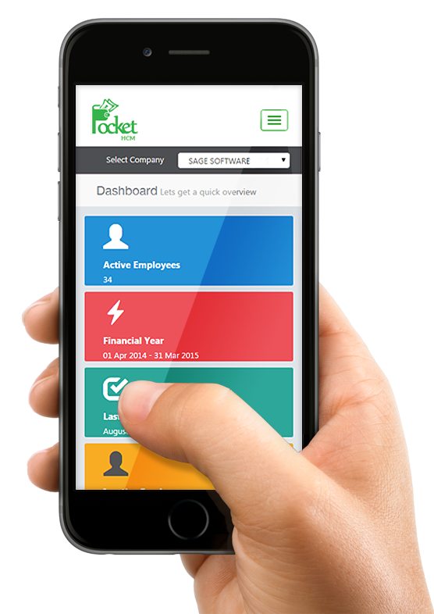
How to Develop first Flutter WISS – Web Interactive Self-Service Aisin Asia Pacific
WISS
20 Feb 2022
Traitet Th. Line @traitet

Slide 2
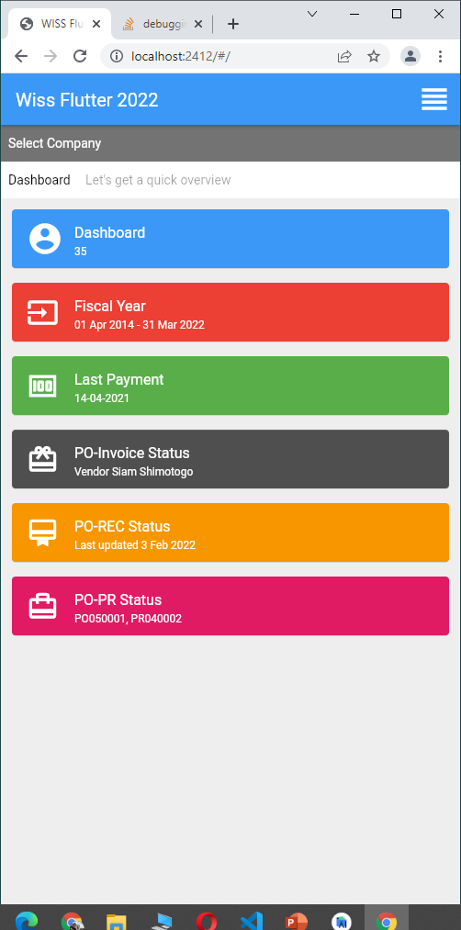
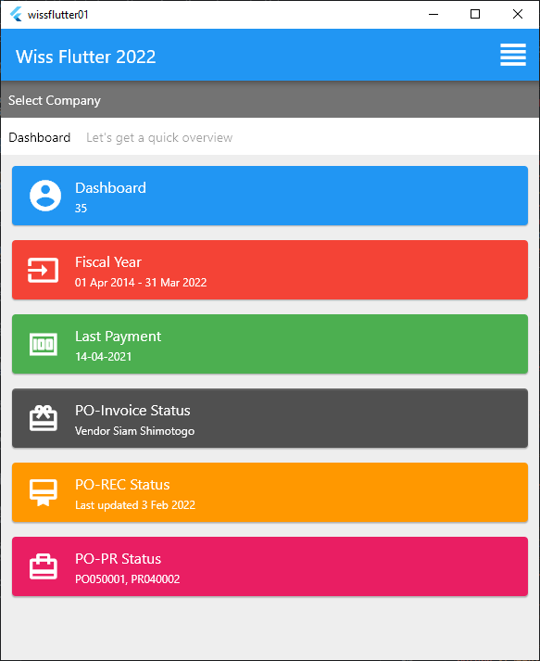
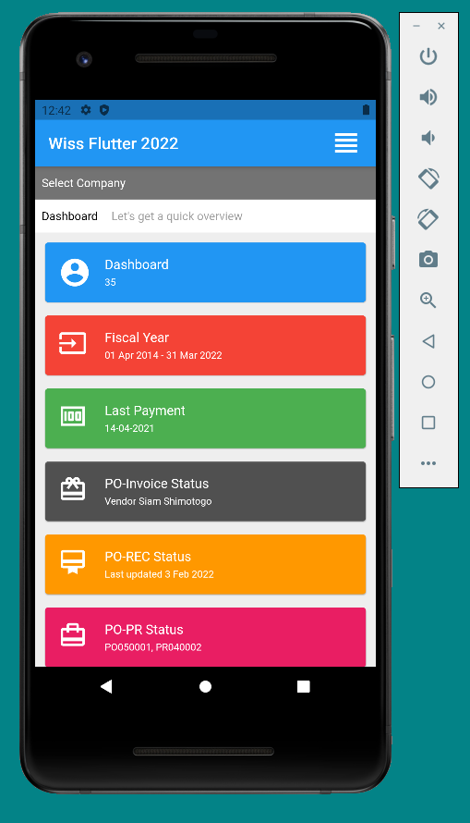
Flutter
Git hub: https://github.com/traitet/wissflutter01.git

Slide 3
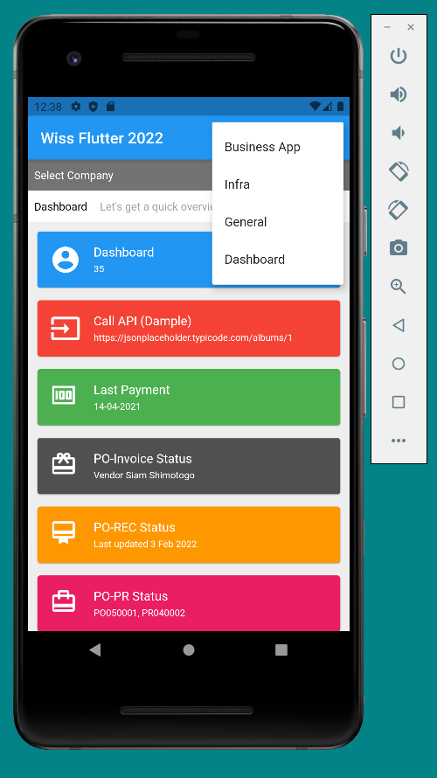
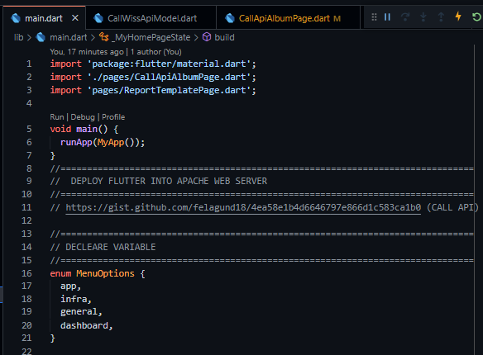
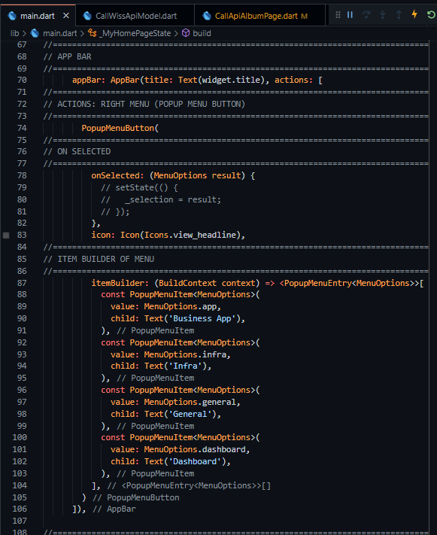
Button Menu in Scaffold
Enum
PopupMenuButton

Slide 4
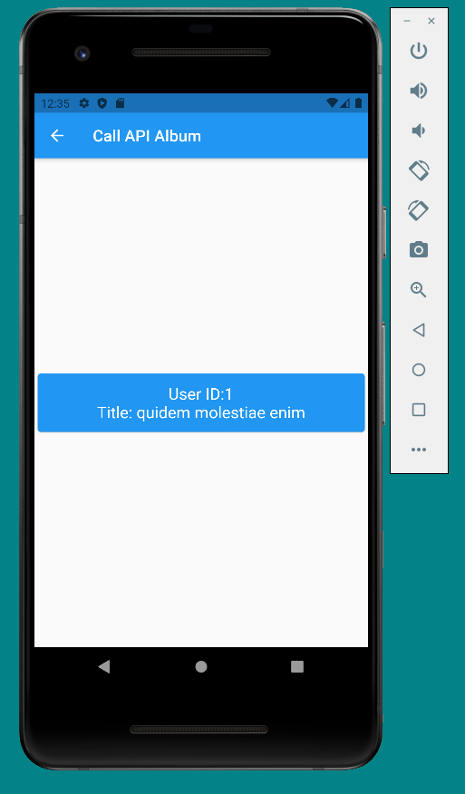
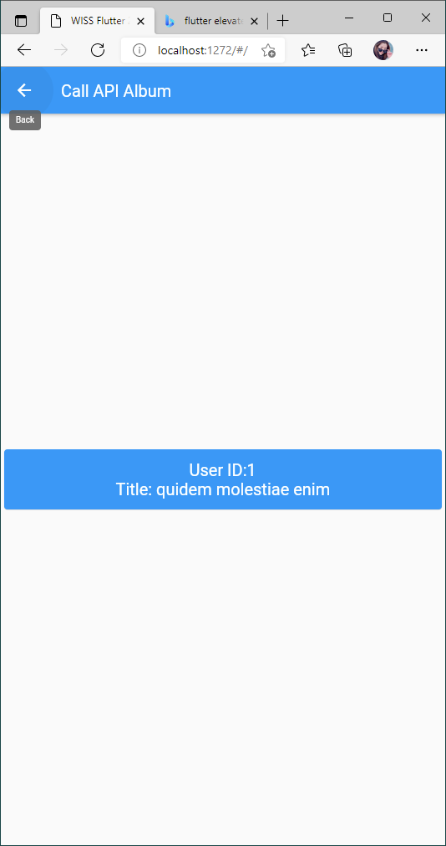
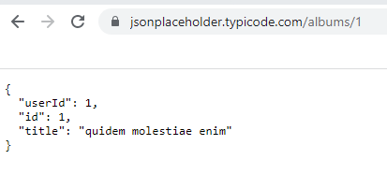
Call API: https://jsonplaceholder.typicode.com/albums/1
Step | Step
1 | Create Album Model
2 | Create Page Call API: https://jsonplaceholder.typicode.com/albums/1 Show in Page

Slide 5
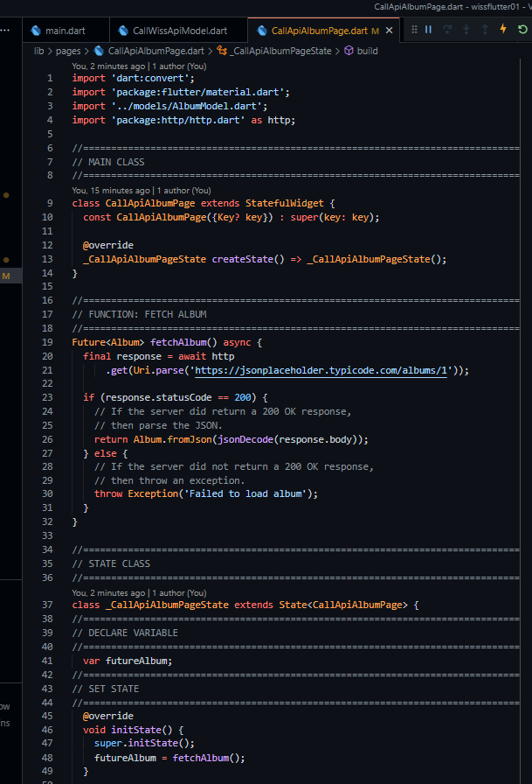
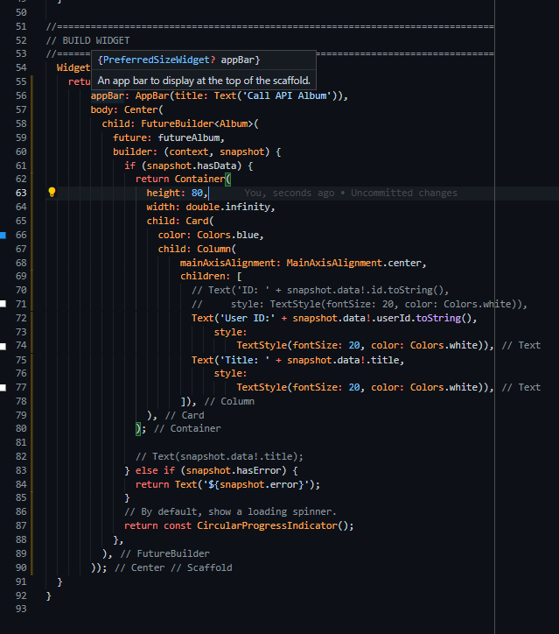
Call API: https://jsonplaceholder.typicode.com/albums/1
Call API Function
Get Data

Slide 6
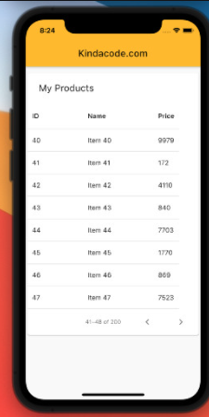
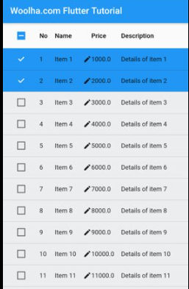
Flutter DataTable

Slide 7
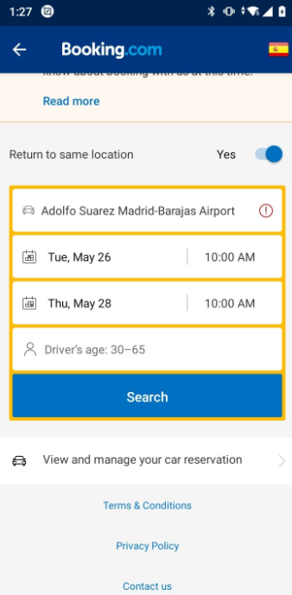
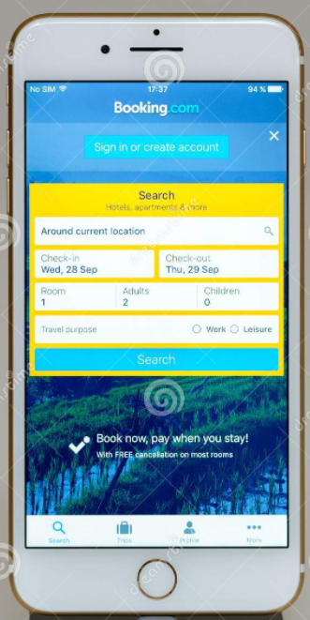
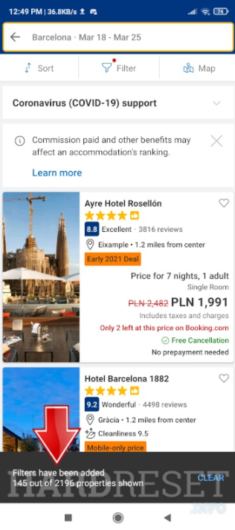
Search Parameter

Slide 8
Tasks
Upload to web
Call api
Run on Android studio

