Slide 1

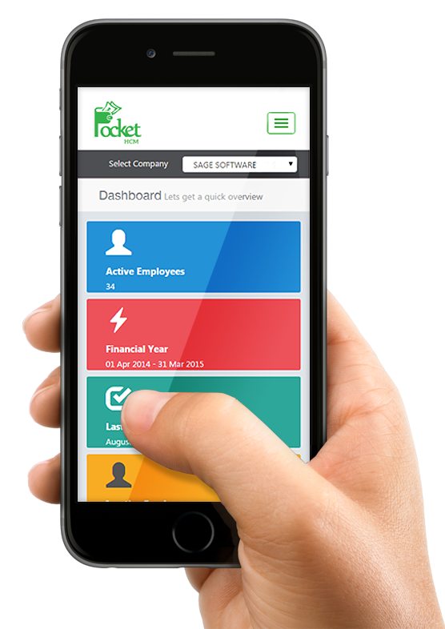
How to Develop first Flutter WISS – Web Interactive Self-Service Aisin Asia Pacific
WISS
25 Feb 2022
Traitet Th. Line @traitet

Slide 2
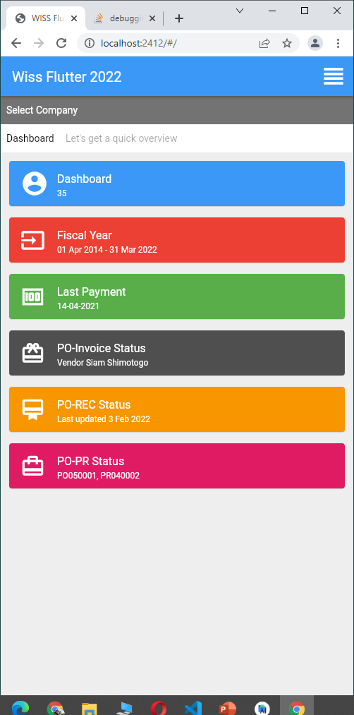
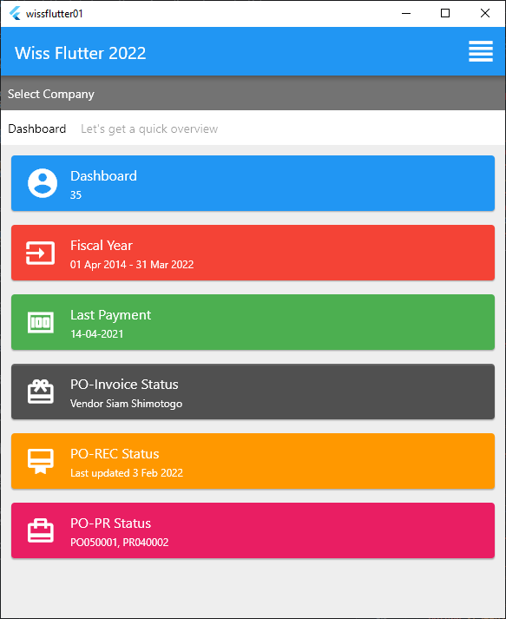
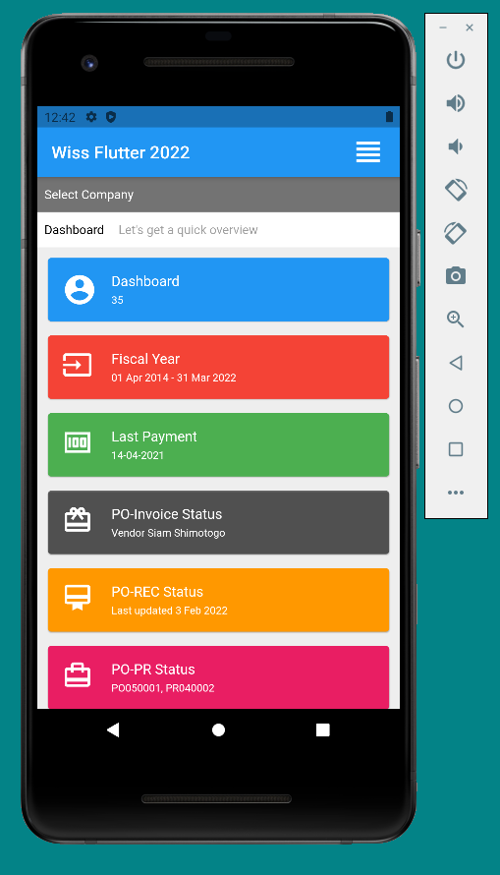
Flutter
Git hub: https://github.com/traitet/wissflutter01.git

Slide 3
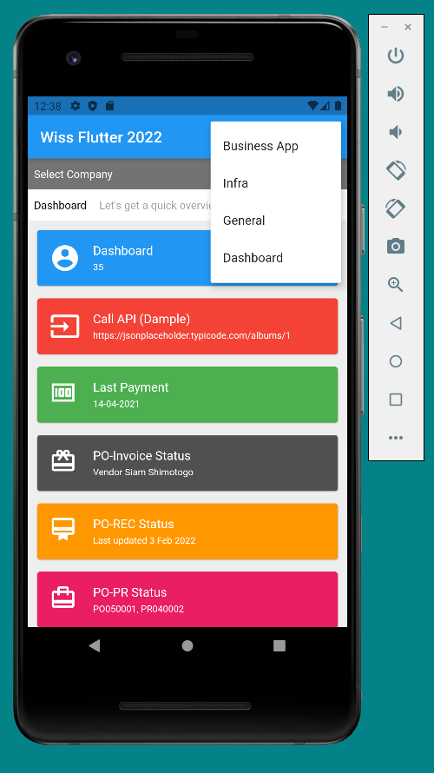
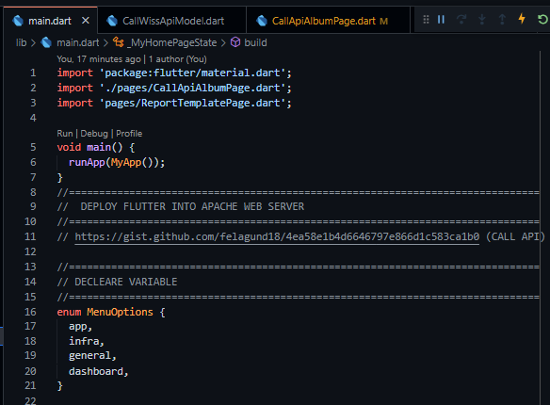
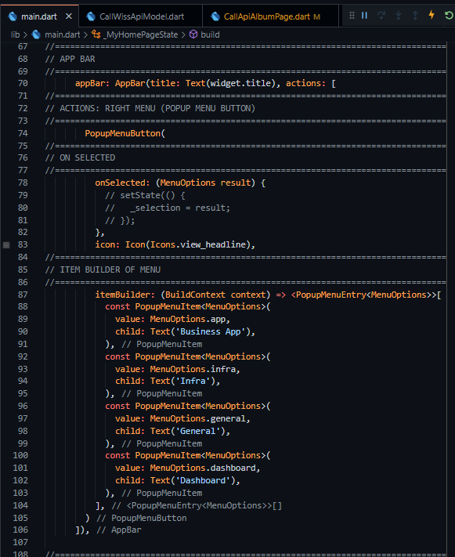
Button Menu in Scaffold
Enum
PopupMenuButton

Slide 4
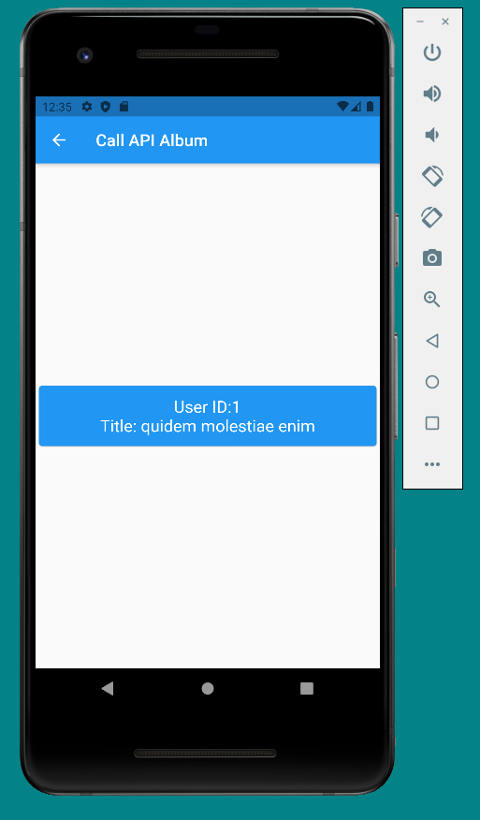
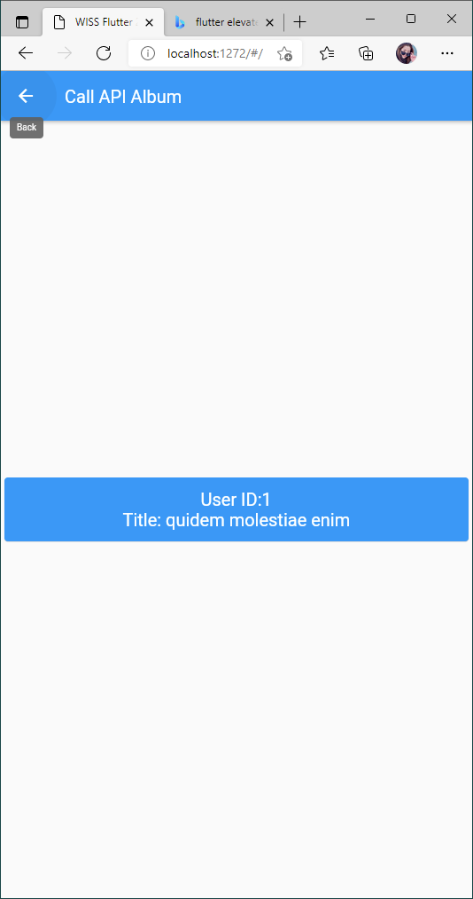
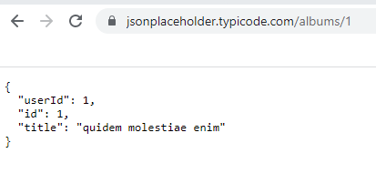
Call API: https://jsonplaceholder.typicode.com/albums/1
Step | Step
1 | Create Album Model
2 | Create Page Call API: https://jsonplaceholder.typicode.com/albums/1 Show in Page

Slide 5
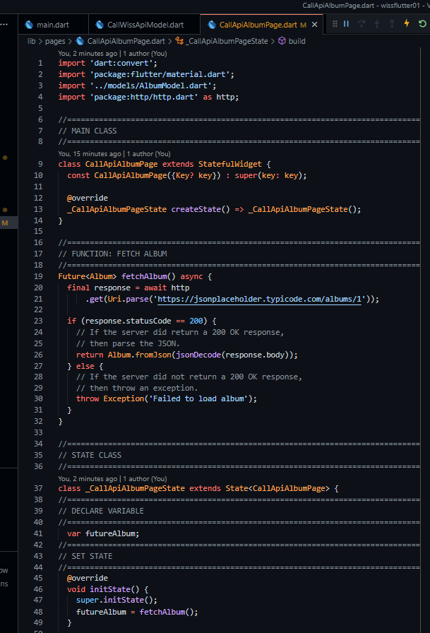
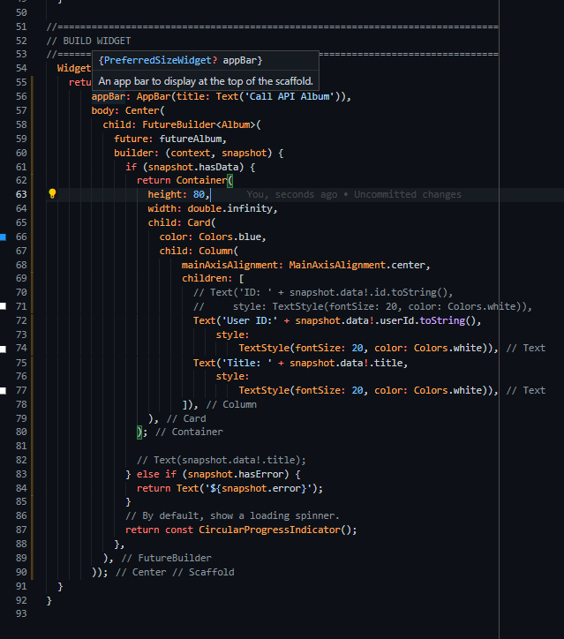
Call API: https://jsonplaceholder.typicode.com/albums/1
Call API Function
Get Data

Slide 6
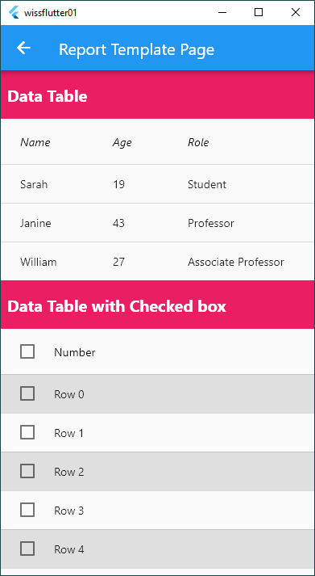
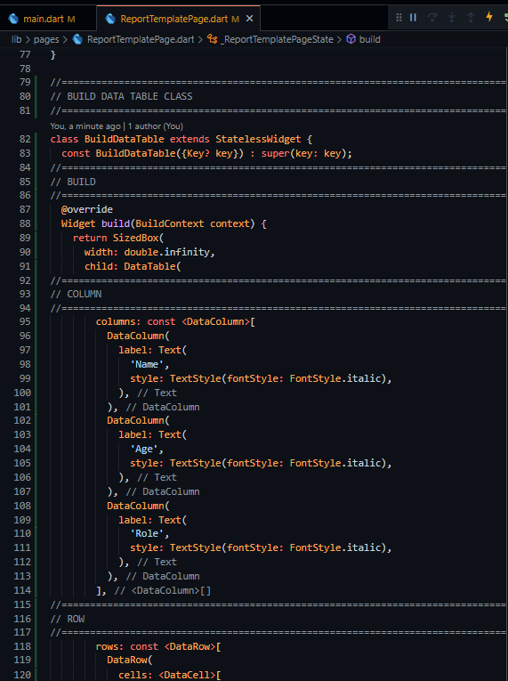
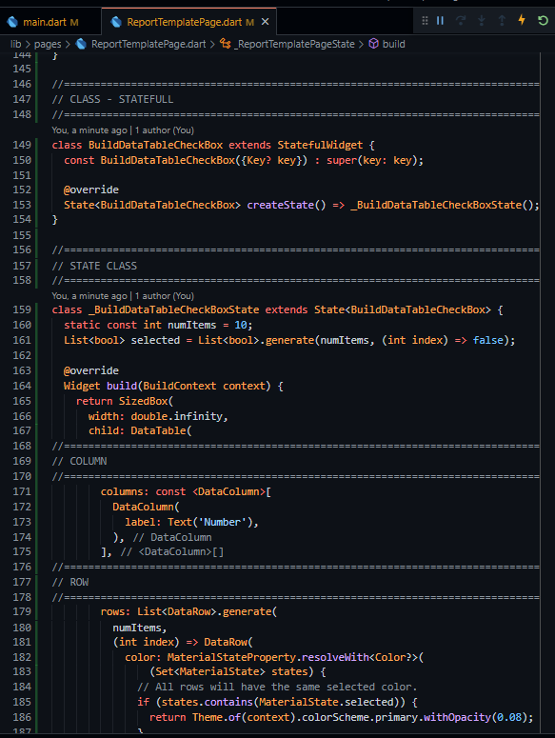
Data Table
Data Table
Data Table with Checkedbox

Slide 7
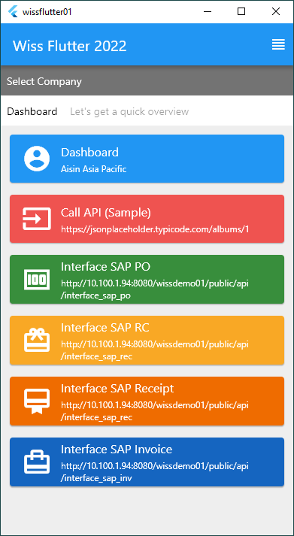
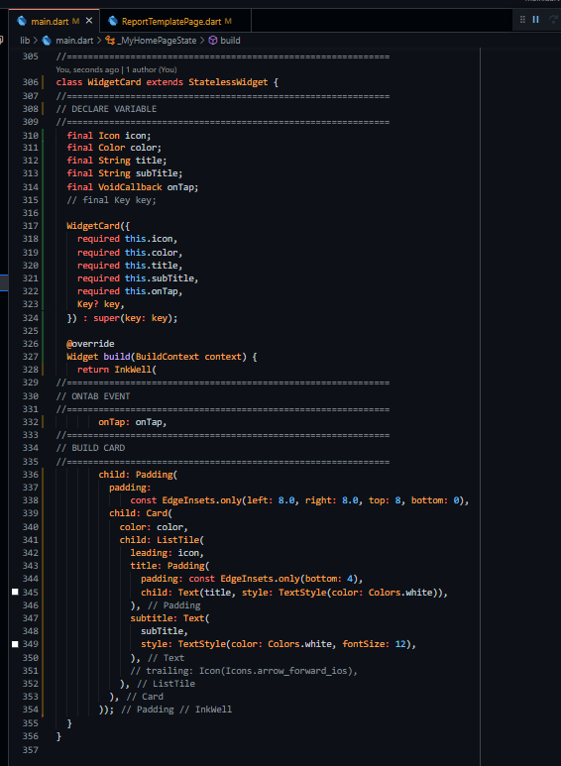
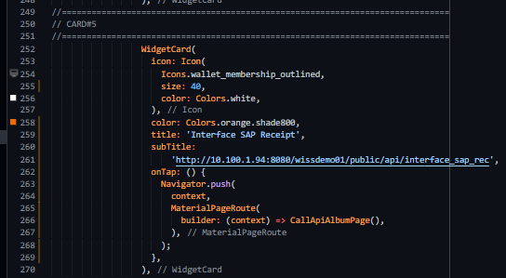
Void call Back
Build Card (Class)
onTap (Void Call Back)
WidgetCard ( onTap: () {Navigate})
BuildCard (onTap:
Param
onTap
(Void Call Back)
Class BuildCard (onTap)
Class WidgetCard (VoidCallBack onTap)

Slide 8
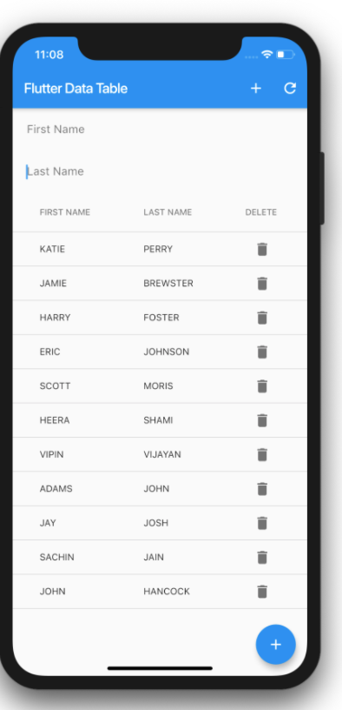
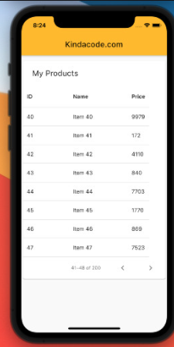
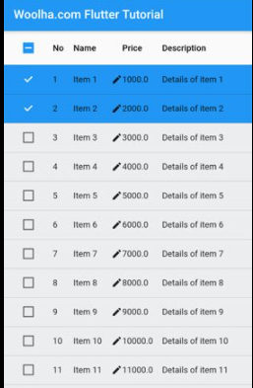
Flutter DataTable

Slide 9
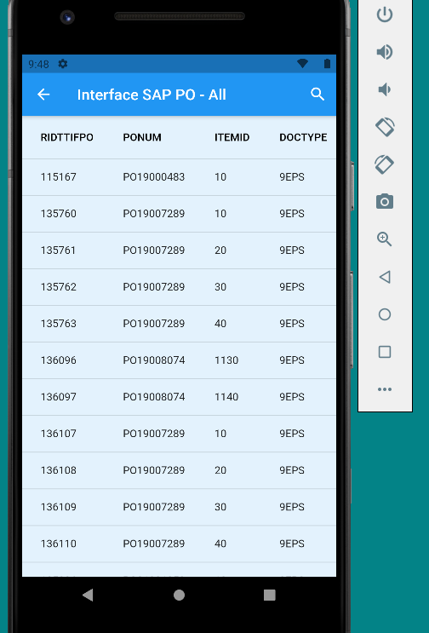
Data Table and API
Get value from api
Check 200
Function get data from api
Model of output data
List of data (many records)
Future Builder
Hasdata (show data, no: loading)
Singlechild scrollview
Singlechild scrollview
Datatable
Column
Row : map data

Slide 10
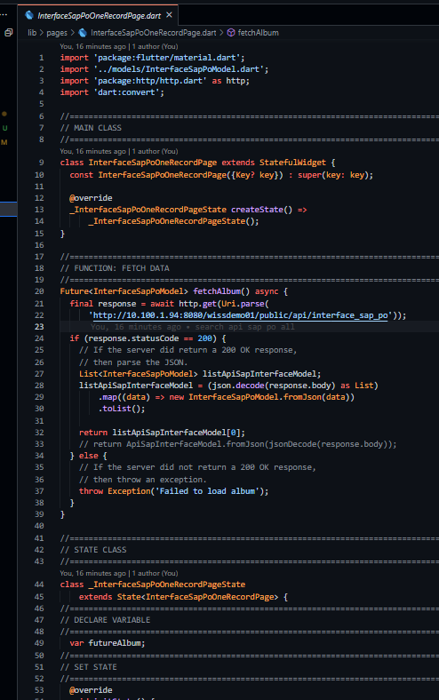
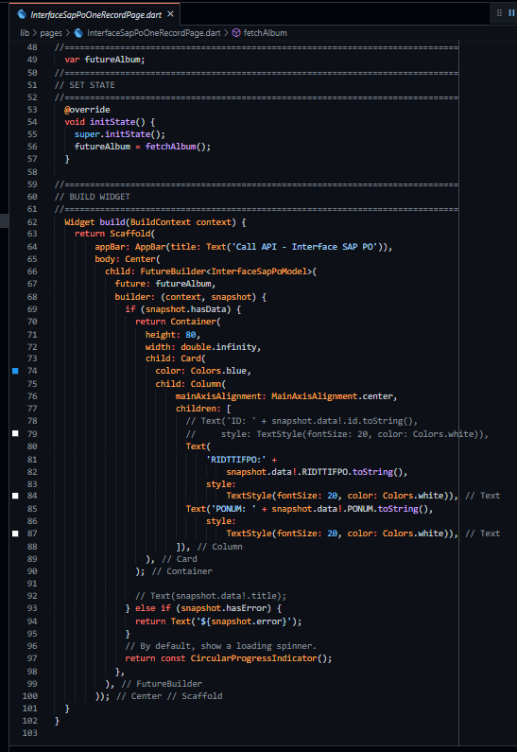
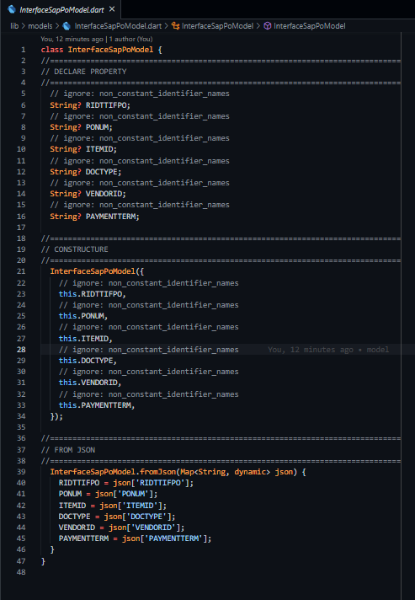
Call API
View = Page (call api)
Model

Slide 11
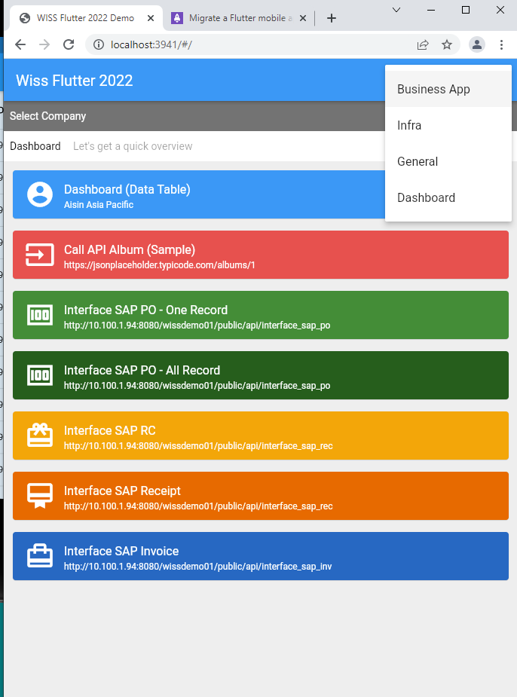
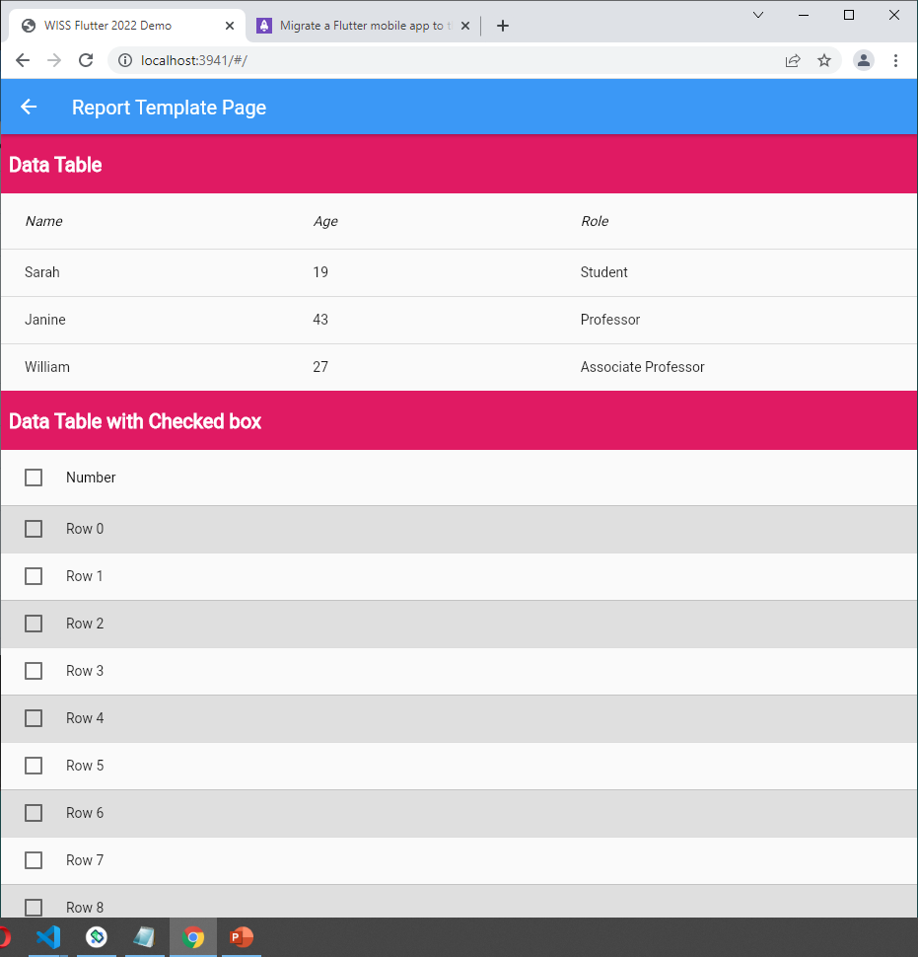
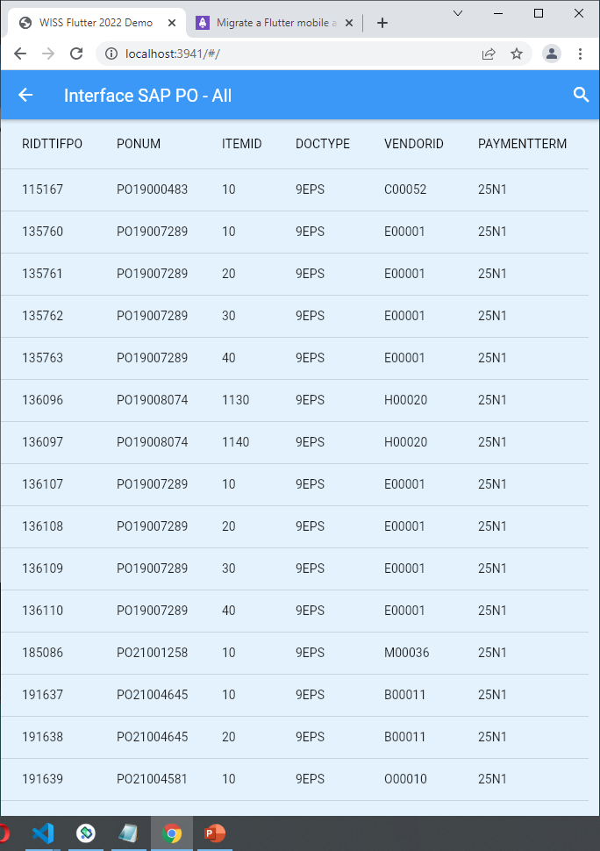
Web UX/UI

Slide 12
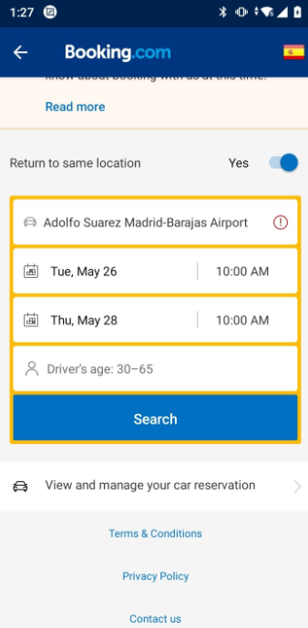
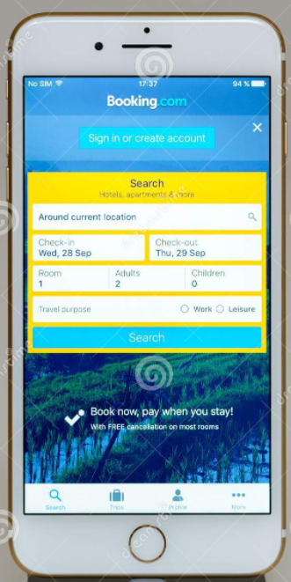
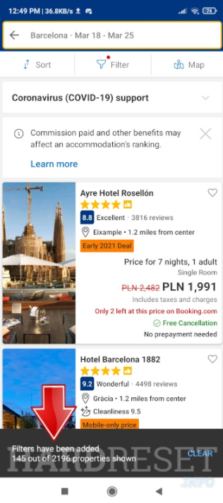
Search Parameter

Slide 13
Tasks
Upload to web
Call api
Run on Android studio

