Slide 1
Lombard Speech Synthesis
Humans modify their voice according to the social situation/context
  Shouting or loud speech is an important mode of speaking
We have tested several ways of generating shouting speech synthesis with our speech synthesizer GlottHMM:
    Adaptation
    Extrapolation
    Modification of the vocoder

Slide 2
Lombard Speech Synthesis
The listening test results show that in a realistic street noise situation the synthetic loud speech is judged by listeners both as appropriate for the situation and as intelligible as natural shouting speech
Of the different types of methods, adaptation and extrapolation performed the best

Slide 3
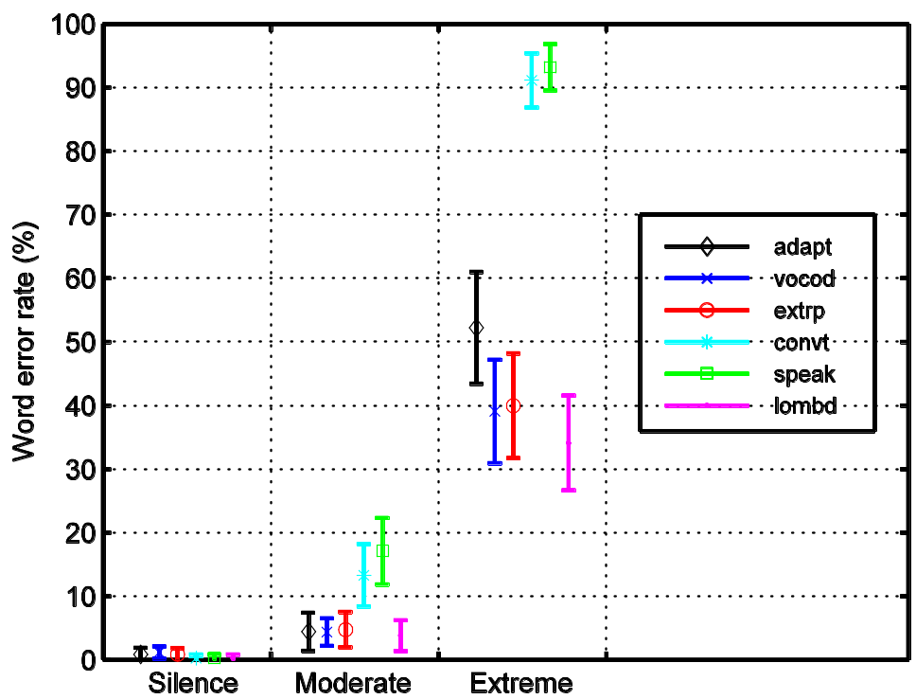
Lombard Speech Synthesis
Word error rates of different methods in silence, moderate noise, and extreme noise.

Slide 4
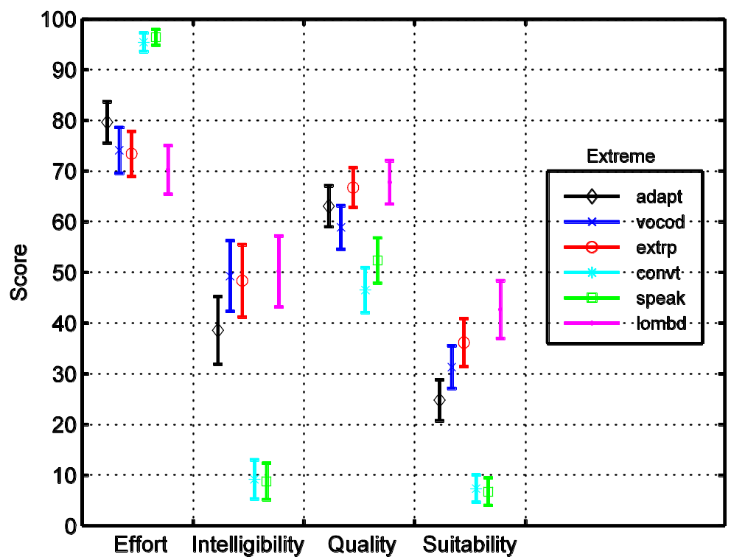
Lombard Speech Synthesis
Effort, intelligibility, quality and suitability of different methods in extreme noise.

Slide 5

Lombard Speech Synthesis - Samples
Method | Sample 1 | Sample 2 | Sample 3
Normal (natural)
Normal (synthetic)
Shouted (extrapolation)
Shouted (adapted)
Shouted (vocoder mod.)
Shouted (natural)

