Slide 1

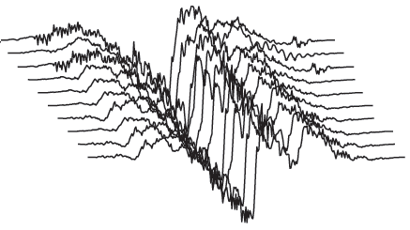
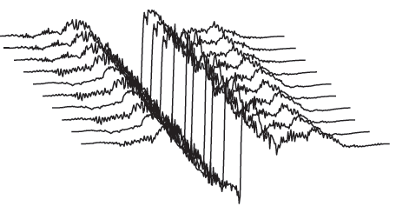
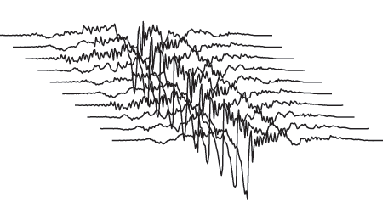
Modeling of vocal effort by adaptation and using matched pulse library
Less effort
More effort
Soft
(extrapolated -0.8)
Soft
(extrapolated -0.5)
Normal
(0.0)
Lombard
(adapted 1.0)
Lombard
(extrapolated 1.5)
Soft and breathy
Soft
Normal
Lombard
Pulse libraries

Slide 2
Modeling of vocal effort by normalization of synthesis parameters
Less effort
More effort
Lax
Modal
Tense
Soft
Normal
Loud
Pulse libraries

