Slide 1
TB OPERATIONS HUB
Using GitHub for TB programme work
A practical web guide for Management, Executive and M&E teams
Docs • Discussions • Issues • Project board

Slide 2
YOUR TB WORK IN ONE PLACE
Start with the task—not the GitHub tool
These four questions cover the most common work for TB programme teams.
Docs
Discussions
Need the indicator definition, reporting calendar, SOP or approved template? Open Docs.
Need clarification on a reporting instruction or want to announce a review? Start a Discussion.
Issues
Project board
Found a data-quality problem or need a reporting change completed? Create an Issue.
Want to know what is new, blocked, in progress or completed? Check the Project board.
Source: GitHub Docs — GitHub Pages, Discussions, Issues and Projects
02

Slide 3
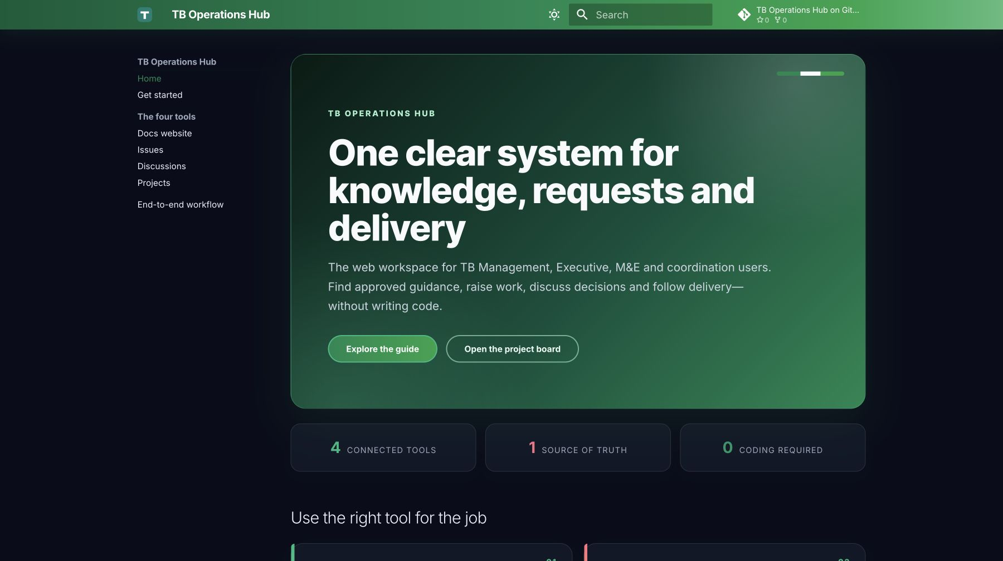
1 — WHEN YOU NEED THE RIGHT REFERENCE
Find the approved TB guidance in Docs
Use Docs before asking for a file in email or a messaging group.
1. Open traj3ctory.github.io/TB-Operations-Hub. 2. Browse the left menu or search: “treatment outcome definition”. 3. Open the approved page and use its linked template or procedure. 4. Share the page link so everyone refers to the same version.
Best for: indicator definitions • SOPs • reporting calendars • templates • approved decisions
Example: search once, open the approved definition, share the page link
Live site: traj3ctory.github.io/TB-Operations-Hub • Hosted with GitHub Pages
03

Slide 4
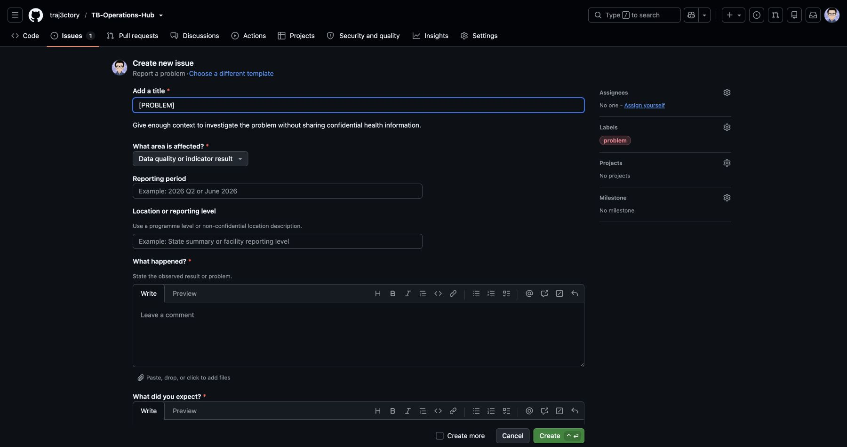
2 — DATA PROBLEMS AND CHANGE REQUESTS
Use an Issue when someone must take action
Example: “Data quality: Q2 treatment-outcome total differs from the validated report.”
Open Issues → New issue → Problem report. Include: reporting period, location or level, expected result, observed result, programme impact and needed-by date. Attach a safe screenshot or file, then submit. Follow progress in comments and on the board.
The TB form collects reporting context, impact and a privacy check
Never upload patient names, IDs or other confidential health information. One Issue = one outcome.
GitHub Docs — Issue templates
04

Slide 5
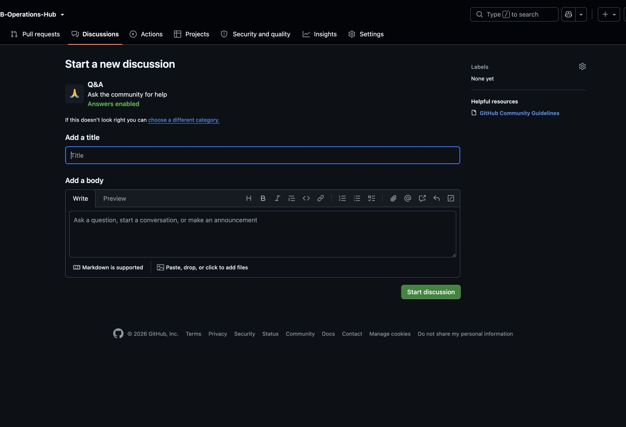
3 — Q&A AND ANNOUNCEMENTS
Use Discussions for questions everyone may share
Example Q&A: “Which reporting month should include late laboratory results?”
1. Select Discussions → New discussion. 2. Choose Q&A, Ideas or Announcements. 3. Write a specific title, explain the TB programme context and mention the people who can answer. 4. Mark the accepted answer so others can find it later.
If the answer requires a change or investigation, create an Issue and link the Discussion.
Source: docs.github.com — Quickstart for GitHub Discussions
05

Slide 6
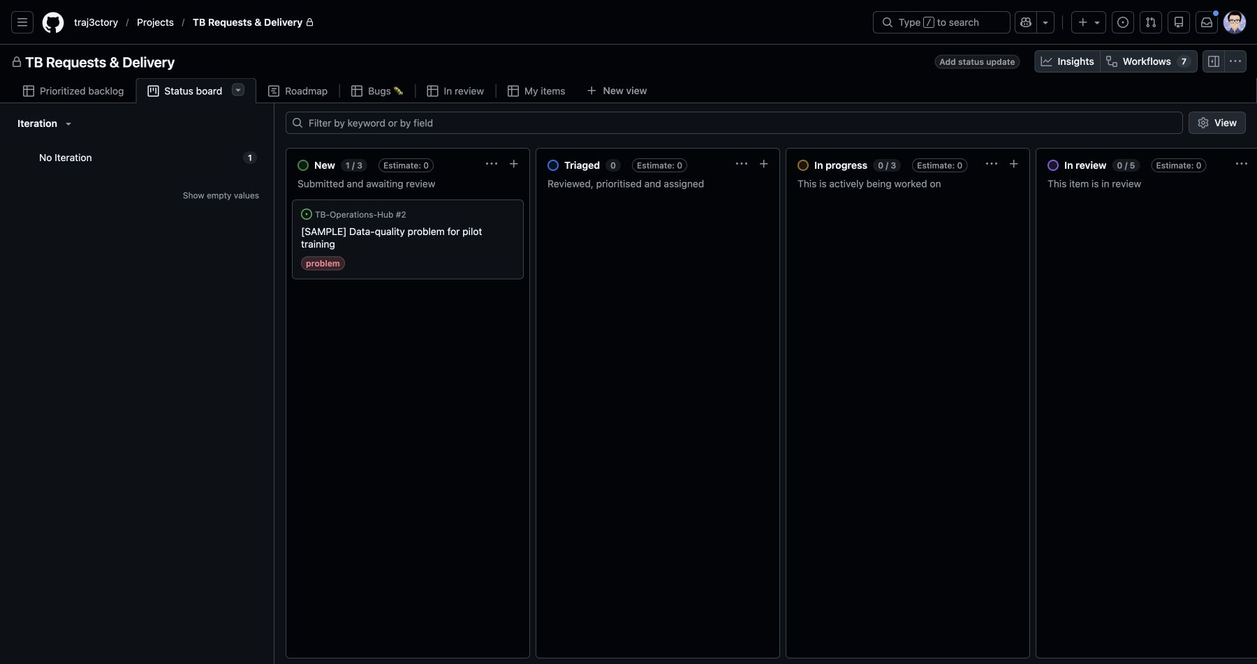
4 — VISUAL STATUS TRACKING
Follow work without chasing updates
M&E users check their request; coordinators manage the queue; leadership sees priorities.
Find the Issue card and read its status: New → Triaged → In progress → Blocked → Done Open the card for the owner, target date and latest comments. Leadership can filter to High priority or Blocked items before the weekly review.
Do not duplicate updates on the board. Put evidence and decisions in the linked Issue.
TB use: filter Blocked items, then open the linked Issue for the reason
Source: docs.github.com — Changing the layout of a project view
06

Slide 7
EXAMPLE — FROM REPORT TO RESOLUTION
A TB data problem moves through one clear path
1 — REPORT
2 — RESOLVE
3 — REUSE
M&E creates an Issue
Coordinator triages it
The team closes the loop
Records the reporting period, expected and observed result, impact and safe evidence.
Sets priority, owner and target date. The owner posts updates in the Issue.
Marks Done. If the answer changes standard practice, the approved guidance is updated in Docs.
The Project board shows status throughout; the Issue keeps the complete record
07

Slide 8
ONE-TIME SETUP — WEB ONLY
The administrator sets up a simple front door
Users should see familiar TB language and only the options they need.
Docs website
Issue forms
Publish indicator definitions, SOPs, calendars, templates and approved decisions. Add a visible “Submit a request” link.
Create two plain-language forms: 1. Request an update 2. Report a problem
Discussion categories
Project fields and views
Use three categories: Announcements • Q&A • Ideas
Fields: Status • Priority • Owner • Target date Views: My requests • Blocked • Leadership
TB recommendation based on GitHub’s native repository features
08

Slide 9
HOW THE TB TEAM USES IT
Each role has a small, repeatable routine
M&E Officers
TB Coordinators
Programme Leadership
Search Docs first. Submit complete Issues, answer follow-up questions and check the board for progress.
Review new Issues, set priority and owner, answer Discussions and publish approved guidance in Docs.
Use the filtered board to review high-priority, overdue and blocked work—and make the decisions requested.
Weekly
M&E checks assigned requests. Coordinators review New and Blocked items. Leadership reviews only priorities, overdue work and decisions needed.
A maintainer handles access, forms and board settings behind the scenes
09

Slide 10
TB OPERATIONS HUB
Two practice scenarios
Practise with two real TB scenarios
1 — Reporting guidance Find an indicator definition in Docs, then ask one unresolved reporting question in Discussions. 2 — Data-quality problem Submit a sample Issue without confidential data. Find it on the board, add a comment and confirm the next owner. Then repeat with one real, low-risk request.
A short guided exercise will make the workflow feel familiar before the wider rollout.
Success means users can choose the right tool without asking an administrator.
Prepared for TB Management, Executive and M&E users • GitHub web interface
10

