Slide 1
Analysis Services 101
Dave Fackler, MCDBA, MCSE, MCT
Director, Business Intelligence Practice
Intellinet Corporation

Slide 2
Agenda
Overview of Analysis Services
Server and Client Architecture
Analysis Services Objects
  Databases and Data Sources
  Dimensions and Measures
  Cubes
Security
Commands
MDX

Slide 3
Overview of Analysis Services

Slide 4
Analysis Services
What is it???
A middle-tier server for OLAP and data mining; manages multi-dimensional cubes of data for analysis and provides rapid client access; allows you to create data mining models from both OLAP and relational data sources

Slide 5
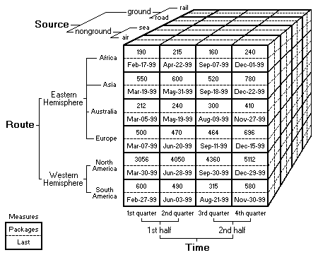
Analysis Services
Okay, but what is OLAP?

Slide 6
Advantages and Features
Ease of use
  Wizards and editors
  Data viewers
Flexible data model
  Multiple storage options
  Partitioning
  Multiple dimension and cube types
  Write-enabled options

Slide 7
Advantages and Features
Scalability
  Optimized aggregations
  Data compression
  Distributed calculations
  Partitioning and distributed cubes
Integration
  Security
  Management
  Other SQL Server tools and features
API’s

Slide 8
Architecture

Slide 9
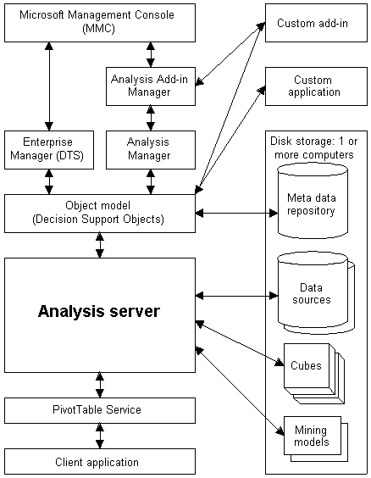
Server Architecture

Slide 10
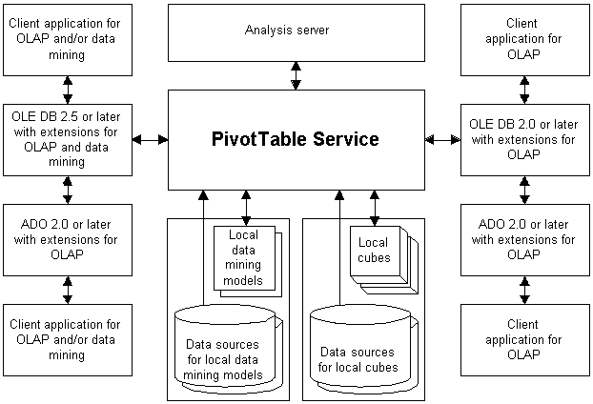
Client Architecture

Slide 11
Analysis Services Objects
(40,000 Foot View)

Slide 12
Databases and Data Sources
Database contains other Analysis Services objects
Data sources define where Analysis Services gets the data to populate dimensions and cubes
  OLE DB providers
  OLE DB for ODBC
  MSSQLServerOLAPService service account

Slide 13
Cubes
Multidimensional structure containing dimensions and measures
Cells (the intersection between dimensions) contain the measure values

Slide 14
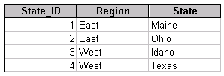
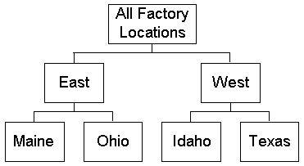
Dimensions
Organized hierarchies of categories, levels, and members
Used to “slice” and query within a cube
Based on an underlying dimension table

Slide 15
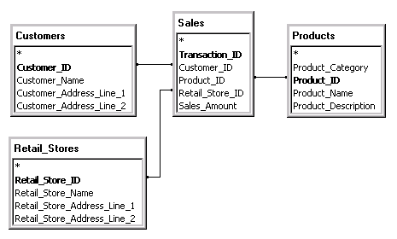
Measures
Contain the data users are interested in
Created using an aggregation function
Based on an underlying fact table

Slide 16
Roles
Defines end-user access to objects
Contains a list of Windows NT/2000 users and/or groups
Defines the type and scope of access
  Database
  Cube
  Dimension
  Cell
  Mining model

Slide 17
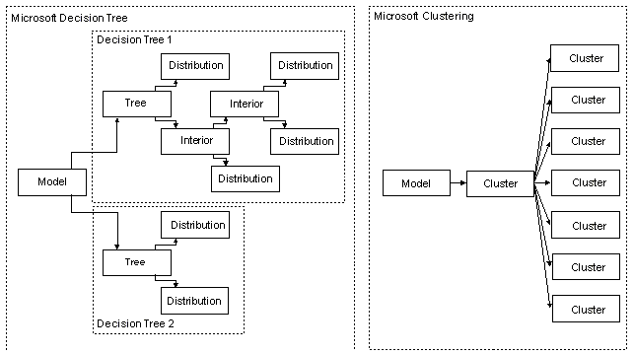
Mining Models
Groupings and predictive analysis based on relational or OLAP data
Interprets data based on statistical information referred to as cases

Slide 18
Repository
Database containing meta-data about the objects
  By default, uses Access (msmdrep.mdb)
  Should be migrated to SQL Server
Data folder to hold multidimensional structures
  Location defined during installation, but can be modified
  Should be on an NTFS partition/volume

Slide 19
Dimensions

Slide 20
Varieties of Dimensions
Regular
Virtual
  Based on member properties
  Does not have stored aggregations
Parent-child
  Based on lineage relationship between dimension members
  Built using member and parent key values
Data mining

Slide 21
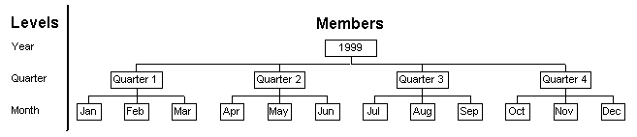
Levels and Members
(All) level and the All member
Levels
  Correspond (loosely) to column names
Members
  Contain the actual dimension data
  Have names and keys

Slide 22
Levels and Members
Properties
  Level
  Member
Custom rollup operators
  Use unary operators to determine rollups
Custom rollup and member formulas
  Use MDX expressions to determine rollups and/or to determine member values
Member groups
  Automatically group large levels

Slide 23
Dimension Characteristics
Shared vs. private
Changing
  Handles dimension changes without fully reprocessing the dimension
  Virtual, parent-child, and ROLAP
Dependent
  Members depend on another dimension
  Advantageous when cross product of two dimensions results in large percentage of combinations that cannot exist

Slide 24
Dimension Characteristics
Balanced vs. unbalanced
  Hierarchy branches descend to the same or different levels
  Unbalanced supported only by parent-child
Ragged
  Members have parents not in the level immediately above them
  Supported in regular and parent-child
Multiple hierarchies

Slide 25
Dimension Characteristics
Storage mode
  MOLAP
  ROLAP
Write-enabled
  Supported only by parent-child
  Allows end-users (and administrators)
  Members can be changed, moved, added, deleted; member properties can be updated
  Changes recorded directly in the underlying dimension table

Slide 26
Dimension Processing
Rebuild the dimension structure
  Invalidates cubes based on the dimension
  Retrieves all dimension data from the underlying dimension table
  Recreates entire dimension structure
Incremental update
  Incorporates changes from the underlying dimension table into the dimension structure
  Cube data still available during updates

Slide 27
Measures

Slide 28
Measures
Define the numbers that end users see
Use aggregation functions
  Sum
  Count
  Min
  Max
  Distinct Count
Display formats

Slide 29
Measures
Calculated measures (or members)
  Use MDX expressions to provide calculations
  Never stored as aggregation data
  Can include Excel and VBA functions
  Have solve orders for dependencies
  Include display attributes (beyond formats)
([Measures].[Price_to_Ship] – [Measures].[Cost_to_Ship]) / [Measures].[Volume_in_Cubic_Meters]

Slide 30
Cubes

Slide 31
Varieties of Cubes
Regular
Linked
  Allow for reuse of cubes across servers
  Local caching helps reduce query loads
Distributed
  Cubes can be broken down into partitions
  Partitions can be spread across servers
  Queries then get distributed (scalability!)

Slide 32
Varieties of Cubes
Virtual
  Like views in a relational database
  Simplify and/or combine cubes together
  Can be used as a security mechanism
Local
  Used by PivotTable Service to provide off-line access to parts of a cube
Real-time
  Combination of Analysis Services and SQL Server can provide real-time capabilities

Slide 33
Cube Characteristics
Storage mode
  MOLAP
    Data and aggregations compressed and stored
  ROLAP
    Data and aggregations stored in relational source
  HOLAP
    Aggregations stored, data remains relational
Aggregation level
  Wizard to decide how much to aggregate
  Optimization wizard to redo based on usage

Slide 34
Cube Characteristics
Partitioning
  Allows you to split cubes for scalability, manageability, etc.
  Partitions defined based on dimensions
Write-enabled
  Allows users to rewrite cube contents
  Changed data stored in a “write-back” partition as difference values
  Non-atomic cell updates can be made if client application can distribute changes

Slide 35
Cube Processing
Full process
  Invalidates cube and recreates structure
  Retrieves all measure data and dimensional keys from underlying fact table
Refresh data
  Retrieves all measure data and dimensional keys from underlying fact table
  Handled via “shadows” to allow uninterrupted end-user access

Slide 36
Cube Processing
Incremental update
  Can be used to add new data to a cube
  Care must be taken not to:
    Duplicate existing data
    Handle changed data correctly
  Need a consistent way to recognize new and modified data within the underlying fact table
  Can sometimes be handled via partitioning instead of via incremental updates

Slide 37
Security

Slide 38
Security
Server authentication
  Direct connections (OLE DB for OLAP)
  Http connections via special ASP/DLL
Roles
  Specify users and groups as members
  Have associated security rights
  Database, cube, and mining model roles
Dimension security
Cell-level security

Slide 39
Commands

Slide 40
Commands
Actions
  Provide mechanisms to do more than just look at the data
  Associated with dimensions, levels, members, or cells
Calculated members
  Most often defined used for new measures
  Can also be used to define new members in any dimension
    [Time].[Last Three Months]

Slide 41
Commands
Named sets
  Allow you to create sets of members within a dimension for analysis purposes
    [Customers].[Top Ten]
  Use MDX expressions to define membership
Drill-through
  Give access to underlying relational data
  Can be used to provide access to lower levels of detail than the cube includes

Slide 42
MDX
(Query language from hell…)

Slide 43

MDX (Multidimensional Expressions)
Query language for a cube
Similar but different from SQL
Handles DML as well as DDL
Basic format is:

Slide 44
MDX
Members, tuples, and sets (Oh My!)
Axis dimensions
  Columns, rows, pages, sections, chapters
  Axis(n)
Slicer dimensions
  Where (<tuple definition>)
MDX functions
  Let’s not go there tonight…

Slide 45
Conclusion
Overview
Architecture
Objects
Security
Commands
MDX
Questions and (maybe) answers?

