Slide 1

Architecture
project name : 두레
team name: 청량음료

Slide 2
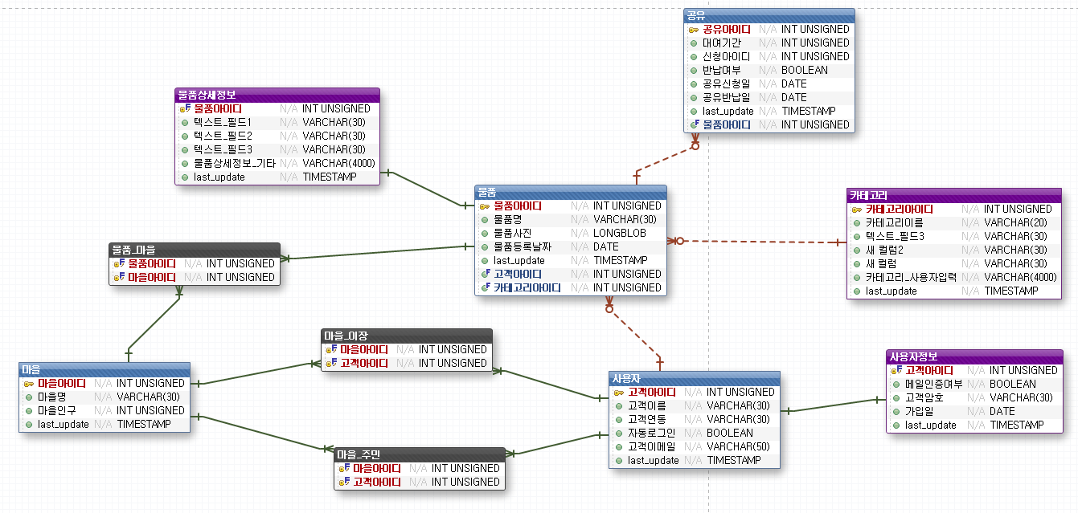
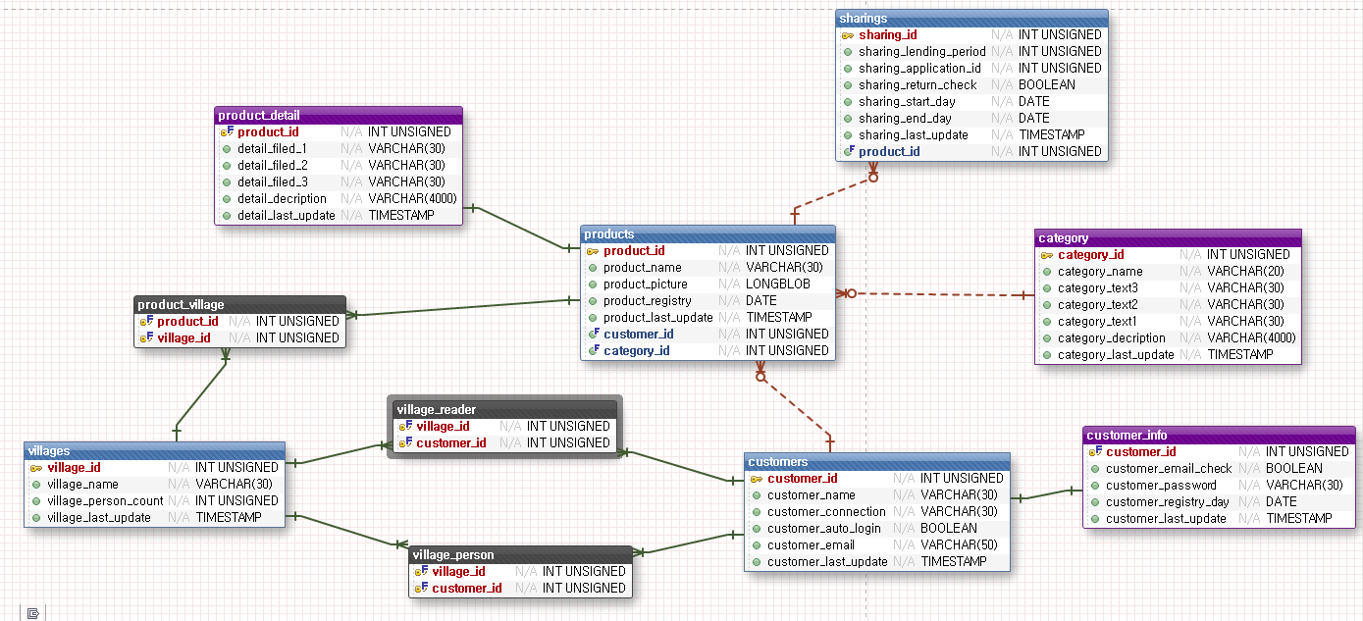
1. DB 설계

Slide 3
2. class 설계
servlet
doore.control
doore.dao
DispatcherServlet
RequestHelper
CommandFactory
Command<<interface>>
ProductCommand
CustomerCommand
VillageCommand
SharingCommand
DAOFactory
MysqlDAOFactory
MySqlProductDAO
MySqlCustomerDAO
MySqlVillageDAO
MySqlSharingDAO
ProductDAO<<interface>>
CustomerDAO<<interface>>
VillageDAO<<interface>>
SharingDAO<<interface>>
ProductVO
CustomerVO
VillageVO
SharingVO

Slide 4
Servlet
HttpServlet
DispatcherServlet
+ init(ServletConfig conf): void
+ processRequest(A): void
+ sendContent(B): void
+ dispatch(C): void
+ doGet(A): void
+ doPost(A): void
A: HttpServletRequest request, HttpServletResponse response
B: HttpServletRequest request, HttpServletResponse response, CommandResult commandResult
C: HttpServletRequest request, HttpServletResponse response, String page

Slide 5
Control - 구조
CommandFactory
+createCommand(String pathName)
: Command
CommandFactory
create
create
create
create
Product
Command
Customer
Command
Village
Command
Sharing
Command
+doAdd(R) : CommandResult
+doUpdate(R) : CommandResult
+doRemove(R) :CommandResult
+getAllProducts() :List<ProductVO>
+getProductByID(int id): ProductVO
+getCreateProduct() : void
+getUpdateProduct() : void
+getDeleteProduct() : void
ProductCommand
<<interface>>
Command
R:HttpServletRequest request,
HttpServletResponse response

Slide 6
Control - 세부내용
CommandResult
ProductCommand
CustomerCommand
viewURL:String
contentType:String
content:content
+doAdd(R) : CommandResult
+doUpdate(R) : CommandResult
+doRemove(R) :CommandResult
+getAllProducts() :List<ProductVO>
+getProductByID(int id): ProductVO
+getCreateProduct(product_name,product_picture,category_id,customer_id) : void
+getUpdateProduct(product_id,product_name,product_picture,category_id,customer_id) : void
+getDeleteProdct(product_id):void
+doAdd(R) : CommandResult
+doUpdate(R) : CommandResult
+doRemove(R) :CommandResult
+getAllCustomers() :List<CustomerVO>
+getCustomertByID(int id): CustomerVO
+getCreateCustomer() : void
+getUpdateCustomer() : void
+getDeleteCustomer() : void
+getCreateCustomer(customer_name,customer_connection,customer_email):
void
+getUpdateCustomer(customer_id,customer_name,customer_connection,customer_email):void
+getDeleteCutomer(customer_id):void
+CommandResult
(String viewURL)
+CommandResult
(String viewURL,String contentType,String content)
+ get***(), set***()
+hasView() : boolean
<<interface>>
Command
RequestHellper
+execute(R) :
CommandResult
request:HttpServletRequest
commandFactory:
CommandFactory
VillageCommand
SharingCommand
+doAdd(R) : CommandResult
+doUpdate(R) : CommandResult
+doRemove(R) :CommandResult
+getAllVillages() :List<VillageVO>
+getVillageByID(int id): VillageVO
+getCreateVillage() : void
+getUpdateVillage() : void
+getDeleteVillage() : void
+getCreateVillage(village_name,village_person_count):void
+getUpdateVillage(village_id,village_name,village_person_count):void
+getDelete(village_id):void
+doAdd(R) : CommandResult
+doUpdate(R) : CommandResult
+doRemove(R) :CommandResult
+getAllSharings() :List<SharingVO>
+getSharingByID(int id): SharingVO
+getCreateSharing() : void
+getUpdateSharing() : void
+getDeleteSharing() : void
+getCreateSharing(lending_period,application_id,return_check):void
+getUpdateSharing(sharing_id,lending_period,application_id,return_check):void
+getDeleteSharing(sharing_id):void
+getCommand():Command
CommandFactory
+createCommand(String pathName) : Command
create
R: HttpServletRequest request, HttpServletResponse response

Slide 7
DAO - 구조
DAOFactory
ProductVO
- int productId
- Sting productName
- String productPicture
- Date registrationDate
- int categoryId
- int cutomerId
MysqlDAOFactory
+ getter(), setter()
create
create
create
create
CustomerVO
MySqlProductDAO
MySqlCustomerDAO
MySqlVillageDAO
MySqlSharingDAO
- int customerId
- String customerName
- customer_connection
- boolean autoLogin
- String customerEmail
+ getter(), setter()
<<interface>>
ProductDAO
<<interface>>
CustomerDAO
<<interface>>
VillageDAO
<<interface>>
SharingDAO
VillageVO
- int villageId
- String villageName
- int population
ProductVO
CustomerVO
VillageVO
SharingVO
+ getter(), setter()
SharingVO
<<abstract>>
DAOFactory
MysqlDAOFactory
- int sharingId
- Date registrationDate
- Date startDate
- Date endDate
- int customerId
- Return_check
+ int mysql {readOnly}
+ getProductDAO(): MySqlProductDAO
+ getCustomerDAO(): MySqlCustomerDAO
+ getVillageDAO(): MySqlVillageDAO
+ getSharingDAO(): MySqlSharingDAO
+ getProductDAO(): ProductDAO{abstract}
+ getCustomerDAO(): CustomerDAO{abstract}
+ getVillageDAO(): VillageDAO{abstract}
+ getSharingDAO(): SharingDAO{abstract}
+ getDAOFactory(): DAOFactory
+ getter(), setter()

Slide 8
DAO - 세부내용
MysqlDAOFactory
create
create
create
create
MySqlProductDAO
MySqlCustomerDAO
MySqlVillageDAO
MySqlSharingDAO
+findAllProducts()
+findProductByID(product_id)
+createProduct(product_name
, product_picture, Category_id, Cutomer_id) : void
+updateProduct(product_id,product_name
, product_picture, Category_id, Cutomer_id) : void
+deleteProduct(product_id) : void
+findAllCustomers()
+findCustomerByID(customer_id)
+createCustomer(customer_name,
customer_connection,
customer_email) : void
+updateCustomer(customer_id,customer_name,
customer_connection,customer_email) : void
+deleteCustomer(customer_id) : void
+findAllVillages()
+findVillageByID(Village_id)
+createVillage(Village_name,
Village_person_count) : void
+updateVillage(Village_id,Village_name,
Village_person_count) : void
+deleteVillage(Village_id) : void
+findAllSharings()
+findSharingByID(Sharing_id)
+createSharing(Lending_period
Application_id,,Return_check) : void
+updateSharing(Sharing_id, Lending_period
Application_id,,Return_check) : void
+deleteSharing(Sharing_id) : void
<<interface>>
ProductDAO
<<interface>>
CustomerDAO
<<interface>>
VillageDAO
<<interface>>
SharingDAO
+findAllProducts()
+findProductByID(product_id)
+createProduct(product_name
, product_picture, Category_id, Cutomer_id) : void
+updateProduct(product_id,product_name
, Product_picture, Category_id, Cutomer_id) : void
+deleteProduct(product_id) : void
+findAllCustomers()
+findCustomerByID(customer_id)
+CreateCustomer(customer_name,
customer_connection,
customer_email) : void
+UpdateCustomer(customer_id,customer_name,
customer_connection,customer_email) : void
+deleteCustomer(customer_id) : void
+findAllVillages()
+findVillageByID(Village_id)
+createVillage(Village_name,
Village_person_count) : void
+updateVillage(Village_id,Village_name,
Village_person_count) : void
+deleteVillage(Village_id) : void
+findAllSharings()
+findSharingByID(Sharing_id)
+createSharing(Lending_period
Application_id,,Return_check) : void
+UpdateSharing(Sharing_id, Lending_period
Application_id,,Return_check) : void
+deleteSharing(Sharing_id) : void

