Slide 1
Python for Data Science: Numpy and Pandas
Session Plan

Slide 2
Learning Objectives of the session
To ensure that learners have a good working knowledge of python to be able to take on the upcoming modules.
To get familiar with Numpy and Pandas

Slide 3
Structure of the Session:
Duration | Topic | Details
5 Min | Explanation of session structure | All the learners need to watch the video lectures of this week Explanation of the agenda and learning objectives of the session
25 min | Concepts covered in the videos of the week | Use the Pop Quiz to gauge the level of understanding of the learners on videos covered during the week and identify areas to focus on. Explanation of the concepts of Numpy and Pandas where the group needs help.
50 min | Hands-on MovieLens Case Study | Explain the functions in Numpy and Pandas while demonstrating the hands-on MovieLens Case Study Summary of the key learnings from the case study.
20 min | Clarification of the doubts in Practice Exercises | Clarification of the doubts that learners may have in the Practice Exercises of the week
15 min | Buffer Zone for Question and Answers | Use this time to clarify additional doubts. Examples from the industry based on the mentor's past experience
5 min | Summary of the session | Summary of the week with the key takeaways Brief about the next session on Python for Visualization and EDA

Slide 4
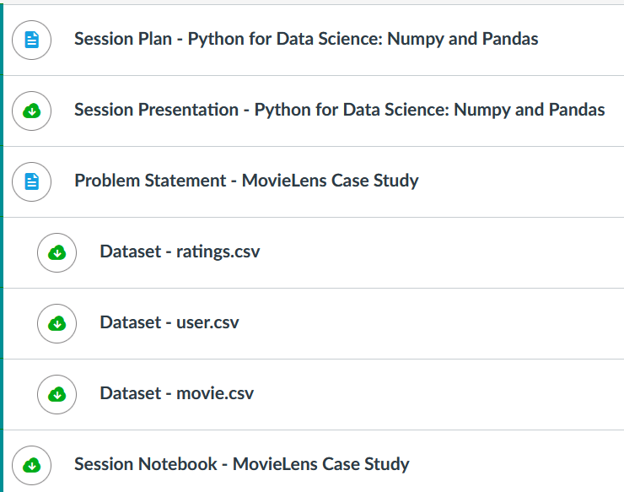
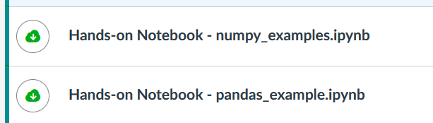
Where we are right now
Week 1
Introduction to Python
Week 2
Numpy & Pandas
Week 3
Visualization & EDA
Week 4
EDA deep Dive
Week 5
Capstone Project
Self-Learning
Mentored Session

Slide 5
Brief intro about pandas
Reference Link: https://pandas.pydata.org/
Documentation: https://pandas.pydata.org/docs/
API Reference: https://pandas.pydata.org/docs/reference/
Cheat Sheet: https://pandas.pydata.org/Pandas_Cheat_Sheet.pdf
Book Reference: Python For Data Analysis – Wes McKinney 2nd ed.

Slide 6
Problem Statement - MovieLens Case Study
Background:
The GroupLens Research Project is a research group in the Department of Computer Science and Engineering at the University of Minnesota. The data is widely used for recommendation systems. However, we will be using this data to act as a means to demonstrate our skill in using Python to “play” with data.
https://grouplens.org/datasets/

Slide 7
Key Questions & Steps
Import all the necessary packages.
Read all the datasets into pandas dataframes.
View the first 5 rows of all the datasets.
What are the shapes of all the datasets?
What are the data types of all the columns in datasets?
Provide a statistical summary of all the datasets.
Find the number of movies per genre in the movie dataset.
How many movies have more than one genre such as Action, Drama, etc?
Which 25 movies have got the highest average ratings?
What is the gender distribution across the genres?

Slide 8
Datasets (ratings)
rating.csv: It contains information on ratings given by the users to a particular movie.
user id: id assigned to every user
movie id: id assigned to every movie
rating: the rating given by the user
timestamp: Time recorded when the user gave a rating

Slide 9
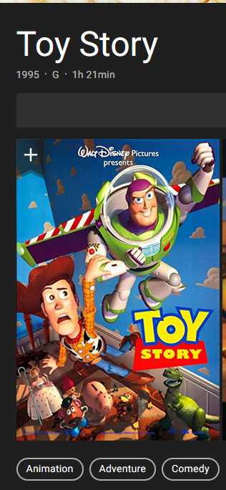
Datasets (movies)
movie.csv: The file contains information related to the movies and their genre.
movie id: id assigned to every movie
movie title: Title of the movie
release date: Date of release of the movie
Genres: (One-Hot Encoding)
Action: Genre containing binary values (1 - for action 0 - not action)
Adventure: Genre containing binary values (1 - for adventure 0 - not adventure)
Animation: Genre containing binary values (1 - for animation 0 - not animation)
Children’s: Genre containing binary values (1 - for children's 0 - not children's)
Comedy: Genre containing binary values (1 - for comedy 0 - not comedy)
Crime: Genre containing binary values (1 - for crime 0 - not crime)
Documentary: Genre containing binary values (1 - for documentary 0 - not documentary)
Drama: Genre containing binary values (1 - for drama 0 - not drama)
Fantasy: Genre containing binary values (1 - for fantasy 0 - not fantasy)
Film-Noir: Genre containing binary values (1 - for film-noir 0 - not film-noir)
Horror: Genre containing binary values (1 - for horror 0 - not horror)
Musical: Genre containing binary values (1 - for musical 0 - not musical)
Mystery: Genre containing binary values (1 - for mystery 0 - not mystery)
Romance: Genre containing binary values (1 - for romance 0 - not romance)
Sci-Fi: Genre containing binary values (1 - for sci-fi 0 - not sci-fi)
Thriller: Genre containing binary values (1 - for thriller 0 - not thriller)
War: Genre containing binary values (1 - for war 0 - not war)
Western: Genre containing binary values (1 - for western - not western)

Slide 10
Datasets (user)
user.csv: It contains information about the users who have rated the movies.
user id: id assigned to every user
age: Age of the user
gender: Gender of the user
occupation: Occupation of the user
zip code: Zip code of the user

