Slide 1
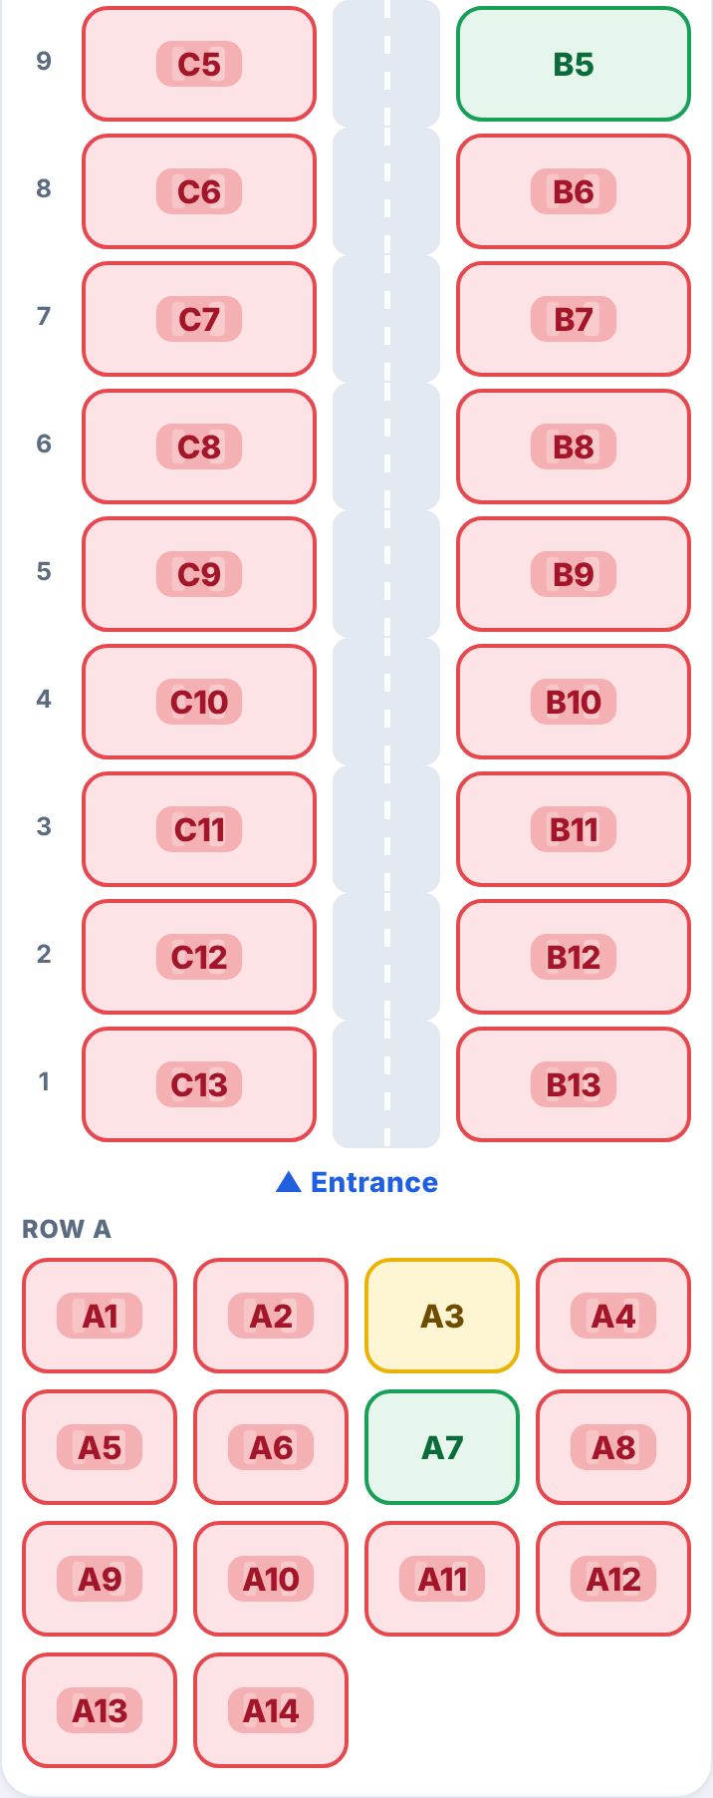
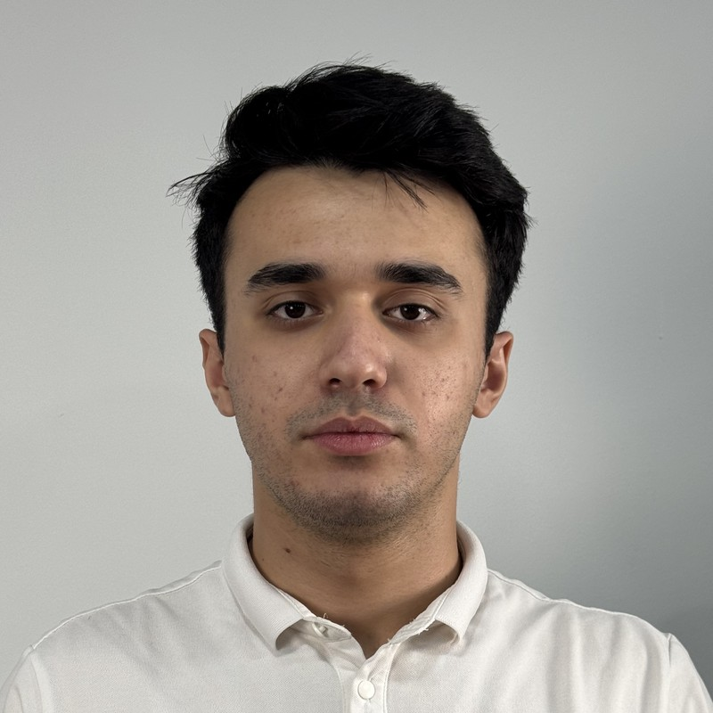
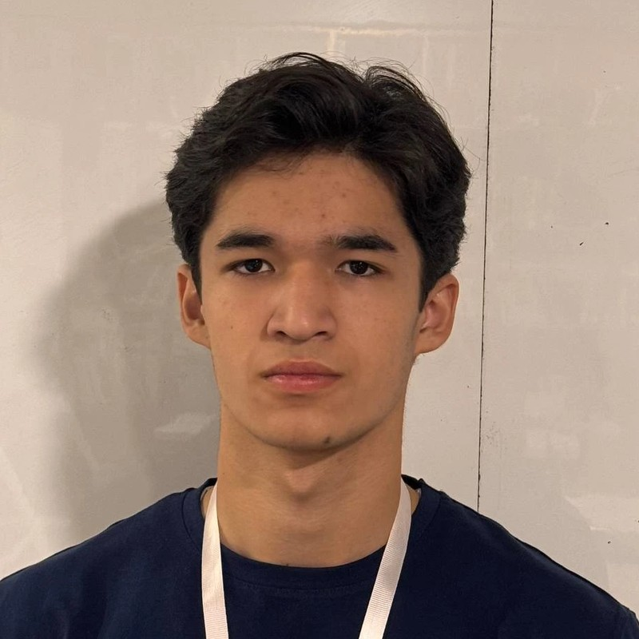
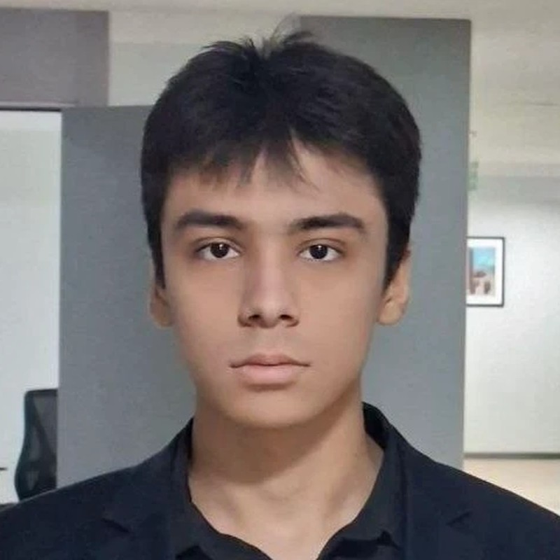
COMPUTER VISION TRACK · MODE: STARTUP
ParkDet
Parking Detector
Free parking spots, seen live
Bahodurov
Bahridin
Gopurjonov
Bobur
Shomurodov
Amirxon
Live spot map
● free ● reserved ● taken
Team ALL-IN-ONE · October 2026 · Live: parkspot-5bo4.onrender.com
Notes:
SPEAKER: Bahodurov Bahridin · 0:00–0:15
"Good afternoon. We are team ALL-IN-ONE and this is ParkDet — short for Parking Detector — a Startup-mode product for the Computer Vision track. ParkDet shows free parking spots, live."
(The phone shows our app's live spot map from a test run: green = free, yellow = reserved, red = taken (a car is parked) — swap in a WIUT screenshot once your lot is live.)

Slide 2







From guesswork to a guaranteed spot
PROBLEM → SOLUTION
THE PROBLEM
OUR SOLUTION
Drivers circle, guessing
No idea where a free spot is
One phone camera per lot
Sees every spot, no sensors
Live free spots on a map
Then navigate to the entrance
Elderly drivers get lost
Big lots, small signs
Book ahead or walk in
QR at the gate, pay before exit
Operators see nothing
Cameras exist, but give no data
Big, simple directions
“B5: straight 25 m, then right”
Notes:
SPEAKER: Bahodurov Bahridin · 0:15–1:00
"Everyone here has circled a parking lot. Drivers don't know where the free spot is and can't reserve one. Elderly drivers get lost in big lots with small signs. And the operator often already has cameras, but gets no data from them.
ParkDet fixes this with one phone camera per lot: it sees every spot, with no sensors. Drivers see free spots live on a map and navigate to the entrance. They book ahead, or just walk in with a QR code at the gate and pay before they leave. And they get big, simple directions: 'B5, straight 25 metres, then right'."
If the team has real evidence (interviews, a timed drive around a lot), add ONE sentence here — never invent numbers.

Slide 3

Try it on your own phone
LIVE DEMO · 2 MINUTES
1
Map → the live lot near you → Navigate to its entrance
2
Book a free spot → sandbox pay → QR ticket → directions
3
Your photo of any lot → cars, rows and empty spots found
4
Operator: phone camera, one-time spot check, pixelated view
parkspot-5bo4.onrender.com
5
Open it a few minutes early: the free server sleeps
Spot taken by another car? The booking moves itself
Notes:
SPEAKER: Gopurjonov Bobur · 1:00–3:00 (2 min, hard stop)
+0:00 "Scan the code — this is the live site." (Site open on the laptop AND one phone; the WIUT camera phone streaming.)
+0:10 Map: "This lot is live — the count comes from a phone camera above it." Tap Navigate (Google Maps opens to the entrance), come back.
+0:35 Free spots & booking: tap a green spot → Book → Pay (say: sandbox) → QR ticket → directions "straight 25 m, then right".
+1:00 JURY INPUT: Vision → upload the jury's photo → "cars, rows and inferred empty spots — nobody drew these spots".
+1:25 Operator view (PIN): pixelated camera + spot overlay; the one-time spot check; drivers never see the camera.
+1:45 "One CPU server, no GPU."
IF THE WIUT CAMERA IS OFFLINE: show it honestly — the map says "camera offline" and booking pauses; the system never guesses.
IF THE SITE IS DOWN: play your own screen recording of this flow (record it once the WIUT lot is live). Never debug on stage.

Slide 4
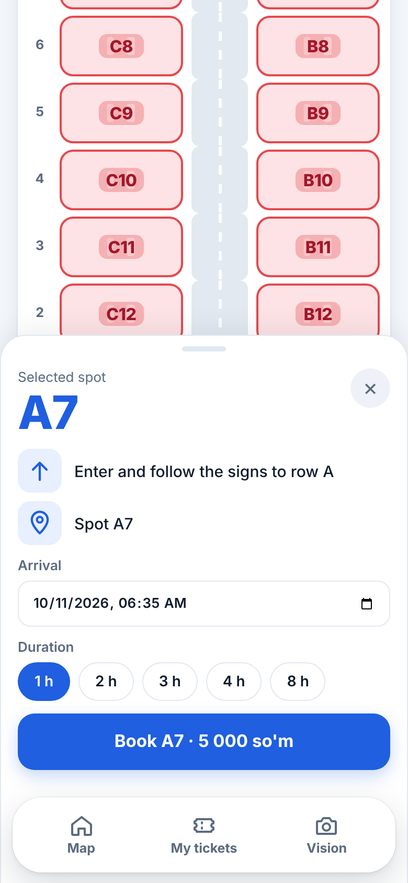
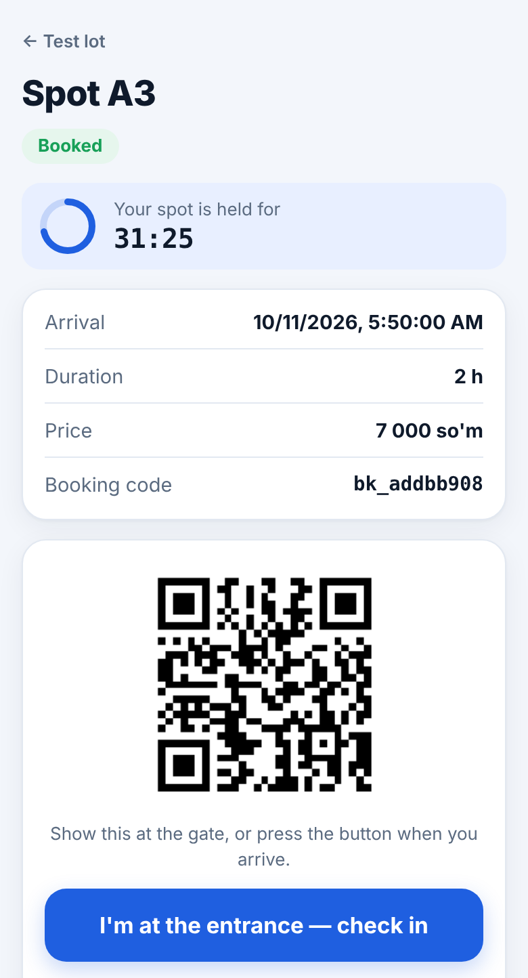
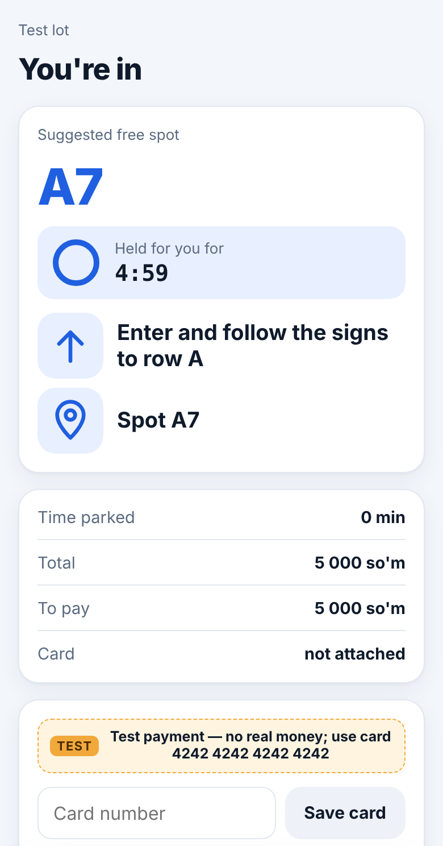
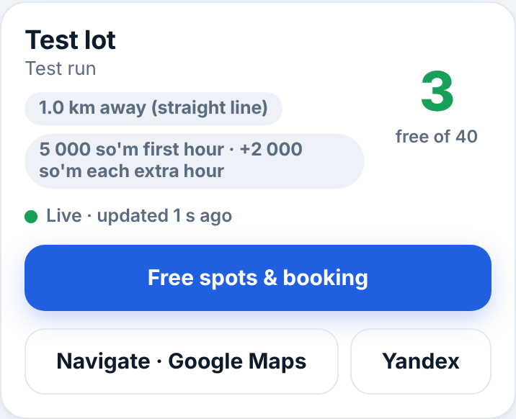
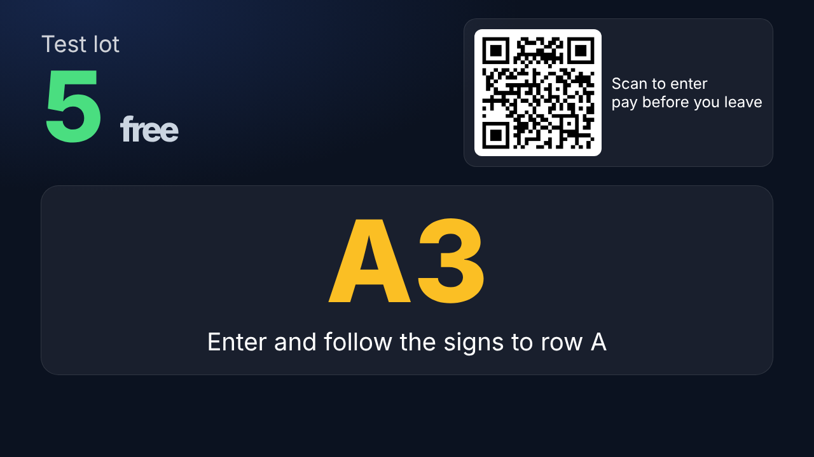
The app, screen by screen
PRODUCT DEMO
Nearby lots
Find me a spot
Booking ticket
Walk-in
Entrance screen
Live free spots, distance and price; Navigate opens Google Maps or Yandex
One tap: the nearest free spot and directions
QR ticket and a countdown of the hold
Scan the gate QR, get a spot, pay before leaving
Free count and the nearest spot, big and simple
Screens from test runs of the app; payment is in test mode
Notes:
SPEAKER: Gopurjonov Bobur · 3:00–3:20
"Here are the app's main screens: nearby lots with live free spots and Navigate; Find me a spot, which picks the nearest free spot; the ticket with its QR code and a countdown of how long the spot is held; the walk-in page from the gate QR, where you pay before leaving; and the entrance screen." Hand over to Amirxon.

Slide 5




How it works — and what we measured
TECHNOLOGY
HOW IT WORKS
Phone camera
one picture every 3–10 s
2 detectors, CPU
top-down + street-level YOLO11
Spots + occupancy
found automatically, cautious
Driver app
map, booking, directions — live
MEASURED
REAL CONDITIONS
0.14 s
per camera frame, 4-core CPU, no GPU
Offline: “no data”, no booking
< 400 MB
server memory
Privacy: never saved, pixelated
~20
cameras per small server (we plan 8)
Open models: YOLO11 (Ultralytics, AGPL-3.0), Leaflet, © OpenStreetMap. Ours: spot discovery, occupancy rules, booking engine, apps.
Notes:
SPEAKER: Shomurodov Amirxon · 3:20–4:45
"How it works. A phone at the lot sends a picture every few seconds. Two open YOLO11 detectors — one for cameras looking down, one for street-level views — run together on an ordinary CPU. Then our part: the spots are found automatically from the rows of parked cars, the operator confirms them once, and occupancy is cautious — any sign of a car keeps a spot occupied. The result feeds the map, booking and directions.
Measured: 0.14 seconds per camera frame on a 4-core CPU, no GPU, under 400 MB of memory — one small server handles about 20 cameras; we plan for 8. If a camera goes offline we show 'no data' and pause booking — we never guess. Pictures are never saved and the operator sees them pixelated."
Measurement conditions: synthetic 1280×720 frames, both detectors (worst case), 4-core Xeon 2.1 GHz, 2 threads; on the free demo server (0.1 CPU) a frame takes ~2.7 s — say so if a judge notices.
Q&A: detectors are pretrained (Ultralytics, AGPL-3.0); the top-down model must be retrained on our own data before commercial use (README). Everything after detection was written during the final.
TEAM-ONLY RUNBOOK (not for presenting)
10 minutes before: open the site to wake the free server · WIUT camera phone streaming, charging, screen on, one picture every 5–10 s · map shows the lot "Live" · operator PIN at hand · two lot photos on the laptop for the jury input · your own screen recording of the flow ready offline.
If something fails: slow photo → "free tenth-of-a-CPU server"; camera offline → show it (map says so, booking pauses); site down → play the recording at the same step; wrong detection → name it calmly; never debug on stage.

Slide 6
Who else solves parking — and what they miss
COMPETITORS IN UZBEKISTAN
Who | What it does | Strong points | Weak points vs ParkDet
Poytaxt Parking Tashkent city app, 2025 | Pay for street parking by zone | Official and city-wide; Payme, Click, Uzum, Paynet | Street parking only; no booking found; app rated 2.4 / 5
Gate systems with plate recognition e.g. Tashkent airport, since 2022 | Automatic entry, exit and payment | No paper tickets, no cashier | Know who entered, not which spot is free; hardware at every gate
Yandex Maps, 2GIS | Show lots and route drivers to them | Already on every phone | No live free spots or booking found — ParkDet hands navigation to them
City traffic centre pilot Tashkent, April 2026 | Joins private lots into one city system | City backing | Pilot; no driver app announced — a possible partner
Per-spot sensors e.g. Hikvision parking guidance | A sensor or camera over every spot | Very accurate per spot | One device per spot = costly install; none found in Uzbekistan
ParkDet us | One phone camera per lot: live map, booking, walk-in, directions | No per-spot hardware; works with a phone or an existing camera | Prototype: accuracy on Tashkent photos still to measure
Market signal: Tashkent airport's parking tender (May 2026) asks the operator for online booking and free-space boards.
Sources for every row: speaker notes
Notes:
SPEAKER: Shomurodov Amirxon · 4:45–5:30
"Who else solves parking in Uzbekistan? The city's Poytaxt Parking app takes payment for street parking — but it's street-only and we found no booking. Gate systems with plate recognition, like Tashkent airport's since 2022, know who came in — not which spot is free. Yandex Maps and 2GIS show where lots are — we found no live free spots or booking, so we simply hand navigation over to them. The city traffic centre started a pilot in April to join private lots into one system — a possible partner for us. And per-spot sensors are accurate, but need a device over every spot; we found no installation in Uzbekistan. ParkDet needs one phone per lot. And demand is real: the airport's May tender asks for online booking and free-space boards."
Say "we found" — these are absences in our search, not proven facts. Open every link once before the defence.
SOURCES (checked 10 Oct 2026 via search results; open each before the defence)
Poytaxt Parking: spot.uz/ru/2025/06/23/paid-parking/ (app rating 2.4/5, payment options) · kun.uz/ru/news/2025/05/05/v-tashkente-v-testovom-rejime-zapushcheny-pervyye-pridorojnyye-platnyye-parkovki · afisha.uz/ru/gorod/2025/05/06/parking (operator Streetpark Systems, zones 5,000–12,000 so'm/h)
Airport gate system: kun.uz/ru/news/2022/11/24/v-aeroportu-tashkenta-zarabotala-pervaya-umnaya-parkovka-v-strane (333 spaces, plate recognition) · anhor.uz/news/smart-parking/ (Amano equipment, installed by K2) · spot.uz/ru/2023/01/09/parking-airport/
Airport tender: spot.uz/ru/2026/05/04/airport-parking-lease/ · anhor.uz/news/parkovki-2/ (6 lots, 1,543 spaces, 3 years; tenant must add plate recognition, online payment and booking, free-space boards)
City pilot: kun.uz/ru/news/2026/04/21/v-tashkente-pristupili-k-realizatsii-pilotnogo-proyekta-po-sistemnomu-upravleniyu-parkovkami · uza.uz (private lots near shops joined to one city system; space accounting and occupancy control)
Maps: yandex.com/maps (Tashkent parking places) · 2gis.uz (Tashkent paid car parks listing)
Per-spot guidance product: hikvision.com Smart Parking solution brochure (parking guidance systems); no Uzbek installation found in our search.

Slide 7


Drivers pay per hour, split 50/50 with the lot
BUSINESS MODEL AND PILOT
HOW WE EARN
3-MONTH PILOT IN ONE LOT
Customers: malls, business centres, universities, dealerships, paid city lots
Month 1 · Install and check
1–2 phone cameras at [pilot lot]; spot check; label photos
1
Revenue: drivers pay 5 000 so'm for the first hour and 2 000 so'm for each extra hour; 50% goes to the parking lot, 50% is our income
2
Month 2 · Drivers use it
Map, booking and walk-in live; weekly accuracy report
Operator gains: paid bookings, no gate staff for walk-ins, usage data
3
Month 3 · Pay and decide
Local payment provider; ROI review; go / no-go
Price per driver = 5 000 so'm (first hour) + 2 000 so'm × extra hours
Split = 50% parking lot · 50% ParkDet
Our cost per camera / month = [server $] ÷ 8 + [phone] ÷ [months] + [support]
Pilot cost: [sum] — people, server, phones, labelling
Payback: [__] months
Our ask: one lot to pilot in
Every [bracket] = a real quote or interview number, never a guess
Notes:
SPEAKER: Bahodurov Bahridin · 5:30–6:50
"How we earn: drivers pay 5,000 so'm for the first hour and 2,000 so'm for each extra hour. Half of every payment goes to the parking lot, half is our income. We work with malls, business centres, universities, dealerships and paid city lots. The lot gets paid bookings, no gate staff for walk-ins, and data on how the lot is used. Our cost per camera is a share of one server, the phone and support.
To prove it: a three-month pilot in one lot. Month one: one or two phone cameras, the spot check, and labelling photos from that lot. Month two: drivers use the map, booking and walk-in, and the operator gets a weekly accuracy report. Month three: a real local payment provider, an ROI review, go or no-go. The pilot costs [sum] and pays back in [__] months.
Our ask: one lot to pilot in."
Replace every [bracket] with a sourced number, or say "this is our hypothesis, to be validated in the pilot".

Slide 8



ParkDet
Thanks for watching
Parking Detector · Free parking spots, seen live
Notes:
SPEAKER: Bahodurov Bahridin · 6:50–7:00 (finish by 6:55)
"Thanks for watching — we're happy to take your questions."
Q&A owners: CV / model → Amirxon; app, demo, deployment → Bobur; business, pilot, users → Bahridin.

