Slide 1
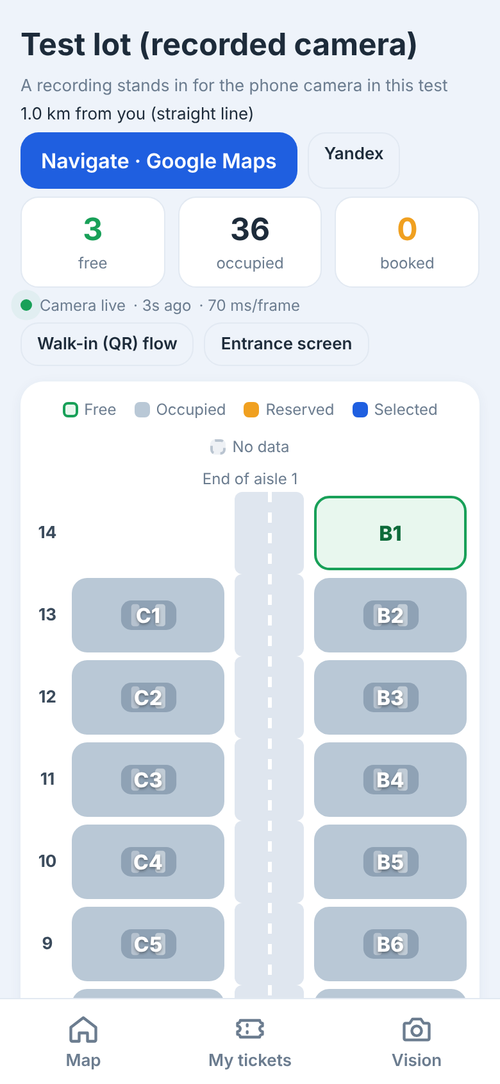
COMPUTER VISION TRACK · MODE: STARTUP
ParkSpot
A phone camera above any parking lot → a live map of free spots, navigation to the entrance, booking, and step-by-step guidance to the spot.
Bahodurov
Bahridin
Gopurjonov
Bobur
Shomurodov
Amirxon
Team ALL-IN-ONE · October 2026 · Live prototype: parkspot-5bo4.onrender.com
Notes:
SPEAKER: Bahodurov Bahridin · 0:00–0:15
"Good afternoon. We are team ALL-IN-ONE, and this is ParkSpot — a Startup-mode product for the Computer Vision track. ParkSpot turns a phone camera above any parking lot into a live map of free spots: drivers navigate to the lot, book a spot before they arrive, and are guided to it step by step."
(Replace the three circles with the speakers' photos.)

Slide 2



Finding a free spot is still guesswork
THE PROBLEM
Driver
Circles the lot not knowing where a spot is. Cannot reserve one before leaving home.
Elderly drivers
Elderly and new drivers need large, simple, one-step-at-a-time directions — not a maze of signs.
Lot operator — pays
Often already has cameras, but no live occupancy, no booking, no data on how the lot is used.
Our evidence: [N] driver interviews · [N] operator conversations · [observed time-to-park at ___] — fill in only what the team actually collected.
Notes:
SPEAKER: Bahodurov Bahridin · 0:15–1:00
"Everyone in this room has circled a parking lot looking for a spot. The driver doesn't know where the free spots are and can't reserve one. For elderly or inexperienced drivers it's worse — they need big, simple, one-step directions. And the lot operator — the person who pays us — often already has cameras, but gets nothing from them: no live occupancy, no booking, no data."
State ONLY evidence you actually have ("We spoke to [N] drivers and [N] operators; [one real quote]"). If none: "We are validating this with operators in the pilot" — never invent numbers.

Slide 3
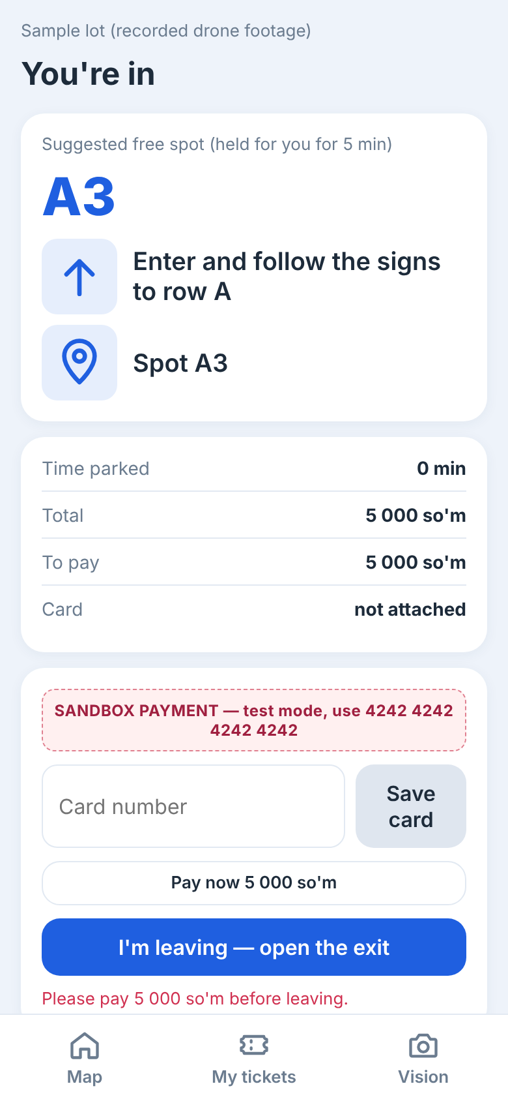
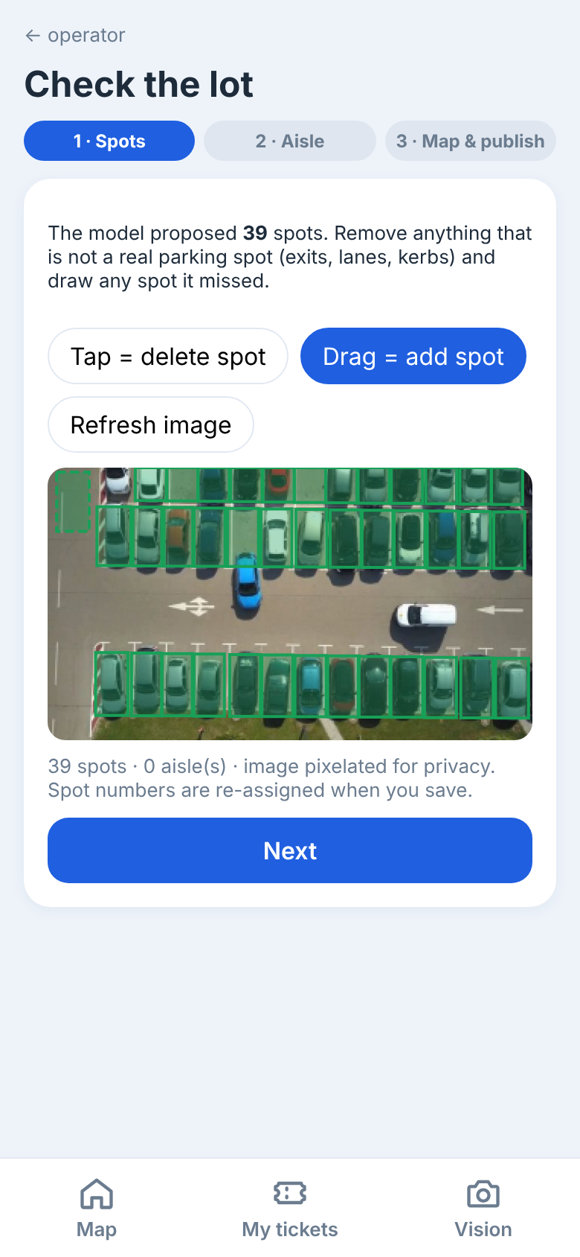
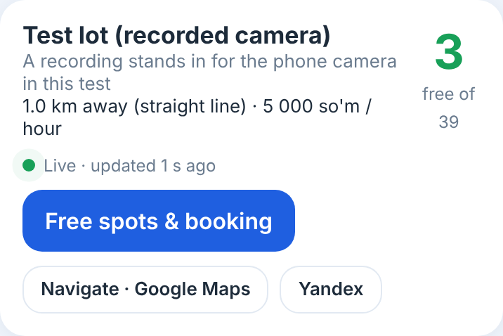
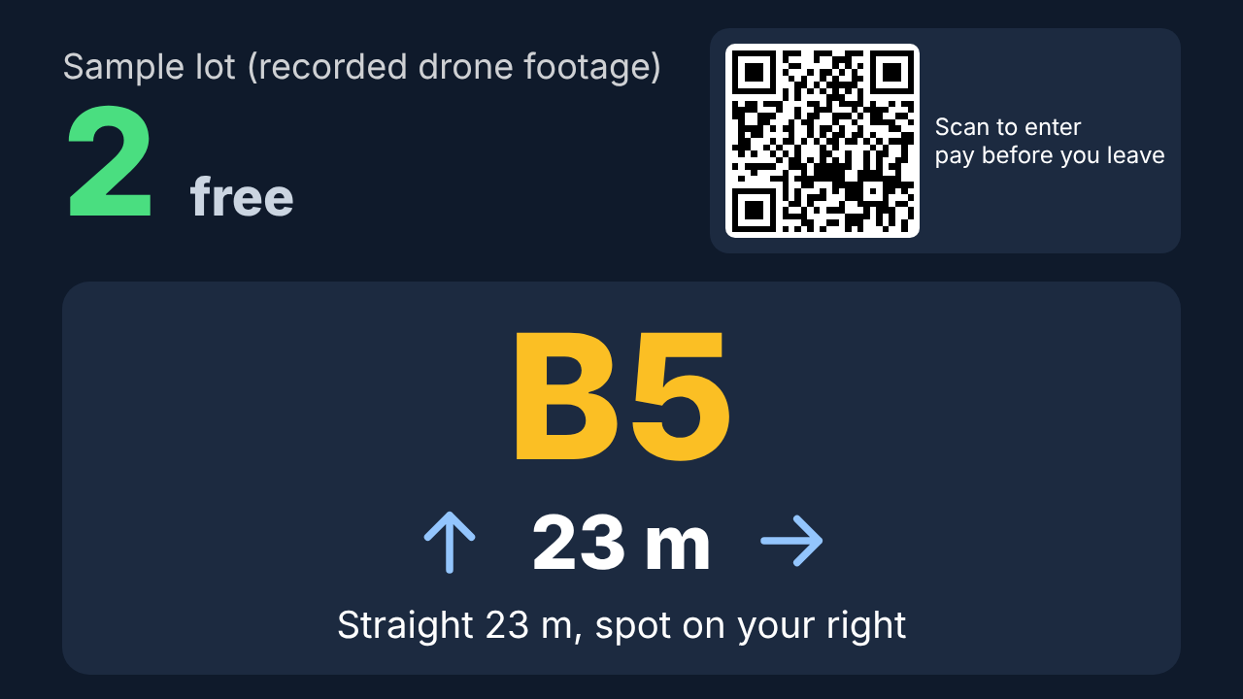
From one camera to the right spot
THE PRODUCT
Map & navigation
Spots & booking
Walk-in
Entrance screen
Operator
Live free counts on a map. Navigate opens Google Maps or Yandex to the entrance.
Pick a free spot, book, get a QR ticket and in-lot directions.
Scan the gate QR, get a spot, pay any time before leaving.
Big numbers and arrows, made for elderly drivers.
Phone camera, one-time spot check, pixelated camera view.
Payments in the prototype are sandbox (test mode) and labelled as such
Notes:
SPEAKER: Bahodurov Bahridin · 1:00–1:15 (then hand over to Bobur)
"ParkSpot takes one camera and drives five screens. Drivers see live free counts on a map and navigate to the entrance. They pick a free spot, book it and get a QR ticket with directions. Drivers without a booking scan a QR at the gate and pay before they leave. An entrance screen shows the nearest spot with big arrows. And the operator mounts a phone, checks the spots once, and sees a pixelated camera view. Bobur will show it live."
Say it: payments in the prototype are sandbox — no real money moves.

Slide 4

Try it on your own phone
LIVE DEMO · 2 MINUTES
1
Map → the live lot near you → Navigate to its entrance
2
Book a free spot → sandbox pay → QR ticket → "straight 25 m, then right"
3
Your photo of any lot → cars, rows and empty spots found
4
Operator: phone camera, one-time spot check, pixelated view
parkspot-5bo4.onrender.com
5
Open it a few minutes early: the free server sleeps
Spot taken by another car? The booking moves itself
Notes:
SPEAKER: Gopurjonov Bobur · 1:15–3:00 (1 min 45 s, hard)
+0:00 "Scan the code — this is the live site." (Site open on the laptop AND one phone; the WIUT camera phone streaming.)
+0:10 Map: "This lot is live — the count comes from a phone camera above it." Tap Navigate (Google Maps opens to the entrance), come back.
+0:35 Free spots & booking: tap a green spot → Book → Pay (say: sandbox) → QR ticket → directions "straight 25 m, then right".
+1:00 JURY INPUT: Vision → upload the jury's photo → "cars, rows and inferred empty spots — nobody drew these spots".
+1:25 Operator view (PIN): pixelated camera + spot overlay; mention the one-time spot check and that drivers never see the camera.
+1:40 "One CPU server, no GPU." Hand over to Amirxon.
IF ANYTHING FAILS: "switching to the recorded run" → docs/demo-backup.mp4 at the same step. If the WIUT camera is offline, show it honestly: the map says "camera offline" and booking pauses — the system never guesses.

Slide 5
A system, not one model call
TECHNOLOGY
1 · Camera picture
2 · Quality gate
3 · Two detectors
4 · Spot layout
A phone at the lot sends one JPEG every 3–10 s
Light, blur, glare; a dark frame gets a second, stretched view
Aerial + ground-view YOLO11, ONNX on CPU, merged
Found automatically, confirmed once by the operator — ours
5 · Occupancy
6 · Booking engine
7 · Map & apps
Cautious: box, centre and ground point; smoothed over pictures
Holds, no-shows, camera-confirmed parking, re-assignment — ours
Live map, navigation, in-lot directions, entrance screen
Stack: Python · FastAPI · onnxruntime · OpenCV · SQLite · React · Leaflet + OpenStreetMap — one Docker container, deployed from our repository.
Notes:
SPEAKER: Shomurodov Amirxon · 3:00–3:30
"Under the hood this is a pipeline, not one call to someone else's model. A phone at the lot sends a picture every few seconds. A quality gate checks light, blur and glare; dark frames get a second, contrast-stretched view. Two open detectors run together — one for top-down views, one for side views. Then our parts: the spot layout is found automatically and confirmed once by the operator; occupancy is cautious — any sign of a car, including where its wheels touch the ground, keeps a spot occupied; a booking engine enforces reservations with the camera; and the apps add the map, navigation and in-lot directions. One container, CPU only."
Q&A: detectors are pretrained (YOLO11 COCO + an aerial-view model from Ultralytics assets); everything after detection was written during the final.

Slide 6




What a weekend copy would not have
INNOVATION · THE REPLICATION TEST
Zero-config spot discovery
Bookings enforced by the camera
Rows of parked cars found by RANSAC, empty spots inferred from gaps in car widths, aisle traffic ignored. The operator only confirms.
Booked spot taken → the booking moves to the nearest free spot; arrival confirmed by the camera. No plates read.
A phone is the camera
Honest and private by design
Mount, tap Create, check once, publish: a lot goes live in minutes — and restores itself after a server restart.
No camera picture → "no data", never "free". Images pixelated on the server; drivers never see the camera.
Moat over time: our labelled Tashkent lot data + operator integrations
Notes:
SPEAKER: Shomurodov Amirxon · 3:30–4:10
"Why can't another team rebuild this in a weekend? One — zero-config spot discovery: we find the rows of parked cars and infer the empty spots, so a new camera needs no hand-drawn spots; the operator just confirms. Two — bookings are enforced by the camera: if someone takes your spot, your booking moves, and we never read a licence plate. Three — any phone is the camera: a lot goes live in minutes, and the phone even restores the lot if our free server restarts. Four — honest and private by design: with no picture we show 'no data', never 'free'; images are pixelated on the server and drivers never see them."

Slide 7
Measured, not claimed
PROOF
77 ms
374 MB
13 / 13
per frame, CPU only (p95 99 ms; 640×360, 4-core Xeon 2.1 GHz, 2 threads)
peak server memory (4K photo), no GPU, no PyTorch at run time
hand-drawn reference spots found by auto-layout (dev set)
Set | Spots | Accuracy | "Free" right
Dev: public sample clip, 4 frames | 52 | 100% | 100%
Dev + synthetic night | 52 | 92% (was 71%) | 33% (was 12%)
Dev + synthetic rain / fog / blur | 52 | 100% | 100%
Test: our Tashkent photos | [N] | [__%] | [__%]
Dev set = the clip we tuned on, so 100% is not proof of generalisation; the Tashkent test set is what counts
Notes:
SPEAKER: Shomurodov Amirxon · 4:10–4:40
"Numbers we measured, not claimed. 77 milliseconds per frame on an ordinary 4-core CPU, under 400 megabytes of memory — one cheap server runs many cameras. Auto-layout found all 13 spots a human drew on the reference footage.
Be honest about this table: the first rows are a development set — the clip we tuned on, so 100% proves nothing about new lots. The synthetic night test exposed a real weakness: 71% accuracy; our fix lifted it to 92%, but only a third of the 'free' answers at night are right. The last row is our Tashkent test set: [real numbers, or: 'we are labelling it with our own tool — results are on our Quality page']."
NEVER fill the last row with guesses.

Slide 8
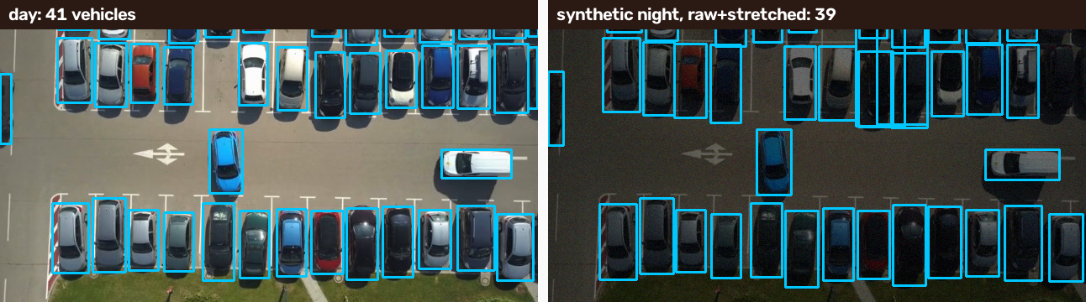
Where it breaks today
KNOWN FAILURE CASES
Night: dark cars missed
Occupied spots can look free (synthetic night: 33% of "free" answers right). Next: real night photos, fine-tune.
Rows with fewer than 3 cars
Not found automatically — the operator draws them once in the spot check.
Day: 41 vehicles. Synthetic night: 37 on the raw frame, 30 after a standard enhancement (worse), 39 with raw + stretched views merged — the fix we shipped.
Distant cars, row ends, occlusion
Cars ~10 px wide: 29 of 41 found; trees and poles not yet measured.
Synthetic night = (0.22·x)^1.15 per pixel + Gaussian noise σ 6, declared in eval/evaluate.py
Notes:
SPEAKER: Shomurodov Amirxon · 4:40–5:00
"Where it breaks today. At night dark cars get missed, so an occupied spot can look free — the worst error for a driver. A standard enhancement made it worse: 37 cars became 30. Detecting on the raw frame and a stretched copy gets 39 of 41 — progress, not solved; next is real night photos and fine-tuning. Rows with fewer than three cars aren't found automatically — the operator draws them once. Very distant cars are partly missed, and occlusion isn't measured yet."
This slide earns trust — say it calmly.

Slide 9
Built for real conditions
ENGINEERING CONSTRAINTS
Question | Answer
Where inference runs | Server CPU, no GPU. The camera phone only sends pictures.
Speed | 77 ms per frame (177 ms when both detectors run); 1080p: 86 ms.
Capacity | 1 picture / 3 s per camera → 17–39 cameras per 2-thread worker.
Cost per camera | [server $ / month] ÷ 8 cameras (worst case, 50% load).
Night | Two-view detection; synthetic night 92%. Real night: [to collect].
Rain, fog, blur | Synthetic on the dev set: no drop. Real rain: [to collect].
Privacy | Pictures never stored; operator view pixelated; no plates read.
Camera offline | Spots shown as "no data", booking pauses — never guessed.
Capacity = 3 s ÷ 0.177 s (both detectors) to 3 s ÷ 0.077 s; 4-core Xeon 2.1 GHz, 2 threads
Notes:
SPEAKER: Shomurodov Amirxon · 5:00–5:15 (point at the table; the jury reads the rest)
"Inference runs on a server CPU — the phone only sends pictures. 77 milliseconds per frame. A spot changes over minutes, so one picture every three seconds is plenty: one small worker serves 17 to 39 cameras — we plan for eight. Pictures are never stored, the operator sees them pixelated, and if a camera goes offline we show 'no data' and pause booking."
Our free demo server is far smaller (a tenth of a CPU): about 2 s per photo — say so if a judge notices. Fill [server $ / month] with a real quote.

Slide 10


The lot operator pays — per camera
BUSINESS MODEL
Customers
Revenue
Operator's gain
Mall and business-centre lots, university and dealership customer parking, paid city lots.
Subscription: [price] per camera per month. Booking fee: [__%] of each reservation. Both to validate in the pilot.
Paid bookings, fewer cars circling, no gate staff for walk-ins, usage data.
Revenue / camera / month = [subscription] + [bookings per day] × [fee] × 30
Cost / camera / month = [server $] ÷ 8 + [camera or phone] ÷ [months of use] + [support]
Every bracket is an input the team fills from real quotes or interviews — no invented prices
Notes:
SPEAKER: Bahodurov Bahridin · 5:15–5:55
"Who pays? The lot operator — malls, business centres, university and dealership parking, paid city lots. We charge per camera per month plus a small fee per booking. The operator gains paid bookings, fewer cars circling, no gate staff for walk-ins, and data. Per camera, revenue is the subscription plus bookings times the fee; cost is the server divided by eight cameras, the phone — or an existing camera — and support."
Replace every [bracket] with a sourced number, or say "this is our hypothesis, to be validated in the pilot".

Slide 11
A 3-month pilot in one lot
BUDGET AND ROI
1
Pilot cost | 3 months
People | 3 × 3 months × [salary]
Server | 3 × [$ / month]
Cameras | existing, or [N] phones × [price]
Labelling | [hours] × [rate]
Detector licence | retrain on our data, or [fee]
Total | [sum]
Month 1 · Install and check
1–2 phone cameras at [pilot lot, e.g. WIUT]; one-time spot check; label day and night photos; fine-tune.
2
Month 2 · Drivers use it
Map, booking and walk-in live; weekly accuracy report to the operator.
3
Month 3 · Pay and decide
Payback = [total] ÷ ([revenue] − [cost] per month) = [__] months
Local payment provider; ROI review with the operator; go / no-go.
Pilot KPIs: "free" precision ≥ [target] · spot accuracy ≥ [target] · bookings per day · time to park, before vs after
Notes:
SPEAKER: Bahodurov Bahridin · 5:55–6:30
"The pilot is three months in one lot. Month one: one or two phone cameras at [pilot lot], the one-time spot check, and day and night photos labelled from that lot to fine-tune. Month two: drivers use the map, booking and walk-in; the operator gets a weekly accuracy report. Month three: a real local payment provider, an ROI review with the operator, and a go / no-go decision. The pilot costs [total], mostly people; with [N] cameras at [price] it pays back in [__] months."
Every bracket must be a sourced number or said aloud as an assumption.

Slide 12
Our ask: one lot to pilot in
NEXT STEPS
1
Run the WIUT lot live and label a Tashkent test set — day, night, rain
2
Retrain the detector on our own data: fixes night, removes licence risk
3
Pilot with one operator for 3 months
Thank you — questions?
Bahodurov Bahridin · Gopurjonov Bobur · Shomurodov Amirxon
parkspot-5bo4.onrender.com
github.com/trallexxs/parkspot
Notes:
SPEAKER: Bahodurov Bahridin · 6:30–7:00 (finish by 6:55)
"Next: run the WIUT lot live and label a real Tashkent test set — day, night and rain — and publish the numbers; retrain the detector on our own data, which fixes night and removes the licence risk of today's pretrained weights; and run a three-month pilot with one operator. That is our ask: one lot to pilot in. Thank you — we're happy to take questions."
Q&A: CV / model → Amirxon; app, demo, deployment → Bobur; business, pilot, users → Bahridin. Backup slides follow.

Slide 13
Data, models and licences
BACKUP · Q&A
Item | Source | Licence / note
Ground-view detector | YOLO11n (COCO), Ultralytics | AGPL-3.0
Aerial-view detector | Ultralytics assets parking model | AGPL-3.0; VisDrone-style classes → retrain before commercial use
Sample camera clip | Ultralytics sample video | AGPL-3.0; never shown to drivers as a real lot
Reference spots | Ultralytics hand-drawn spots | AGPL-3.0; used only to evaluate
Map | Leaflet; OpenStreetMap tiles | BSD-2-Clause; © OpenStreetMap contributors (ODbL)
Synthetic night / rain / fog / blur | Our script, method declared | Our code
Test set | Our own photos of Tashkent lots | [N photos]; no faces or plates kept
Elimination-stage reuse | trallexxs/trafficcv | YOLO11n weights file only (declared)
Notes:
BACKUP for Q&A — "Where did your data come from? Is anything not yours?"
Everything pretrained is listed with its licence; all code after detection — layout discovery, occupancy, booking engine, map and apps, evaluation — was written during the final. The aerial model's classes match VisDrone (research data), so before any commercial use we retrain on our own labelled data. Payments are sandbox.

Slide 14
Demo runbook
BACKUP · TEAM ONLY
10 minutes before
If something fails
Open the site to wake the free server
WIUT camera phone streaming, charging, screen on
Map shows the lot "Live"; operator PIN at hand
Recorded demo video ready, offline
Two lot photos on the laptop for the jury input
Slow photo: "free tenth-of-a-CPU server"
Camera offline: show it — the map says so and booking pauses
Site down: switch to the recorded run, same step
Wrong detection: name it as a known failure case
Never debug on stage — the clock keeps running
Notes:
Team checklist, not for presenting. Rehearse the full 7:00 at least three times with a timer; cut words, not the demo. The jury may ask any member about code written with an LLM: Amirxon — layout.py, detector.py, occupancy.py, evaluate.py; Bobur — frontend pages, map, deployment; Bahridin — booking rules in lots.py, pricing assumptions.

