Slide 1
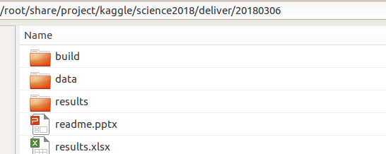
0. Deilvery
- What is in the downloaded delivery?
Python source code
Data split and some example of converted format.
Example of trained model and submission csv.
Training log for loss over training iterations

Slide 2
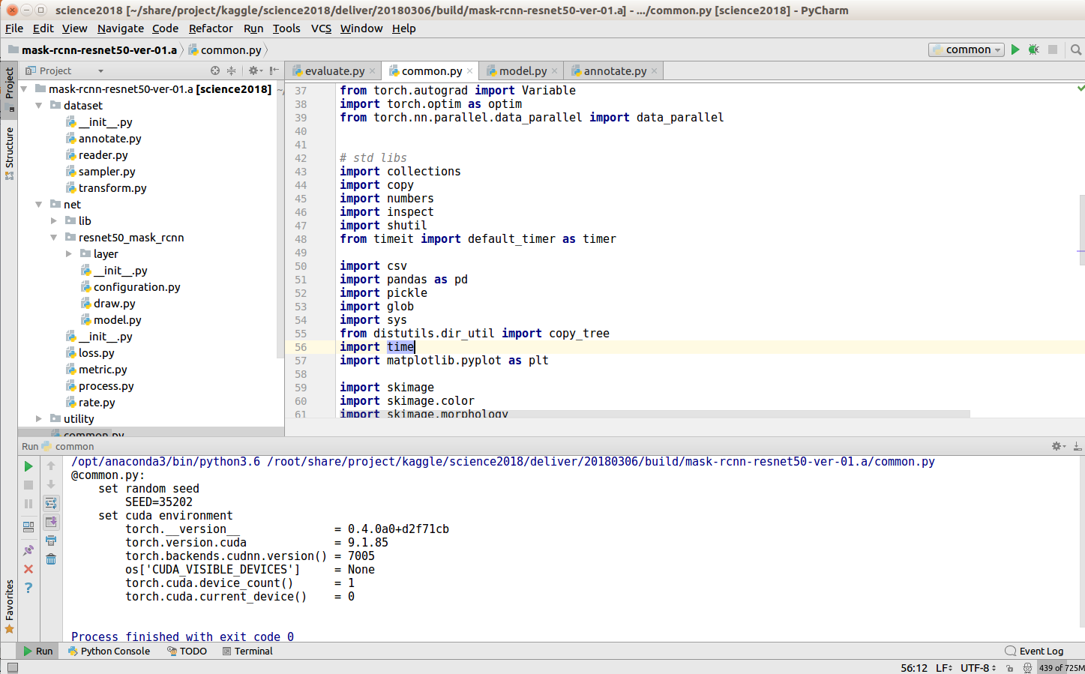
1. Software Setup (version: mask-rcnn-resnet50-ver-01.a)
- python 3.6 / Pycharm as IDE - pytorch 0.4.0 (please build from source. Anaconda/Pip installation is only up to 0.30)
0.4.0 support zero dimension torch tensor array and torch scalar
run "common.py" to check your version

Slide 3
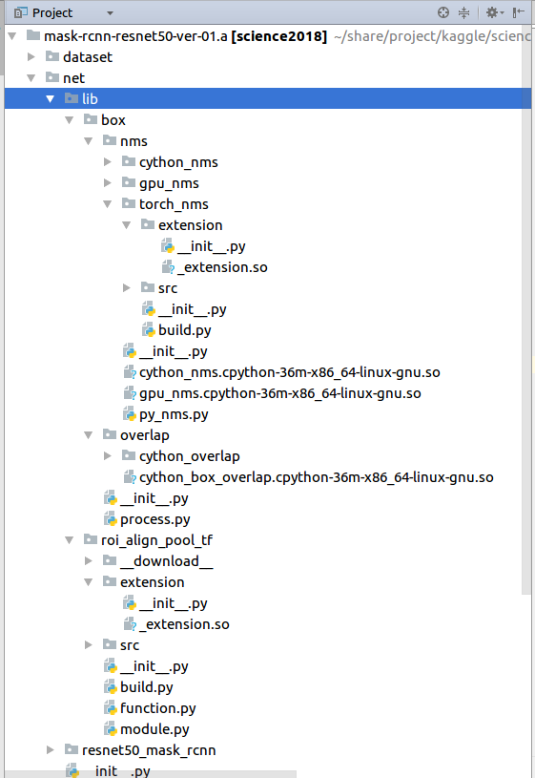
- Software setup. You must build the torch *.so lib for your system
1. lib/box/nms/torch_nms/extension/_extension.so
>> /usr/local/cuda-9.1/bin/nvcc -c -o nms_kernel.cu.o nms_kernel.cu -x cu -Xcompiler -fPIC -arch=sm_52
>> python build
2. lib/roi_align_pool_tf/extension/_extension.so
This is porting of roi align pooling layer from tensorflow implementation. Note that this is not the same as mask-rcnn paper.
>> /usr/local/cuda-9.1/bin/nvcc -c -o crop_and_resize_kernel.cu.o crop_and_resize_kernel.cu -x cu -Xcompiler -fPIC -arch=sm_52
>> python build

Slide 4
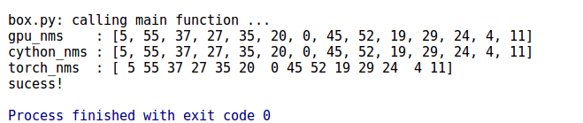
- You must build the cython *.so lib for your system
1. lib/box/nms/cython_nms_xxx.so
>> /opt/anaconda3/bin/python3 setup.py build_ext --inplace
2. lib/box/nms/gpu_nms_xxx.so
>> /opt/anaconda3/bin/python3 setup.py build_ext --inplace
To check mns, see "box/process.py" run_check_nms()
3. lib/box/overlap/cython_box_overlap_xxx.so
>> /opt/anaconda3/bin/python3 setup.py build_ext --inplace

Slide 5
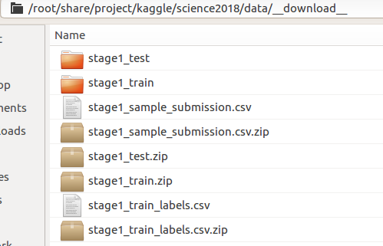
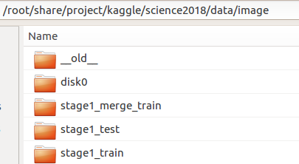
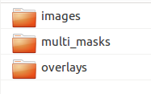

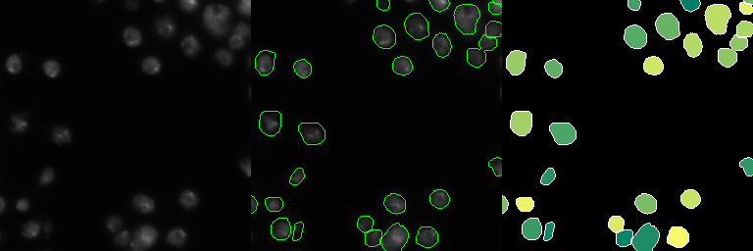
2. Data Setup
- run the functions at dataset/annotate.py: "run_make_train_annotation()" and "run_make_test_annotation()"
download and unzip here
Converted format for training
(we create visualisation and more user friendly format)

Slide 6
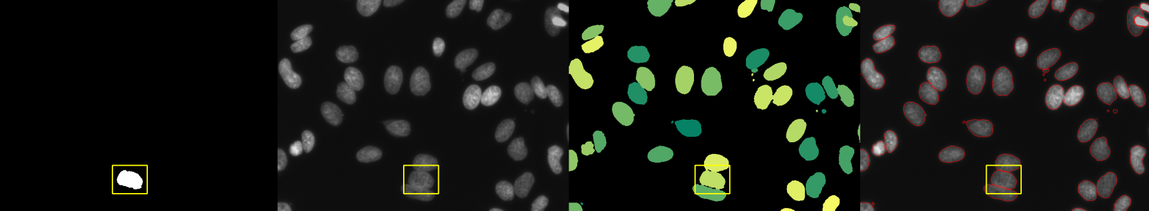
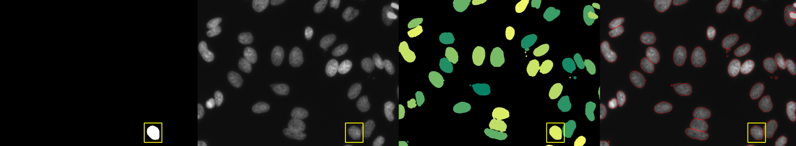
- run the function "run_check_dataset_reader() at dataset/reader.py to see if your data is setu correctly
press any key to iterate over all mask instances

Slide 7
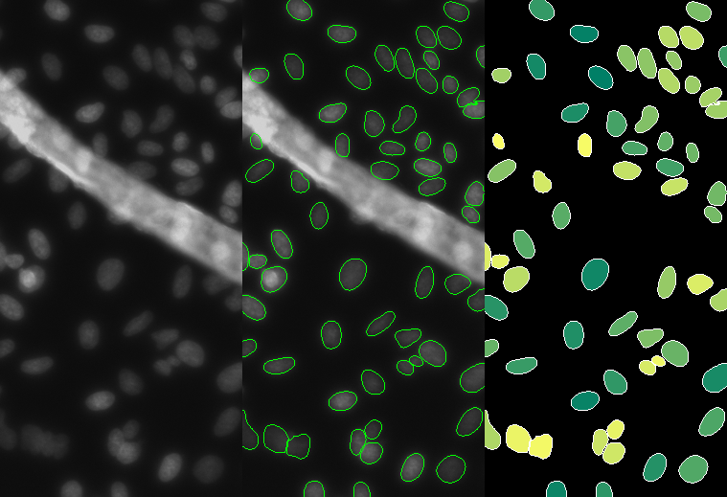
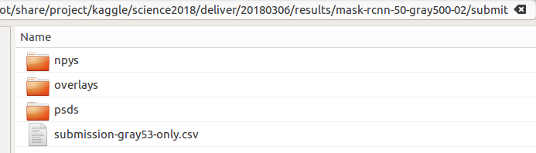
4. Make a submission with the given trained model (00016500_model.pth)
- This will test if the mask rcnn can run correctly (at inference)
- Run the functions of "submit.py": run_submit()
run_npy_to_sumbit_csv()
this only make prediction and save results as images and npy.
this read the npy and do post processing to make submission csv
- Example results (see folder "results/mask-rcnn-50-gray500-02/submit")
(LB 0.419 for 53 gray images subset)
** you need not submit. Just make your csv file and see if your file is the same as mine or not)

Slide 8
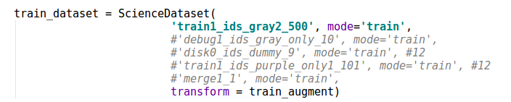
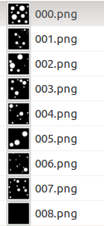
5. Train a model on the dummy images
- Run function "run_train()" of train_0.py
- Set both train and validation split to 'disk0_ids_dummy_9'
- This is simple dummy data. You should be able to train all loss to 0!
You can see some training visualisation: rpn precision, rcnn precision and mask precision

Slide 9
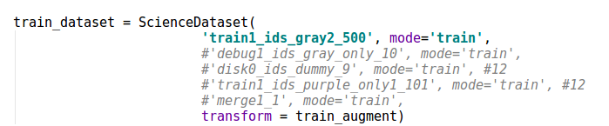
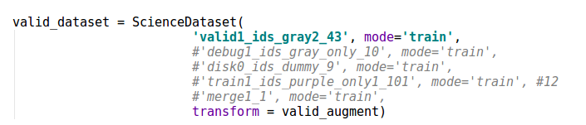
5. Train a model on the gray train images
- Set both train and validation split as follows
- this is used to produce model 00016500_model.pth

Slide 10
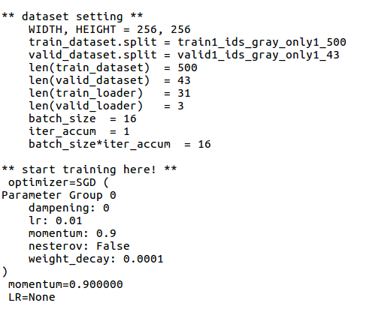
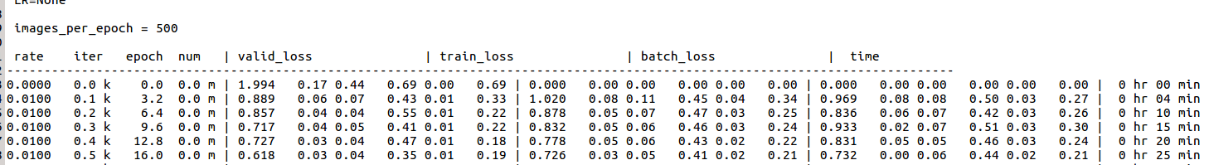
- An example of training loss is given at: "20180306/results/mask-rcnn-50-gray500-02/log.train.txt"
total loss
rpn loss (classification and regression)
rcnn loss (classification and regression)
mask loss

Slide 11
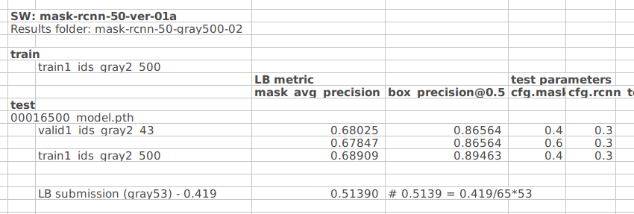
6. Other Evaluation
- Run function "run_evaluate()" of evaluate.py
- You can measure detection box precision at 0.5, and mask average precision from 0.5 to 1.0
- Results of 00016500_model.pth is given at "results-1.xlsx"

Slide 12
