Slide 1
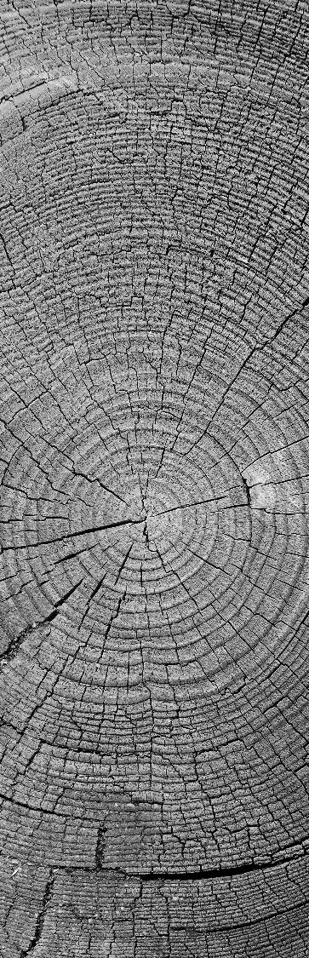
Compression
Project Work: Sven Stocker, Sandro Mösch Presenting: Said Aroua
FIT HS24

Slide 2
Agenda
Overview
Project Work
Huffman Code Implementation
Comparing Algorithms
Conclusions
Applying Information Theory to Compression

Slide 3
goal
Compression of Air
Compression of Data
Reduce use of
Network
Storage
Added compute cost
text.txt
text.gz
100 KB
20 KB

Slide 4
Categories & Applications
Lossless Compression
Text
Binary
Lossy Compression
Photos
Audio
Video

Slide 5
Categories & Applications
Lossless Compression
Text
Binary
Lossy Compression
Photos
Audio
Video

Slide 6
Huffman codES
David A. Huffman, 1952
Concept
Analyse frequency of “symbols” in the data
Encode the most common symbols with the shortest code word

Slide 7
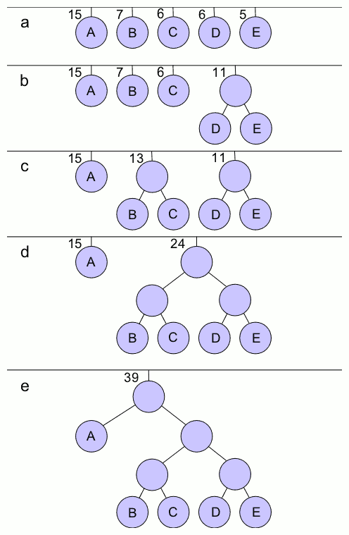
Huffman codES: Huffman tree
Merging the lowest frequencies
Code words in the final tree
From root to leaves
Left child -> 1
Right child -> 0
Huffman Table
Symbol to code word (comp)
Code word to symbol (decomp)
Source: Wikipedia

Slide 8
comparing algorithms
Abraham Lempel
Jacob Ziv
Lempel-Ziv algorithms
LZ77, LZ78
Lempel-Ziv-Markov chain algorithm
LZMA

Slide 9
Comparing algorithms
 | file | algorithm | original size (bytes) | compressed size (bytes) | compression ratio | compression time (seconds) | decompression time (seconds)
0 | a.txt | LZMA | 1 | 60 | 0.016667 | 0.004394 | 0.000076
1 | a.txt | LZ77 | 1 | 9 | 0.111111 | 0.000016 | 0.000005
2 | a.txt | LZ78 | 1 | 5 | 0.200000 | 0.000019 | 0.000005
3 | aaa.txt | LZMA | 100000 | 148 | 675.675676 | 0.006094 | 0.000351
4 | aaa.txt | LZ77 | 100000 | 121 | 826.446281 | 0.000448 | 0.000070
5 | aaa.txt | LZ78 | 100000 | 2235 | 44.742729 | 0.027355 | 0.000705
6 | alphabet.txt | LZMA | 100000 | 176 | 568.181818 | 0.005286 | 0.000241
7 | alphabet.txt | LZ77 | 100000 | 290 | 344.827586 | 0.000386 | 0.000065
8 | alphabet.txt | LZ78 | 100000 | 11340 | 8.818342 | 0.025116 | 0.003076
9 | mobydick.txt | LZMA | 646431 | 221948 | 2.912534 | 0.184310 | 0.010535
10 | mobydick.txt | LZ77 | 646431 | 263147 | 2.456540 | 0.040082 | 0.002759
11 | mobydick.txt | LZ78 | 646431 | 565865 | 1.142377 | 0.812628 | 0.912195
12 | random.txt | LZMA | 100000 | 76264 | 1.311235 | 0.016281 | 0.003839
13 | random.txt | LZ77 | 100000 | 75200 | 1.329787 | 0.003229 | 0.000319
14 | random.txt | LZ78 | 100000 | 170150 | 0.587717 | 0.098430 | 0.058102
Built-in Python Modules
lzma (LZMA)
zlib (LZ77)
Own Python implementation
LZ78
Data sets
a.txt -> single character
aaa.txt -> 100K * "a"
alphabet.txt -> repetitions of the alphabet
mobydick.txt -> content of the book
random.txt -> random characters

Slide 10
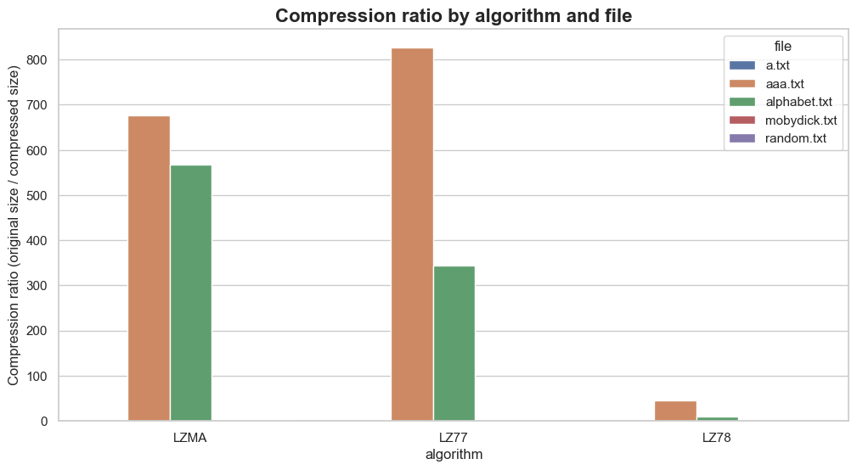
results

Slide 11
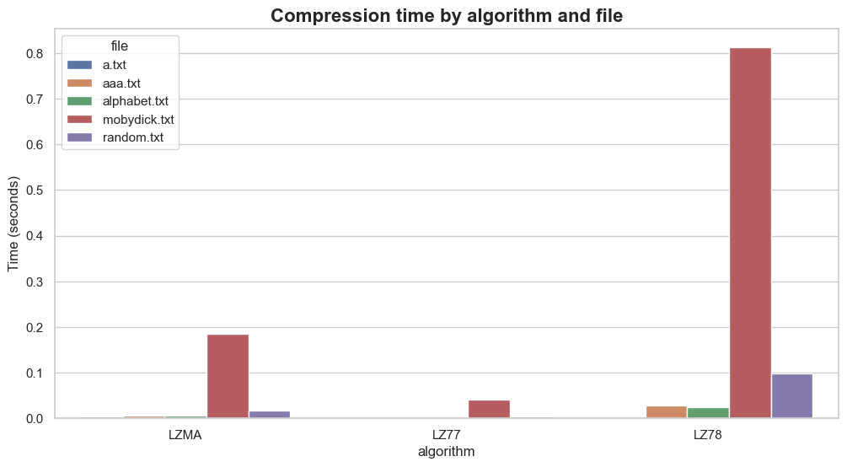
results

Slide 12
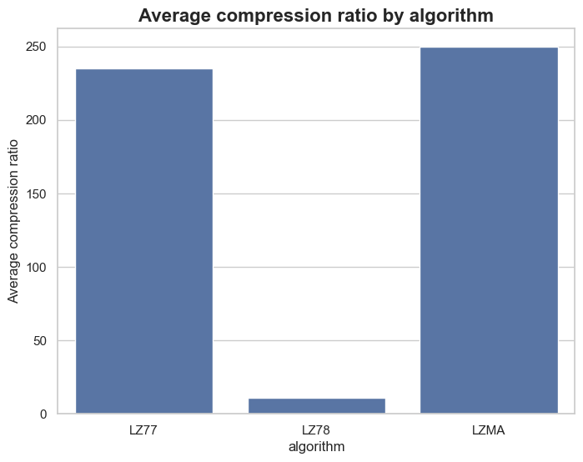
results

Slide 13
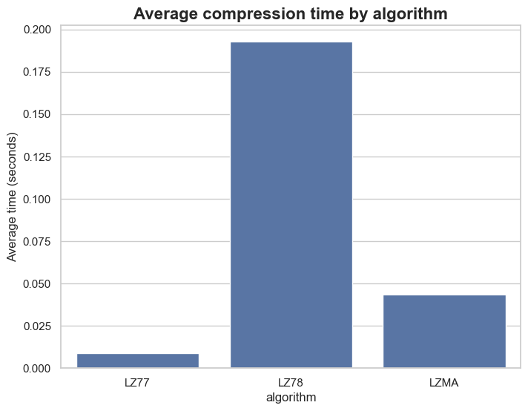
results

Slide 14
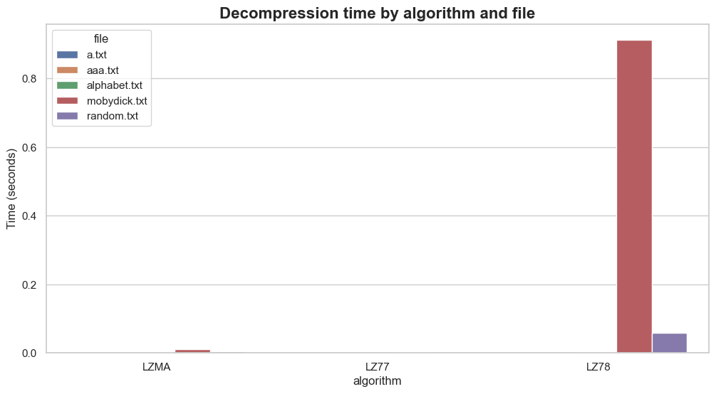
results

Slide 15
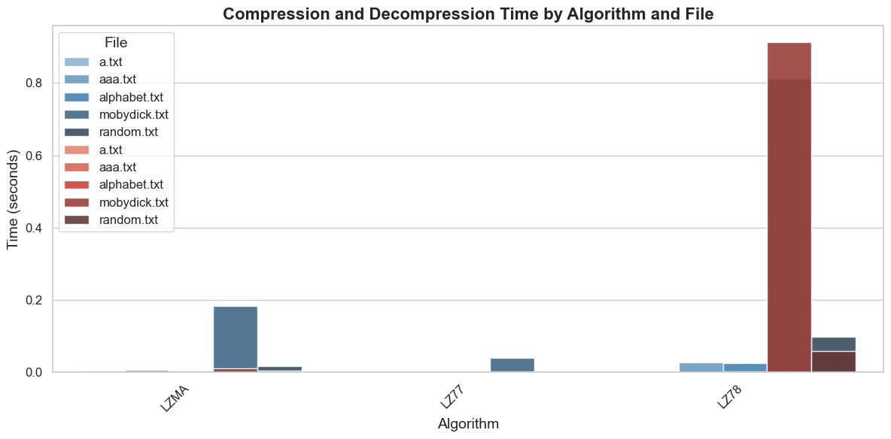
results

Slide 16
Take aways: compression algorithms
Don't roll your own crypto compression
Understanding the data and domain helps choosing the optimal algorithm
Expected patterns
Lossy vs. lossless
Maybe compression is not worth it?
Example: DNA sequence compression (HapZipper)
20 times smaller files
2-4 times better compression ratio than conventional compression
Faster

Slide 17
Entropy & compression: an experiment
100 files differing contents
Entropy (bits/symbol) of content between 1 and 8 bits
Compressed with LZ77 and LZMA
Plot compression ratio against entropy

Slide 18
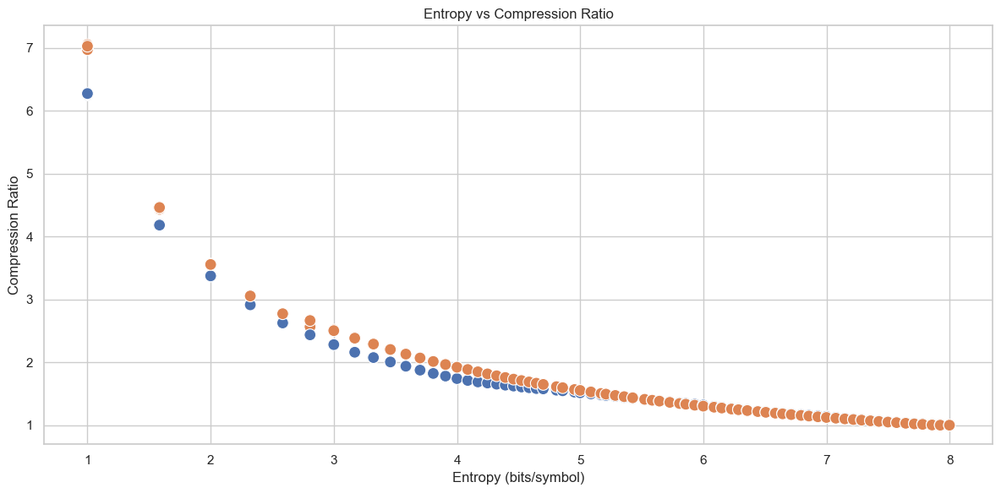
results

Slide 19
Take aways
Low entropy ~ predictable ~ patterns -> good compression
High entropy -> bad compression

Slide 20
THANK YOU

Slide 21
Questions?

