Slide 1
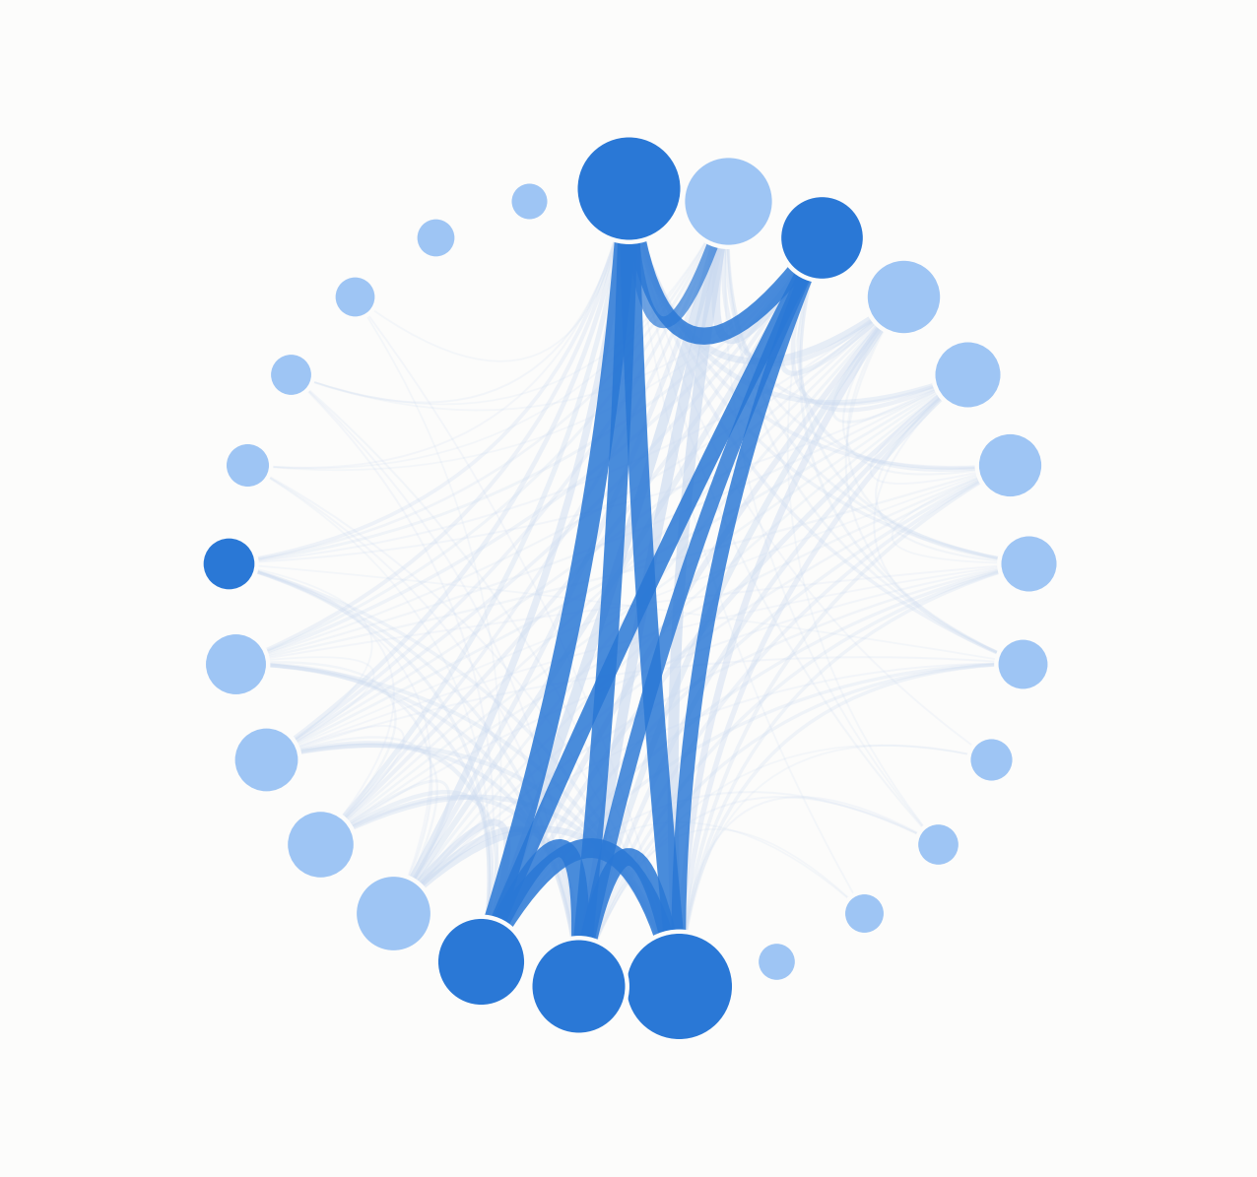
Do the clubs everyone talks about actually win?
Premier League transfer narratives, network science,
and performance — 2016–2025
Dante Shoghanian · Wilson Chatham · Prof. Richard Tang August 19, 2026
Notes:
The backdrop is the real club co-mention network from 34,903 press articles — mention that when someone asks. Keep the open conversational: we measured who dominates the transfer conversation and asked whether it predicts results.

Slide 2
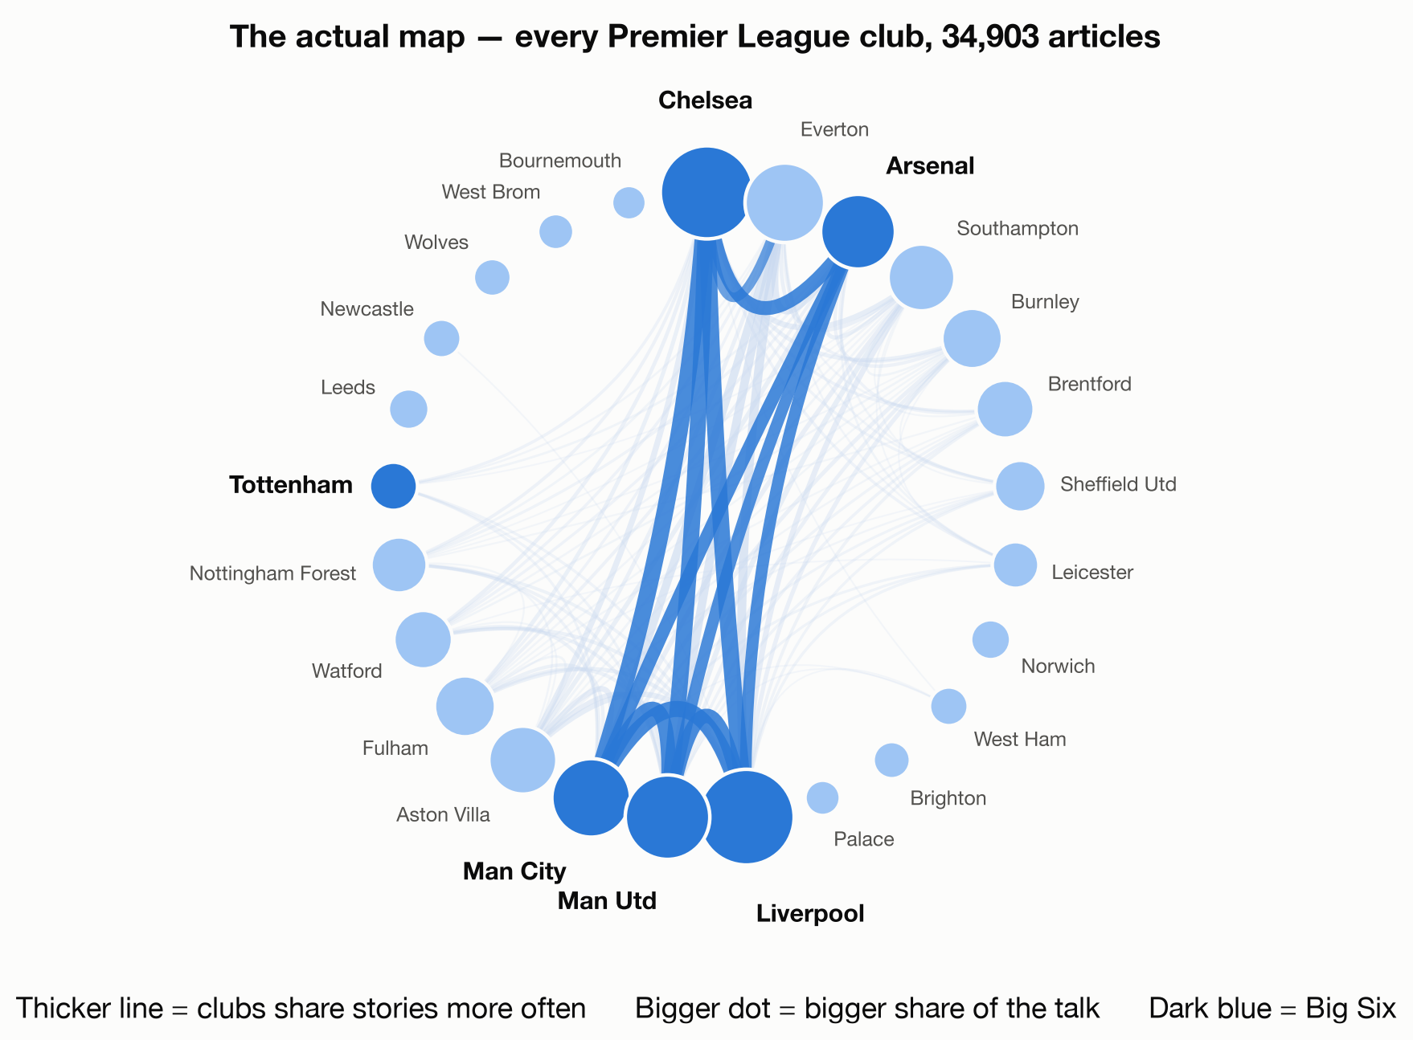
THE QUESTION
Every summer, the talk. Does it mean anything?
All summer, the media argues about who's "winning the window."
We mapped that conversation.
Wisdom of crowds: coverage reflects the public's collective expectations. If crowds aggregate information well, the map should carry signal about the season to come.
Notes:
Point at the map — it's built from the actual data, not a diagram. The Big Six sit in the middle of everything. Land the wisdom-of-crowds framing here; it's the narrative spine of the talk.

Slide 3
HOW IT WORKS
Turning talk into a network
Clubs are dots. When two clubs appear in the same story, we draw a line between them.
“Arsenal join Chelsea in race for £60m striker”
one story = one link between Arsenal and Chelsea
Centrality = how much a club sits at the center of that map.
A club's score is its total links across all 34,903 stories, scaled 0 to 1 — the most-talked-about club sits at 1, and a club at 0.5 is in half as many conversations.
Notes:
The 'aha' slide — teach the one concept everything depends on. Blue dot is a club everyone writes about. Ask Andy: which club do you think this was in 2016? Let the audience feel smart. Wilson leads formulation. The headline on the card is an illustrative example, not a real quote. If asked for the exact metric: strength centrality — a club's weighted degree, i.e. the sum of its co-mention links with every other club across all stories, normalized 0-1 by the max club (Liverpool = 1). We also computed PageRank and eigenvector centrality as robustness checks; strength is what the regressions use (press_strength_norm).

Slide 4
WHAT WE BUILT
From nine years of articles to one score per club
Collect
Read
Connect
Score
Compare
Nine seasons of
press transfer stories
A program spots each
club name in the text
Clubs named together
get linked
Each club gets a share-
of-the-talk score
Line scores up against
money and results
34,903
1.9M
377
9
press articles
entity mentions extracted
clubs in the network
seasons, 2016–2025
All automatic — press a button and the whole thing rebuilds from scratch.
Notes:
Brag formula: (1) hard problem — press coverage, financials and results were never designed to be joined; (2) smart solution — we automated it end to end. Keep it high level; only if someone asks the how: spaCy named-entity recognition does the reading step. Walk the pipeline left to right in one breath each; the tiles carry the scale. Dante leads.

Slide 5
THE EVIDENCE · 1 OF 2
Networks are a proven prediction tool
Disease
Watching the most central people in a social network predicted the 2009 flu outbreak two weeks early — position is a leading indicator.
Christakis &
Fowler, PLoS ONE
Elections
A 61-million-person experiment: information moving through the network drove more real-world voting than the message itself.
Bond et al.,
Nature
Stock markets
Industries central in the trade network earn higher returns — centrality is a priced, predictive attribute.
Ahern, SSRN
News networks
Build a firm network from news co-mentions and it predicts returns, downgrades, and defaults — our exact pipeline, applied in finance.
Schwenkler &
Zheng
Across disease, politics, and markets: where you sit in the network predicts what happens next.
Notes:
Stream 1 from the team's literature review: networks as a PREDICTION tool. One row per domain, same sentence shape each time: network position predicted a real-world outcome. The Schwenkler & Zheng row is the closest cousin — text co-mentions to network to prediction, in finance. Wilson leads.

Slide 6
THE EVIDENCE · 2 OF 2
And they already work in sports
Passing networks
283,259 passes across 23 EPL teams: the structure of a team's passing network predicts its performance.
Grund 2012,
Social Networks
Champions League
Network density and centralization predict the outcome of offensive plays — the result holds across competitions.
Pina et al. 2017,
Frontiers
The whole field
A review of soccer network science: the method is established, including tracking networks over time as we do yearly.
Buldú et al. 2018,
Frontiers
Fan networks
Club and fan network centrality from Twitter predicted EPL match results with 81% accuracy — the closest sports precedent for ours.
Miranda-Peña
et al. 2021
The gap we fill: every study aims networks at the pitch — nobody has aimed them at the media.
Notes:
Stream 2: networks are RELEVANT and established in sports — passing lanes, offensive plays, whole-field reviews, and one Twitter-centrality precedent. Then the gap sentence, which is the reason our paper exists. If Andy's family asks 'better than betting odds?' — Forrest et al. 2005 is the benchmark; ours is a new, complementary signal at season horizon.

Slide 7
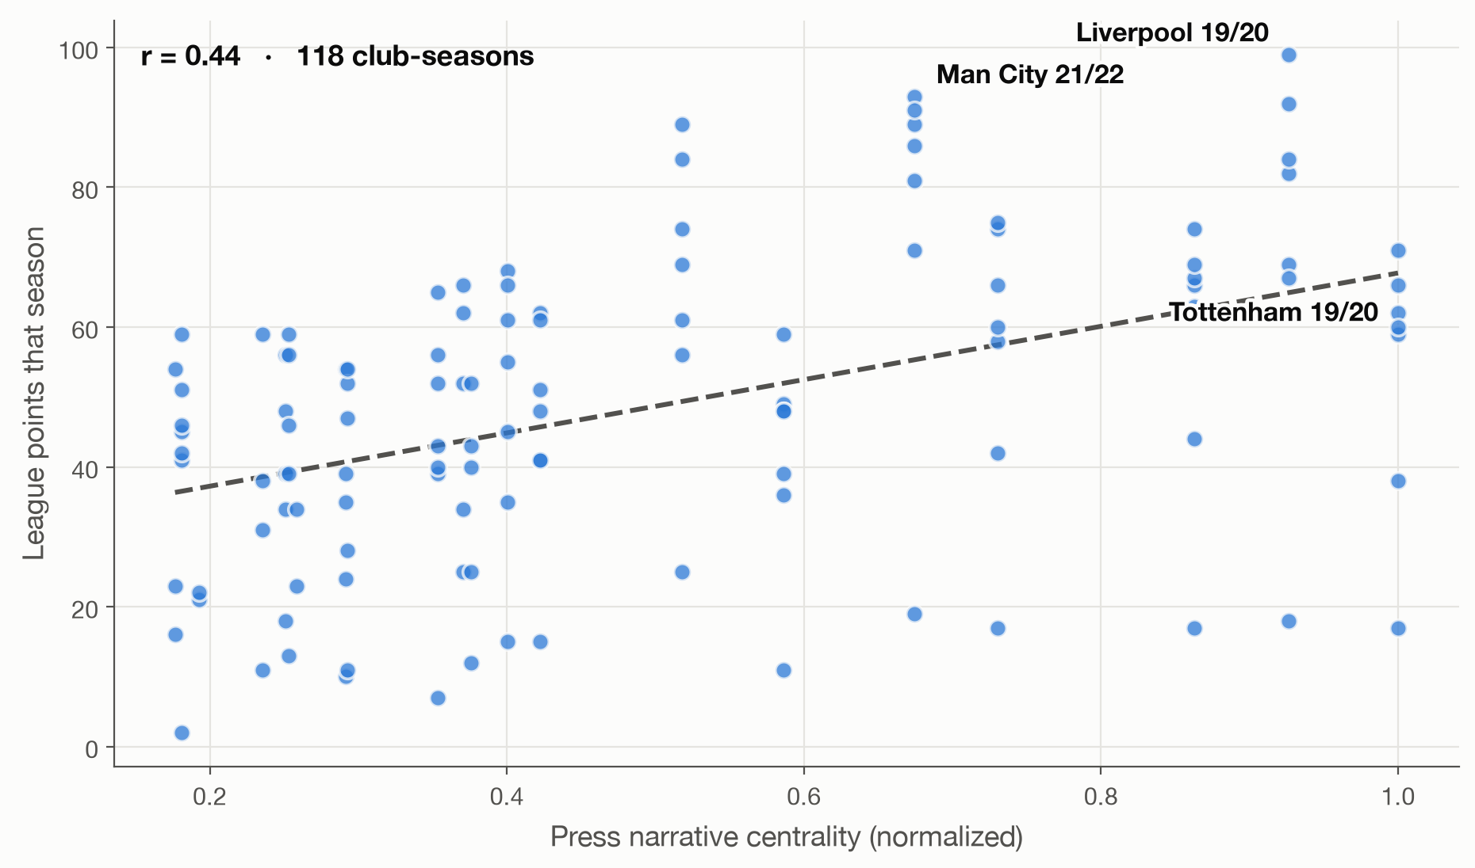
WHAT WE FOUND
Clubs at the center of the conversation win more
Notes:
HANDOFF to Professor Tang. Let the picture talk first: each dot is a club-season; right = more central in the press; up = more points. The audience should see the slope before anyone says 'regression.'

Slide 8
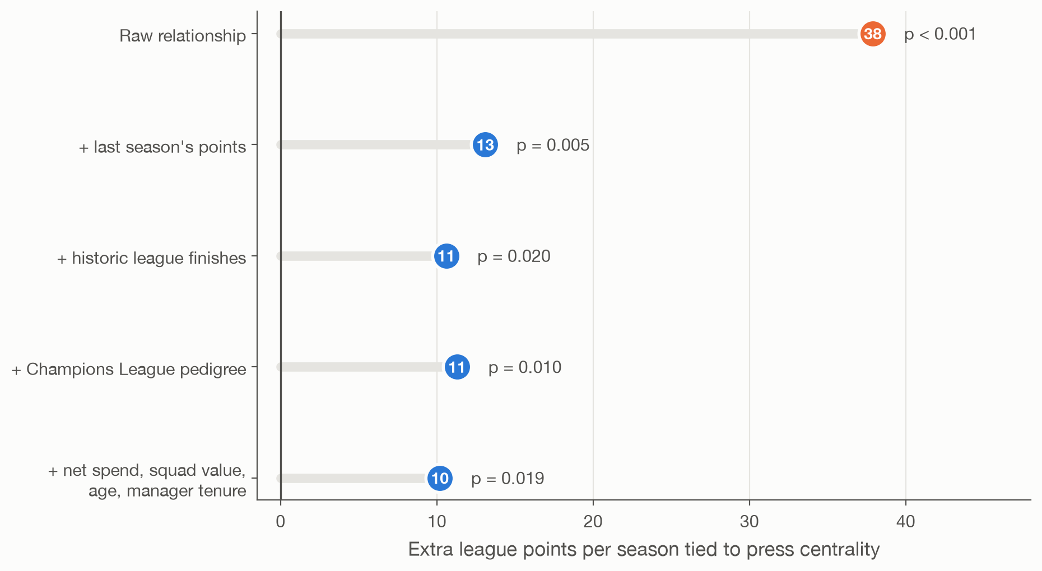
THE HARD TEST
Is hype just money in disguise? No.
The effect shrinks but never dies — and ~10 points is roughly the gap between mid-table and the European spots.
Notes:
Professor Tang's slide, built from results/regression_points.html. Orange dot = raw model (coef 37.9, p<0.001). Each row down adds controls: last season's points (13.1, p=0.005), historic finishes (10.6, p=0.020), UCL pedigree (11.3, p=0.010), then money + squad + manager (10.2, p=0.019). Goal-difference models tell the same story (13.6, p=0.02 with full controls). One sentence: the conversation carries information money and history don't explain.

Slide 9
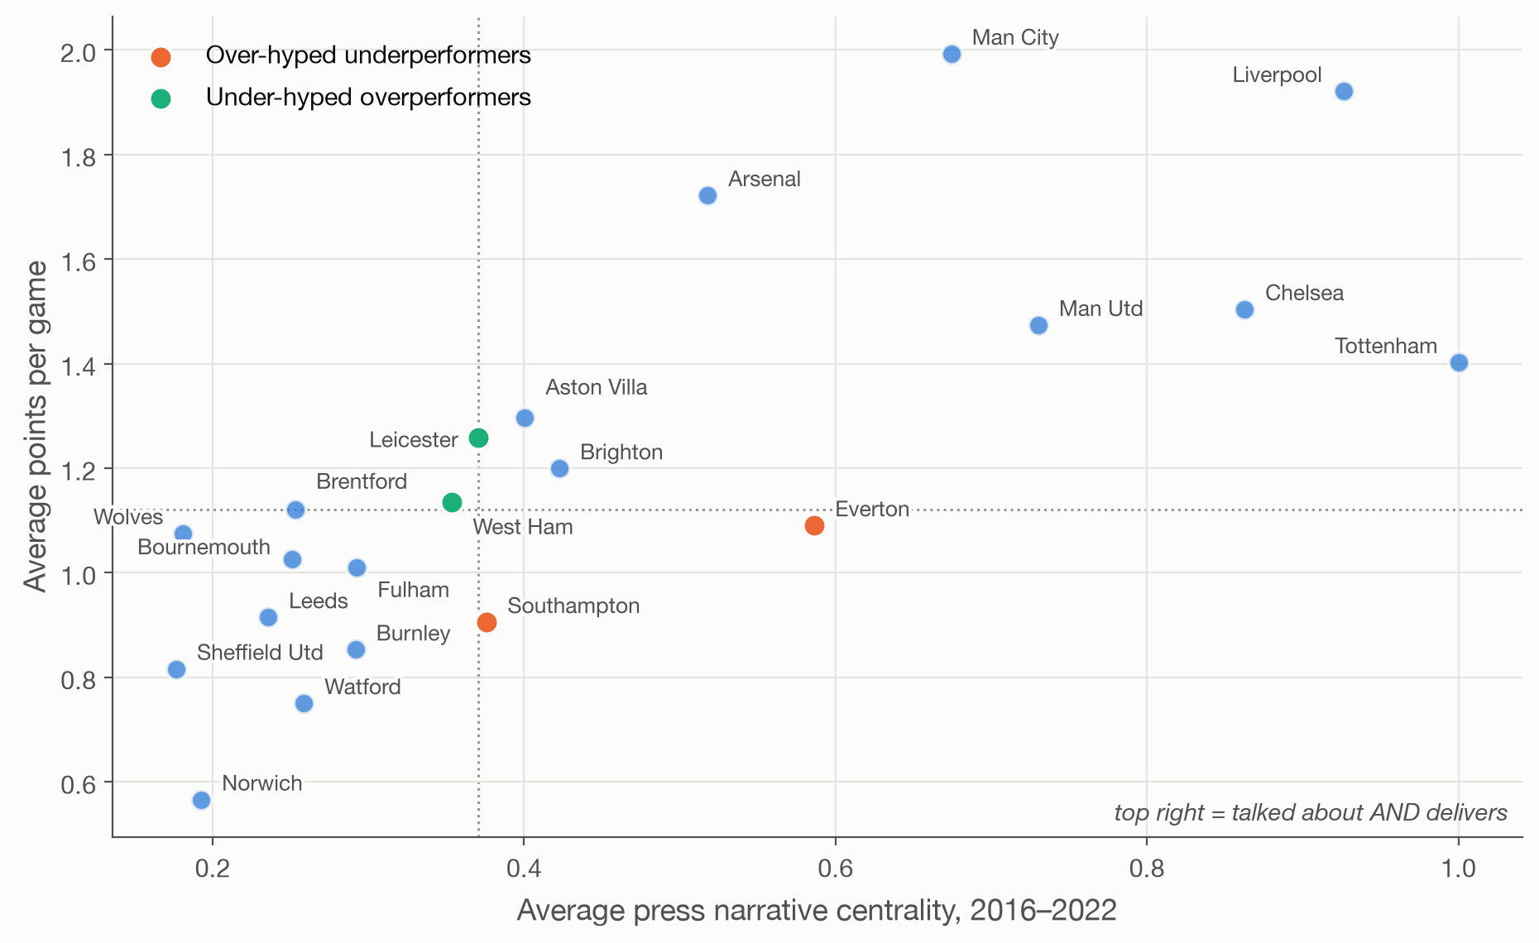
THE FUN PART
Who earns the talk — and who doesn't
Notes:
Orange = over-hyped underperformers; aqua = under-hyped overperformers. Invite the room to react to specific clubs — Andy's guests will have opinions. Let discussion happen here.

Slide 10
WHERE THIS GOES
From within-game networks to season-level prediction
The paper
The next test
The practical angle
Position against two literatures: network prediction, and networks in sport. Prior work validated the method inside games — we take it to the season level.
Preseason centrality as a leading indicator: does the summer conversation predict the coming season before a ball is kicked?
A narrative signal is cheap, fast, and public — worth testing against market baselines in analytics and betting.
Notes:
The third card is the bridge to Andy's guests (sports analytics CMO, betting platform). Right register: 'we think this signal is worth testing against market baselines' — don't oversell.

Slide 11
So — do the clubs everyone talks about actually win?
Mostly, yes. And the talk itself carries signal money can't explain.
Notes:
Recap in one breath, then open the floor. Have the repo up in a tab in case anyone wants the notebooks or the ego-network explorer.

