Slide 1








Pizza Hut
Report
Prepared by: tramthaitu

Slide 2



EXECUTIVE SUMMARY
Overview: This report analyzes Pizza Hut's customer behavior and operational challenges, offering strategies to improve retention, optimize revenue, and enhance marketing efficiency.
Key Findings:
Retention Challenge: Only 8.3% of customers return after their first purchase; 80% of revenue comes from new customers. The loyal "Cannot Lose Them" segment is small (6%), while inactive "Hibernating" and "Lost" customers make up 24.6% of transactions.
Customer Insights: Customers are concentrated in Ho Chi Minh City (174k) and Hanoi (167k), with higher revenue in these areas. Men purchase more frequently, but women spend more per transaction. Delivery dominates in Ho Chi Minh City (65bn VND), while Hanoi balances delivery and take-away (43bn VND).
Sales Trends: Revenue peaks in October-December (holidays) and on the 25th-30th (salary cycles), but dips in January-February post-Lunar New Year.
Voucher Usage: 90.84% of customers don’t use vouchers; the 9.16% who do contribute 35.847 trillion VND, showing promotional potential.
Machine Learning: LightGBM predicts voucher usage with 89.4% Recall "Yes" but 33.38% Precision "Yes," meaning 66% of vouchers may be wasted.

Slide 3
A. Data Analysis
1. Overview of Data & Analysis Approach
Column | Description
Bill_ID | The unique ID of the order
Channel | The channel through which the order was consumed
OrderFrom | The location through which the order was made
TransactionDate | The date of the order
SalesAmount | The amount customer paid for the order
CustomerID | The unique ID of the customer
CustomerGender | The gender of the customer
VoucherStatus | Whether a voucher was used for the order
Province | The general location of where the order was made
The dataset used in this project is extracted from the exam dataset of the RMIT Business Analytics Champion (RBAC) 2023 competition, provided by the sponsor Pizza Hut Vietnam. This is a real-world dataset that has been adjusted to reflect actual business scenarios in the food and beverage industry in the Vietnamese market.
The dataset consists of approximately 1,000,000 rows, with no missing values, and includes 9 attributes as described.

Slide 4
2. Current Situation
The Cohort Chart shows that the rate of customers returning after their first purchase at Pizza Hut is very low. Starting from the first month, only 8.3% of customers return to make a purchase, and there is no significant fluctuation in the following months.
The Pareto Chart indicates that 80% of revenue comes from new customers, while returning or loyal customers contribute only a small portion to the total revenue.
=> Pizza Hut is currently focusing on attracting new customers but has not prioritized retaining existing ones, leading to a lack of long-term customer loyalty and engagement with the brand.
Cohort Analysis | Column Labels
Row Labels | 1 | 2 | 3 | 4 | 5 | 6 | 7 | 8 | 9 | 10 | 11 | 12
2021 | 300.00% | 37.76% | 34.23% | 31.69% | 29.27% | 28.09% | 26.12% | 25.56% | 24.45% | 23.53% | 22.55% | 48.09%
2022
January | 100.00% | 8.30% | 7.85% | 6.42% | 6.67% | 6.18% | 6.14% | 6.50% | 5.23% | 5.01% | 4.27% | 6.40%
February | 100.00% | 7.72% | 5.74% | 5.99% | 5.38% | 5.10% | 5.48% | 4.36% | 4.38% | 3.64% | 4.03% | 1.64%
March | 100.00% | 6.99% | 6.34% | 6.05% | 5.55% | 5.61% | 4.72% | 4.74% | 4.00% | 4.25% | 1.56%
April | 100.00% | 6.96% | 6.23% | 5.34% | 5.58% | 4.59% | 4.59% | 3.86% | 4.22% | 1.56%
May | 100.00% | 6.83% | 5.94% | 5.77% | 4.66% | 4.51% | 3.66% | 4.18% | 1.47%
June | 100.00% | 7.11% | 5.52% | 4.44% | 4.26% | 3.70% | 3.88% | 1.35%
July | 100.00% | 6.28% | 4.96% | 4.48% | 3.85% | 4.04% | 1.55%
August | 100.00% | 5.97% | 5.30% | 4.13% | 4.54% | 1.41%
September | 100.00% | 6.13% | 4.64% | 4.86% | 1.57%
October | 100.00% | 5.70% | 5.30% | 1.60%
November | 100.00% | 6.28% | 1.75%
December | 100.00% | 2.54%
2023 | 100.00%

Slide 5
Who are the customers?
3. Customer Profile & Purchasing Behavior Analysis
Who are the customers?
Most customers do not provide gender information when making purchases, accounting for approximately 80% of transactions. Among the remaining 20% of transactions where gender information is available, men account for twice as many transactions as women, indicating that men tend to make purchases more frequently.
Although women have fewer transactions, the average revenue per customer is nearly equal between men and women. This suggests that women tend to spend more per transaction compared to men.

Slide 6
Who are the customers?
3. Customer Profile & Purchasing Behavior Analysis
Where do they live?
The majority of customers are located in major cities such as Ho Chi Minh City (174k) and Hanoi (167k). Additionally, customers in the southern region also account for a significant number with 143k, while the northern region has 106k.
Only Ho Chi Minh City and Hanoi are the two areas where the average revenue is higher than the overall average revenue (304.84k).
=> Pizza Hut's customers are primarily concentrated in large cities, where the standard of living and income levels are higher.

Slide 7
3. Customer Profile & Purchasing Behavior Analysis
Which channels do they purchase from?
The year 2022 marked the boom of online shopping trends after the pandemic, especially through delivery and take-away services. Although the delivery channel dominated in revenue, the number of orders was lower than take-away, reflecting an interesting difference in consumer behavior.
In Ho Chi Minh City, convenience is prioritized, making delivery the most popular method, generating 65bn in revenue. Among delivery channels, websites were the most commonly used (25bn), followed by call centers (23bn).
In Hanoi, a balance between convenience and experience was observed in both delivery and take-away. Take-away generated 43bn in revenue, with 33bn coming from direct in-store orders, reflecting customers' habit of combining shopping with enjoying the store atmosphere.
Unlike Ho Chi Minh City, the southern provinces recorded a higher number of take-away orders than delivery, but the revenue from both channels was nearly equal. This indicates that the average order value for delivery was higher, possibly due to shipping fees or a trend of group ordering.
Despite sharing the same take-away preference as the South, people in the northern provinces showed a strong attachment to direct in-store ordering for both take-away and delivery. This could result from the shopping culture and careful spending habits of Northern consumers.

Slide 8
3. Customer Profile & Purchasing Behavior Analysis
What influences purchasing behavior?
Monthly Sales Trends: Pizza Hut's sales show a strong upward trend during the year-end period from October to December. This increase is driven by higher demand for family and friend gatherings during major holidays like Halloween, Black Friday, and Christmas. Conversely, sales tend to decline in January and February, likely due to customers tightening their budgets after Lunar New Year celebrations. The remaining months maintain relatively stable sales figures without significant fluctuations.
Daily Sales Patterns: Daily sales remain generally consistent but experience noticeable growth between the 25th and 30th of each month. This period typically coincides with salary payments, leading to increased consumer spending on dining out.

Slide 9
3. Customer Profile & Purchasing Behavior Analysis
What influences purchasing behavior?
Based on the chart, it is evident that the majority of Pizza Hut customers do not use vouchers when making purchases. Specifically, 952,452 customers (90.84%) do not use vouchers, while only 96,123 customers (9.16%) take advantage of these promotions. This indicates that most of Pizza Hut's revenue comes from customers who are willing to spend without requiring discounts.
However, when examining the revenue from both customer groups, an interesting point emerges. The total revenue from the non-voucher group reaches 284.034 trillion VND, accounting for the majority of Pizza Hut’s sales. Meanwhile, although the group of customers using vouchers represents a smaller proportion, they still contribute over 35.847 trillion VND. This suggests that despite being fewer in number, voucher users still have significant spending potential if suitable promotional programs are implemented

Slide 10
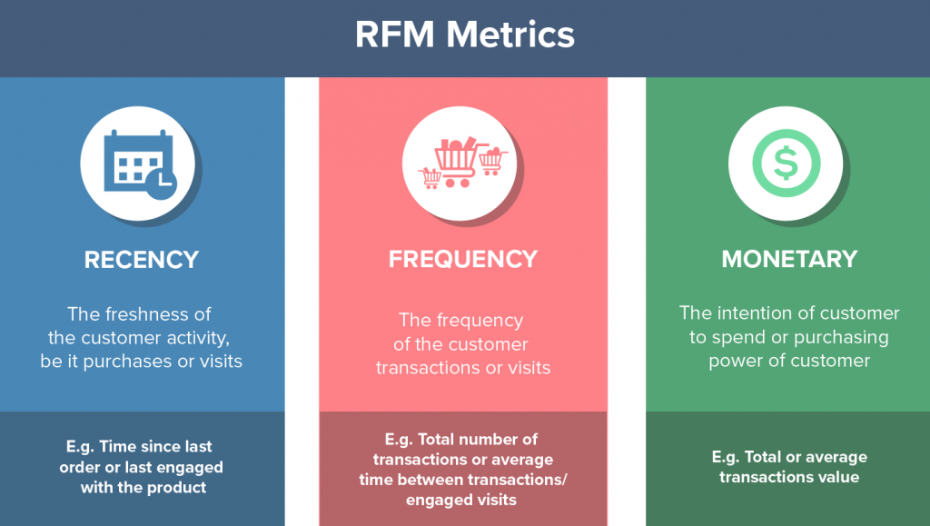
4. Customer Segmentation Using the RFM Model
What is the RFM model?
The RFM model is an analytical approach that focuses on three key aspects of customer behavior: Recency, Frequency, and Monetary value. By analyzing these three metrics, businesses can gain valuable insights into customer value and behavior, enabling them to make more informed business decisions and personalize their marketing strategies. This model helps companies identify their best customers, allowing for more targeted and efficient marketing efforts.
R- Recency refers to how recently a customer made their last purchase.
Recency = Date of report – Date of most recent use.
F- Frequency measures how often a customer makes purchases over a given period.
Frequency = Count number of times using the service/Number of contract years.
M- Monetary value represents the total value of a customer's purchases.
Monetary = Sum(GMV)/ Number of years of contract.

Slide 11
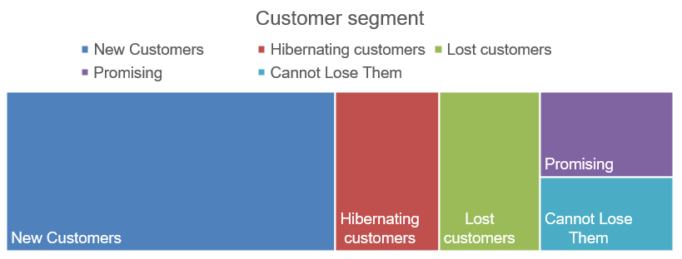
4. Customer Segmentation Using the RFM Model
Customer segment
The majority of Pizza Hut's customers are new, accounting for 703,033 transactions (~76.5%), while the loyal "Cannot Lose Them" group is the smallest, with only 55,077 transactions (~6%). Notably, inactive customers, categorized as "Hibernating" and "Lost customers," total 226,532 transactions (~24.6%), highlighting retention challenges. The "Promising" segment (63,933 transactions) has potential but remains underutilized. This underscores the urgent need for effective customer relationship management, focusing on converting new customers into repeat buyers and re-engaging past customers.

Slide 12
5. Predicting Voucher Usage Status of Customers
Model | Accuracy | Precision | Recall | F1-Score
Random Forest | 0.8027 | No: 0.9755 | No: 0.8030 | No: 0.8809
 |  | Yes: 0.2907 | Yes: 0.8001 | Yes: 0.4265
XGBoost | 0.8257 | No: 0.9870 | No: 0.8188 | No: 0.8951
 |  | Yes: 0.3323 | Yes: 0.8935 | Yes: 0.4845
LightGBM | 0.8267 | No: 0.9871 | No: 0.8199 | No: 0.8958
 |  | Yes: 0.3338 | Yes: 0.8940 | Yes: 0.4861
The collected transaction data is severely imbalanced, with approximately 90% of customers not using vouchers and the remaining 10% using them. After balancing the data, we proceeded to train three models: Random Forest, XGBoost, and LightGBM.
With the goal of identifying customers who will use vouchers to provide them with targeted incentives—encouraging more frequent purchases and higher order values—the Recall "Yes" metric was chosen because it maximizes the prediction of customers who will use vouchers, alongside Precision "Yes".
LightGBM emerged as the optimal choice, achieving an Accuracy of 0.8267 and a Recall "Yes" of 0.8940 (89.4%), indicating the highest coverage of potential voucher users. However, its Precision "Yes" of 0.3338 suggests that approximately 66% of issued vouchers may be wasted (given to customers who won’t use them)

Slide 13
B. Strategic Recommendations
1. Increase customer retention and build loyalty
a. Build a Loyalty Program Solution: Design a point-based or membership card program with attractive benefits. For example:
Earn points for each transaction (1 point for every 10,000 VND spent), which can be redeemed for discount vouchers or free items.
Offer special benefits for the "Cannot Lose Them" group, such as 20% discounts for loyal customers or a free dessert upon reaching a certain transaction milestone.
Goal: Encourage customers to return more frequently, especially the "Promising" group (63,933 transactions), which has the potential to become loyal. Benefit: Increase the customer retention rate from 8.3% to at least 15-20% within 6 months.
b. Personalize the Customer Experience Solution: Leverage transaction data to tailor personalized offers. For example:
Send targeted emails or SMS with 10-15% discounts to "Hibernating" and "Lost" customers to incentivize their return.
Recommend dishes based on purchase history (e.g., if a customer frequently orders large pizzas, suggest a family combo at a special price).
Goal: Reactivate inactive customer segments (24.6% of transactions) and strengthen brand engagement. Benefit: Boost revenue from dormant customers and reduce the churn rate of "Lost" customers.

Slide 14
2. Optimizing Revenue from Customer Segments
a. Encourage Voucher Usage to Increase Transaction Value Solution: Enhance promotional campaigns leveraging vouchers, specifically targeting non-voucher users (90.84%):
Offer a 15% discount voucher for the next purchase when customers spend over 300,000 VND.
Launch "Buy 1 Get 1" deals or discounted family combos exclusively for voucher users.
Goal: Increase voucher redemption rate from 9.16% to 15-20% within 3 months. Benefit: Boost average transaction value, particularly from customers willing to spend without discounts.
b. Focus on Female Customers Solution: Since women have a higher average transaction value despite fewer transactions, Pizza Hut can:
Launch female-targeted campaigns, such as a "Girls' Night" combo (pizza, salad, drinks at a discount).
Offer special vouchers or promotions on occasions like International Women’s Day (March 8) or Vietnamese Women’s Day (October 20).
Goal: Increase female-driven transactions to 30% within 6 months. Benefit: Drive revenue growth from high-value customer segments.

Slide 15
3. Capitalizing on Seasonal Shopping Trends
a. Boosting Revenue During Peak Months (October-December) Solution: Launch themed holiday campaigns:
Halloween: "Spooky Pizza" combo featuring themed pizza, drinks, and desserts.
Black Friday: 20% discount on all online orders.
Christmas: Family combo with large pizza, fried chicken, and small gifts for kids.
Goal: Increase peak-season revenue by 20-30% compared to the previous year. Benefit: Maximize high demand during festive periods.
b. Minimizing Revenue Decline in January-February Solution: Implement light promotional campaigns to stimulate demand:
"New Year Kickoff": Buy 1 Get 1 deals on weekdays.
Offer 50,000 VND vouchers for January purchases, redeemable in February.
Goal: Reduce revenue drop to below 10% compared to other months. Benefit: Maintain stable cash flow during low seasons.
c. Leveraging End-of-Month Days (25th-30th) Solution: Ramp up advertising with targeted promotions:
15% discount on orders placed between the 25th-30th.
Free dessert for orders over 400,000 VND.
Goal: Increase end-of-month revenue by 15% compared to regular days. Benefit: Capitalize on periods when customers have higher spending capacity.

Slide 16
3. Capitalizing on Seasonal Shopping Trends
a. Boosting Revenue During Peak Months (October-December) Solution: Launch themed holiday campaigns:
Halloween: "Spooky Pizza" combo featuring themed pizza, drinks, and desserts.
Black Friday: 20% discount on all online orders.
Christmas: Family combo with large pizza, fried chicken, and small gifts for kids.
Goal: Increase peak-season revenue by 20-30% compared to the previous year. Benefit: Maximize high demand during festive periods.
b. Minimizing Revenue Decline in January-February Solution: Implement light promotional campaigns to stimulate demand:
"New Year Kickoff": Buy 1 Get 1 deals on weekdays.
Offer 50,000 VND vouchers for January purchases, redeemable in February.
Goal: Reduce revenue drop to below 10% compared to other months. Benefit: Maintain stable cash flow during low seasons.
c. Leveraging End-of-Month Days (25th-30th) Solution: Ramp up advertising with targeted promotions:
15% discount on orders placed between the 25th-30th.
Free dessert for orders over 400,000 VND.
Goal: Increase end-of-month revenue by 15% compared to regular days. Benefit: Capitalize on periods when customers have higher spending capacity.

Slide 17

SUMMARY
Pizza Hut needs to shift its focus from solely attracting new customers to retaining and re-engaging existing ones, while also optimizing revenue from different customer segments. Strategies such as building a loyalty program, personalizing customer experiences, and leveraging seasonal and regional shopping trends will help Pizza Hut improve customer return rates, enhance loyalty, and maximize revenue. Continuous measurement and adjustment will ensure these strategies deliver long-term effectiveness.

