Slide 1


Carpe Datum
Sy tran
Catherine hwang
Yong yang
Seobin yoon
Gninet dagnogo

Slide 2





Introduction

Slide 3
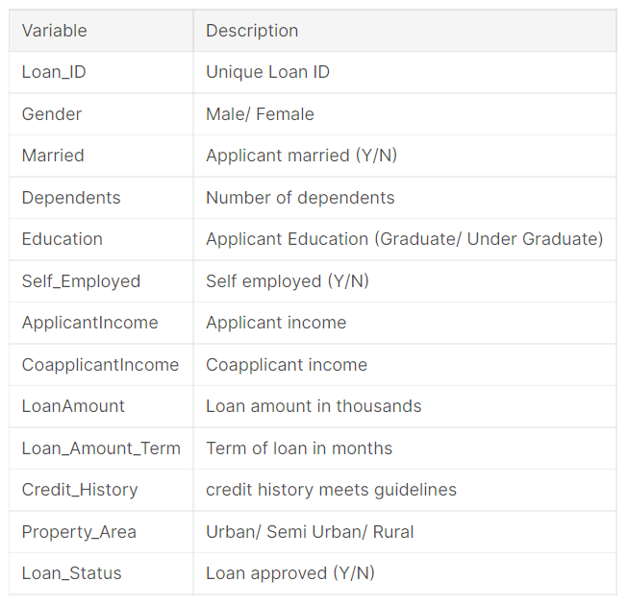
Data Review
Data Source
https://www.kaggle.com/ninzaami/loan-predication/tasks

Slide 4
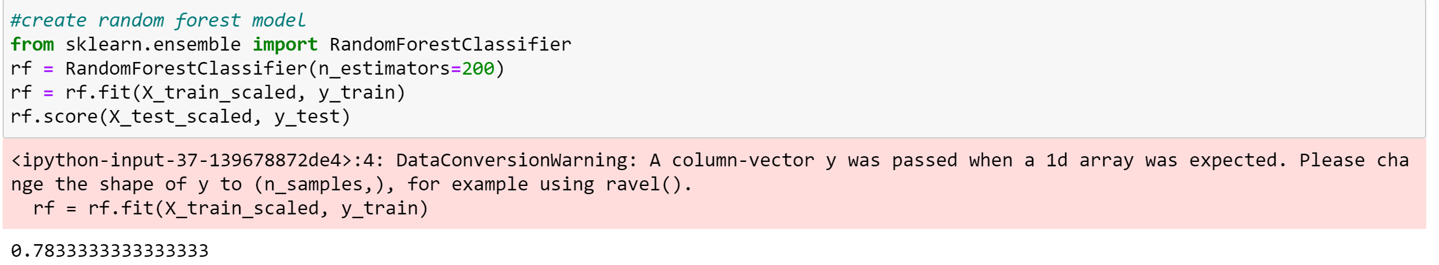
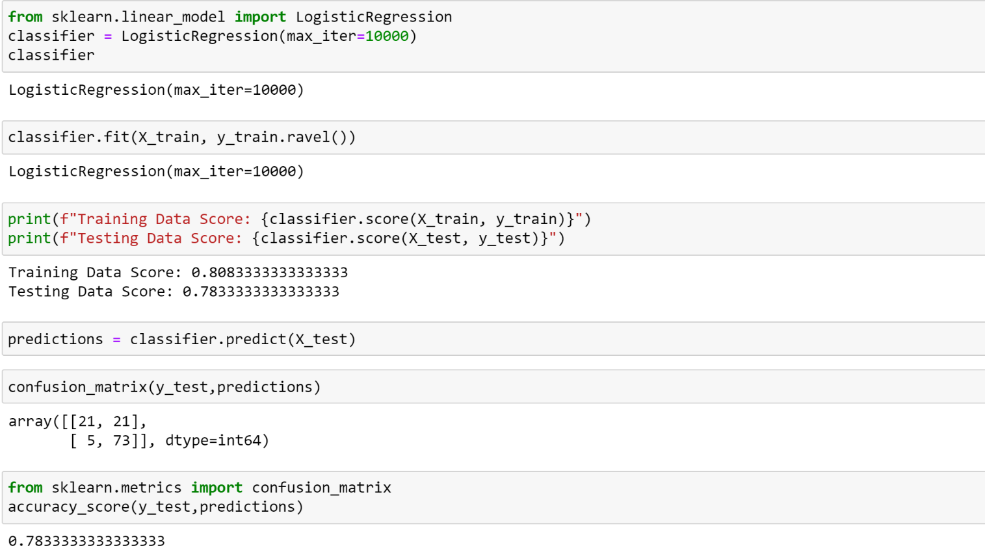
Random Forest Regression VS Logistic Regression
outcome
Nearly 80% Accuracy!

Slide 5
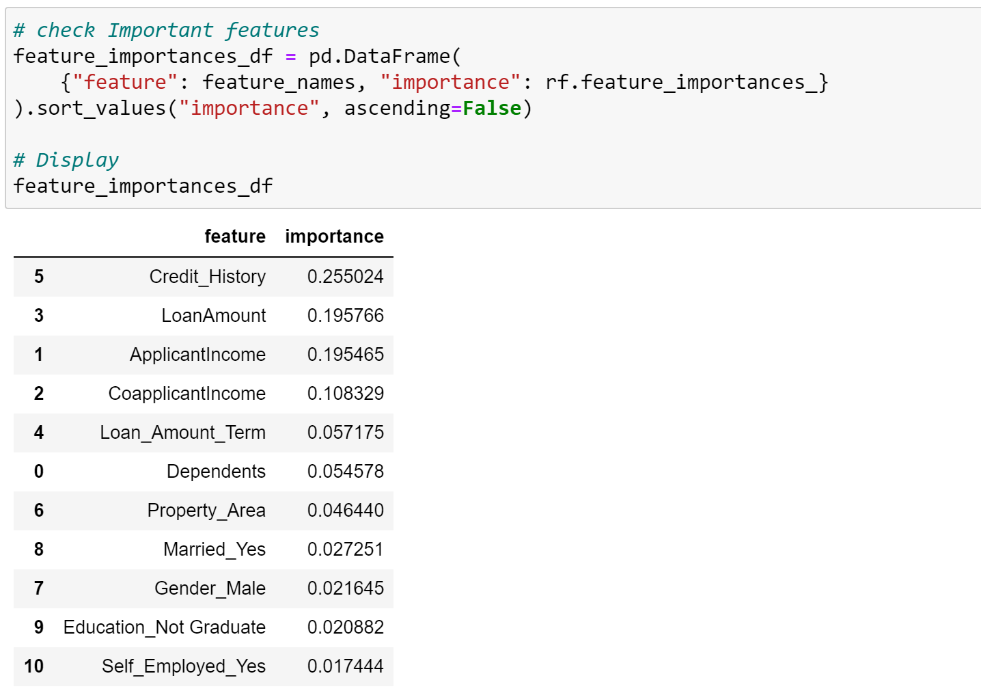
Feature Importance
Most important | Least important
Credit History Loan Amount Applicant Income | Gender Education Self Employed or not

Slide 6
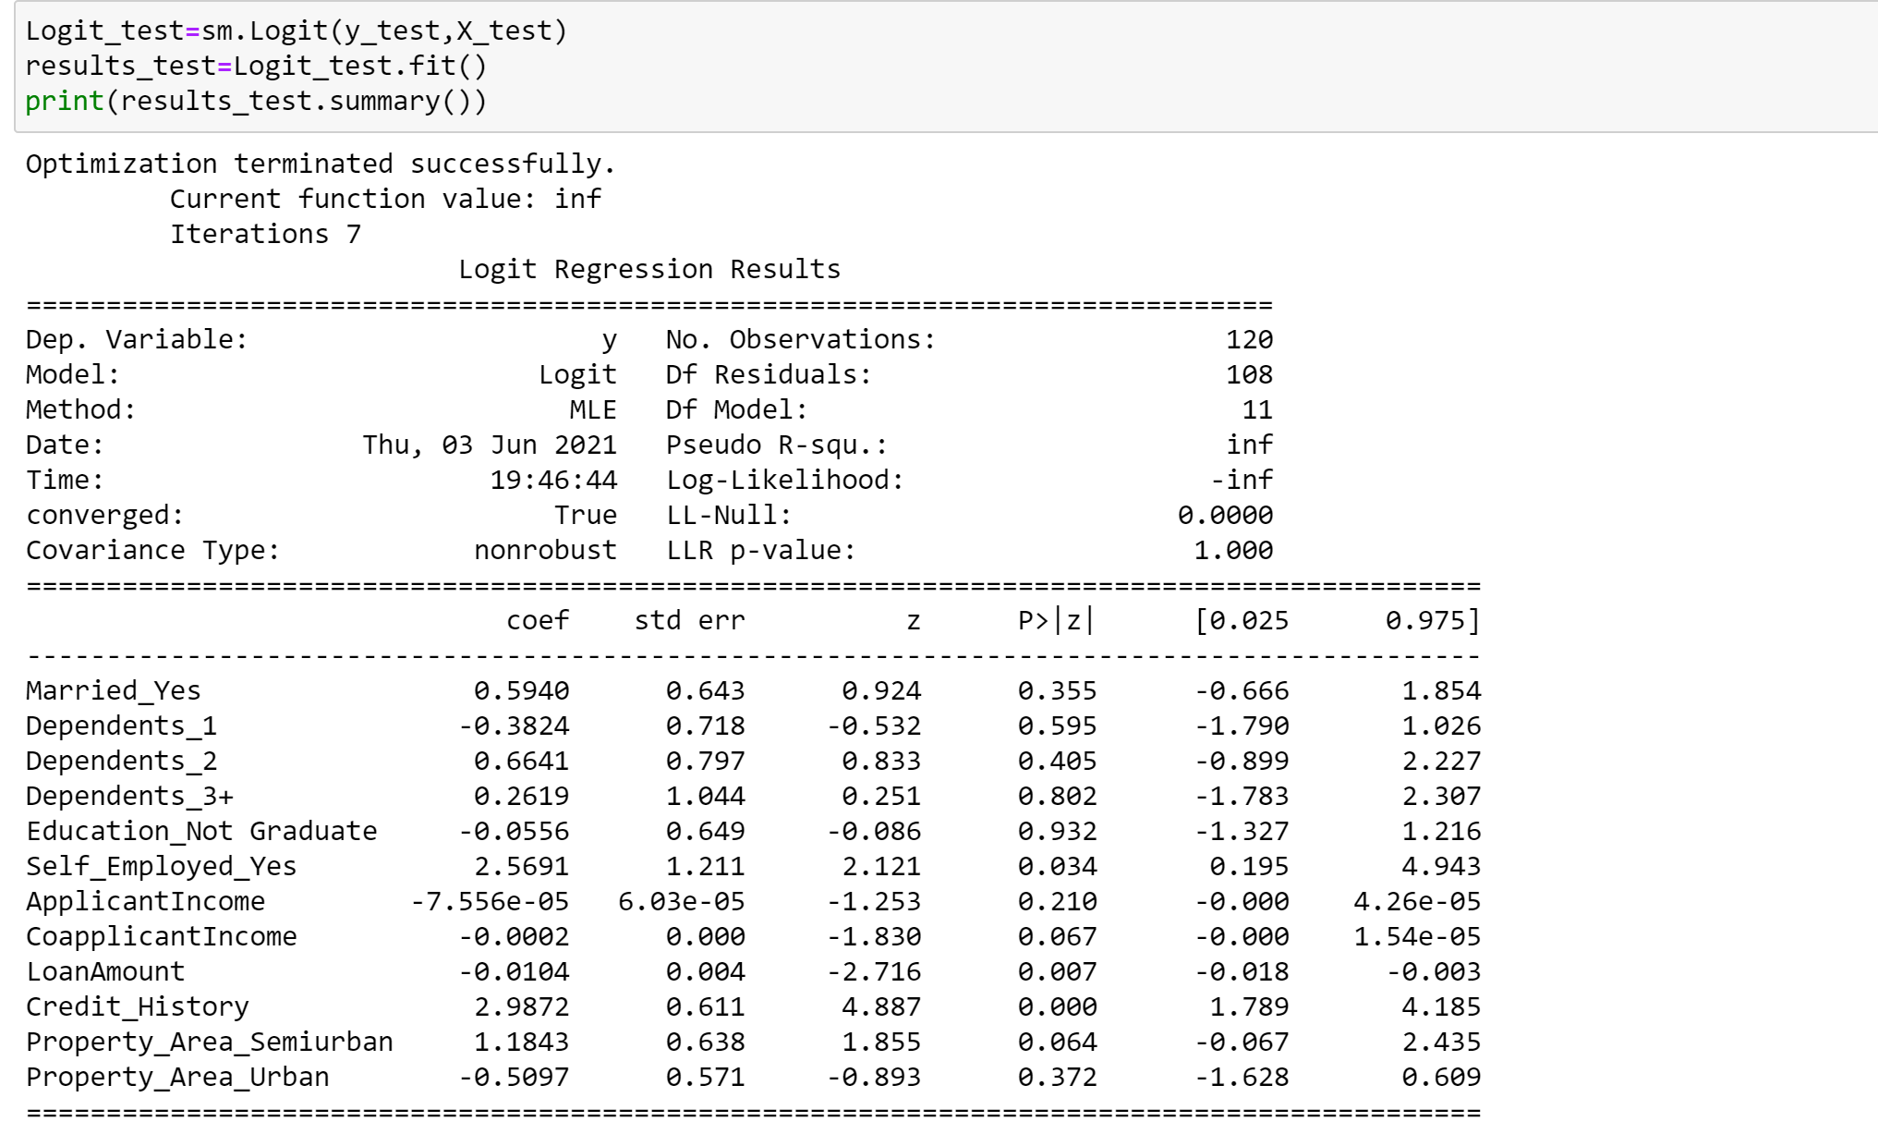
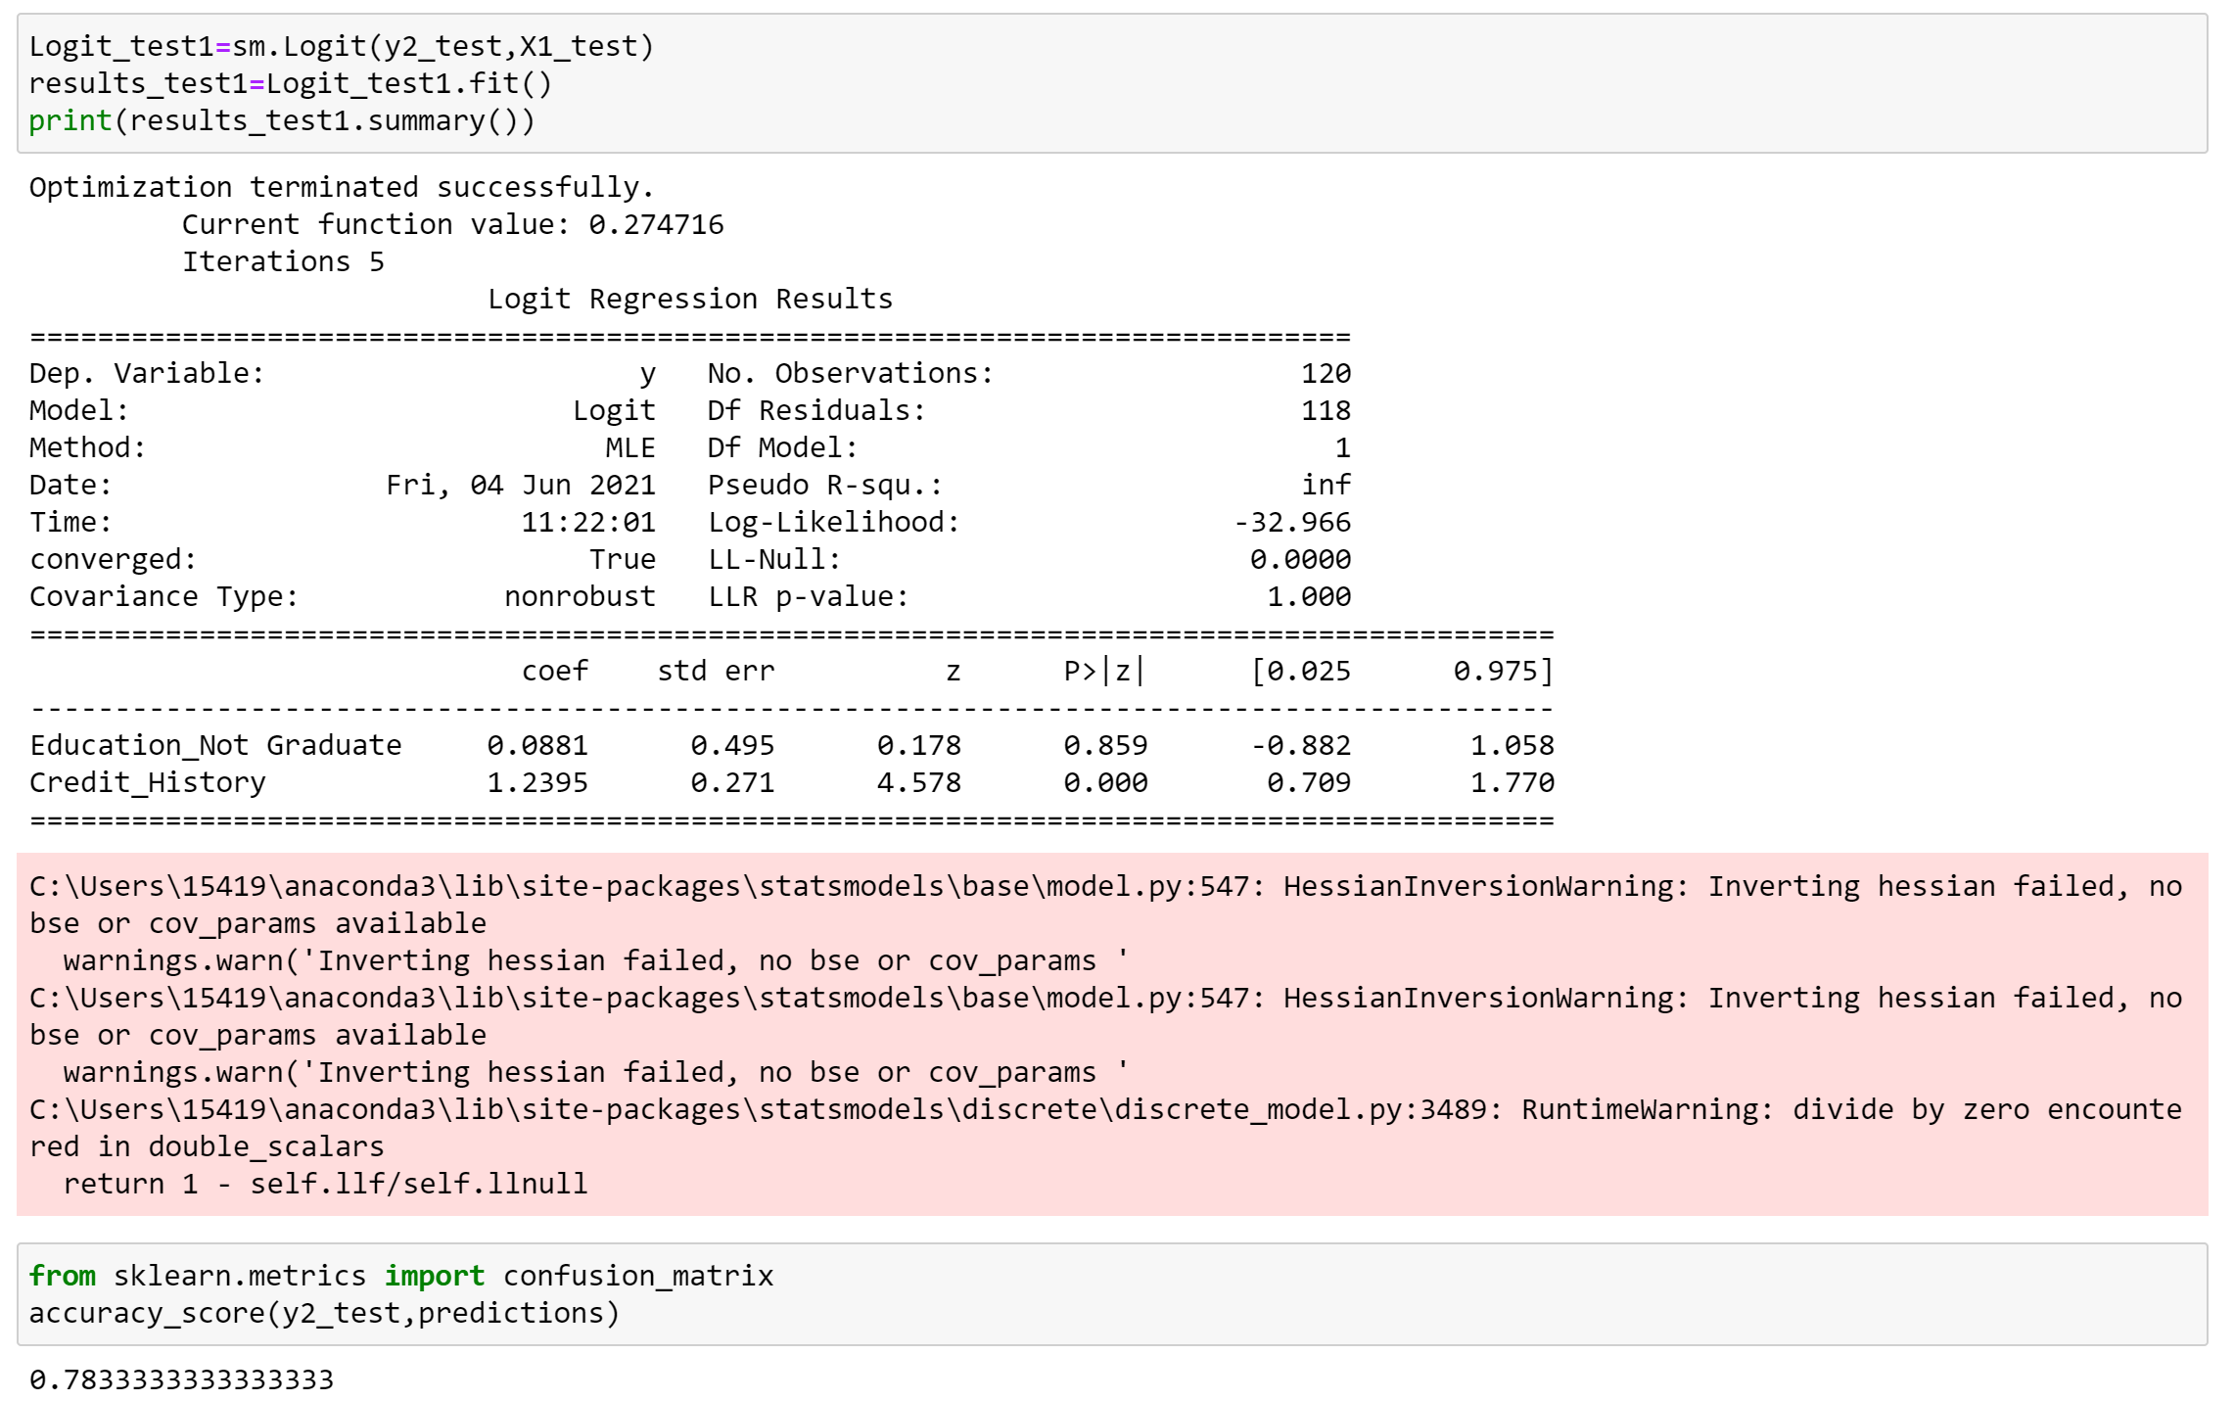
Statistic Summary

Slide 7
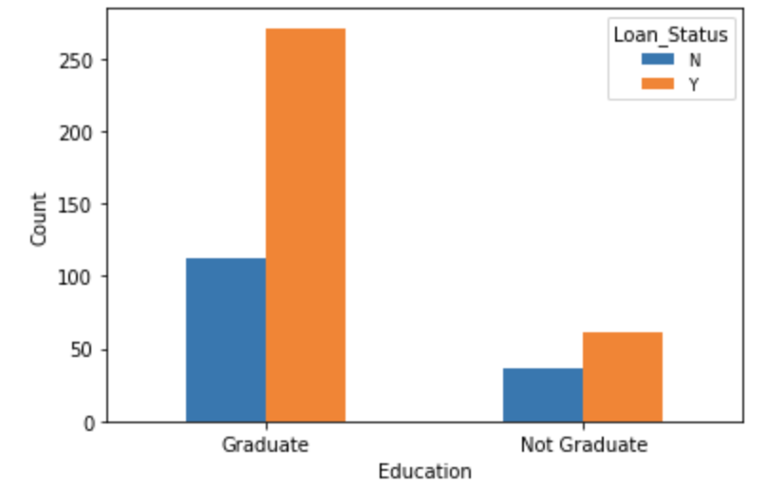
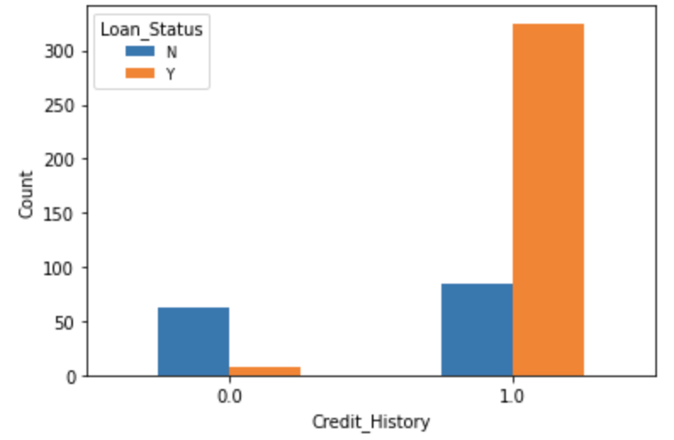
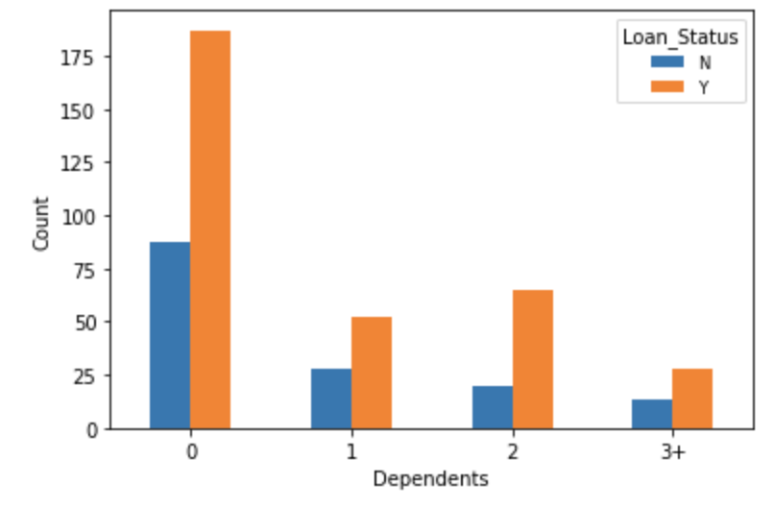
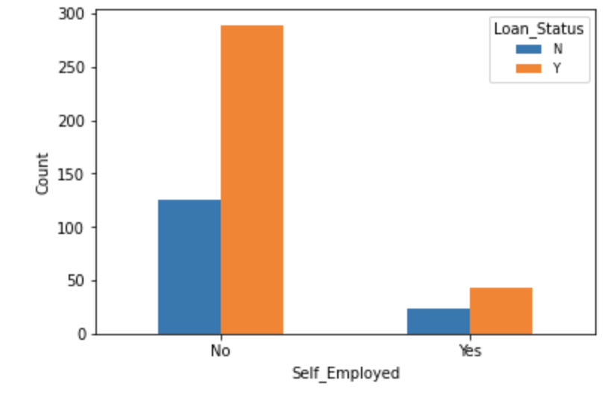
Visualizations
Majority of the applicants have zero dependents and are also likely to accepted for loan.
Majority of the applicants are Graduate and graduates have higher proportion of loan approval
Majority of the applicants are not self employed.
Applicants with a credit history are far more likely to be accepted and vice versa

Slide 8

Demo time!

