Slide 1
The FAT file system Introduction and Coding
Presented by Group 2 for real !

Slide 2



TEAM MEMBERS
Tran Dinh Bien
Le Van Duong
Nguyen Duc Tung
Team Leader
Code
Member
Code
Member
Presenter
Slideguy
Code

Slide 3
ASSIGN WORK
1. Tran Dinh Bien
Implement User IO part, main part, algorithm diagram
General management of progress and implementation work
2. Nguyen Duc Tung
Implement ParseFAT part, slide and present.
3. Le Van Duong
Implement Linked List part, main part, slide.

Slide 4
01
About FAT file
So, what are we talking about ?

Slide 5
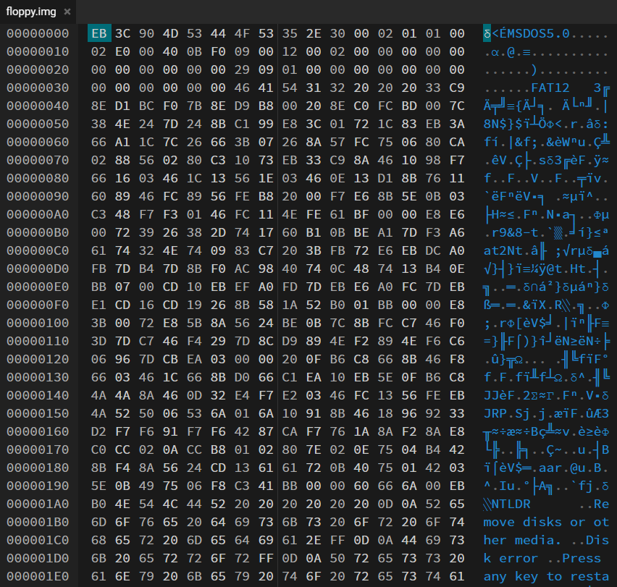
What is the FAT file ?
The FAT file system is heavily based on the file map model in terms of its on-disk layout.
This file system was used on all versions of MS-DOS and PC-DOS, and on early versions of Windows; it is still used on floppy disks formatted by Windows and some other systems.
It is a reasonably simple and robust file system.
There are 3 basic variants of the FAT file system:
FAT12: usually used by floppy disks and small hard disks
FAT16: superseded 12-bit version as hard disks became bigger
FAT32: is a more complex version of previous one due to bigger hard disks still

Slide 6

Overview
sectors
We can consider any disk as a simple storage area made up just of a number of
Reserved Sectors
All sectors are the same size, 512 bytes, on practically all FAT file systems.
All disks using the FAT file system are divided into several basic areas.
Disk
512
bytes
File Allocation Tables
Root Directory
Data Area

Slide 7
Reserved Sectors
These are sectors that are not actually part of the file system, including Boot Sector (the first sector of disk) which contains specific information describing the rest of the file system …
In most cases there is only 1 sector, being the allowance for the Boot Sector

Slide 8

Overview
sectors
We can consider any disk as a simple storage area made up just of a number of
All sectors are the same size, 512 bytes, on practically all FAT file systems.
All disks using the FAT file system are divided into several basic areas.
File Allocation Tables
Disk
Reserved Sectors
Root Directory
Data Area
512
bytes

Slide 9
File Allocation Tables
The FAT is a data structure that maps the data sectors of disk. It is similar to an array of FAT entries and each entry in the FAT corresponds to a cluster in Data Area. Entry N relates to cluster N.
Each entry contains a value which is the number of the cluster that follows this one in a file.
File Allocation Tables
0
1
2
3
4
5
n
0x004
…
0xFFF
0x00C
0xFFF
The first two entries (entry 0 and 1) store special values
Value = 0xFFF means there are no more clusters

Slide 10
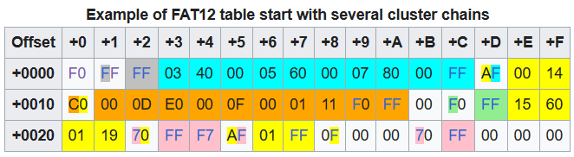
FAT12
The FAT12 file system uses 12 bits per FAT entry, thus 2 entries span 3 bytes in little-endian byte order:

Slide 11
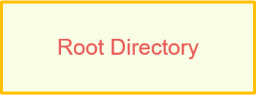
Overview
sectors
We can consider any disk as a simple storage area made up just of a number of
All sectors are the same size, 512 bytes, on practically all FAT file systems.
All disks using the FAT file system are divided into several basic areas.
Disk
Root Directory
Reserved Sectors
File Allocation Tables
Data Area
512
bytes

Slide 12

Root Directory
The Root Directory is the primary directory of the disk. Unlike other directories locate in the Data Area, space for the Root Directory is allocated statically, when disk is formatted; so it has a finite limit on the number of files or directories that can be created therein.
Root Directory
32 bytes
Every directories are divided into 32-byte entries which contain information about files or subdirectories located in it.

Slide 13
32-byte directory entries, both in the Root Directory and Subdirectories, are have the the same format:
32 bytes

Slide 14
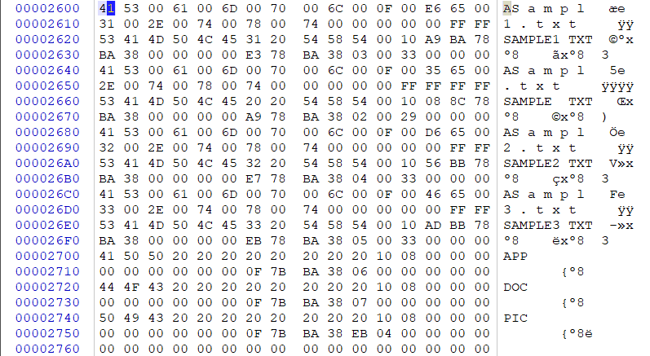

Slide 15
Root Directory
The Root Directory is the primary directory of the disk. Unlike other directories locate in the Data Area, space for the Root Directory is allocated statically, when disk is formatted; so it has a finite limit on the number of files or directories that can be created therein.
Root Directory
32 bytes
Every directories are divided into 32-byte Directory entries which contain information about files or subdirectories located in it.

Slide 16
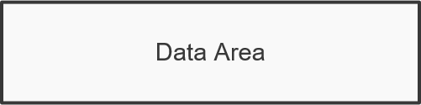
Overview
sectors
We can consider any disk as a simple storage area made up just of a number of
All sectors are the same size, 512 bytes, on practically all FAT file systems.
All disks using the FAT file system are divided into several basic areas.
Data Area
Disk
Reserved Sectors
File Allocation Tables
Root Directory
512
bytes

Slide 17
Data Area
The Data Area contains file and subdirectory data and span the remaining sertors on the disk. It is divided into clusters, which are the same thing as allocation units. A group of clusters create a cluster chain containing data of a file or subdirectory.
Data Area
2
3
4
n
The first cluster is always from cluster 2

Slide 18
Overview
sectors
We can consider any disk as a simple storage area made up just of a number of
All sectors are the same size, 512 bytes, on practically all FAT file systems.
All disks using the FAT file system are divided into several basic areas.
Disk
Reserved Sectors
File Allocation Tables
Root Directory
Data Area
512
bytes

Slide 19
How the FAT work ?
Directory entry
Data Area
Filename: Text1.txt
StartCluster: 2
2
3
4
n
Directory entry
Text1.txt
Folder1
Text1.txt
Filename: Folder1
StartCluster: 3
File Allocation Tables
0
1
2
3
4
n
0x004
…
0xFFF
0xFFF

Slide 20

— Talk to yourself
“ Nếu bạn đã quá mệt mỏi với việc ngồi code, hãy nằm code ”

Slide 21
02
Coding
Liu tiu diu ~

Slide 22
Flowchart
Begin
Open File Fat (floppy.img)
FILE * FATptr = fopen(“floppy.img”, “rb”)
FATptr != NULL
False
File not exist
End
True
Read Boot Sector
Calculate Fat Address, Root Directory Address, Data Area Address
Add to Linked List –> HEAD = 0x2600

Slide 23
CurrentAddress = Address of Node HEAD
CurrentAddress = Root Directory Address
True
False
FAT_Print_RootDirector
Num of Files = Total File in Root
FAT_Print_Folder (CurrentAddress)
Num of Files = Total File in Folder
INVALID
User Input (scanf)
-1 <= UserInput <= Num of Files
User Input = -1
Delete Node HEAD in Linked List
User Input = 0
User Input == {1 -> Num Of Files}
End
Read File with User Input positon to Calculate Cluster Number and find Attribute
Attribute of File == Folder
False
FAT_Read File
True
Current Address = Cluster Number
Add Head to Linked List – Node Address = Current Address

Slide 24
Resources
Special thanks to our teacher:
Nguyen Van Nghia aka NghiaNV16
Here’s the reference resources for this presentation:
About the FAT file system :
Design of the FAT file system – Wikipedia
A tutorial on the FAT file system (tavi.co.uk)
Coding :
HexEd.it - Browser-based Online and Offline Hex Editing
CSS
</>
HTML

Slide 25
Thanks!
For your attention !
2 3 con kiến ăn xôi
Các bạn hỏi nhẹ nhàng thôi

